Slide 1
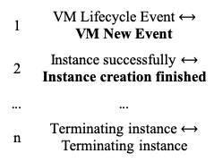
Log templates (train)
Log embeddings (train)
1 | VM Lifecycle Event
2 | Instance successfully
... | ...
n | Terminating instance
1 | [0.582, 0.913, ..., -0.132]
2 | [0.573, 0.102, ..., -0.249]
... | ...
n | [0.947, -0.841, ..., 0.987]
Matched templates
Nearest neighbor matching by cosine similarity
1 | VM Lifecycle Event $⟷$ VM New Event
2 | Instance successfully $⟷$ Instance creation finished
... | ...
n | Terminating instance $⟷$ Terminating instance
Language Model
Template
Log templates (test)
Log embeddings (train)
1 | VM New Event
2 | Instance creation finished
... | ...
n | Terminating instance
1 | [0.56, 0.88, ..., -0.167]
2 | [0.53, 0.08, ..., -0.201]
... | ...
n | [0.947, -0.841, ..., 0.987]

