Slide 1
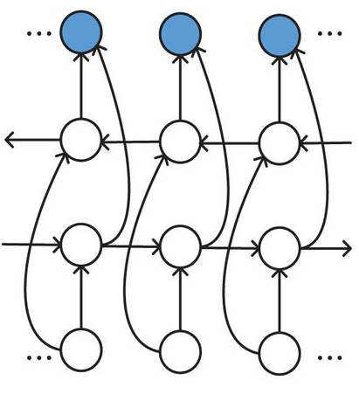


Training data
New log data (prediction/test)
Log parsing
Nearest template matching for test logs
Templates ($e_{i}$)
1. VM * Lifecycle * event 2. Took * seconds to
build instance * …
1. VM Lifecycle event 2. Took seconds to
build instance …
Test data
Bi-LSTM Model
pred₁-e_{s+1} ... pred_{k}-e_{s+1}
$$\left({{{0.132 \atop 0.982} \atop …} \atop {… \atop {0.113 \atop 0.923}}}\right)$$
Training data
Vectorization
Template → embedding table
1 | [0.582, -0.982, ..., -0.132]
2 | [0.573, -0.632, ..., -0.249]
...
Next template
class prediction (classification)
Next embedding
prediction
(regression)
Language Model
Anomaly prediction
Classification
Regression

