Slide 1
MoviSign
Nikhil Handigol Te-Yuan Huang Chi Liu

Slide 2
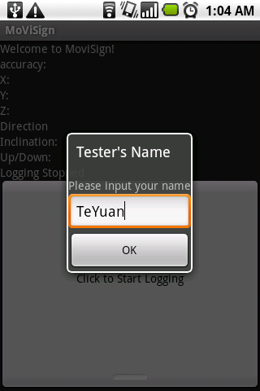
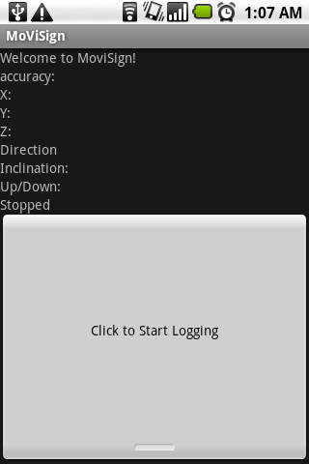
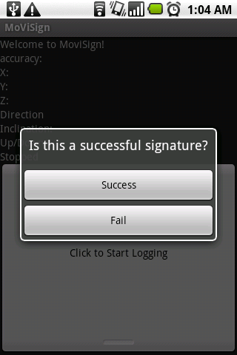
Collecting Training Data

Slide 3
Feature Extraction
Segmentation
Feature
Data Processing

Slide 4
Accelerometer

Slide 5
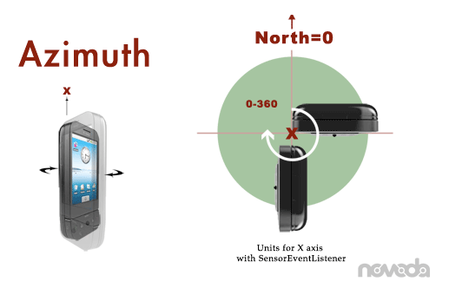
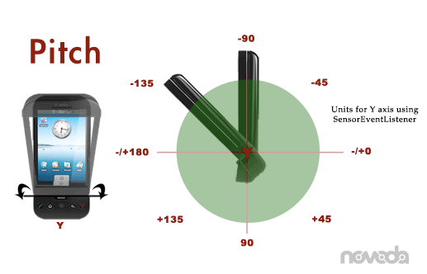
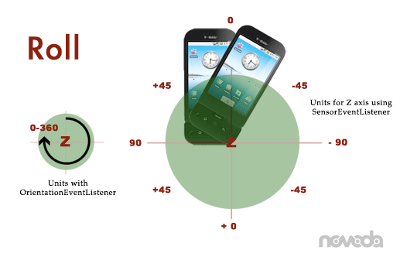
Orientation Sensor

Slide 6
Training & Testing
Training
SVM Linear Kernel
L1 soft margin
Leave-one-out
Testing
Test on the sample left out

Slide 7
Results
Error Rate

