Slide 1
MoviSign
Nikhil Handigol Te-Yuan Huang Chi Liu

Slide 2
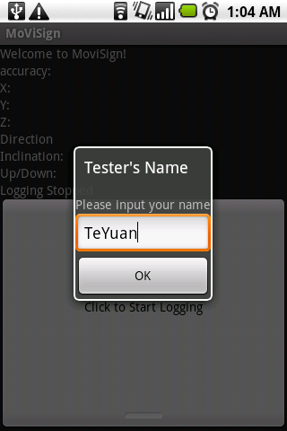
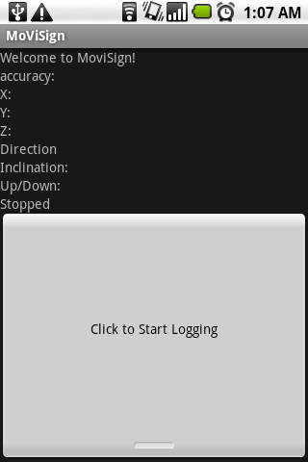
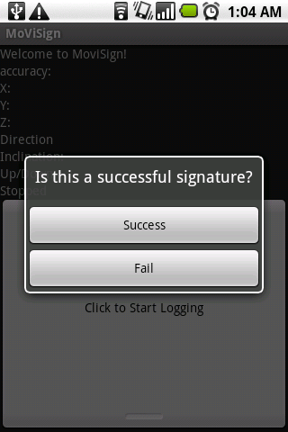
Collecting Training Data

Slide 3
Feature Extraction
Data Processing
Segmentation
- chop the data into s segments based on timestamp
- s will be proportional to number of features
Feature
- use the mean of acceleration(in x,y,z directions) and orientation in each segment as features
- 6 features extracted in each segment

Slide 4
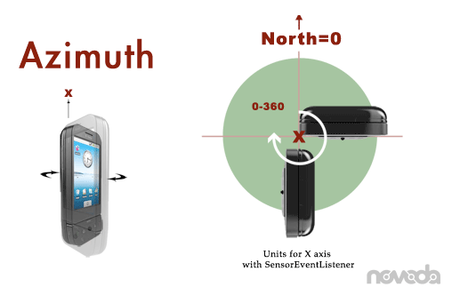
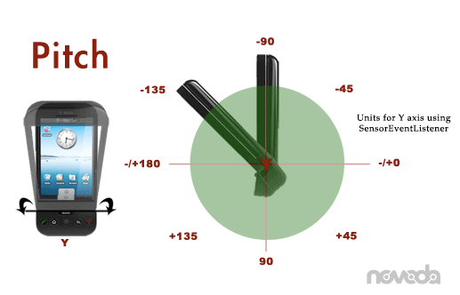
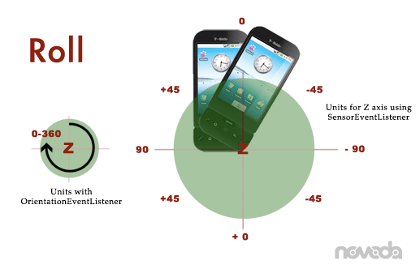
Accelerometer & Orientation Sensor

Slide 5
Training & Testing
Training
SVM with Linear Kernel
L1 soft margin
K-fold cross validation(K = 20 or leave-one-out)
Testing
Test on the sample left out

Slide 6
Results
Error Rate

Slide 7
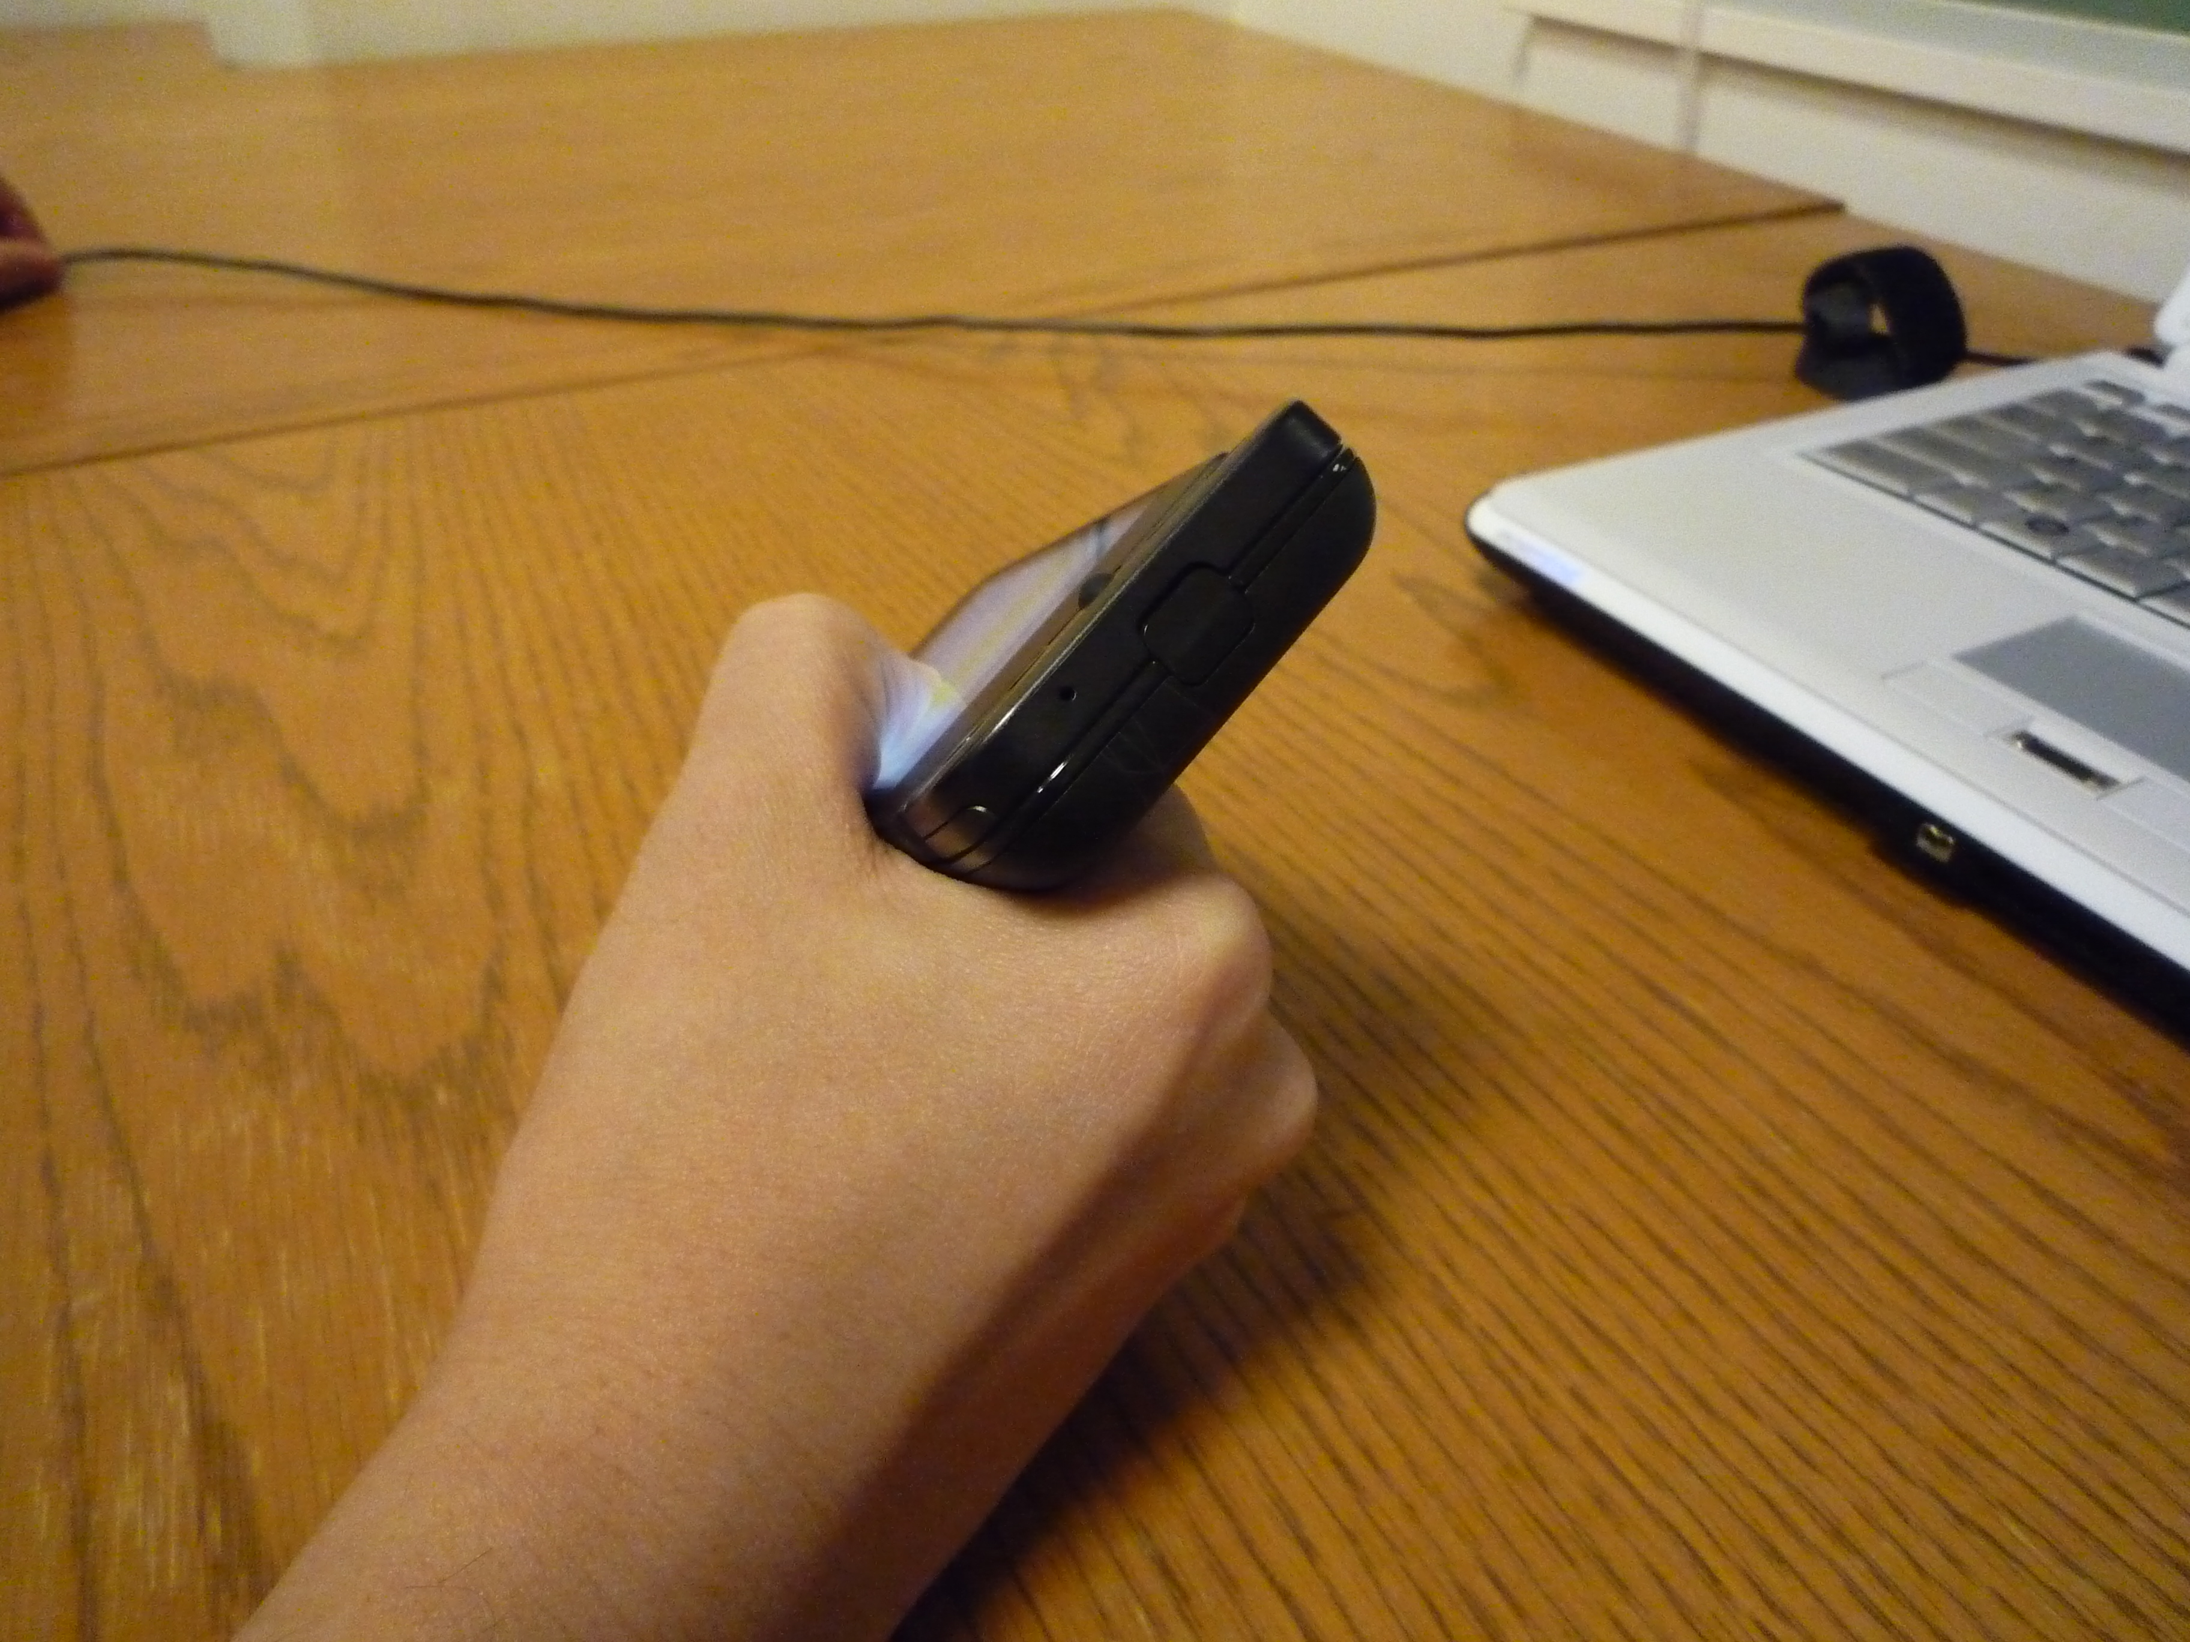

Live Demo

