Slide 1
MoviSign
Nikhil Handigol Te-Yuan Huang Chi Liu

Slide 2
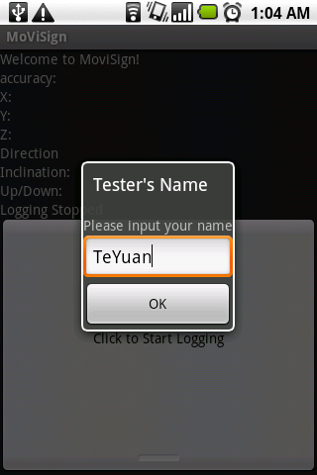
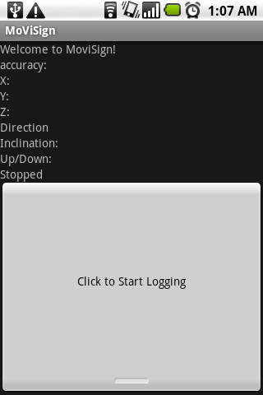
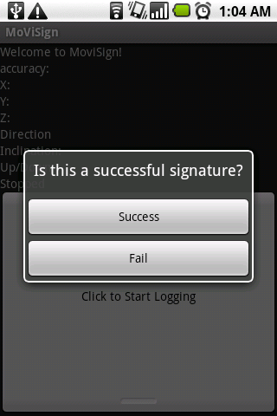
Collecting Training Data

Slide 3
Accelerometer

