Slide 1
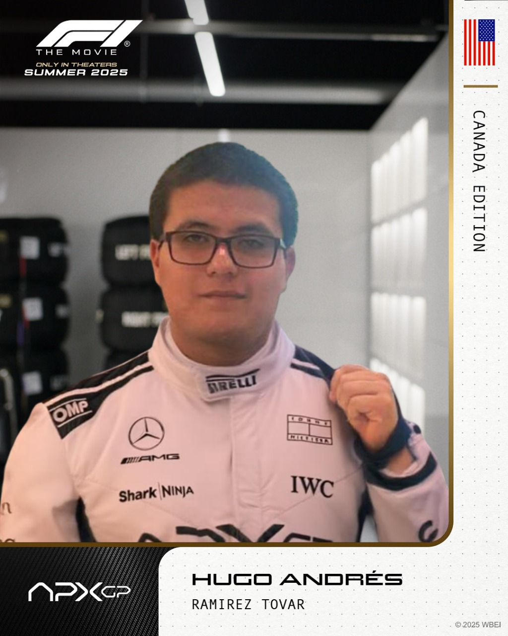

FORMULA 1 AND THE ART OF AERODYNAMICS

Slide 2
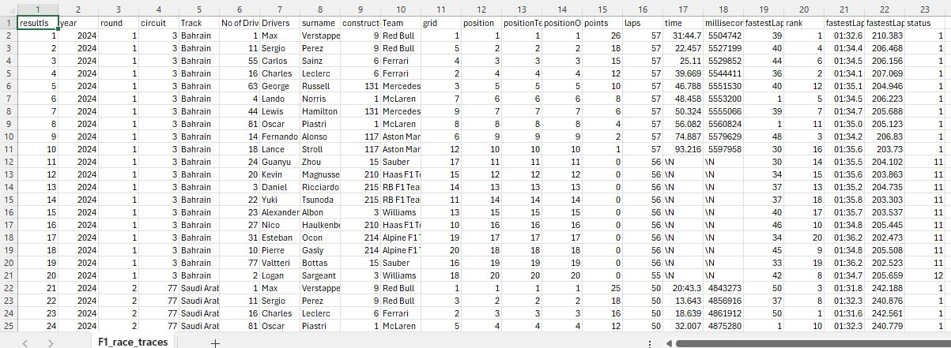
DATASET
The project integrates data related to race results, team, driver, position, and time, with a wind tunnel summary.
Dimensions: F1_race_traces.csv (23 variables, 878 observations) and constructors_wind_tunnel.csv (6 variables, 10 observations).
The project information was compartmentalized across multiple files, so I needed to integrate it, remove irrelevant data, and synthesize points earned by drivers and teams to provide evidence to support the project's conclusions.

Slide 3
INTERESTING STATICS OR GROUPINGS
Formula 1 - the power of data analysis, given that the difference between victory and defeat is measured in thousandths of a second.
During a race weekend, F1 teams employ between 30 and 50 data scientists to analyze and process information,
F1 car generates up to 300 GB of data per race weekend, and up to 200 different parameters are optimized.

Slide 4
INTERESTING STATICS OR GROUPINGS
Max Verstappen lap of 1.18.792 during the 2025 Italian grand prix qualifying has become the fastest lap done in F1 history
The fastest pitstop of the 2025 F1 season was 1.9 seconds by the Mclaren F1 team on the Hungarian grand prix
Andrea Kimi Antonelli podium on the Canadian grand prix converted him on the 3rd youngest driver to achieve one in F1 history

Slide 5
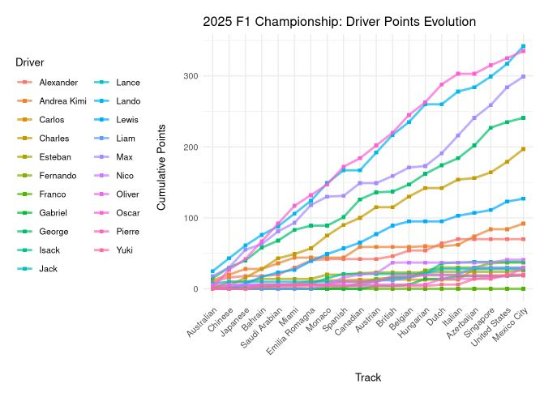
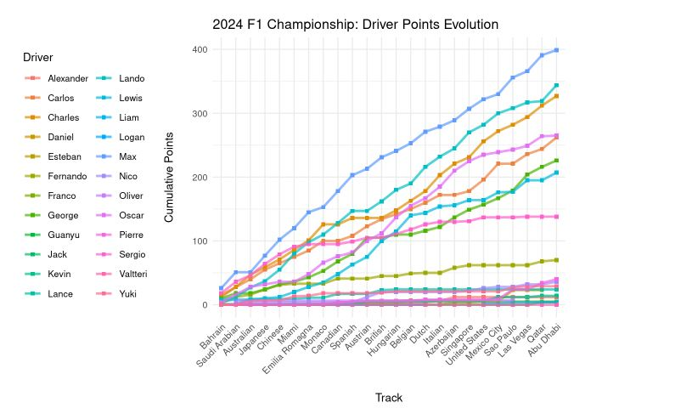

Slide 6
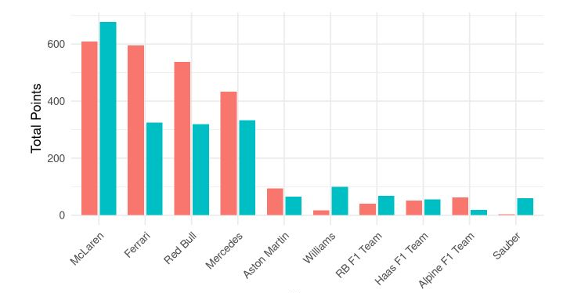

Slide 7
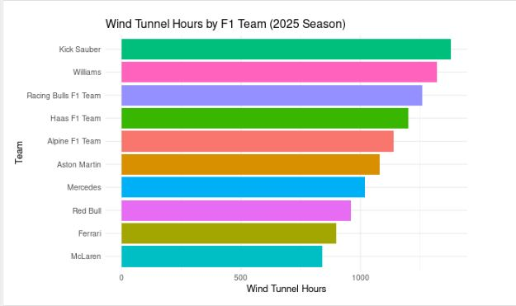

Slide 8
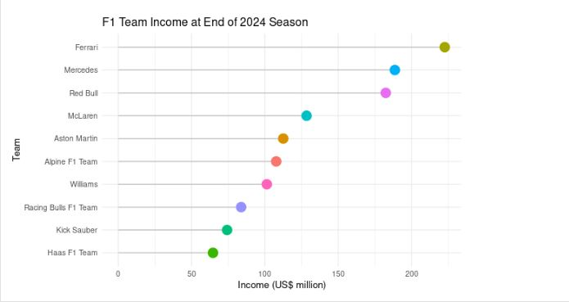

Slide 9

RESULTS
The project results show how teams that were near the bottom of the constructors' championship in 2024 are now consistently fighting for points in every race in the 2025 season.
In the 2024 season, the Williams team scored a total of 17 points, in only 6 out of 24 races. In the current 2025 season, the Williams team has scored a total of 111 points in 14 races, in addition to achieving a podium finish at the Azerbaijan Grand Prix.
The project suggests that this turnaround is due to the increased number of wind tunnel hours available for further aerodynamic development of their car. The same concept applies to teams like Haas and Kick Sauber, who have seen their performance improve thanks to the new FIA regulations.

Slide 10
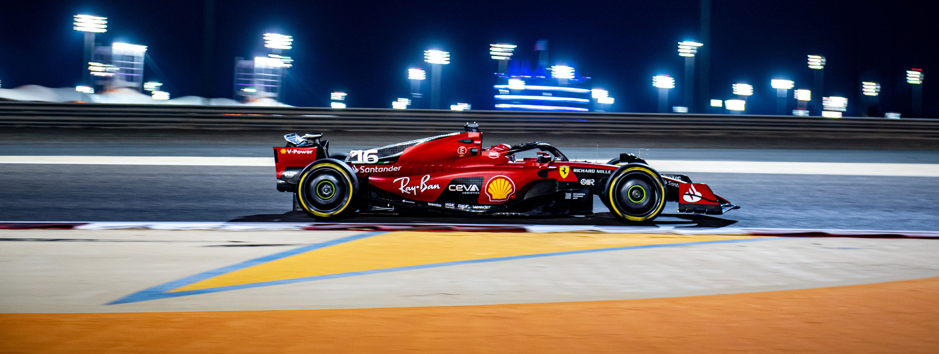
THANKS FOR YOUR TIME

