Slide 1

Academic Year 2024 - 25 S8 PROJECT WORK II
Second Review
PROJECT TITLE
AI-BASED FARMER QUERY SUPPORT AND ADVISORY SYSTEM
BIP PROJECT ID 2026IN024
CATERGORY INTERNAL
BATCH MEMBERS
HARI HARAN D (7376222AD140)
ABIRAMI D R (7376222AD107)
ARUNA A (7376221CD104)
GUIDE
Mr Chozharajan P
Assistant Professor - II
Department of Artificial Intelligence and Data Science

Slide 2
AIM & OBJECTIVES OF THE PROJECT
(Problem Statement)
AIM:
The aim of this project is to develop an AI-Based Farmer Query Support and Advisory System that helps farmers get quick, accurate, and easy-to-understand agricultural advice using modern AI and web technologies.
PROBLEM STATEMENT
Farmers often face difficulty in accessing correct agricultural information at the right time. Existing systems are complex, do not support regional languages, and depend heavily on middlemen. There is a need for a simple, AI-based advisory system that provides reliable information in a farmer-friendly manner.
26-02-2026
SECOND REVIEW PRESENTATION
2

Slide 3
AIM & OBJECTIVES OF THE PROJECT
(Problem Statement)
OBJECTIVE:
To help farmers get quick agricultural advice
To use AI to understand farmer questions
To support Tamil and English language
To provide weather and market price information
To build a simple and user-friendly web system
To store farmer data using MongoDB / MySQL
26-02-2026
SECOND REVIEW PRESENTATION
2

Slide 4
LITERATURE SURVEY
Journal Paper Title with Author | Works carried out (withdetails of Methods/ Materials/ Software/ Algorithms/ fabrication/ techniques/ components used) | Information gathered relevant to your project
AI Based Farmer’s Assistance Chatbot Patha Druva, International Journal for Research in Applied Science and Engineering Technology (IJRASET), 2023 | Developed a chatbot using Natural Language Processing (NLP) to assist farmers. - Provides predictions on fertilizer requirements and nutrient levels. - Uses pre-determined data sources, including The Indian Council of Agricultural Research, for accuracy | Helps farmers manage crops efficiently. - Provides real-time assistance for agricultural queries. - Enhances agricultural productivity using AI.
D. Anekar, "Farmer’s Assistant using AI Voice Bot," International Journal of Advanced Research in Science Communication and Technology (IJARSCT) | - Developed an AI-based chatbot to assist farmers in multiple languages (English, Hindi, Marathi). - Utilized Natural Language Processing (NLP) to process and respond to user queries. - Designed to improve agricultural productivity by providing information on crop management, fertilizers, and best practices. - Integrated with AI voice recognition for a user-friendly experience. | Enables farmers to get real-time guidance in multiple languages. - Enhances accessibility and ease of use with voice-based interactions. - Supports better decision-making in crop selection, fertilizers, and irrigation.

Slide 5
LITERATURE SURVEY
Journal Paper Title with Author | Works carried out (withdetails of Methods/ Materials/ Software/ Algorithms/ fabrication/ techniques/ components used) | Information gathered relevant to your project
"Farmer-Bot: An Interactive Bot for Farmers" Narayana Darapaneni, Rajiv Tiwari, Anwesh Paduri, Suman Saurav, Rohit Chaoji, Sohil, arXiv, April 2022 | Developed an AI-based chatbot specifically designed for farmers. - Utilized Natural Language Processing (NLP) to provide interactive support. - Implemented machine learning techniques to enhance recommendations. - Designed to offer agricultural guidance, weather updates, and farming tips. | - Helps farmers make informed decisions using AI. - Provides real-time information on farming techniques, weather conditions, and crop recommendations. - Enhances agricultural efficiency through automated assistance.
Chatbot in Python By Sneha S, Sneha M, Shashank S, Soundarya C, Venkatesh R IRJET (Volume 06, Issue 11, Nov 2019) | Used AIML (Artificial Intelligence Markup Language) for pattern-based query responses. Latent Semantic Analysis (LSA) to find word similarities and generate responses. - Implemented using Python and Flask Web Framework. - Integrated APIs like Wikipedia, Weather Forecast, News, and Government Services for real-time data. | Demonstrates chatbot implementation using AIML and LSA.Explores how chatbots handle queries efficiently.Provides insights into integrating external APIs to improve chatbot intelligence.

Slide 6
SCOPE OF THE PROJECT
Farmers often face difficulty in getting correct information related to crops, weather, pests, and market prices. This project, AI-Based Farmer Query Support and Advisory System, provides smart agricultural advice using Artificial Intelligence (AI). Farmers can ask questions in Tamil or English through a simple web application.
The system uses AI and NLP to understand queries and generate suitable responses. It is developed using Spring Boot with Spring AI for backend, React.js and JavaScript for frontend, and MongoDB/MySQL for data storage. Open-source AI models like Ollama and external APIs are used to provide accurate and updated information.
This system helps farmers make better decisions and improves access to agricultural knowledge.
SECOND REVIEW PRESENTATION

Slide 7
NEED FOR THE CURRENT STUDY
In India, a significant number of farmers face challenges accessing crucial agricultural information due to language barriers, as most digital platforms are available only in English.Lack of accurate and timely information on soil types, weather predictions, market prices, and suitable seeds affects farmers' decision-making and productivity.There is a need for a simple, user-friendly digital solution that provides relevant agricultural insights in regional languages.This study addresses this gap by developing a chatbot that supports Tamil and Hindi, empowering farmers with localized and accessible information.
SECOND REVIEW PRESENTATION

Slide 8
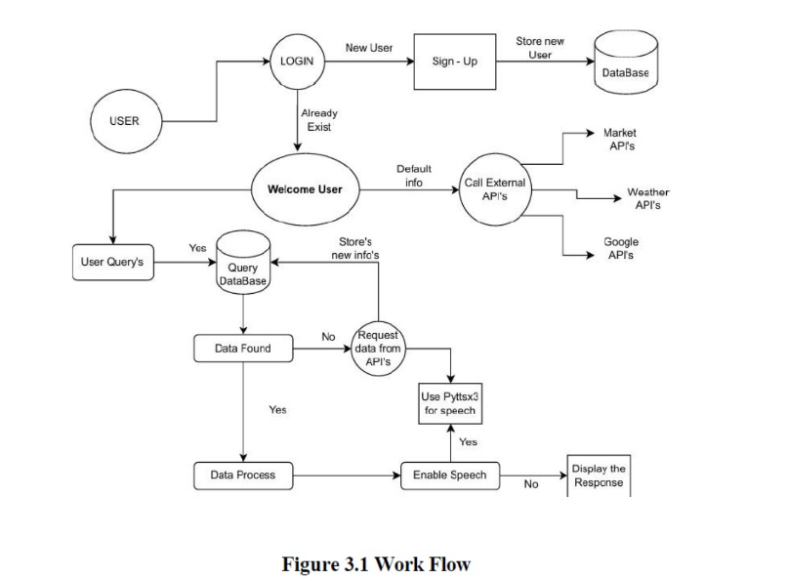
PROPOSED METHODOLOGY ( Flow Chart)

Slide 9
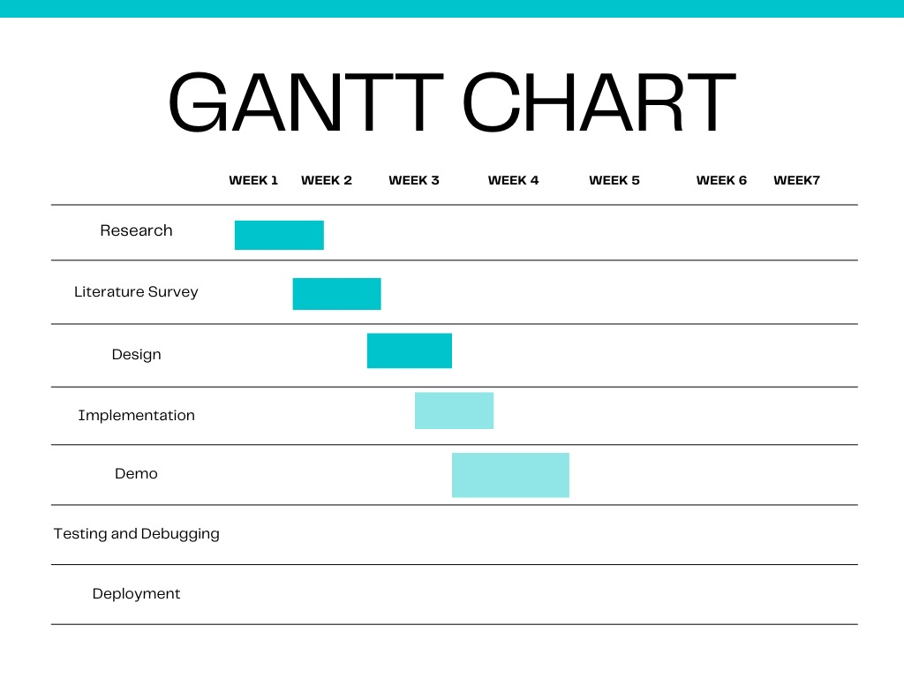
PROPOSED METHODOLOGY ( Gantt Chart)

Slide 10
CHOICE OF COMPONENTS / MODULES / METHODS/TECHNIQUES EQUIPMENT USED FOR PROJECT DEVELOPMENT
COMPONENTS & MODULES:
User Interface (Frontend) – Website for farmers to interact with the chatbot.
Chatbot Engine (Backend) – AI-powered chatbot built using Python.
Database Module – MongoDB for storing agricultural queries and responses.
API Integration Module – Fetches real-time weather, market prices, and agricultural updates.
Speech Processing Module – Converts text to speech using pyttsx3 for voice responses.
METHODS & TECHNIQUES:
Natural Language Processing (NLP): Helps chatbot understand user queries.
Machine Learning (Optional): Can improve chatbot responses over time.
Web Development: React.js for frontend and Flask/Django for backend.
Data Storage & Retrieval: Efficient handling of user queries with MongoDB.
SECOND REVIEW PRESENTATION

Slide 11
DESIGN(S) (HARDWARE / SOFTWARE ARCHITECTURE)
SYSTEM ARCHITECTURE OVERVIEW :
User Interface (Frontend - React.js)
Farmers interact with the chatbot through a React.js-based web application.
Provides a simple, user-friendly interface for text and voice-based queries.
Backend Processing (Flask/Django - Python)
Manages chatbot logic, processes user queries, and fetches responses.
Implements Natural Language Processing (NLP) to understand and respond effectively.
Database Management (MongoDB)
Stores predefined agricultural FAQs, chatbot responses, and user interactions.
Allows efficient data retrieval for real-time assistance.
API Integration Module
Fetches real-time weather updates, market prices, and agriculture news from external APIs.
Ensures farmers receive up-to-date information.
Speech Processing Module
Uses pyttsx3 (Text-to-Speech) to convert responses into voice output.
Helps farmers who prefer audio-based assistance.

Slide 12
ANALYSIS OF RESULT AND DISCUSSION

Slide 13
INDIVIDUAL CONTRIBUTIONS TO THE WORK
Batch Member 1 : 7376222AD140-HARI HARAN D
Front-End ,UI UX:
Design a simple and user-friendly interface using React.js and JavaScript
Create pages for farmer query input and response display
Ensure easy navigation and clear layout for better UI/UX
Connect frontend with backend using REST APIs

Slide 14
INDIVIDUAL CONTRIBUTIONS TO THE WORK
Batch Member 2 : 7376222AD107 ABIRAMI D R
DATABASE & API HANDLING
Design and manage database using MongoDB / MySQL
Store farmer queries, responses, and system data
Integrate Weather API and Market Price API
Ensure secure and fast data access

Slide 15
INDIVIDUAL CONTRIBUTIONS TO THE WORK
Batch Member 3 : 7376221CD104 ARUNA A
Backend Developer
Develop backend services using Spring Boot
Handle farmer queries and system logic
Integrate AI models (Ollama / AI APIs) for query processing
Manage request and response flow between frontend and AI services
.

Slide 16
PLAN FOR PUBLICATIONS
Journal / Conference Identified for Submission
Tentative Dates for Submission / Presentation / Acceptance

Slide 17
Status on Partial Completion and Submission of Project Report
List of Documents to be Submitted
SL.No | List of Documents | Status ( Provide the drive link of prepared document)
1 | Cover Page & Title Page (Both are in same format)
2 | Bonafide Certificate
3 | Declaration
4 | Acknowledgement
5 | Chapter I – Introduction
6 | Chapter 2 – Literature Survey

Slide 18
Any Other Relevant Details

Slide 19
Any Other Relevant Details

Slide 20
REFERENCES
( Journal Papers/ Books / Website in IEEE Format )
Journal
[1]. Patha Druva, Nelki Sainithin, Muppa Manisai, and K. Sreelatha, "AI-Based Farmer’s Assistance Chatbot," International Journal for Research in Applied Science & Engineering Technology (IJRASET), vol. 11, no. 3, pp. 1234-1242, Mar. 2023. DOI: 10.22214/ijraset.2023.53180.
[2]. D. Anekar, "Farmer’s Assistant using AI Voice Bot," International Journal of Advanced Research in Science Communication and Technology (IJARSCT), Apr. 2023. DOI: 10.48175/IJARSCT-9121.
[3] N. Darapaneni, R. Tiwari, A. R. Paduri, S. Saurav, R. Chaoji, and S. Sohil, "Farmer-Bot: An Interactive Bot for Farmers," arXiv preprint, arXiv:2204.07032, Apr. 2022. DOI: 10.48550/arXiv.2204.07032.
[4] A. Kumar, P. K. Meena, D. Panda, and M. Sangeetha, "Chatbot in Python," International Research Journal of Engineering and Technology (IRJET), vol. 6, no. 11, pp. 391, Nov. 2019. . Available: https://www.irjet.net

