Slide 1
Worksheet_1
Normalization

Slide 2
Duration: 20 mins
Set a timer and start working for each question
Make a copy of this ppt and save it in your drive.
Rename it with your name,
Add your answers to the next slide of the question slide and attach the new tables created from excel.
Problem statement: You have just joined an organization as a database
administrator. You have been trained on database basics, which includes
normalization, and to test your knowledge, you have been asked to solve two
questions: A and B.

Slide 3
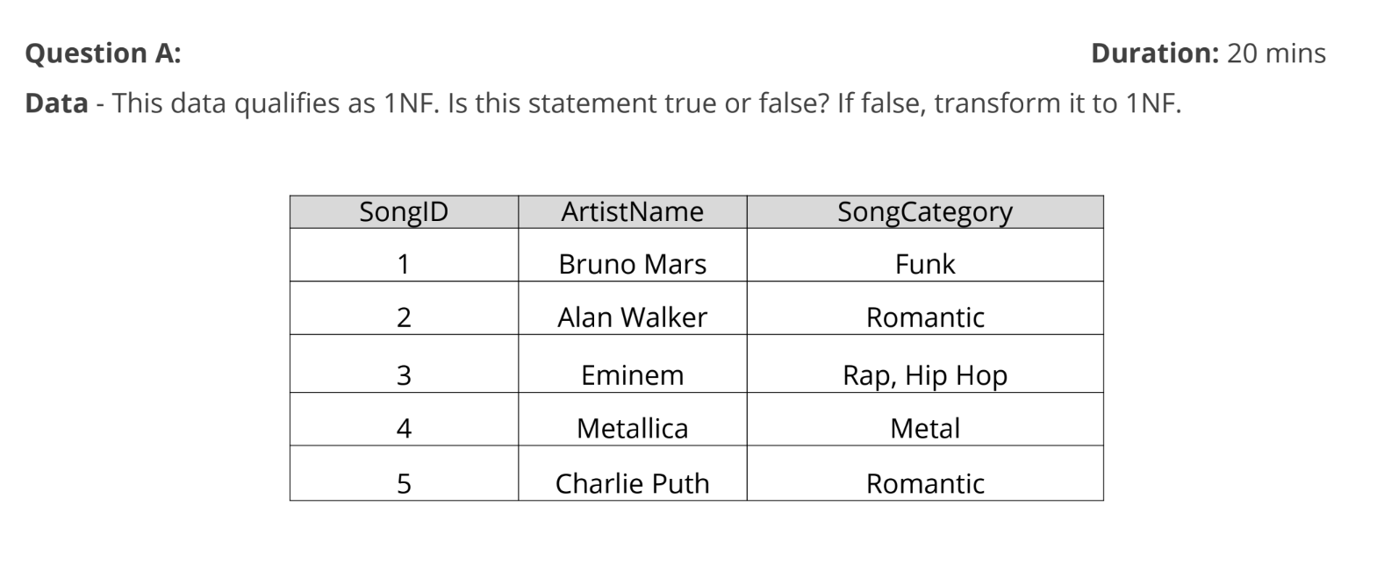

Slide 4
Transformed Table (After 1NF):
SongID | Artist Name | Song Category
1 | Bruno Mars | Funk
2 | Alan Walker | Romantic
3 | Eminem | Rap
3 | Eminem | Hip Hop
4 | Metallica | Metal
5 | Charlie Puth | Romantic

Slide 5
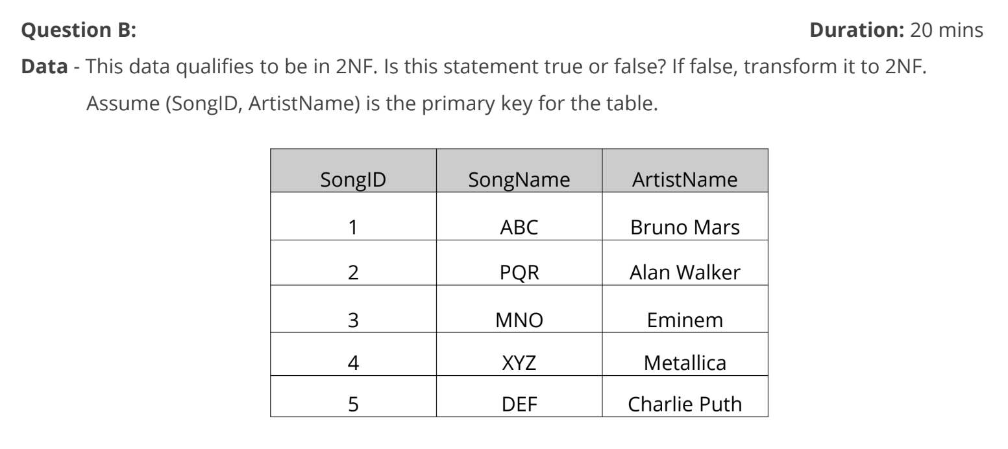

Slide 6
Transformed Tables (After 2NF):
SongID | Artist Name
1 | Bruno Mars
2 | Alan Walker
3 | Eminem
4 | Metallica
5 | Charlie Puth
Song Name | Artist Name
ABC | Bruno Mars
PQR | Alan Walker
MNO | Eminem
XYZ | Metallica
DEF | Charlie Puth

