Slide 1
Emulation-based Adaptive Differential Evolution: Fast and Auto-tunable Approach for Moderately Expensive Optimization Problems
Complex & Intelligent Systems

Slide 2
Background

Slide 3
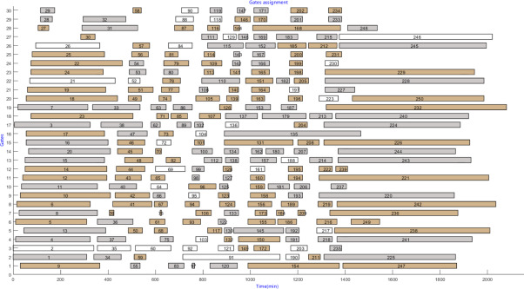
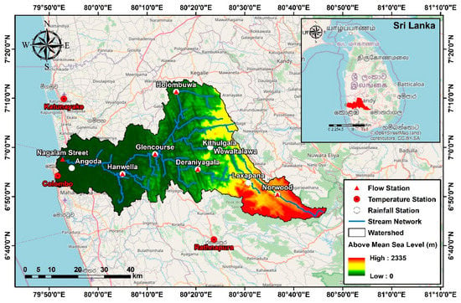
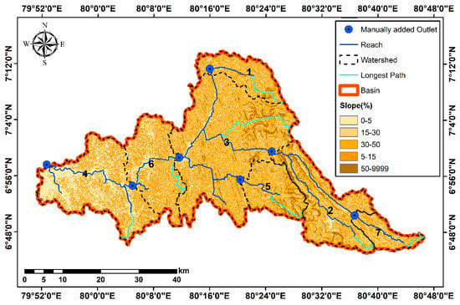
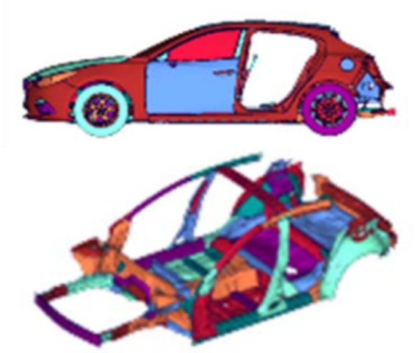
Background
Expensive Optimization Problem (EOP) in real-world
Function Evaluation (FE) is computationally or financially expensive in EOPs.
The number of FE is restricted due to limited budget.
Classification of EOP
[Shan+ 10]
Non-expensive (Normal)
Moderately EOP (M-EOP)
EOP
Problem Example
Automatic Calibration of Watershed Models [Makumbura+ 22]
Vehicle Structure Optimization [Oyama+ 17]
Airport Gate Allocation [Deng+ 22]
Evaluation Time Ex.
Less than 1 second
2 minutes
20 hours
Max. Number of FEs
Hundreds of thousands
Several thousand
Hundreds to a few thousand
Main approach
Evolutionary Algorithm (EA)
Not adequately researched
Surrogate-assisted EA (SAEA)
(to be explained in detail next)

Slide 4
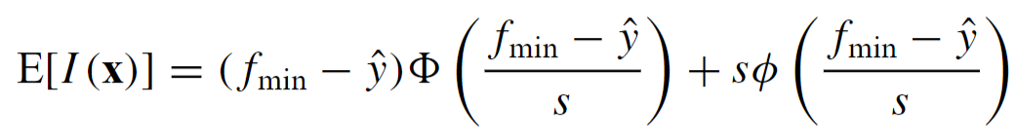
Research Purpose
SAEA: Main Approach for EOPs
Usefulness in EOPs
Surrogates of the objective function are constructed using machine learning (ML).
Surrogates identify expected-to-improve solutions without FE.
Need for an approach for M-EOPs
Limitations in M-EOPs
Premature convergence
Time-consuming
Fixed parameter configuration
( )
Hundreds to a few thousand FEs
Several thousand FEs
( )
[Sun+ 15]
SAEAs have strong exploitation nature.
[Briffoteaux 22]
ML models are repeatedly construct/used. Reducing the runtime is crucial in M-EOPs.
e.g., Expected Improvement (EI) metric
[Jones+ 98]
[Lobo+ 07]
Advance fine-tuning is hindered in (M-)EOPs although tuning configuration is important.
Research Purpose
Proposing a 1) High-performance, 2) Fast, and 3) Auto-tunable EA for M-EOPs.

Slide 5
Research Approach
Auto-tunable and Computationally Efficient Adaptive EA
Adaptive EA
Auto-tunable: Parameter configurations are automatically controlled during a run.
Much faster than SAEAs: Adaptive EAs do not use ML techniques.
Slow convergence: Most are not for (M-)EOPs, i.e., hundreds of thousands of FEs.
Idea to boost convergence speed
Existing Adaptive EAs
Proposed Algorithm
Trial-and-error Adaptation
Configurations are updated based on ones generated good solutions in past generations.
Adaptation with Prior Validation
Pre-screen candidate configurations before use without FE.
Individual-based Adaptation
The effectiveness of each configuration is usually validated with only one sample.
Subpopulation-based Adaptation
The effectiveness of configurations are carefully validated using multiple samples.

Slide 6
Preliminary

Slide 7
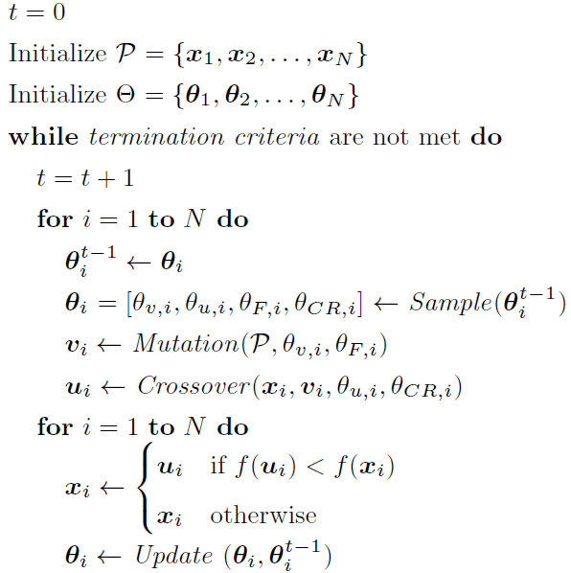


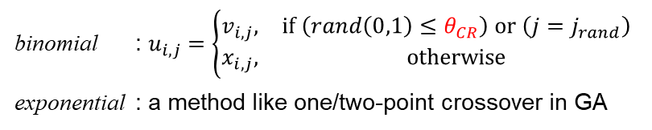

Component
Differential Evolution (DE)
A population-based evolutionary algorithm
Mutation: generate a mutant solution $v_{i}$ for each $x_{i}$
[Storn+ 97]
parameter
Scaling factor $θ_{F}∈[0, 1]$
strategy
rand/1 $v_{i}=x_{r1}+θ_{F}(x_{r2}−x_{r3})$
rand/2 $v_{i}=x_{r1}+θ_{F}(x_{r2}−x_{r3})+θ_{F}(x_{r4}−x_{r5})$
best/1 $v_{i}=x_{best}+θ_{F}(x_{r1}−x_{r2})$
best/2 $v_{i}=x_{best}+θ_{F}(x_{r1}−x_{r2})+θ_{F}(x_{r3}−x_{r4})$
current-to-rand/1 $v_{i}=x_{i}+θ_{F}(x_{r1}−x_{i})+θ_{F}(x_{r2}−x_{r3})$
current-to-best/1 $v_{i}=x_{i}+θ_{F}(x_{best}−x_{i})+θ_{F}(x_{r1}−x_{r2})$
current-to-pbest/1 $v_{i}=x_{i}+θ_{F}(x_{pbest}−x_{i})+θ_{F}(x_{r1}−\tilde{x_{r2}})$
rand-to-best/1 $v_{i}=x_{r1}+θ_{F}(x_{best}−x_{r1})+θ_{F}(x_{r2}−x_{r3})$
(mutation strategy)
Crossover: generate a trial solution $u_{i}$ from $x_{i}$ and $v_{i}$
parameter
Crossover rate $θ_{CR}∈[0, 1]$
binomial : $u_{i,j}=\left\{\begin{matrix}v_{i,j}, & if \left(rand\left(0,1\right)≤θ_{CR}\right) or \left(j=j_{rand}\right) \\ x_{i,j}, & otherwise\end{matrix}\right.$
exponential : a method like one/two-point crossover in GA
strategy
(crossover strategy)
Selection: select next $x_{i}$ from current $x_{i}$ and $u_{i}$

Slide 8
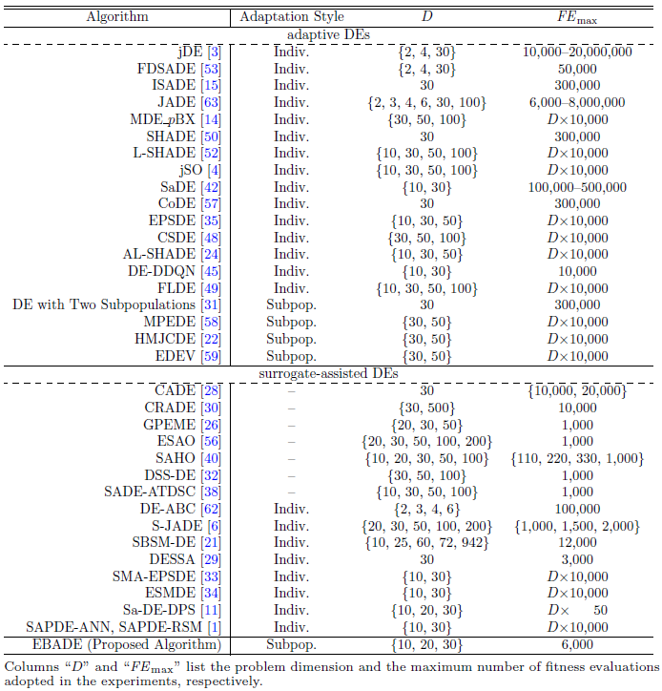
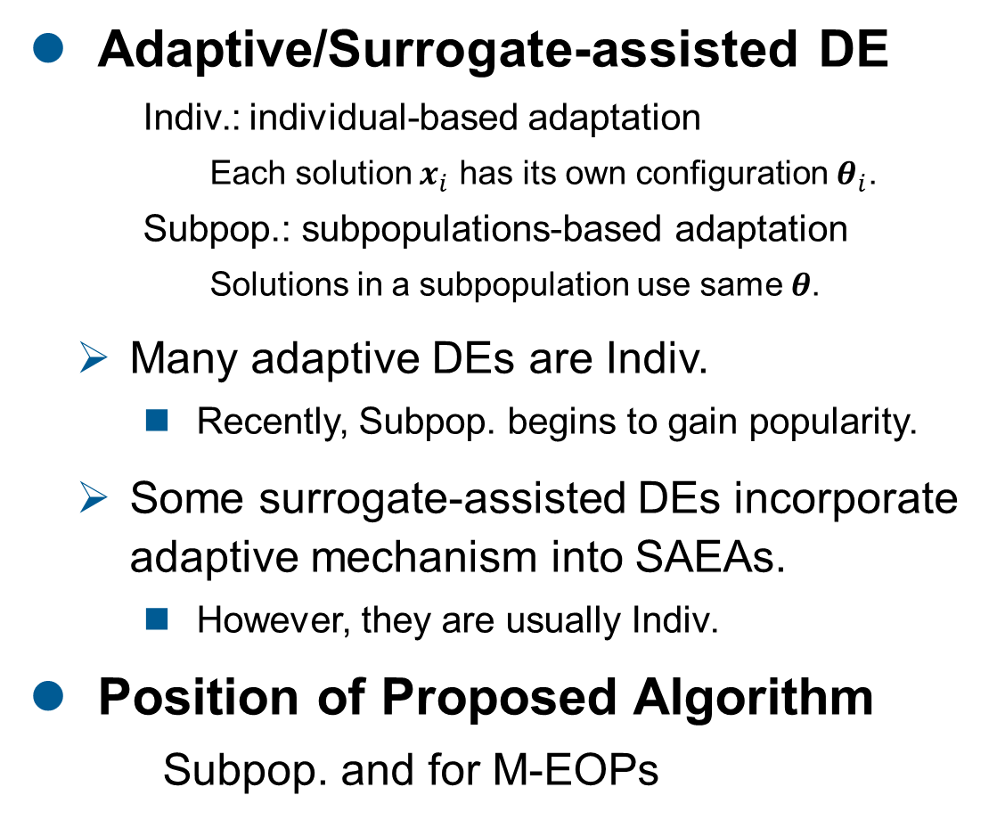
Related Works
Prob. Dim.
Max. # of FEs
Adaptive/Surrogate-assisted DE
Indiv.: individual-based adaptation
Each solution $x_{i}$ has its own configuration $θ_{i}$.
Subpop.: subpopulations-based adaptation
Solutions in a subpopulation use same $θ$.
Many adaptive DEs are Indiv.
Recently, Subpop. begins to gain popularity.
Some surrogate-assisted DEs incorporate adaptive mechanism into SAEAs.
However, they are usually Indiv.
Position of Proposed Algorithm
Subpop. and for M-EOPs

Slide 9
Proposed Algorithm: EBADE – Emulation-based Adaptive DE

Slide 10















Concept
Emulating the efficient sampling method of SAEAs
Prior Validation: prescreening “expected-to-improve” candidate
Subpopulation-based Adaptation: validating with respect to multiple samples
SAEA
EBADE
Prescreening of Solution
Prescreening of Configuration
$$x_{1}^{′}$$
$$θ_{1}^{′}$$
generated by $θ_{1}^{′}$
$$x_{2}^{′}$$
deriving the best EI metric
$$θ_{2}^{′}$$
Target
deriving the best FIR metric
$$x_{2}^{′}$$
$$θ_{2}^{′}$$
$$x_{3}^{′}$$
$$θ_{3}^{′}$$
by $θ_{3}^{′}$
by $θ_{2}^{′}$
Unevaluated solutions
Surrogate
Solution to be evaluated
Unused configurations
Pseudo solution generation
Configuration to be used
Surrogate Accuracy Measuring using Multiple Samples
Configuration Worthiness Measuring using Multiple Samples
$$acc$$
$$θ_{i}^{′}$$
$+1$
$+1$ : good
$−1$ : bad
Validation data
Surrogate
Accuracy
Subpopulation
Configuration
label

Slide 11
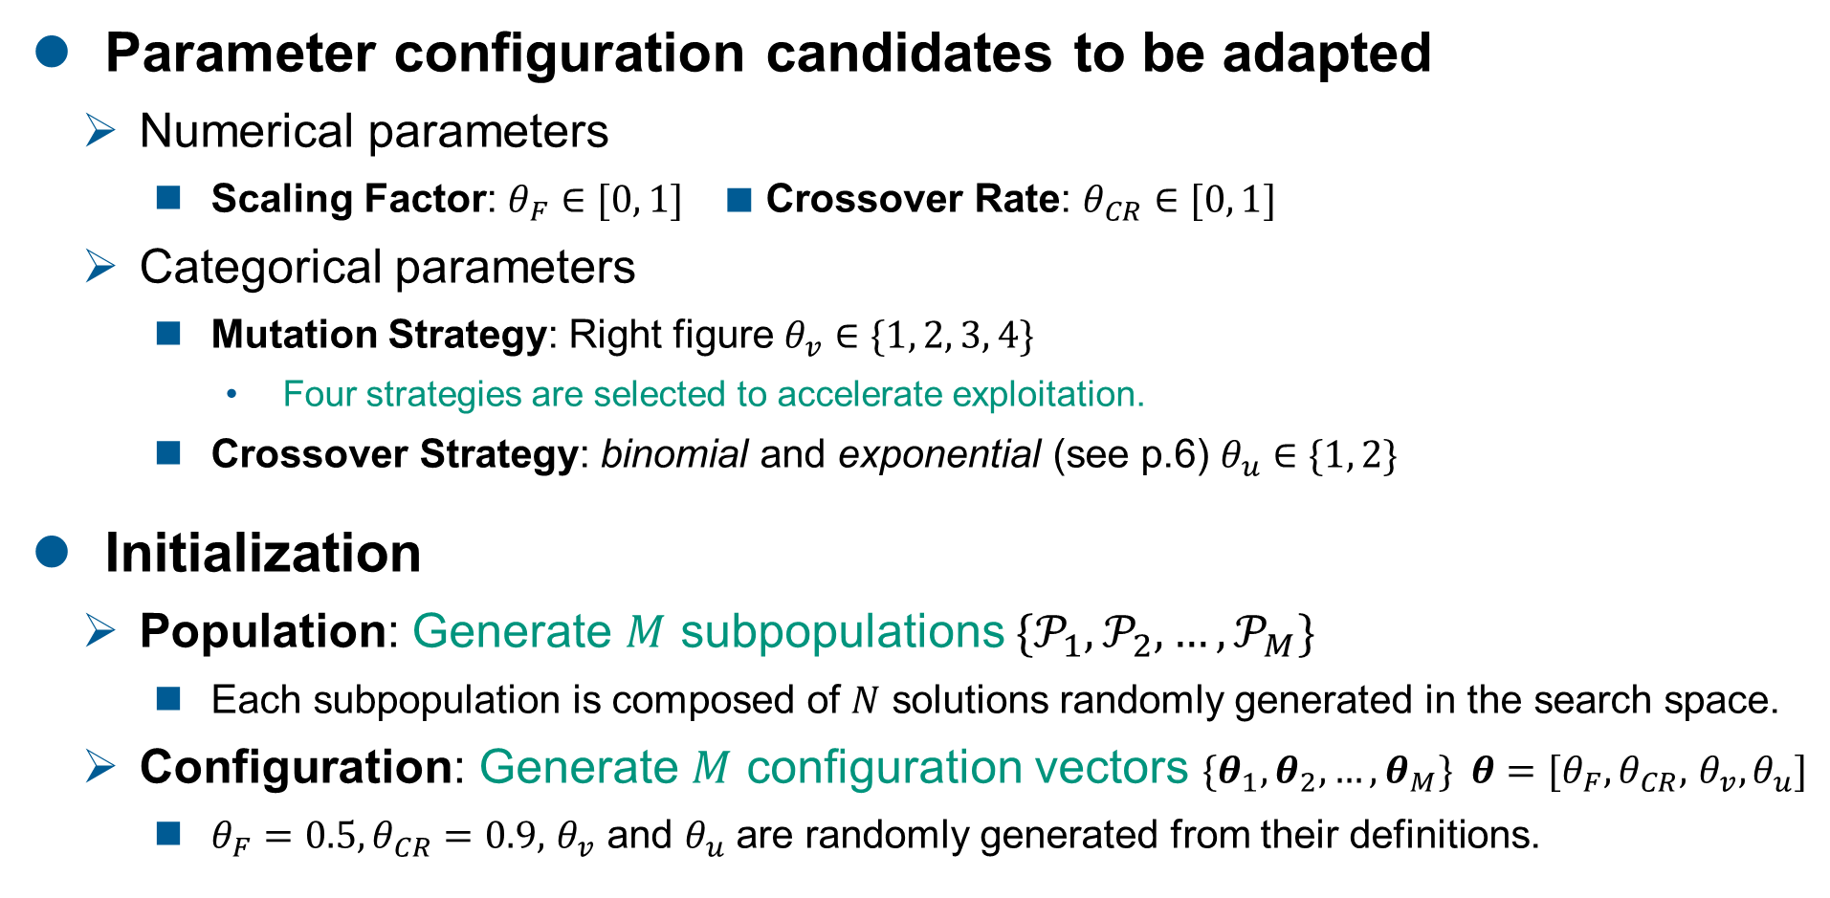
Preliminary
Parameter configuration candidates to be adapted
Numerical parameters
Scaling Factor: $θ_{F}∈[0, 1]$ ■ Crossover Rate: $θ_{CR}∈[0, 1]$
Categorical parameters
Mutation Strategy: Right figure $θ_{v}∈\{1, 2, 3, 4\}$
Four strategies are selected to accelerate exploitation.
Crossover Strategy: binomial and exponential (see p.6) $θ_{u}∈\{1, 2\}$
Initialization
Population: Generate $M$ subpopulations $\{𝒫_{1},𝒫_{2}, …,𝒫_{M}\}$
Each subpopulation is composed of $N$ solutions randomly generated in the search space.
Configuration: Generate $M$ configuration vectors $\{θ_{1},θ_{2}, …,θ_{M}\} θ=[θ_{F},θ_{CR},$ $θ_{v}, θ_{u}]$
$θ_{F}=0.5,θ_{CR}=0.9,$ $θ_{v}$ and $θ_{u}$ are randomly generated from their definitions.
exploitation
best/1
current-to-best/1
rand-to-best/1
current-to-pbest/1
rand/1
current-to-rand/1
rand/2
Each definition is in p.6
exploration
[Cai+ 13]

Slide 12
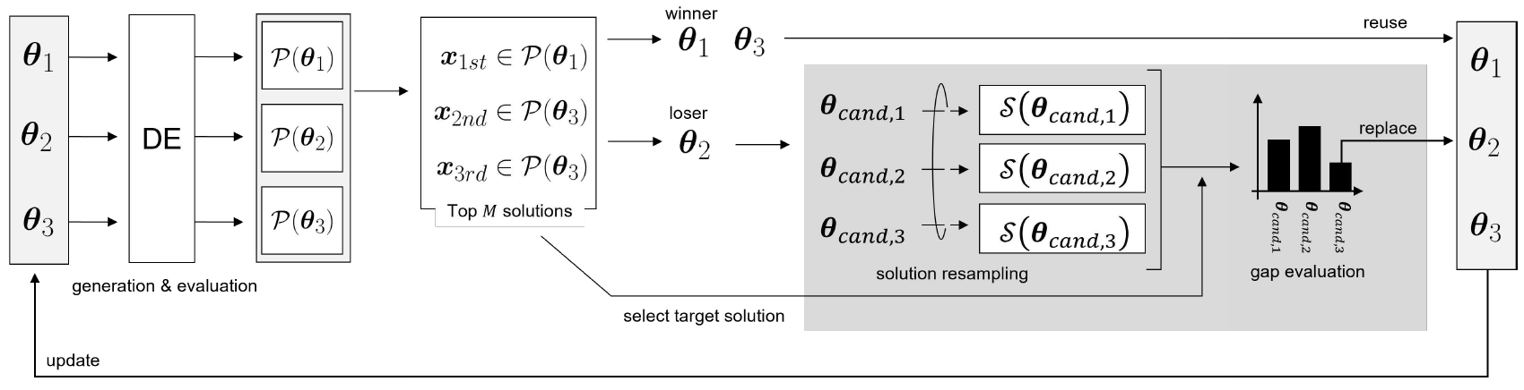
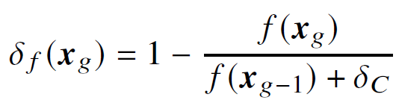






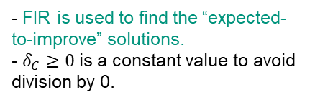


Overall Framework
EBADE
An example with $M=3$ and $K=3$, where $K$ is the number of candidate $θ$s.
Search
Post-hoc Validation
Prior Validation
Good
Ranks in the top
Bad
Failing to be ranked
In terms of FIR
Multi-Population
Solution having the best FIR
Minimum Euclidean distance
between the best FIR solution and the solution in the subpopulation
FIR: Fitness Improvement Ratio
generated by $θ_{cand,1}^{}$
★
- FIR is used to find the “expected-to-improve” solutions.
- $δ_{C}≥0$ is a constant value to avoid division by 0.
$$θ_{cand,1}^{}$$
Target
deriving the best FIR metric
Search Space
Target Solution
$$θ_{cand,2}^{}$$
$$θ_{cand,3}^{}$$
$$θ_{cand,3}^{}$$
by $θ_{cand,2}^{}$
by $θ_{cand,3}^{}$

Slide 13
Experiment

Slide 14
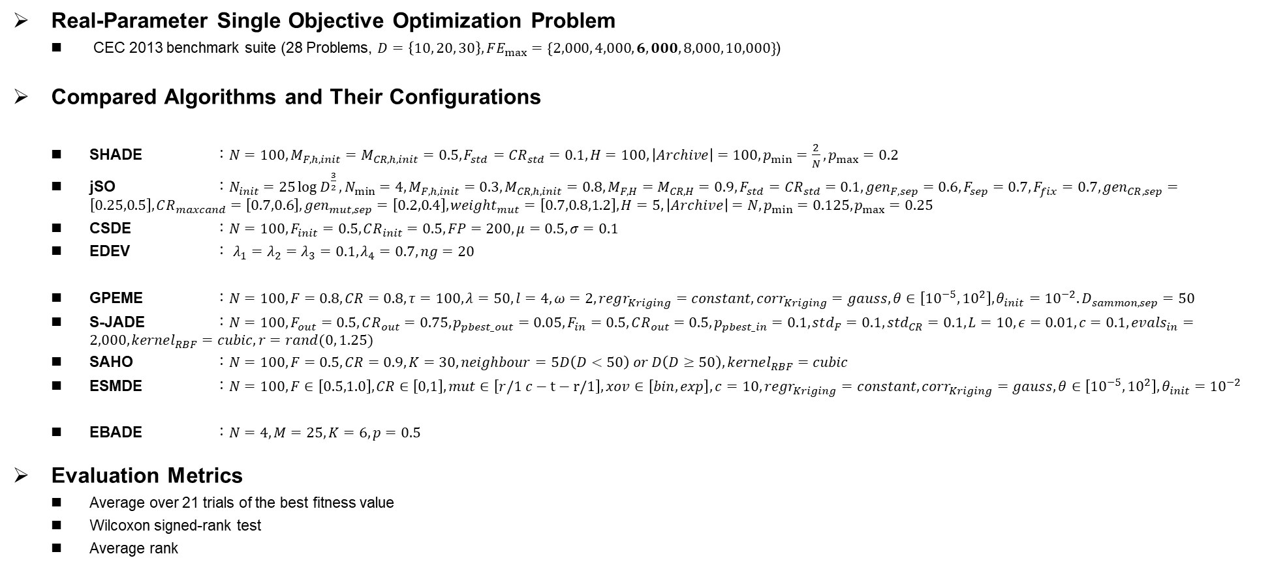
Experiment: Settings
Real-Parameter Single Objective Optimization Problem
CEC 2013 benchmark suite (28 Problems, $D=\left\{10, 20, 30\right\}, FE_{max}=\{2,000, 4,000, 6,000, 8,000, 10,000\}$)
Compared Algorithms and Their Configurations
SHADE ：$N=100,M_{F,h,init}=M_{CR,h,init}=0.5,F_{std}={CR}_{std}=0.1,H=100,\left|Archive\right|=100,p_{min}=\frac{2}{N},p_{max}=0.2$
jSO ：$N_{init}=25\log{D^{\frac{3}{2}}},N_{min}=4,M_{F,h,init}=0.3,M_{CR,h,init}=0.8,M_{F,H}=M_{CR,H}=0.9,F_{std}={CR}_{std}=0.1,{gen}_{F,sep}=0.6,F_{sep}=0.7,F_{fix}=0.7,{gen}_{CR,sep}=\left[0.25,0.5\right],CR_{maxcand}=\left[0.7,0.6\right],{gen}_{mut,sep}=\left[0.2,0.4\right],{weight}_{mut}=\left[0.7,0.8,1.2\right],H=5,\left|Archive\right|=N,p_{min}=0.125,p_{max}=0.25$
CSDE ：$N=100, F_{init}=0.5,CR_{init}=0.5,FP=200,μ=0.5,σ=0.1$
EDEV ： $λ_{1}=λ_{2}=λ_{3}=0.1, λ_{4}=0.7, ng=20$
GPEME ：$N=100,F=0.8, CR=0.8,τ=100,λ=50,l=4,ω=2,regr_{Kriging}=constant,corr_{Kriging}=gauss,θ∈\left[{10}^{−5},{10}^{2}\right],θ_{init}={10}^{−2}.D_{sammon,sep}=50$
S-JADE ：$N=100,F_{out}=0.5, CR_{out}=0.75, p_{pbest_out}=0.05, F_{in}=0.5, CR_{out}=0.5,p_{pbest_in}=0.1,std_{F}=0.1, std_{CR}=0.1,L=10,ε=0.01, c=0.1,evals_{in}=2,000,kernel_{RBF}=cubic, r=rand(0, 1.25)$
SAHO ：$N=100, F=0.5, CR=0.9, K=30,neighbour=5D\left(D<50\right) or D\left(D≥50\right),kernel_{RBF}=cubic$
ESMDE ：$N=100,F∈\left[0.5,1.0\right], CR∈\left[0,1\right],mut∈\left[r/1 c−t−r/1\right],xov∈\left[bin,exp\right],c=10,regr_{Kriging}=constant,corr_{Kriging}=gauss,θ∈\left[{10}^{−5},{10}^{2}\right],θ_{init}={10}^{−2}$
EBADE ：$N=4,M=25, K=6,p=0.5$
Evaluation Metrics
Average over 21 trials of the best fitness value
Wilcoxon signed-rank test
Average rank
Adaptive DEs
[Tanabe+ 13]
[Brest+ 17]
[Sun+ 20]
[Wu+ 18]
Surrogate-assisted DEs
[Liu+ 14]
[Cai+ 19]
[Pan+ 21]
[Mallipeddi+ 15]
Proposed Algorithms

Slide 15
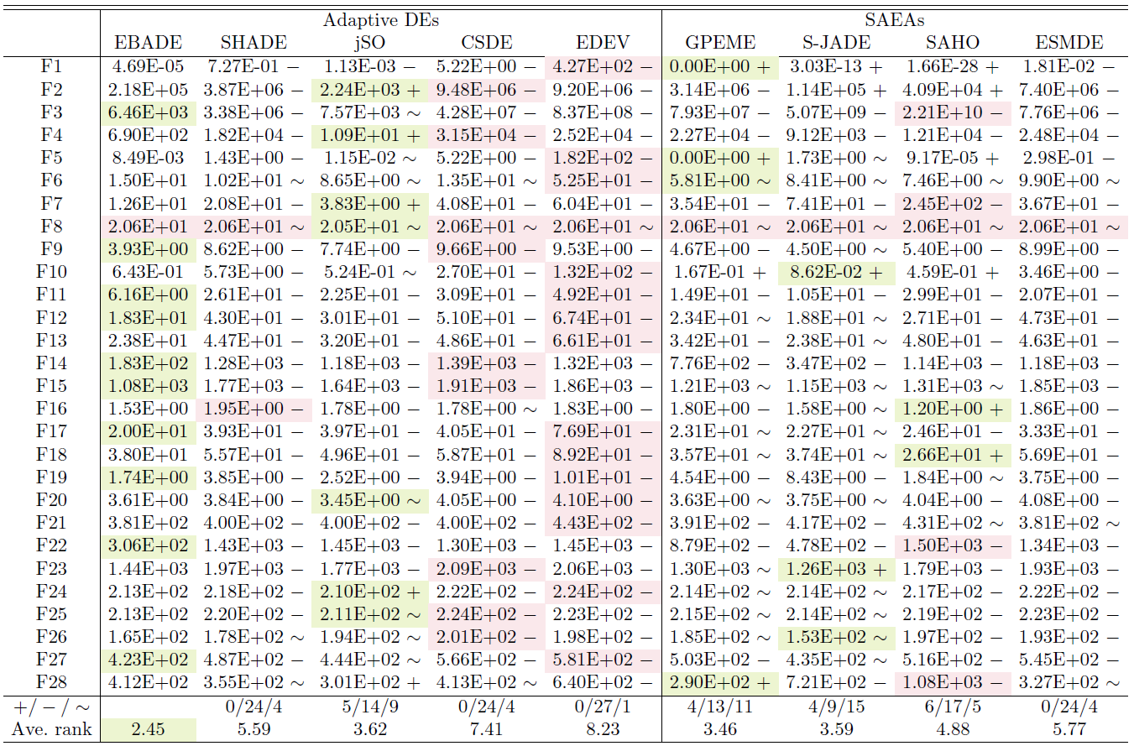
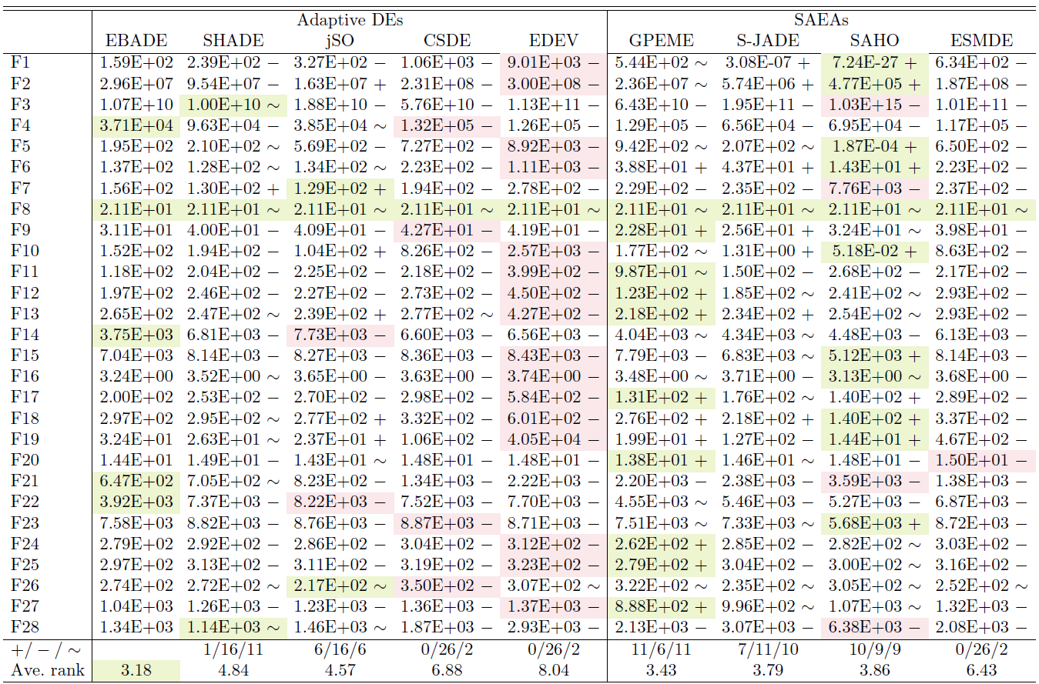


Experiment: Results (Fitness at 6,000FEs)
EBADE outperforms adaptive DEs and is highly competitive with SAEAs
EBADE is superior with statistical significance (the number of “-” is 9 to 27)
The best average rank is obtained by EBADE in all dimensions.
Best value
Worst value
＋/－/～ in Wilcoxon test
＋ ：ours underperforms
－ ：ours outperforms
～ ：cannot find significance
$$D=10$$
$$D=30$$

Slide 16
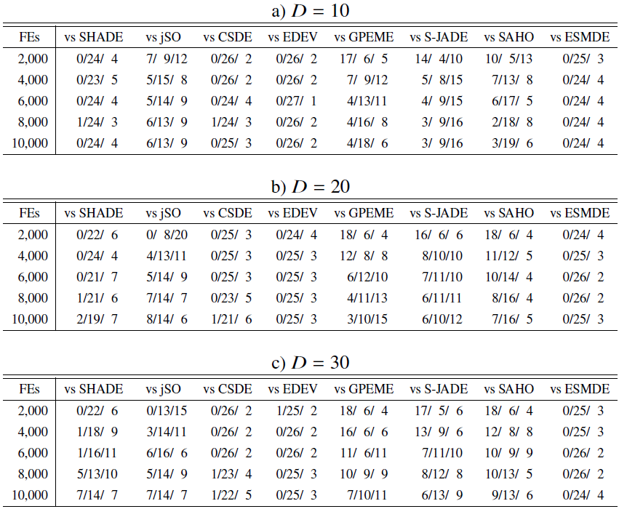
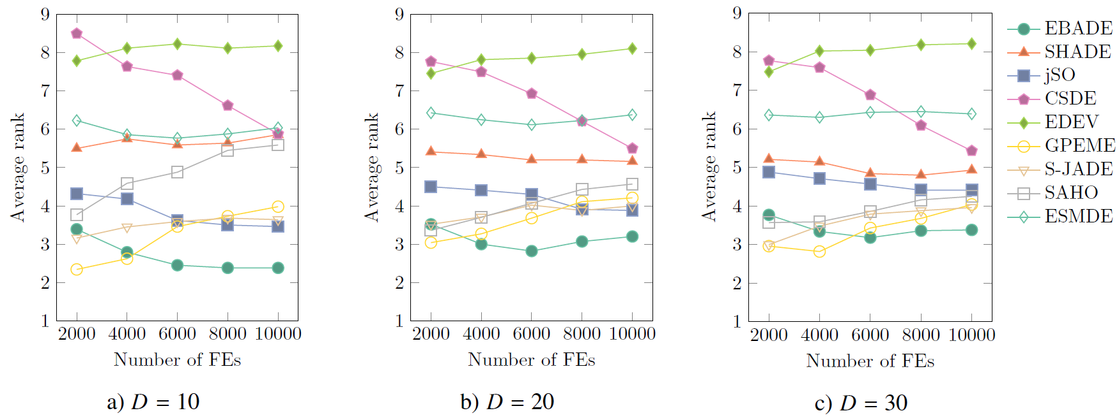
Experiment: Results (Summary)
＋/－/～ in Wilcoxon test
＋ ：ours underperforms
－ ：ours outperforms
～ ：cannot find significance
Usefulness of EBADE and Limitation of SAEA in M-EOPs
EBADE keeps deriving the best performance after 6,000 FEs, i.e., M-EOPs
The ranks of SAEAs decreases as the increase of the number of FEs.
Some adaptive DEs becomes effective as the increase of the number of FEs.
(jSO and CSDE)
Wilcoxon signed-rank test
Average rank
Notes:
Next, we check the scalability of performance to problem dimension. The left figures are averaged rank against the number of FEs and the right table is the summary of Wilcoxon signed-rank test. As a whole, our proposal keeps deriving the best performance with the increase of problem dimension, thus our proposal is well-scaled with problem dimension. However, the scalability to the number of FEs is slightly weak since sometimes our proposal ranks second or third under 500 FEs. Still, the effectiveness of our proposal remains intact since the number of “-” surpasses that of “+” in 32 pairs out of 36 pairs in the right table.

Slide 17
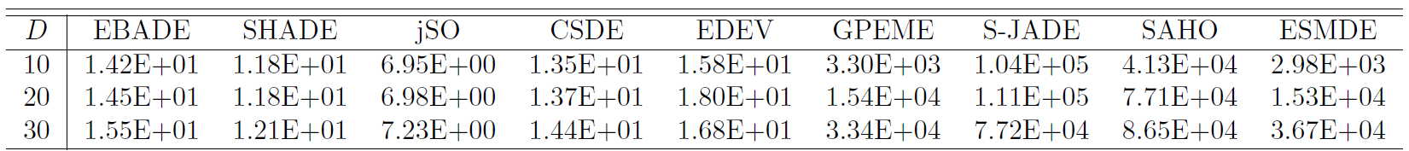
Experiment: Computational Time
Average runtime [sec] required to complete one trial (6,000 FEs)
The runtime of EBADE is slightly longer than those of adaptive DEs.
However, this is not cared in M-EOPs.
The runtime of EBADE is much faster than those of SAEAs.
These long runtime of SAEAs are not accepted in M-EOPs.
Adaptive DEs
SAEAs
Notes:
Next, we check the scalability of performance to problem dimension. The left figures are averaged rank against the number of FEs and the right table is the summary of Wilcoxon signed-rank test. As a whole, our proposal keeps deriving the best performance with the increase of problem dimension, thus our proposal is well-scaled with problem dimension. However, the scalability to the number of FEs is slightly weak since sometimes our proposal ranks second or third under 500 FEs. Still, the effectiveness of our proposal remains intact since the number of “-” surpasses that of “+” in 32 pairs out of 36 pairs in the right table.

Slide 18
Discussion

Slide 19
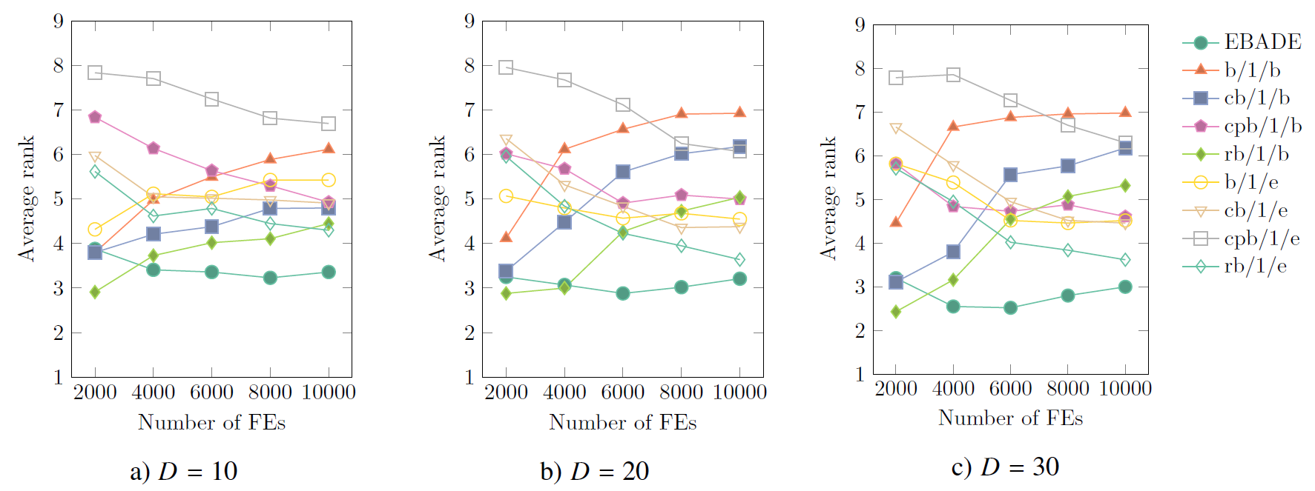

Discussion 1/3
Impact of parameter adaptation in M-EOPs
EBADE is compared with DEs with fixed parameter configuration.
Eight variants ($θ_{F}=0.5, θ_{CR}=0.9$)
Result (average rank)
EBADE is in top rank with 6,000 FEs and more.
cb/1/b and rb/1/b are in high rank under 4,000 FEs. However, their rank degrades with a greater number of FEs.
mutation
best/1
current-to-best/1
current-to-pbest/1
rand-to-best/1
binomial
b/1/b
cb/1/b
cpb/1/b
rb/1/b
crossover
exponential
b/1/e
cb/1/e
cpb/1/e
rb/1/e
Conclusion
The effectiveness of parameter adaptation of EBADE is confirmed.

Slide 20
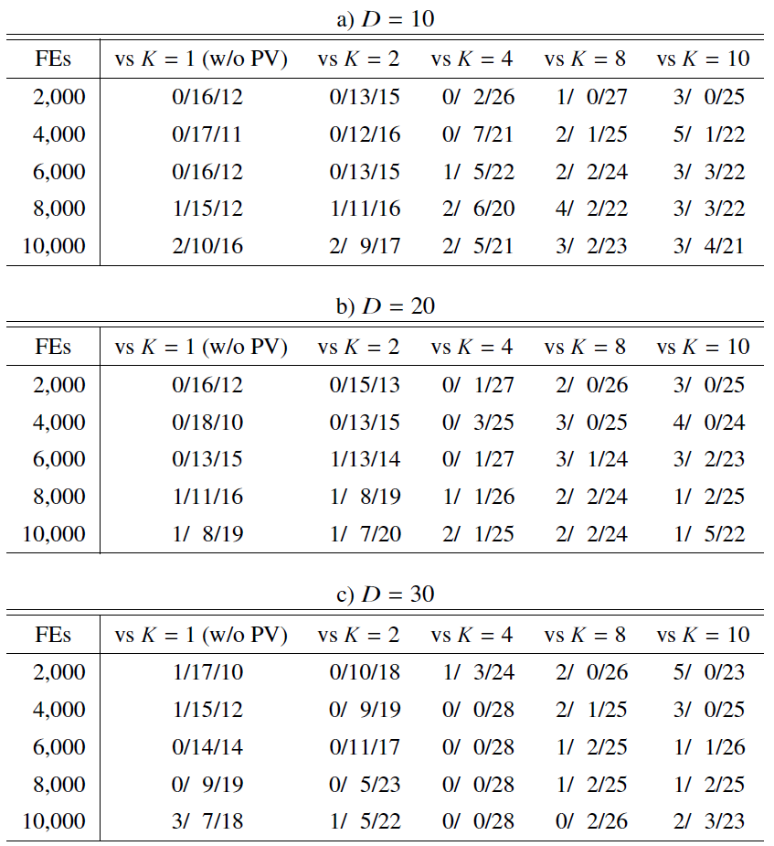
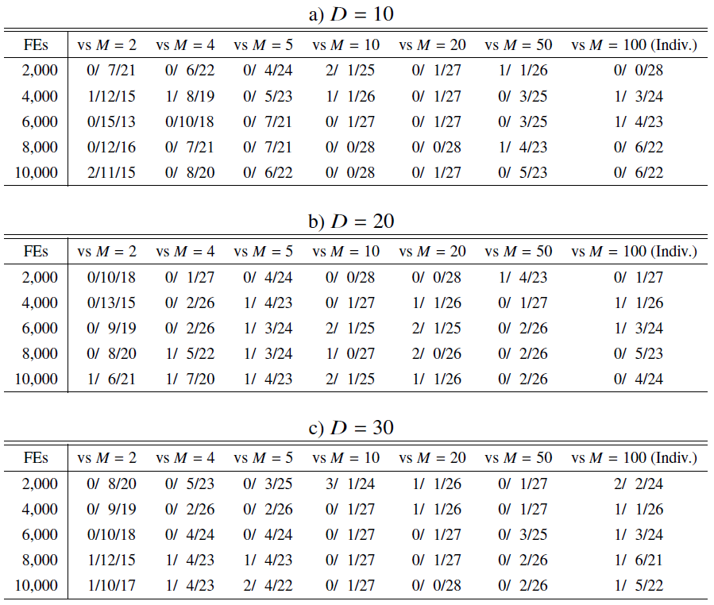



Discussion 2/3
Parameter analysis for $K$ (# of candidate $θ$s) and $M$ (# of subpopulations)
Ablation studies of the prior validation and multi-population can also be conducted.
Result
The performance of EBADE is sensitive to $K$ and $M$.
The default setting outperforms or is competitive with the others.
EBADE with $K=1$ or $M=100$ clearly underperform the others.
Can be turned off by setting $K=1$
Ditto by setting $M=100$
＋/－/～ in Wilcoxon test
＋ ：default setting underperforms
－ ：default setting outperforms
～ ：cannot find significance
Conclusion
The prior validation and multi-population mechanisms are necessary.

Slide 21
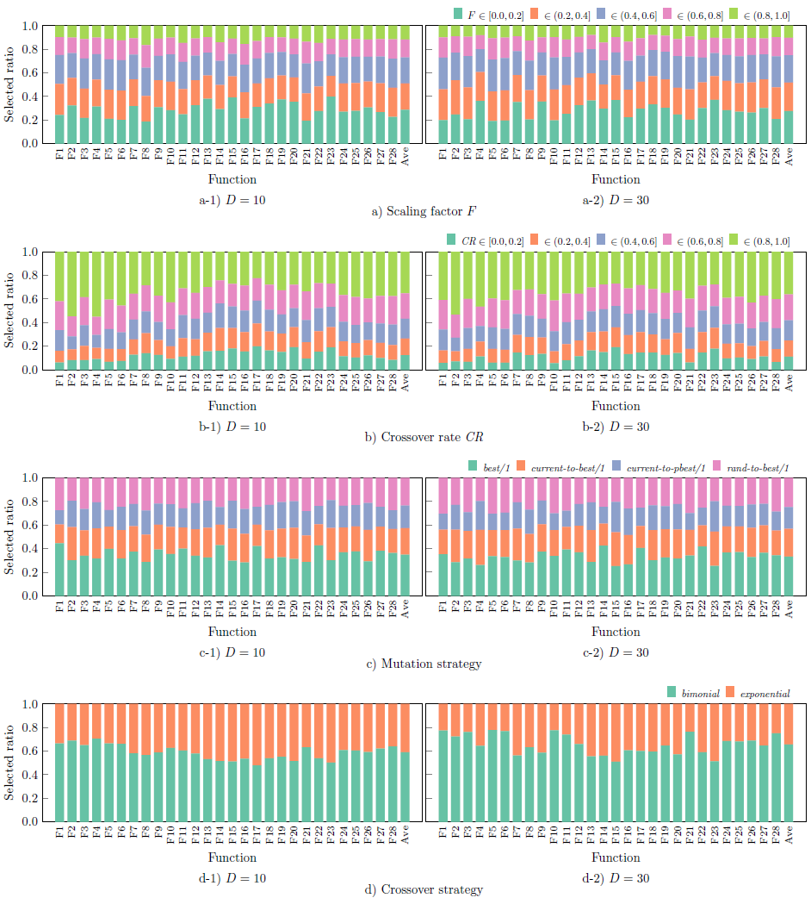
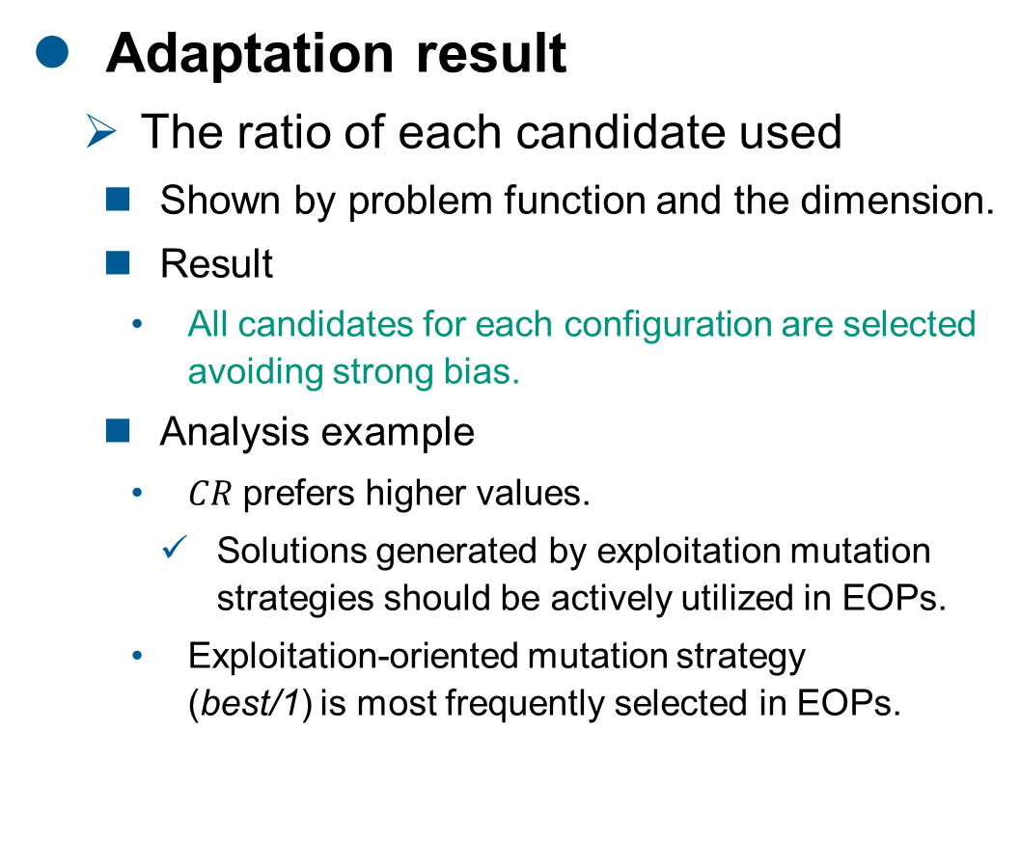
Discussion 3/3
Adaptation result
The ratio of each candidate used
Shown by problem function and the dimension.
Result
All candidates for each configuration are selected avoiding strong bias.
Analysis example
$CR$ prefers higher values.
Solutions generated by exploitation mutation strategies should be actively utilized in EOPs.
Exploitation-oriented mutation strategy (best/1) is most frequently selected in EOPs.
Conclusion
EBADE exhibited high performance by selecting more candidates appropriate for EOPs.

Slide 22
Conclusion

Slide 23
Conclusion
Emulation-based Adaptive DE for M-EOPs
EBADE emulates sample-efficient approaches like SAEAs.
Prior validation mechanism prescreens candidate configurations without FEs.
Multi-population mechanism validates candidate configurations with respect to multiple samples.
High performance, Fast, and Auto-tunable
Outperforming adaptive DEs and highly competitive with SAEAs.
Much shorter runtime than those of SAEAs.
Automatic performance improvement and easy-to-use
Future Work
Extension to multi-objective EOPs
Development of solution screening mechanism without using any ML technique.
Notes:
As the conclusion, we proposed a new adaptive SAEA, namely Surrogate-assisted DE with Adaptation of Training Data Selection Criterion (SADE-ATDSC). Our proposal constructs multiple RBF surrogate model with different criteria, and selects one model with the best accuracy before prescreening of candidate solutions.
Our proposal outperformed state-of-the-art SAEAs up to 100 dimension and also derived much smaller computational time.
As future works, (we further investigate the correlation between the stage of search and the effect of adaptation and then) we define the frequency of adaptation. Moreover, our future proposal will also adapt surrogate settings in addition to the training data selection criterion, to improve the performance by finding more effective use of surrogates in SAEAs.

Slide 24
References
[Shan+ 10] S. Shan and G. G. Wang, “Survey of modeling and optimization strategies to solve high-dimensional design problems with computationally-expensive black-box functions,” Struct. Multidiscip. Optim., vol. 41, no. 2, pp. 219–241, Mar. 2010.
[Deng+ 22] W. Deng, H. Ni, Y. Liu, H. Chen, and H. Zhao, “An adaptive differential evolution algorithm based on belief space and generalized opposition-based learning for resource allocation,” Appl. Soft Comput., vol. 127, p. 109419, Sep. 2022.
[Makumbura+ 22] R. K. Makumbura, M. B. Gunathilake, J. T. Samarasinghe, R. Confesor, N. Muttil, and U. Rathnayake, “Comparison of Calibration Approaches of the Soil and Water Assessment Tool (SWAT) Model in a Tropical Watershed,” Hydrology, vol. 9, no. 10, p. 183, Oct. 2022.
[Oyama+ 17] A. Oyama, T. Kohira, H. Kemmotsu, T. Tatsukawa, and T. Watanabe, “Simultaneous structure design optimization of multiple car models using the K computer,” in IEEE Symp. Ser. Comput. Intell. (SSCI), Nov. 2017, pp. 1–4.
[Jones+ 98] D. R. Jones, M. Schonlau, and W. J. Welch, “Efficient global optimization of expensive black-box functions,” J. Global Optimiz., vol. 13, no. 4, pp. 455–492, 1998.
[Sun+ 15] C. Sun, Y. Jin, J. Zeng, and Y. Yu, “A two-layer surrogate-assisted particle swarm optimization algorithm,” Soft Computing, vol. 19, no. 6, pp. 1461–1475, Jun. 2015.
[Briffoteaux 22] G. Briffoteaux, “Parallel surrogate-based algorithms for solving expensive optimization problems,” Ph.D., University of Lille, 2022. [Online]. Available: https://hal.science/tel-03853862/
[Lobo+ 07] F. J. Lobo, C. F. Lima, and Z. Michalewicz, Parameter Setting in Evolutionary Algorithms. Berlin, Heidelberg: Springer Science & Business Media, 2007.
[Storn+ 97] R. Storn and K. Price, “Differential Evolution – A Simple and Efficient Heuristic for Global Optimization over Continuous Spaces,” J. Global Optimiz., vol. 11, pp. 341–359, 1997.
[Cai+ 13] Cai, Y., Wang, J.: Differential evolution with neighborhood and direction information for numerical optimization. IEEE Trans. Cybern. 43(6), 2202–2215(2013)
[Tanabe+ 13] Tanabe, R., Fukunaga, A.: Success-history based parameter adaptation for Differential Evolution. In: IEEE Congr. Evol. Comput. (CEC), pp. 71--78 (2013)
[Brest+ 17] J. Brest, M. S. Maučec, and B. Bošković, “Single objective real-parameter optimization: Algorithm jSO,” in IEEE Congr. Evol. Comput. (CEC), Jun. 2017, pp. 1311–1318.
[Wu+ 18] G. Wu, X. Shen, H. Li, H. Chen, A. Lin, and P. N. Suganthan, “Ensemble of differential evolution variants,” Inf. Sci., vol. 423, pp. 172–186, Jan. 2018.
[Sun+ 20] Sun, G., Yang, B., Yang, Z., Xu, G.: An adaptive differential evolution with combined strategy for global numerical optimization. Soft Comput. 24(9), 6277--6296 (2020)
[Liu+ 14] Liu, B., Zhang, Q., Gielen, G.G.E.: A Gaussian Process Surrogate Model Assisted Evolutionary Algorithm for Medium Scale Expensive Optimization Problems. IEEE Trans. Evol. Comput. 18(2), 180-192 (2014)
[Cai+ 19] X. Cai, L. Gao, X. Li, and H. Qiu, “Surrogate-guided differential evolution algorithm for high dimensional expensive problems,” Swarm Evol. Comput., vol. 48, pp. 288–311, Aug. 2019.
[Pan+ 21] J.-S. Pan, N. Liu, S.-C. Chu, and T. Lai, “An efficient surrogate-assisted hybrid optimization algorithm for expensive optimization problems,” Inf. Sci. , vol. 561, pp. 304–325, Jun. 2021.
[Mallipeddi+ 15] Mallipeddi, R., Lee, M.: An evolving surrogate model-based differential evolution algorithm. Appl. Soft Comput. 34, 770-787 (2015)

