Slide 1
Move actions
Attack actions
0
1
2
3
13
14
15
4
5
6
7
8
16
17
9
10
11
18
19
20
12

Slide 2
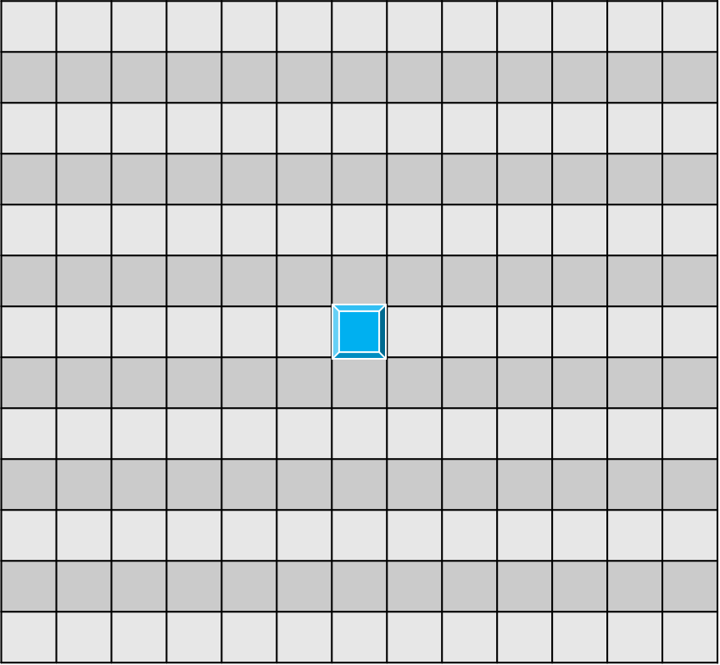
Observation
Of each agent
13X13X5
Table
Is_wall?
(0/1)
Is_my team?
(0/1)
My_team_hp
[0-1]
other_team?
(0/1)
other_team_hp
[0-1]

