Slide 1
Lecture-5
Classification and Training models

Slide 2
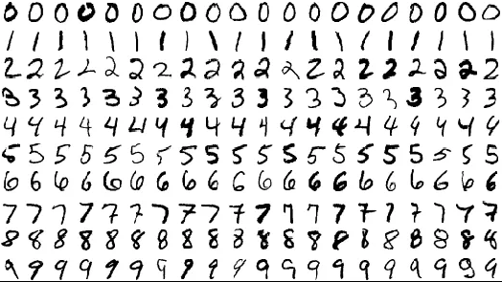
MNIST
Dataset of 70k images of hand written images
Each image is labelled
Open lecture-5.ipynb
Go back to notebook

Slide 3
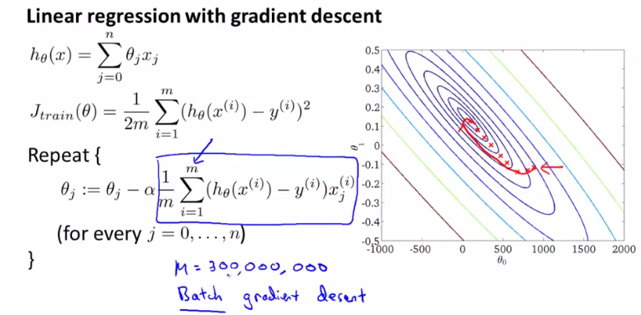
BGD

Slide 4
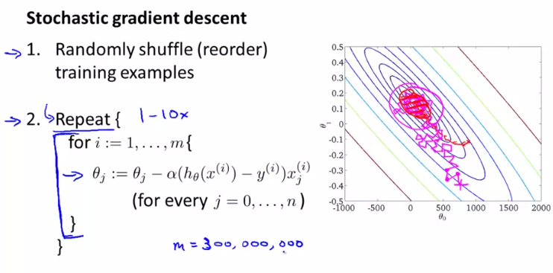
SGD
Go back to notebook

Slide 5

Confusion matrix
First row represents the non 5 images
52826 were correctly classified as non-5’s (true negatives)
1753 were wrongly classified as non 5s (false negatives)
Second row represents the images of 5s
851 were wrongly classified as 5s (false positives)
4570 were correctly classified as 5s (true positives)
Perfect classifier would have only true positives and true negatives

Slide 6
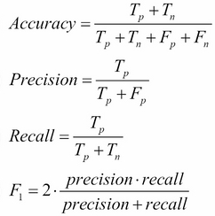
Precision – Recall – F1
Go to notebook

Slide 7
Precision recall tradeoff
F1 score favors classifiers with similar precision and recall
Some contexts you want high precision and in some high recall
Eg:
Classifier to detect videos safe for kids – high precision
Detect shoplifters on surveillance images – high recall
Unfortunately, increasing precision reduces recall and vice versa
This is called precision/recall tradeoff
Call decision_function() to get score and set threshold yourself instead of using threshold = 0 as set by predict() function.
Go to notebook

Slide 8
So far…
Treated ML models and algos like black boxes
Optimized a regression system, improved a digit image classifier without knowing how they actually work
You don’t need to know
But, having a good understanding helps you home in on appropriate model, set good hyperparameters
We will look at Linear Regression, Softmax Regression and Logistic Regression in great detail

Slide 9
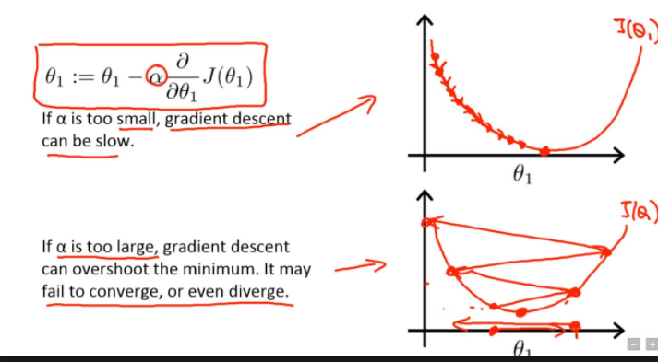
Gradient Descent pitfalls

Slide 10
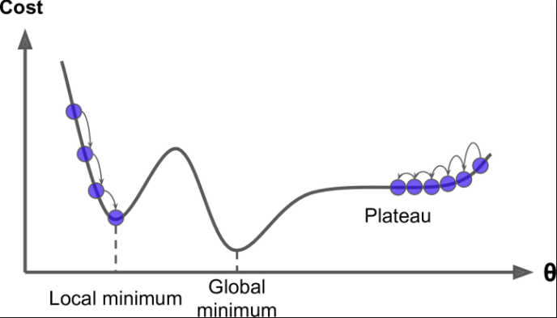
Gradient Descent pitfalls
Fortunately, MSE cost function happens to be a convex function, which means there are no local minima, only 1 global minima

Slide 11
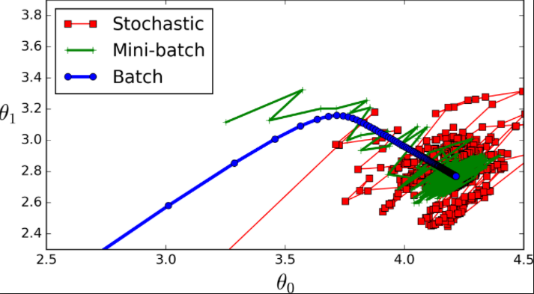
Mini Batch Gradient Descent
Explain logic

Slide 12
Polynomial Regression
What if data is more complex than simple straight line
Good news is that a linear model can be used to fit nonlinear data
Simple way is to add powers of each feature as new features
This is called polynomial regression
Go to notebook
PolynomialFeatures (degree=d) transforms an array containing n features into array containing (n+d)!/d!n!
Beware of combinatorial explosion of number of features

Slide 13
Learning Curves
How to know what is the degree to be set?
High degree model will overfit. Lower degree will underfit
How can you tell if your model is overfitting or underfitting?
If model performs well on training data but generalizes poorly on cross validation metrics => overfitting
If model performs poorly on both => underfitting
Another way is to look at learning curves
Plots of models performance on training set and validation set as function of training set size
Train model several times on different sized subsets of training set.
Open notebook

Slide 14
Bias Variance Trade off
Important theoretical result of ML is that model’s generalization error can be expressed as sum of 3 very different errors:
Bias – Due to wrong assumptions like assuming data is linear when it is actually quadratic. High bias model is likely to underfit
Variance – Due to excessive sensitivity to small variations in training data. Model with many degrees of freedom likely to overfit
Irreducible error – Due to noisiness of data itself. Clean up your data.
Increase in bias leads to decrease in variance and vice versa. Hence it is a tradeoff.

Slide 15
Regularized Linear models
One way to reduce overfitting is to have fewer degrees of freedom
For linear model, regularization is way to reduce overfitting
Regularization is achieved by constraining weights of the model
Ridge Regression – sum of square of weights times α added to cost function.
Lasso Regression - sum of modulus of weights times α added to cost function.
L1 eliminates least important features. Performs feature selection and outputs sparse model
Elastic Net – Middle ground. Adds r times Lasso and 1-r times Ridge
Go to notebook

Slide 16
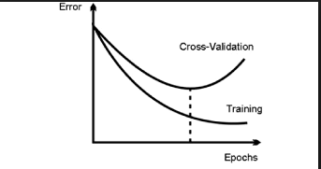
Early stopping
Stop when iterative learning when validation error reaches minimum
Go to notebook

Slide 17
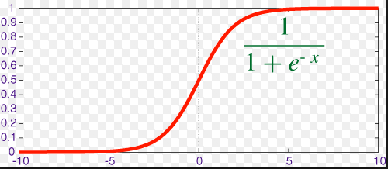
Logistic Regression
Used to estimate the probability an instance belongs to a particular class
If estimated probability > 0.5 then model predicts that the instance belongs to that class
So how does it work?
To linear regression, it finds the sigmoid - Logit

Slide 18
Logistic Regression
Y_pred = {0 if p < 0.5 ,
1 if p >= 0.5 }
Cost function,
J = { -log(p) if y = 1,
-log(1-p) if y =0 }
Go to notebook for doing Logistic Regression on Iris dataset

Slide 19
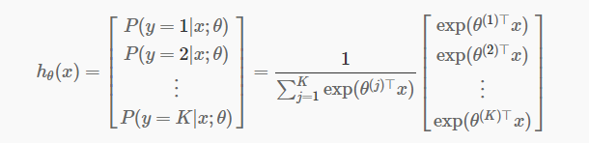
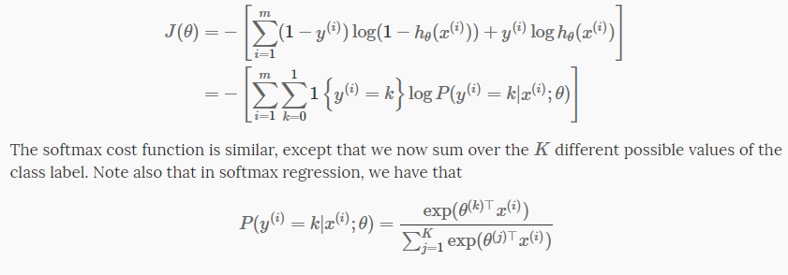
Softmax Regression
Go to notebook

