Slide 1
ML in Python - Beginners
Day - 1

Slide 2
Agenda
Clarity on terminologies
Why study Probability and Statistics?
What is probability?
What is Bayes rule?
What is a probability distribution?
Different / Major probability distributions
Sampling from probability distributions
Introduction to Numpy / Scipy / Matplotlib
How to represent probability distributions using Numpy / Scipy / Matplotlib?
Define a problem and discuss solutions

Slide 3
Terminologies
Artificial Intelligence - the theory and development of computer systems able to perform tasks normally requiring human intelligence
Machine Learning - is an application of AI that has the ability to automatically learn and improve from data without being explicitly programmed
Deep Learning - subset of machine learning in Artificial Intelligence (AI) that has networks which are capable of learning
Neural Networks - a computer system modelled on the human brain and nervous system
Big Data - extremely large data sets that may be analysed computationally to reveal patterns, trends
Data Science – Professional field encompassing all/some of the above

Slide 4
Terminologies
Data Science
Big Data
Artificial Intelligence
Weak AI
Strong AI
Bayesian Networks
Machine Learning
Linear Regression
Decision Tree
SVM
...
Logistic Regression
Neural Networks
Convolutional Nets
Recurrent Nets
LSTM
...
Adversarial Nets
Deep Learning

Slide 5
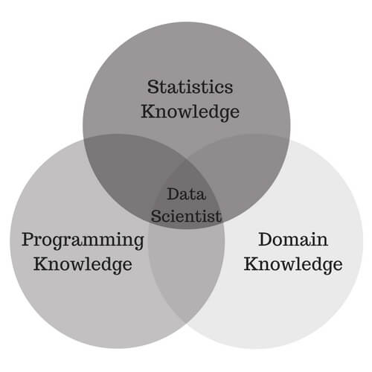
Why Probability and Statistics?
Probability – Extent to which something is likely to happen
Statistics - Science of collecting and analysing numerical data in large quantities, especially for the purpose of inferring proportions in a whole from those in a representative sample
Discuss the rent example
How did you guess the rent?
Uncertainty is everywhere and we must tame it to be used for our needs
Learning in the Machine learning definition happens through fundamentals of Probability and Statistics

Slide 6
Probability
Probability – Extent to which something is likely to happen
Expressed as a number between 1 and 0
An event with a probability of 1 can be considered a certainty
Discuss examples of events where probability is 0, 0.5, 1
P(A) = n(A) / (n(A) + n(B))
Each coin toss is an independent event
Idea that a number of consecutive results (six "heads" for example) makes it more likely that the next toss will result in a "tails" is known as the gambler's fallacy

Slide 7
Frequentist Probability
Check if a given coin is fair or not
conduct some experiments and record 1 if heads come up and 0 if we see tails
Repeat this 1000 tosses and count each 0 and 1
600 heads (1s) and 400 tails (0s)
how frequent heads or tails came up in the past, we will get 60% and 40% respectively
Those frequencies can be interpreted as probabilities of a coin coming up heads or tails
This is called a frequentist view on the probabilities

Slide 8
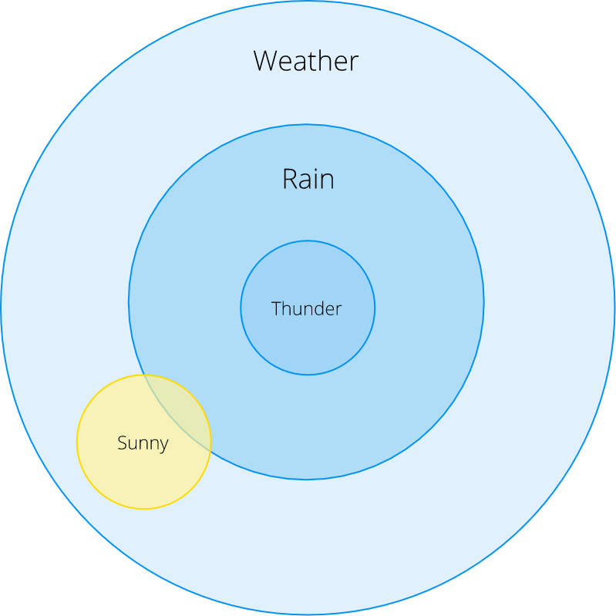

Conditional Probability
We want to know the probability of an event given some other event has occurred
We write conditional probability of an event A given event B as P(A | B)
We can see that P(Rain | Thunder) = 1
What about P(Rain | Sunny)?
Visually this probability is quite small but how can we formulate this mathematically and do exact calculations?
We can see that P(Rain | Thunder) = 1
What about P(Rain | Sunny)?
Visually this probability is quite small but how can we formulate this mathematically and do exact calculations?
In words, we divide probability of both Rain and Sunny by the probability of a Sunny weather

Slide 9


Dependent and Independent Events
Events are called independent if the probability of one event does not influence the other in any way
Bayesian Probability
Bayesian way treats parameters in a probabilistic manner and views them as random variables
It all starts with a simple theorem that allows us to compute conditional probabilities based on prior knowledge
Click here for example on Bayes Theorem

Slide 10
Probability Distributions
When we measured relative frequencies of a coin toss event we have actually calculated a so-called empirical probability distribution
Our coin outcomes have a Bernoulli distribution
If we wanted to calculate a probability of heads after n trials we may use a Binomial distribution
Random Variable - concept analogous to a variable that may be used in probabilistic environments
This means random variable X is distributed according to a Bernoulli distribution with probability of success (heads) equal to 0.6
Discrete Probability Distributions – Random variables have a finite countable number of values
Continuous Probability Distributions – Random variables have a infinite number of values

Slide 11
Binomial Distribution
A random variable X representing the number of successes in a sequence of n independent yes/no trials, each of which yields success with probability p
E(X) = np, Var(X) = np(1−p)
Example of binomial distribution: What is the probability of getting 2 heads out of 10 flips of a fair coin?
In this experiment the probability of getting a head is 0.3, this means that on an average you can expect 3 coin flips to be heads
In this experiment the probability of getting a head is 0.3
You can observe zero head, one head all the way upto ten heads
Implement this distribution in code

Slide 12

Poisson Distribution
A random variable X representing the number of events occurring in a fixed time interval with a rate parameters λ
E(X) = λ, Var(X) = λ
Example of poisson distribution: On average number of cars abandoned on a busy highway is 2 per week
We want to find the probability of a certain number of cars abandoned in a particular week
Implement this distribution in code

Slide 13

Normal Distribution
Continuous distribution or a function that can take on values anywhere on the real line
The normal distribution is parameterized by two parameters: the mean of the distribution μ and the variance σ2
Normal distribution can take values from minus infinity to plus infinity
Example of Normal Distribution: Height of all people in the world (Not exactly true)
Implement this distribution in code

Slide 14
Beta Distribution
Continuous distribution understood as representing a probability distribution of probabilities
Takes values between 0 and 1
Distribution is parameterized by two shape parameters α and β
Example of Normal Distribution: Anyone who follows cricket is familiar with centuries per match
0.2 is considered average centuries per match while 0.3 is considered excellent
Imagine we have a cricket player, and we want to predict how many centuries he will score in this season
Why is your 100s per game in the first few games not a good predictor of your eventual 100 conversion? When a player’s first game is a 100, why does no one predict that he’ll never get a 100 all season? Because we’re going in with prior expectations
Implement this distribution in code

Slide 15

Exponential Distribution
The exponential distribution represents a process in which events occur continuously and independently at a constant average rate
Example: I'm standing at a bus stop - how long till the next bus arrives?
Implement this distribution in code

