Slide 1
Lecture - 7
Ensemble Learning and Unsupervised Learning

Slide 2
Introduction
Wisdom of crowd concept
Group of predictors called ensemble
Ensemble of Decision Trees is called Random Forest
Netflix prize competition used Ensemble methods
Popular Ensemble methods
Bagging
Boosting
Stacking
Random Forests

Slide 3
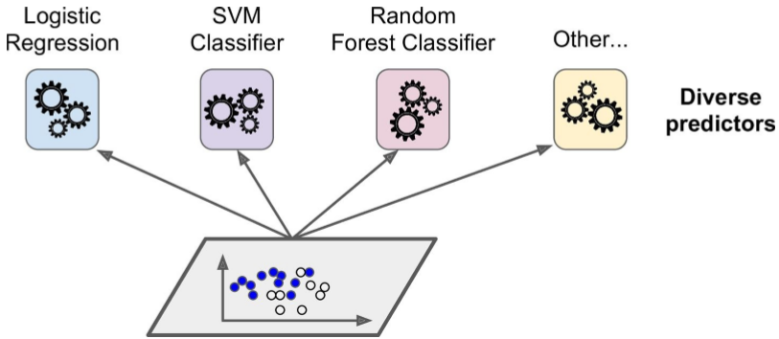
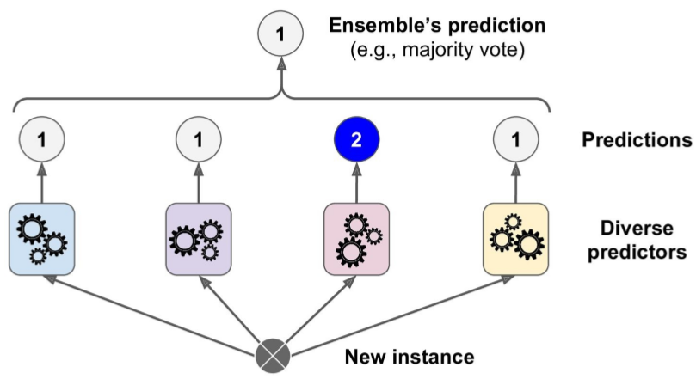
Voting classifier
Many algos with 80% accuracy each
Aggregate predictions of each classifier and predict class that gets most votes
This is hard voting classifier
Ofter achieves higher accuracy than the best model from ensemble

Slide 4
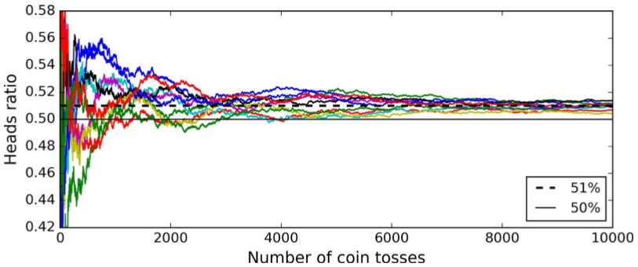
Law of large numbers
Suppose you have biased coin 51% - heads and 49% - tails
Toss 1000 times. Get around 510 heads and 490 tails. Majority heads
Probability of getting majority heads is ~75% for 1000 tosses
With 10k tosses, this probability ~97%
Same analogy for Ensemble
Ensemble work best when predictors are independent
Go to notebook

Slide 5
Soft voting
Predict the class with the highest class probability, averaged over all the individual classifiers
Often achieves higher performance than hard voting because it gives more weight to highly confident votes
Replace voting="hard" with voting="soft“ and ensure that all classifiers can estimate class probabilities
Not the case of the SVC class by default, so you need to set its probability hyperparameter to True

Slide 6
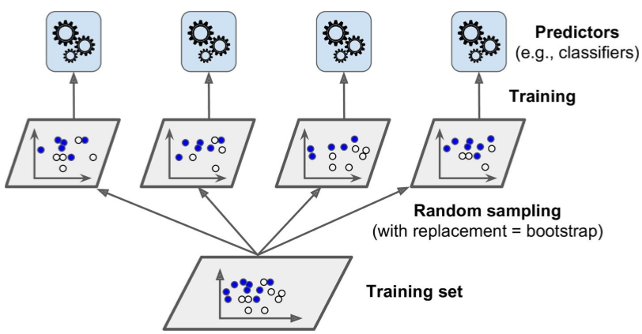
Bagging and Pasting
One way to get diverse classifiers is to use different training algorithms
Another approach is to use same algorithm, but train on different random subsets of data
Bagging – sampling with replacement
Pasting – Sampling w/o replacement
Training done in parallel. Scales well
Go to notebook

Slide 7
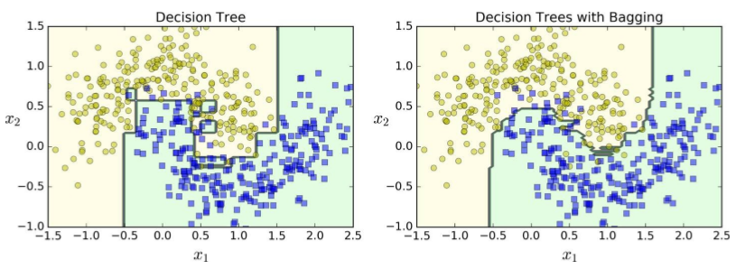
Bagging
Ensemble predictions generalize much better than single Decision Tree
Ensemble has comparable bias but smaller variance

Slide 8
Out of bag evaluation
Some instances sampled several times for a predictor, while others not sampled at all
Default: BaggingClassifier samples m training instances with replacement (bootstrap=True), where m is size of the training set
37% of training instances not sampled are called out-of-bag (oob) instances
They are not the same 37% for all predictors
OOB instances can be used instead of a separate cross validation set
Set oob_score=True when creating a BaggingClassifier to request an automatic oob evaluation after training
Go to notebook

Slide 9
Random Patches and Random Subspaces
BaggingClassifier class supports sampling features as well
Controlled by 2 hyperparams: max_features and bootstrap_features
Each predictor will be trained on a random subset of features
Useful when dealing with high dimensional inputs(like images)
Sampling both instances and features is Random Patches method
Keeping all training instances(bootstrap=False and max_samples=1.0) but sampling features(bootstrap_features=True and/or max_features < 1.0) is Random Subspaces method
Sampling features gives predictor diversity, trading bias for lower variance

Slide 10

Random Forests
Ensemble of Decision Trees trained via bagging method (sometimes pasting)
Instead of BaggingClassifier and passing a DecisionTreeClassifier, use RandomForestClassifier class.
Similarly RandomForestRegressor for regression tasks
RandomForestClassifier has all hyperparams of DecisionTreeClassifier plus all hyperparams of BaggingClassifier
Following BaggingClassifier is roughly equivalent of RandomForestClassifier
Go to notebook

Slide 11
Extra Trees
In a Random Forest, at each node a random subset of features is considered for splitting (as discussed earlier)
Possible to make trees more random by using random thresholds for each feature rather than searching for the best possible thresholds (like Decision Trees)
Forest of such extremely random trees is simply called an Extremely Randomized Trees
This trades more bias for a lower variance
Makes Extra-Trees much faster to train than regular Random Forests

Slide 12
Feature Importance
In a single Decision Tree, important features appear closer to root of tree
Unimportant features appear closer to the leaves.
Possible to get estimate of a feature’s importance by computing average depth at across all trees in the forest.
Access result using feature_importances_ variable.
Go to notebook

Slide 13
Boosting
Ensemble of sequential predictors
General idea is to predictor trying to correct its predecessor
Most popular is
Adaboost
Gradient Boost

Slide 14
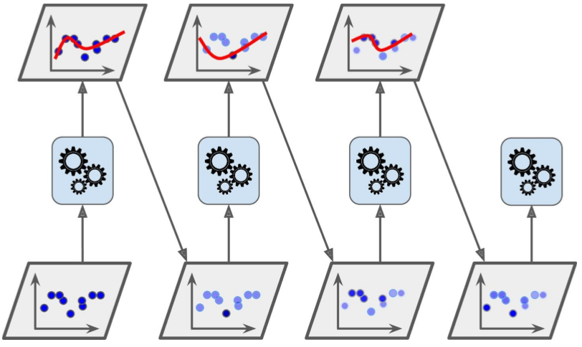
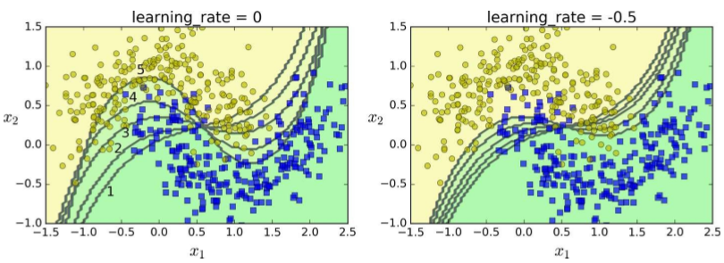
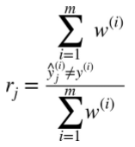
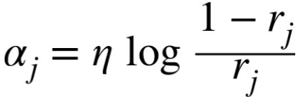
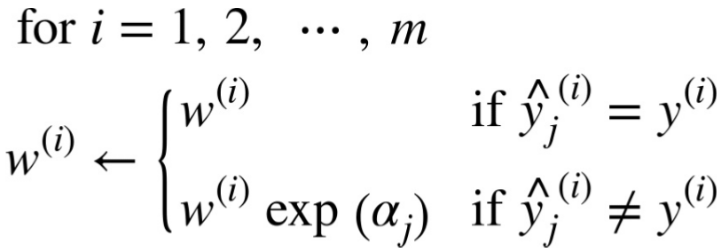
Adaboost
Second classifier trained using updated weights
Each instance weight w(i) is initially set to 1/m
Go to notebook

Slide 15




Gradient Boosting
Like AdaBoost, Gradient Boosting works by sequentially adding predictors, each one correcting its predecessor
Instead of tweaking instance weights at every iteration like AdaBoost, this tries to fit the new predictor to the residual errors made by the previous predictor
GBRT concept using Decision Trees

Slide 16
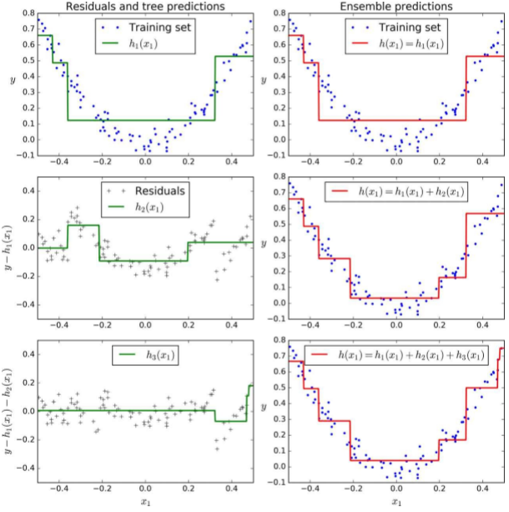
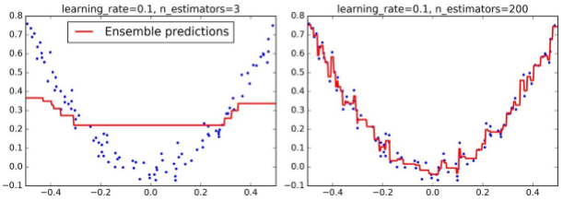
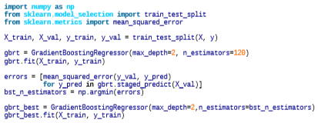
Gradient Boosting

Slide 17
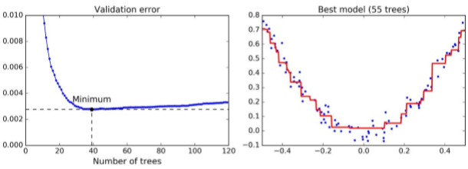
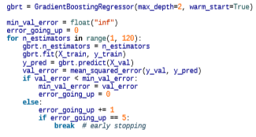
Gradient Boosting
Shows two GBRT ensembles trained with a low learning rate
Possible to implement early stopping by stopping training early

Slide 18
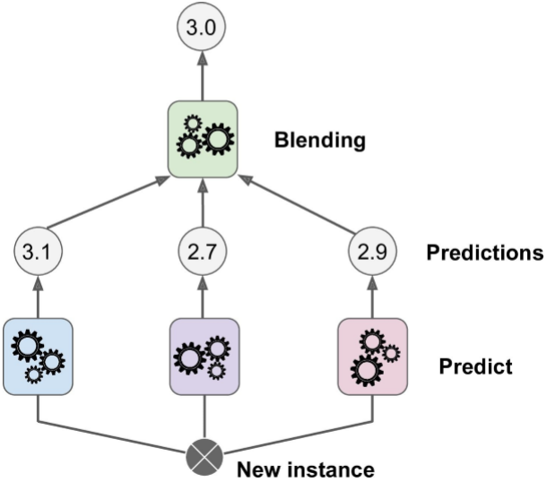
Stacking
Instead of trivial functions like hard voting, train a model to perform this aggregation
Final predictor called a blender or meta learner
Scikit learn does not support stacking directly
Implement yourself or use open source. Click here

Slide 19
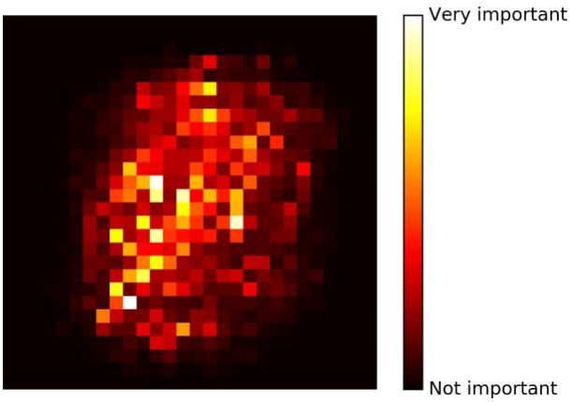
Dimensionality Reduction
Most ML problems have thousands or millions of features
This makes training really slow. Also called curse of dimensionality
MNIST example on the right
DR also helps in data visualization
Things behave differently in higher dimensions
Random point in a 1x1 square has 0.4% chance of being < 0.001 from border. In a 10k unit hypercube the probability is 99.99%
Avg distance between 2 random points from unit square = 0.52. But on a 1L dim hypercube it is 408.25
This implies high dim data are at risk of being sparse: Most training instances far away from each other
New instance also far away from training instances making predictions les reliable
Most popular DR techniques: PCA, Kernel PCA, LLE

Slide 20
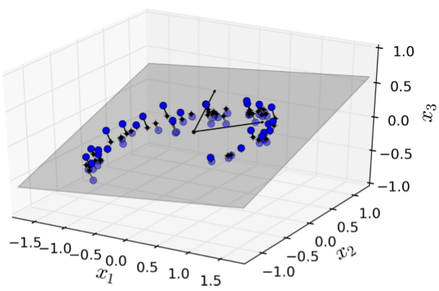
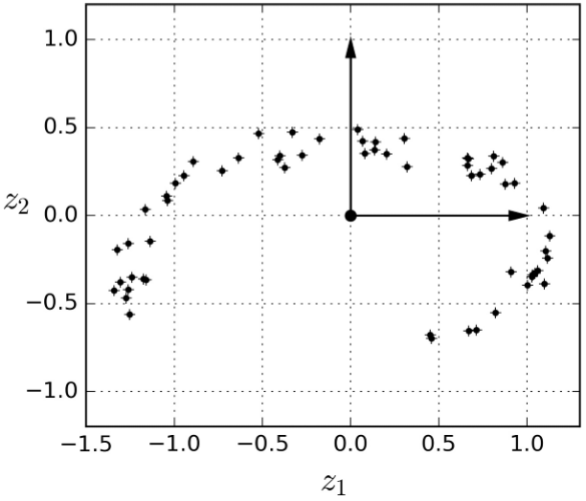
Projection

Slide 21
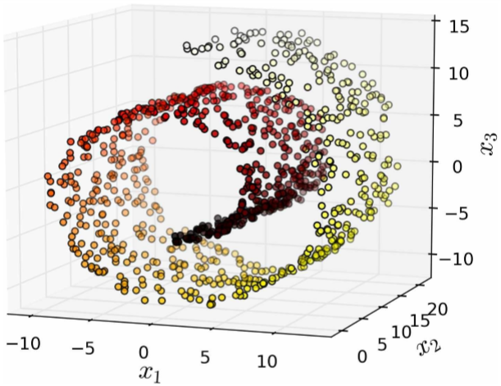
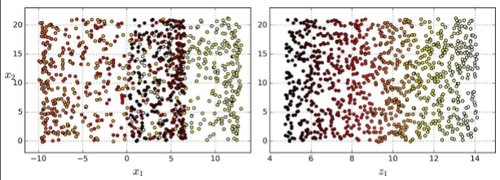
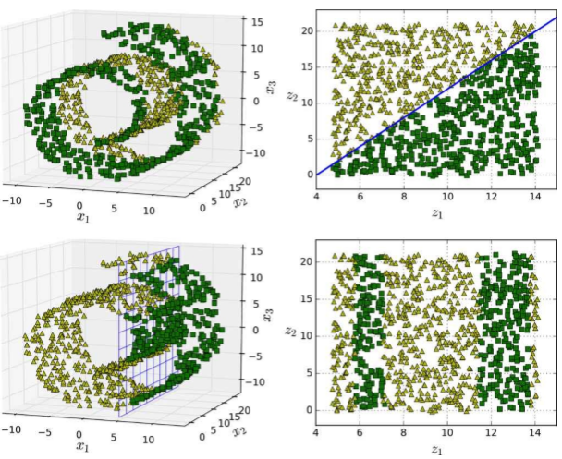
Manifold Learning

Slide 22
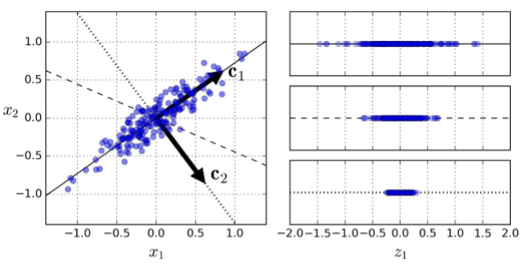
PCA
Most popular
Preserving variance: Explained by image
Identifies axis accounting for largest variance in training set (solid line)
Finds second axis, orthogonal first, accounting for largest remaining variance (dotted line)
If it were a higher dim dataset, PCA would find other axis
1st PC is c1 and the 2nd PC is c2
Discuss PC’s in first figure (3 of them)

Slide 23
PCA
How can you find the Principal Components?
Matrix factorization technique called Singular Value Decomposition
Decompose training set X into U.E.V^{T}
V^{T} contains all the principal components
Go to notebook
PCA assumes dataset centered around origin. Scikit takes care of centering
To project training set(n dim) onto d dim hyperplane(d<n), compute dot product of X and W(containing first d PC)

Slide 24

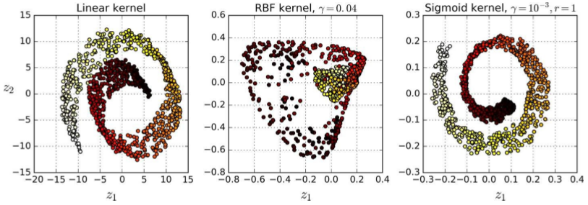
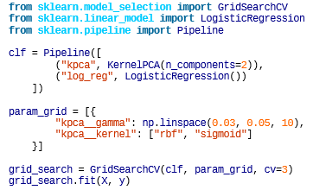
Kernel PCA

Slide 25
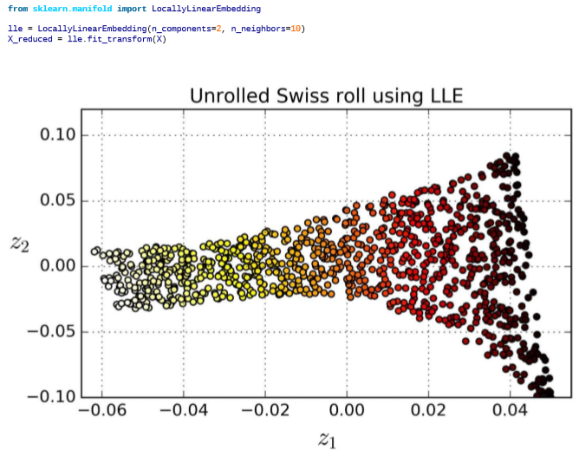
Locally Linear Embedding
Manifold Learning technique
Does not rely on projections
Works by measuring how each training instance linearly relates to closest neighbors
Then, look for low dim representation where these local relationships are best preserved

