Slide 1
Lecture - 3
Introduction to data manipulation tools

Slide 2
Numpy
Numpy
core library for scientific computing in Python.
high-performance
multidimensional array object
tools for working with these arrays
Numpy array
is a grid of values
all of the same type
indexed by a tuple of nonnegative integers.
number of dimensions is the rank of the array
shape of an array is a tuple of integers giving the size of the array along each dimension

Slide 3
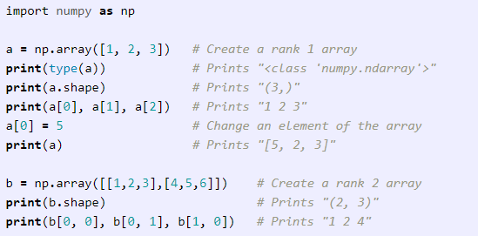
Numpy
We can initialize numpy arrays from nested Python lists, and access elements using square brackets

Slide 4
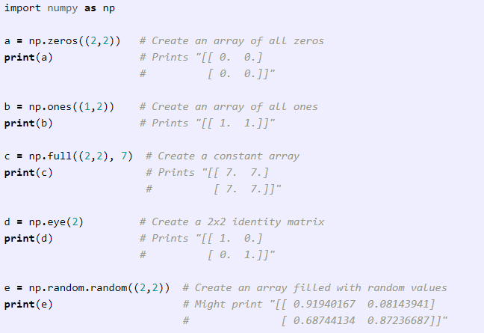
Numpy
Numpy also provides many functions to create arrays

Slide 5
Numpy
Numpy also provides many functions to create arrays

Slide 6
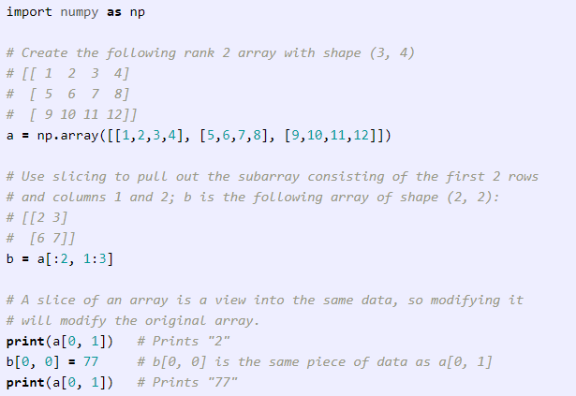
Numpy - Indexing
Similar to Python lists, numpy arrays can be sliced. Since arrays may be multidimensional, you must specify a slice for each dimension of the array

Slide 7
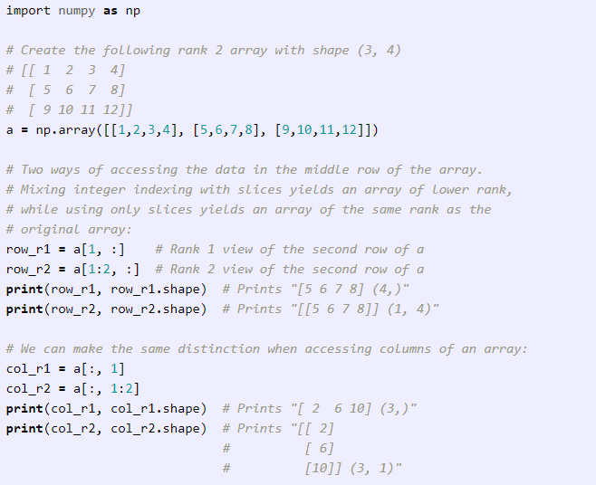
Numpy - Indexing
You can also mix integer indexing with slice indexing. However, doing so will yield an array of lower rank than the original array

Slide 8
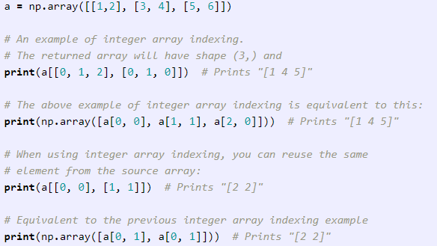
Numpy - Indexing
Indexing into numpy arrays using slicing will always be a subarray of the original array.
While, integer array indexing allows to construct arbitrary arrays using the data from another array. Here is an example

Slide 9
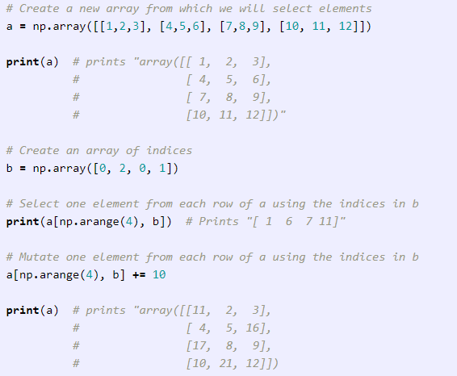
Numpy - Indexing
One useful trick with integer array indexing is selecting or mutating one element from each row of a matrix

Slide 10
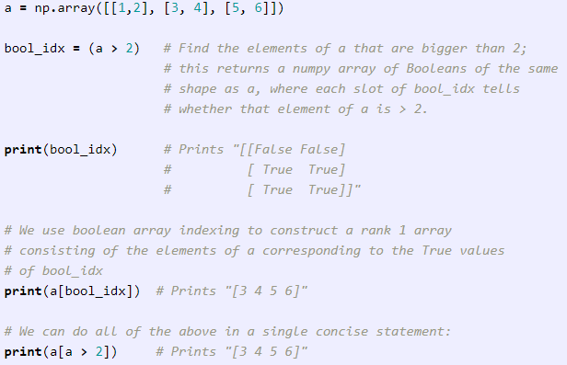
Numpy - Indexing
Boolean array indexing lets you pick out arbitrary elements of an array. Frequently this type of indexing is used to select the elements of an array that satisfy some condition

Slide 11
Numpy - Indexing
Boolean array indexing lets you pick out arbitrary elements of an array. Frequently this type of indexing is used to select the elements of an array that satisfy some condition

Slide 12
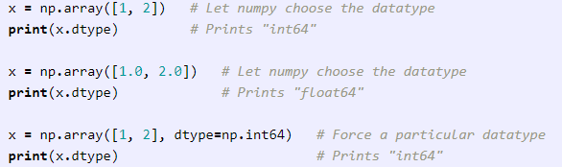
Numpy - Datatypes
Every numpy array is a grid of elements of the same type.
Numpy provides a large set of numeric datatypes to construct arrays.
Numpy tries to guess a datatype but functions that construct arrays have optional argument to explicitly specify the datatype

Slide 13
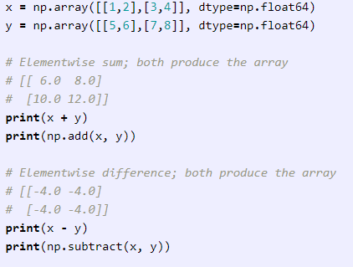
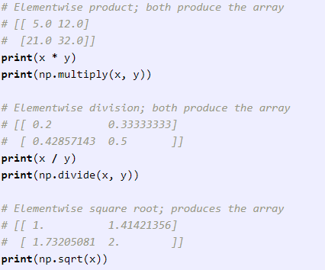
Numpy - Math
Basic mathematical functions operate elementwise
Available both as operator overloads and as functions

Slide 14
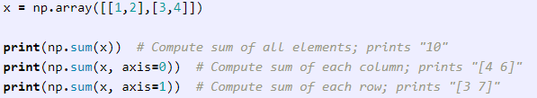
Numpy - Math
Numpy provides many useful functions for performing computations on arrays; one of the most useful is ‘sum’

Slide 15
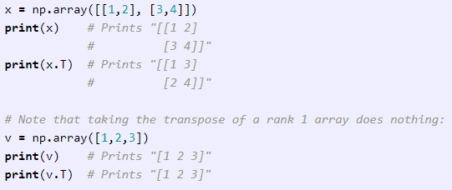
Numpy - Math
We frequently need to reshape or otherwise manipulate data in arrays
Transposing a matrix is widely used

Slide 16
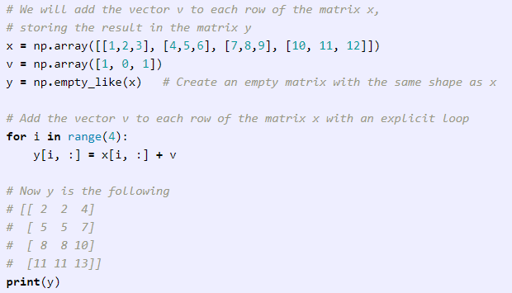
Numpy - Broadcasting
Allows numpy to work with arrays of different shapes when performing arithmetic operations
Use smaller array multiple times for an operation on the larger array

Slide 17
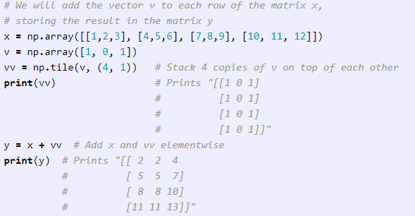
Numpy - Broadcasting
If matrix x is very large, an explicit loop could be slow.
Adding vector v to each row of the matrix x = forming a matrix vv by stacking multiple copies of v vertically, then performing elementwise summation of x and vv.

Slide 18
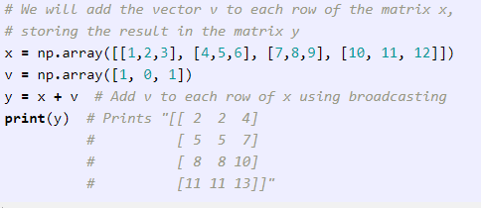
Numpy - Broadcasting
Numpy broadcasting allows us to perform this computation without actually creating multiple copies of v

Slide 19
Numpy - Broadcasting
Broadcasting two arrays together follows these rules:
If arrays do not have same rank, prepend shape of the lower rank array with 1s until both shapes have same length.
Two arrays are compatible in dimension if they have same size in the dimension, or if one of the arrays has size 1 in that dimension.
The arrays can be broadcast together if they are compatible in all dimensions.
After broadcasting, each array behaves as if it had shape equal to the elementwise maximum of shapes of the two input arrays.
In any dimension where one array had size 1 and the other array had size greater than 1, the first array behaves as if it were copied along that dimension

Slide 20
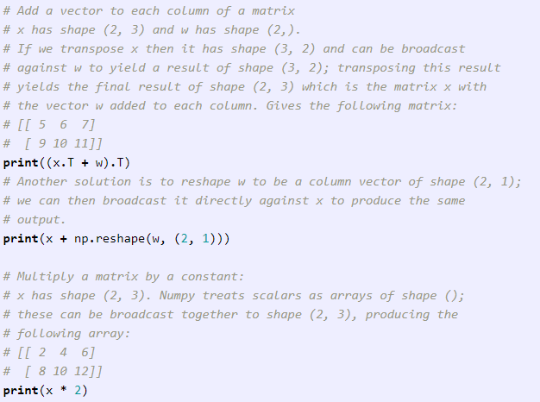
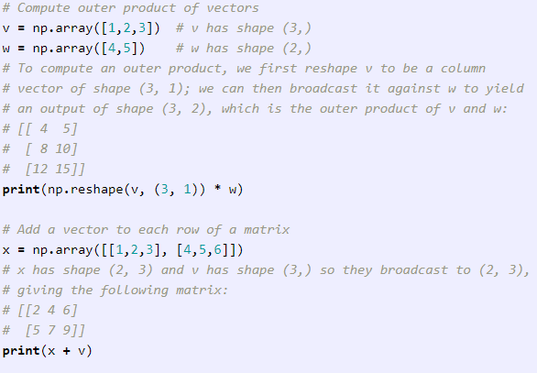
Numpy - Broadcasting
Applications of broadcasting

Slide 21
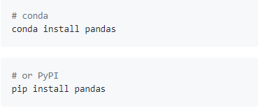
Pandas – Intro & Install
Fast, flexible, and expressive data structures designed to make working with "relational" or "labeled" data both easy and intuitive
Binary installers for the latest released version are available at the Python package index and on conda
Goal of becoming the most powerful and flexible open source data analysis / manipulation tool available in any language

Slide 22
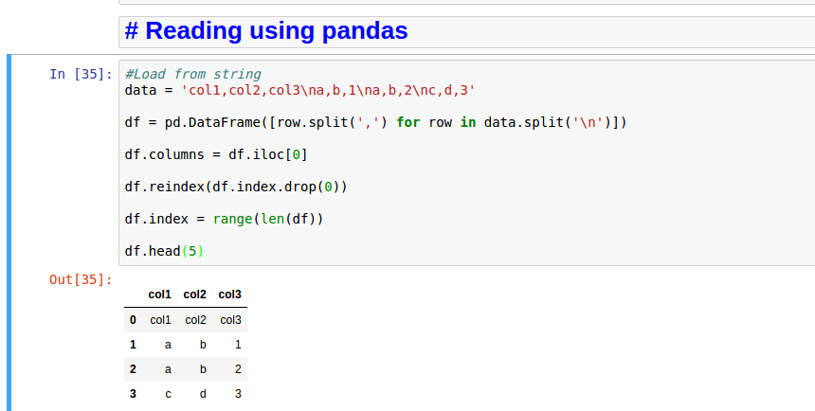
Pandas - Read/Load from text

Slide 23
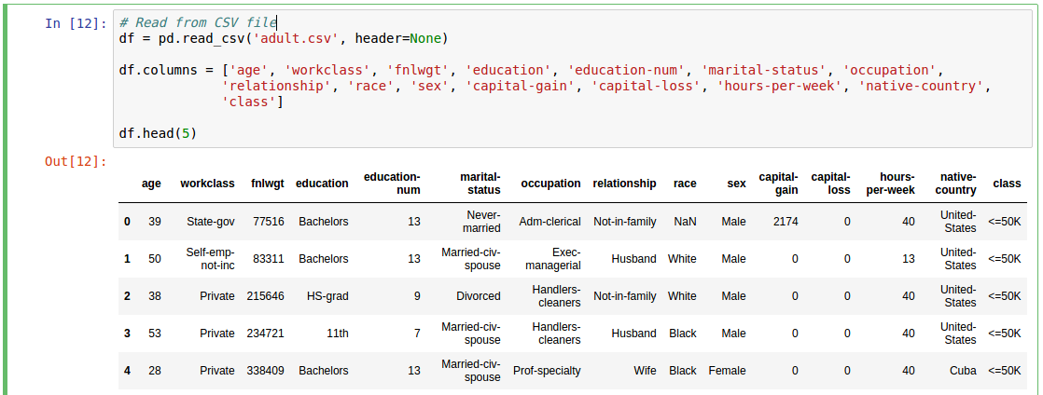
Pandas - Read/Load files

Slide 24
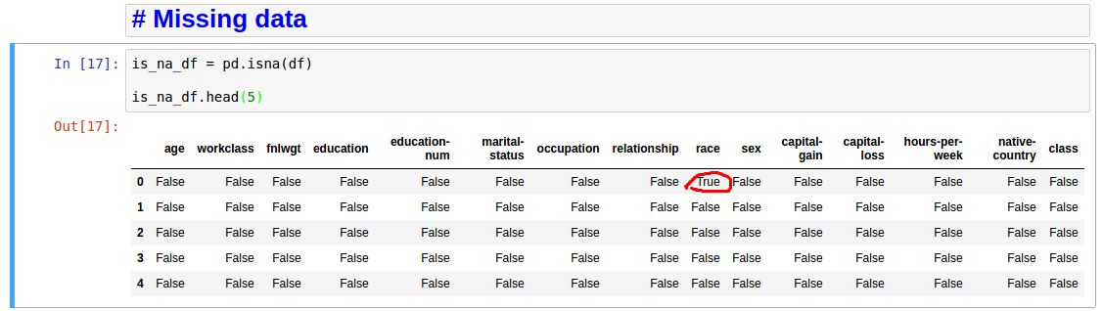
Pandas – Missing data

Slide 25
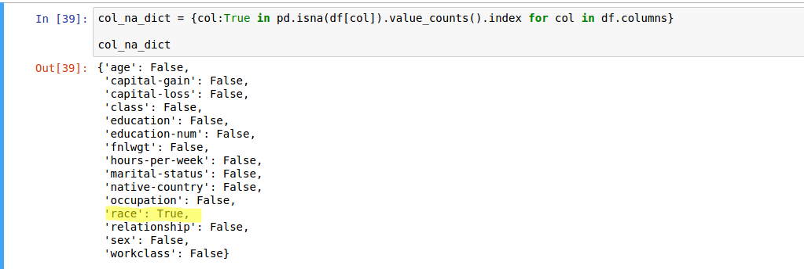
Pandas – Missing data

Slide 26
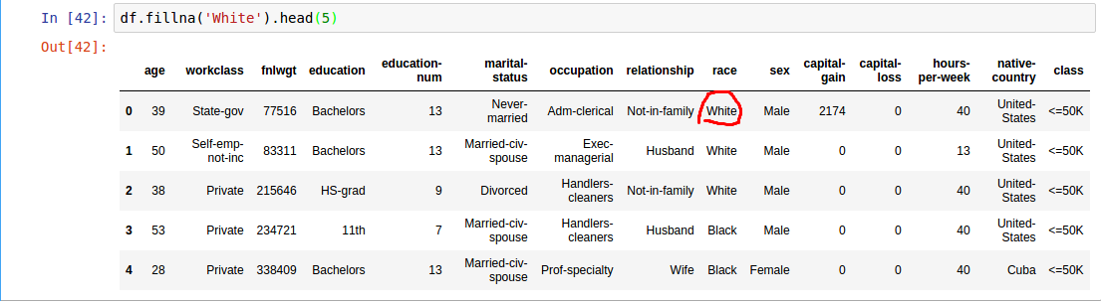
Pandas – Missing data

Slide 27
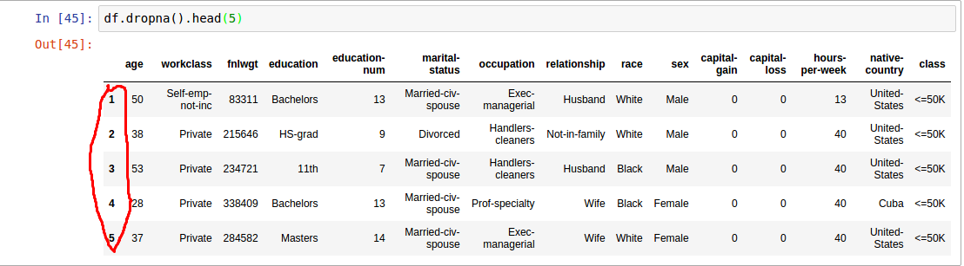
Pandas – Missing data

Slide 28
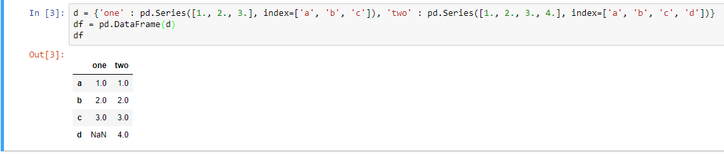
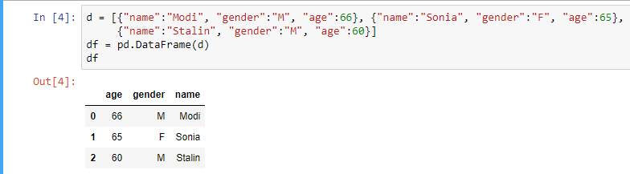
Pandas – From other Data Structures

Slide 29
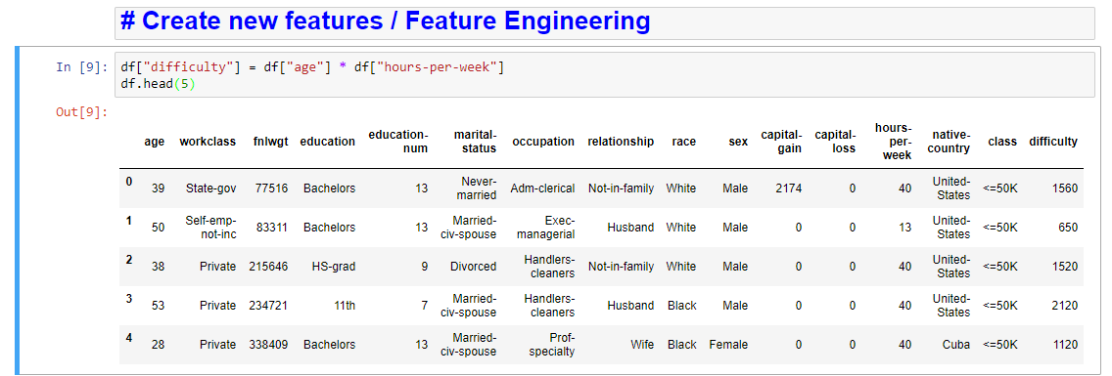
Pandas – Feature engineering

Slide 30
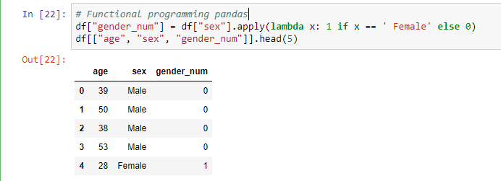
Pandas – Functional Programming

Slide 31
Pandas – Functional Programming

Slide 32
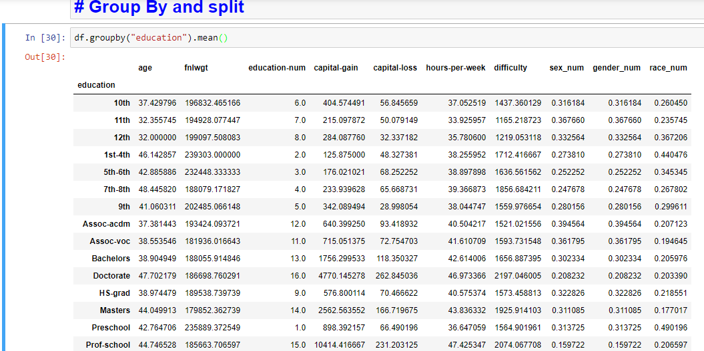
Pandas – Group By operations

Slide 33
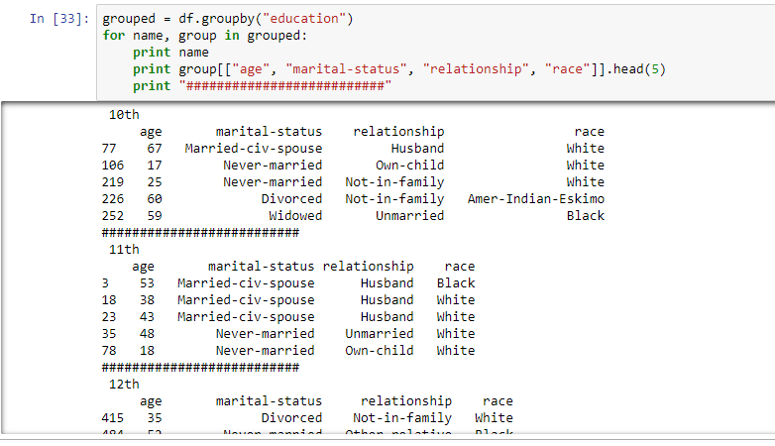
Pandas – Group By iterate

Slide 34
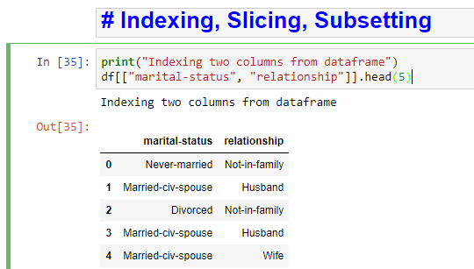
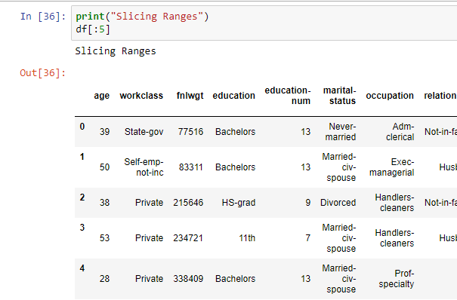
Pandas – Indexing / Slicing / Subsetting

Slide 35
Pandas – Indexing / Slicing / Subsetting

Slide 36
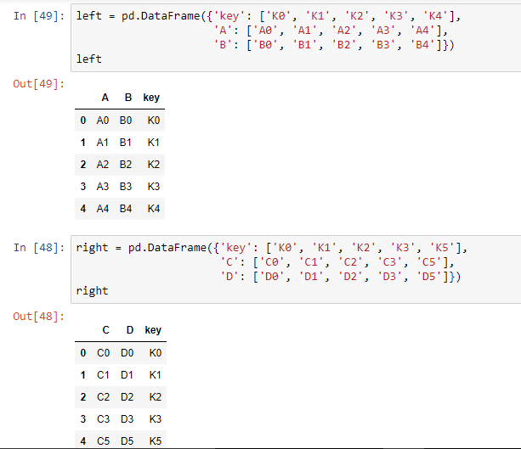
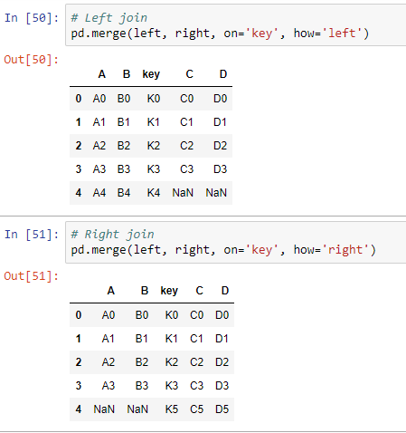
Pandas – Merging / Concat

Slide 37
Pandas – Merging / Concat

