Slide 1
Support Vector Machines & Decision Trees
Lecture - 6

Slide 2
SVM - Intro
Very powerful and versatile ML model
Capable of performing linear or non linear classification, regression and outlier detection
Extremely popular
Well suited for classification of complex but small or medium sized datasets

Slide 3
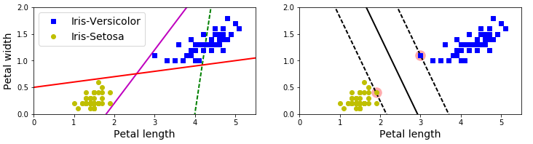
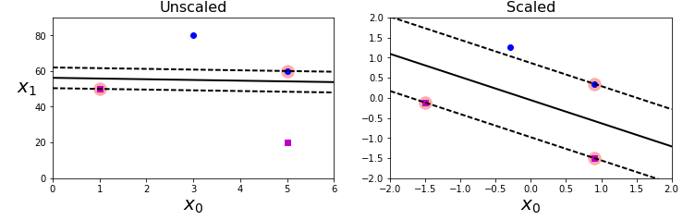
Linear SVM classification
Large margin classification
Sensitivity to feature scales

Slide 4
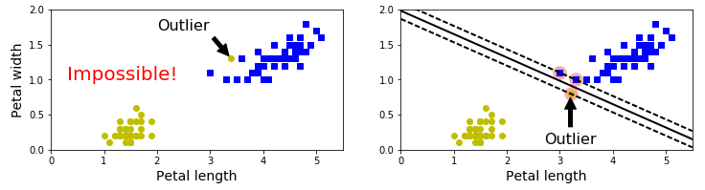
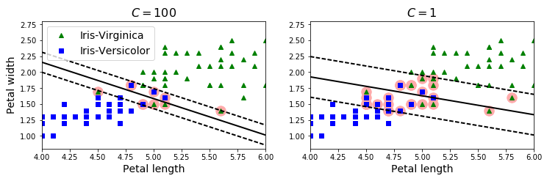
Linear SVM classification
Hard margin needs linearly separable data and is sensitivity to outliers
Soft margin classification using C hyperparameter
Go to notebook

Slide 5
Linear SVM classifier
You could use SVC class - SVC(kernel=‘linear’, C=1)
Slower, especially on large training sets
Not recommended
You could use SGDClassifier – SGDClassifier(loss=‘hinge’, alpha=1/(m*C))
Regular Stochastic Gradient Descent and trains a linear SVM
Does not converge as fast as LinearSVC
Useful to handle huge datasets that do not fit in memory
Handle online classification tasks

Slide 6
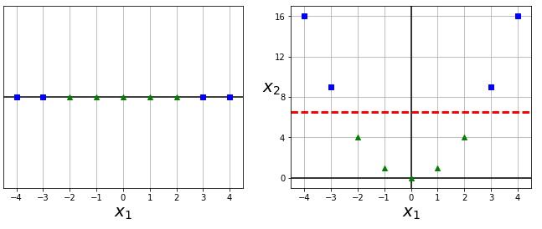
Nonlinear SVM classification
Most datasets are not close to being linearly separable
One approach is to add more features, such as polynomial features
In some cases it results in a linearly separable dataset
Go to notebook

Slide 7
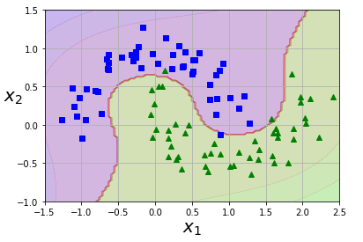
Polynomial SVM
Linear SVM after using polynomial features
But,
Low polynomial degree cannot deal with complex datasets
High polynomial degree creates huge number of features, making model too slow
Miraculous Mathematical technique called Kernels to save us
Go to notebook

Slide 8
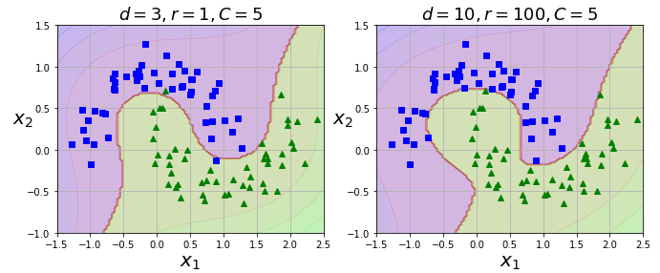
Polynomial kernel
Hyperparameter coef0 controls how much the model is influenced by high degree polynomials

Slide 9
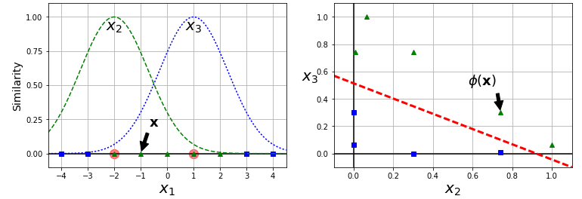
Similarity features
Another technique to tackle non linear problems
Similarity function that measures how much each instance resembles a landmark
Take 1d example discussed earlier

Slide 10
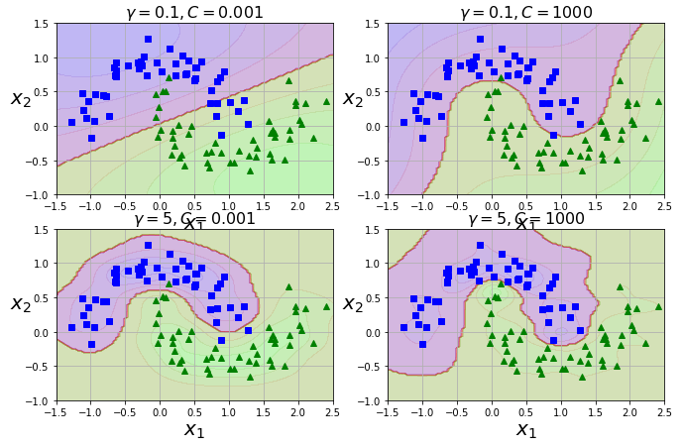
Gaussian RBF Kernel
How to choose landmarks? Every point is a landmark
Implies you are converting a mxn dataset to a mxm. Extremely costly.
Kernel trick optimizes it
Go to notebook

Slide 11
SVM Regression
Trick is to reverse objective to handle regression
Classification – Fit largest possible street between two classes while limiting margin violations
Regression – Fit as many instances as possible on the street while limiting margin violations
Width of street is controlled by hyperparameter ‘epsilon’
Go to notebook

Slide 12
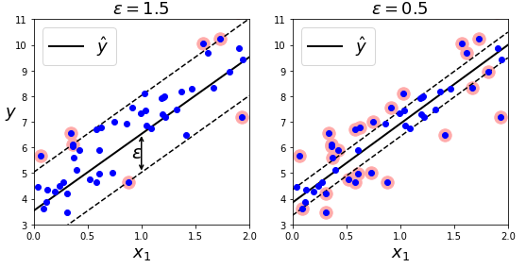
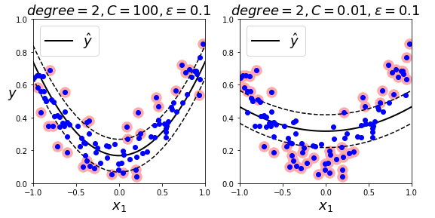
SVM Regression
Adding more training instances within margin does not affect model predictions
For non linear regression tasks, use kernelized SVM model
Go to notebook

Slide 13
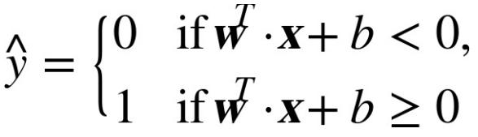
SVM – under the hood
Decision function
Slope of decision function = || w ||
Points where decision function = +-1 will be twice far off from decision boundary
Smaller the weight vector, w, larger the margin

Slide 14
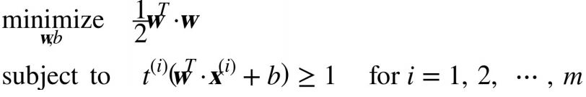
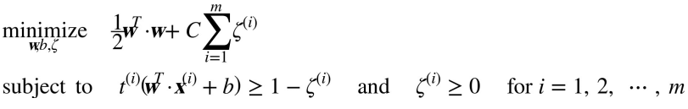
SVM – under the hood
Hard margin classifier
Soft margin classifier

Slide 15
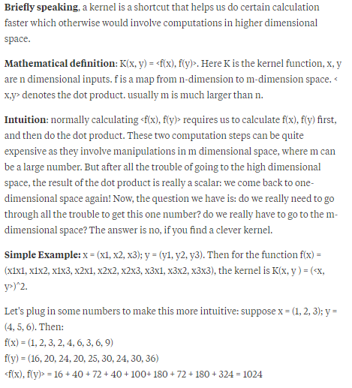
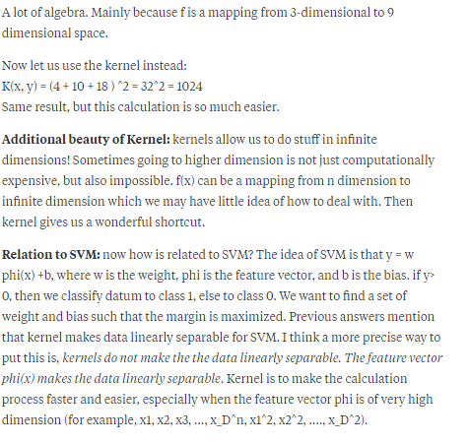
SVM – under the hood

Slide 16
Decision Trees - Intro
Like SVM’s, versatile ML algorithm
Can perform classification and regression and multioutput tasks
Earlier, trained DecisionTreeRegressor on California dataset
We will discuss
How to train, visualize and make predictions with Decision Trees
Go through CART training algo using scikit learn
How to regularize trees
How to use them in Regression tasks
Limitations
Go to notebook

Slide 17
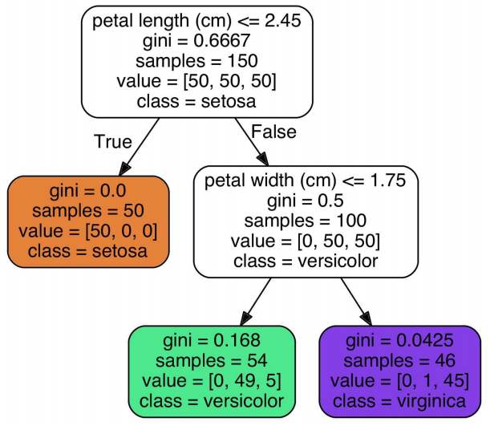
Iris Decision Tree

Slide 18
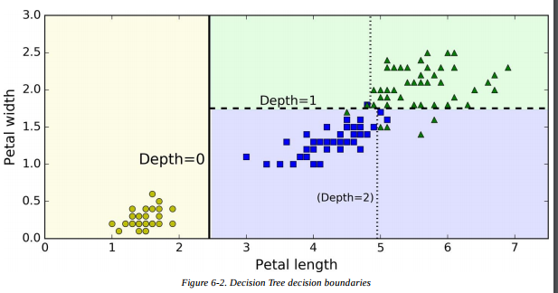
Iris Decision Tree

Slide 19
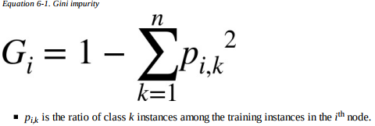
Making predictions
Requires very little data preparation. No need for scaling or centering
Suppose flower has petals 5 cm long and 1.5 cm wide. This is a depth-2 left node, so Decision Tree outputs the following probabilities: 0% for Iris-Setosa (0/54), 90.7% for Iris-Versicolor (49/54), and 9.3% for IrisVirginica (5/54)
Go to notebook

Slide 20
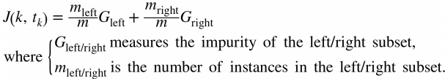
CART Training Algo
Classification And Regression Tree (CART) algorithm to train Decision Trees
idea: Algorithm first splits the training set in two subsets using a single feature k and a threshold tk (e.g., “petal length ≤ 2.45 cm”)
How does it choose k and tk? It searches for the pair (k, tk ) that produces the purest subsets (weighted by their size)

Slide 21
CART
CART is a greedy algorithm: searches for an optimum split at the top level, then repeats the process at each level.
Does not check whether or not the split will lead to the lowest possible impurity several levels down.
Often produces a reasonably good solution, but it is not guaranteed to be the optimal solution
Unfortunately, finding the optimal tree is known to be an NP-Complete problem
requires O(exp(m)) time, making the problem intractable even for fairly small training sets.
This is why we must settle for a “reasonably good” solution.

Slide 22
Computational Complexity
traversing the Decision Tree requires going through roughly O(log2 (m)) nodes. independent of the number of features
So predictions are very fast
However, the training algorithm compares all features (or less if max_features is set) on all samples at each node.
This results in a training complexity of O(n × m log(m))

Slide 23
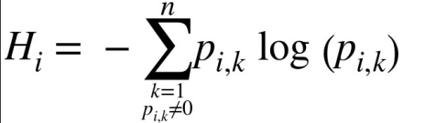
Gini Impurity or Entropy
Gini impurity or entropy? Most of the time it does not make a big difference: they lead to similar trees
Gini impurity is slightly faster to compute, so it is a good default.
However, Gini impurity tends to isolate the most frequent class in its own branch of the tree,
Entropy tends to produce slightly more balanced trees.

Slide 24
Regularization hyperparameters
DT makes very few assumptions about the training data
Tree structure will adapt itself to the training data, fitting it very closely, and most likely overfitting it.
Leading to a nonparametric model, because the number of parameters is not determined prior to training, so the model structure is free to stick closely to the data.
A parametric model such as a linear model has a predetermined number of parameters, so its degree of freedom is limited, reducing the risk of overfitting (but increasing underfitting).
To avoid overfitting the training data, you need to restrict the Decision Tree’s freedom.
In ScikitLearn, this is controlled by the max_depth hyperparameter (the default value is None, which means unlimited).
Similarly: min_samples_split, min_samples_leaf, min_weight_fraction_leaf, max_leaf_nodes, and max_features.
Increasing min_* hyperparameters or reducing max_* hyperparameters will regularize
A node whose children are all leaf nodes is considered unnecessary if the purity improvement it provides is not statistically significant (χ 2 test), using p-value

Slide 25
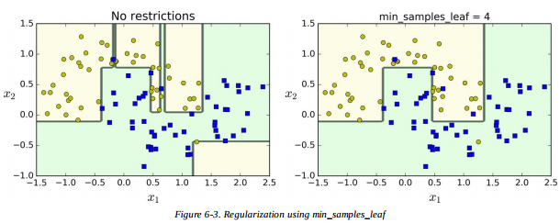
Go to notebook

Slide 26
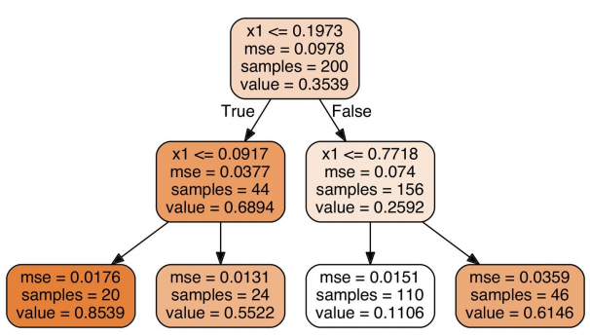

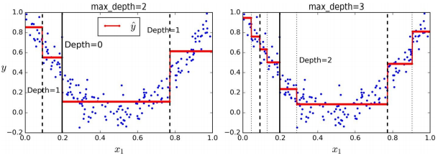
Regression in Decision Trees

Slide 27
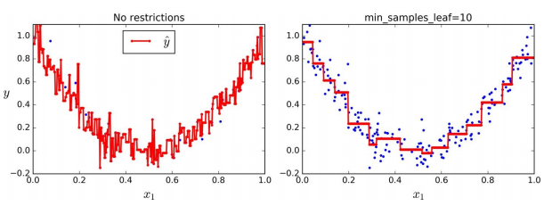
Regression in Decision Trees and Regularization

Slide 28
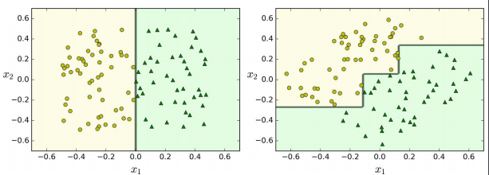
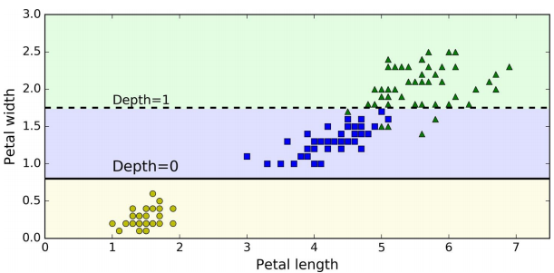
Instability in Decision Trees
Sensitivity to training set rotation. Solution: PCA
Sensitivity to training set details (Removing 4.8cm, 1.8cm). Solution: Random Forest

