Slide 1
Lecture - 4
Machine Learning basics

Slide 2
What is Machine Learning?
Science (and art) of programming computers so that they can learn from data
Definition: Computer Program is said to learn from experience E with respect to some task T and some performance measure P, if its performance on T , as measured by P, improves with experience E. (-Tom Mitchell, 1997)
Eg: Spam filter is a ML program
T is to flag spam for new emails
E is the training data
P ratio of correctly classified emails

Slide 3
Why use Machine Learning?
Traditional Approach
Machine Learning Approach
Study the problem
Write rules
Evaluate
Launch
Analyze errors
Data
Study the problem
Train ML algo
Evaluate
Launch
Analyze errors

Slide 4
Types of Machine Learning systems
Whether or not they are trained with human supervision
Supervised
Unsupervised
Semisupervised
Reinforcement Learning)
Whether or not they can learn incrementally on the fly
Online
Batch

Slide 5
Supervised Learning
Training data fed to the algo includes the desired solutions, called labels
Typical Supervised learning task is classification
Spam filter is a good example: trained with many example emails along with their class (spam or not-a-spam)
Another typical eg: Predict target numeric value
Predict price of a car given features(mileage, age, brand etc.)
This is called regression

Slide 6
Supervised Learning
Most important supervised learning algorithms:
K-Nearest Neighbors
Linear Regression
Logistic Regression
Support Vector Machines
Decision Trees and Random Forests
Neural Networks

Slide 7
Unsupervised Learning
Training data is unlabeled
System tries to learn without a teacher
Most important unsupervised learning algorithms
Clustering
K-Means
Hierarchical Cluster Analysis
Expectation Maximization
Visualization and dimensionality reduction
Principal Component Analysis
Kernel PCA
Locally Linear Embedding
T-distributed Stochastic Neighbor Embedding
Association rule learning
Apriori
Eclat

Slide 8
Unsupervised Learning
Example 1: Say you have data about your blog’s visitors.
Cluster them to find similar users
For eg: it might find that 40% of your visitors are males who love comic books and read your blog in the evening
Helps you target your posts for each group
Example 2: Dimensionality reduction: Simplify data without losing information
Car’s mileage may be highly correlated with its age
Example 3: Anomaly detection – Fraud in credit card transactions

Slide 9
Semi supervised / Reinforcement learning
Training data has lot of unlabeled data and little labeled data
Example: Google Photos
RL has an agent that performs actions and gets rewards in return
Learns by adopting a policy of getting most rewards over time

Slide 10
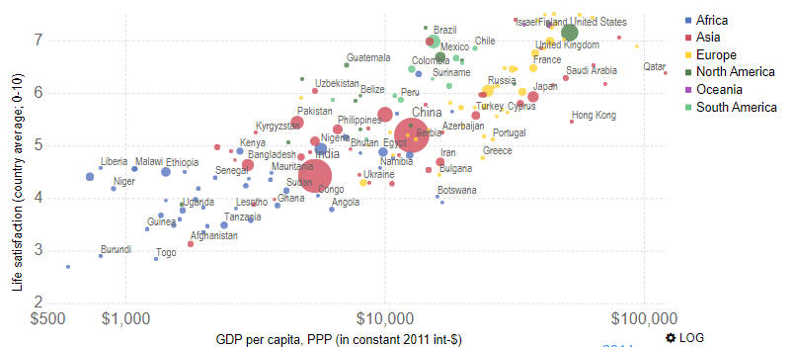
Linear Regression
Life_satisfaction = w0 + w1*GDP_per_capita

Slide 11
Linear Regression
Model is defined by values chosen for w0 and w1
We measure a model by using cost function
Finding the optimal coefficients is called training
Once this is done, you can make predictions
Head to lec4.ipynb
Explain Maths of Linear Regression

Slide 12
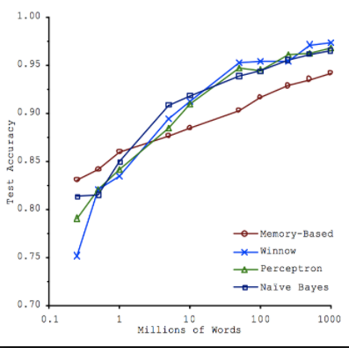
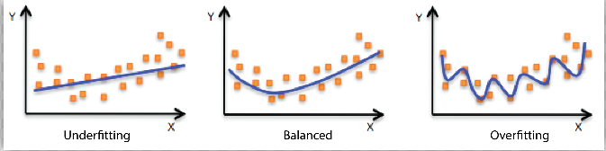
Challenges of Machine Learning
Insufficient Quantity of training data
Unreasonable effectiveness of Data
Non representative training data
Explain the US presidential election(1936) example
Poor Quality data
Irrelevant features
Overfitting/Underfitting

Slide 13
Stepping back…
ML is about making machines get better at task by learning from data
Many different types of ML systems: Supervised, unsupervised etc
In ML project,
gather data in training set
Feed training set to a learning algorithm
Learning algorithm tunes certain parameters to fit the training data
Hopefully, it will make good predictions on new cases
System will not perform well if
Training set is small
Data is not representative, noisy or irrelevant

Slide 14
Testing
Have to check model on new cases
Put model in production and monitor
That is a bad idea
Better option
Split data into training and test
Train model using training set and test using test set
Error rate on new cases is called generalization error or out-of-sample error
Low training error and high generalization error -> Overfitting
How to decide between two models?

Slide 15
Validation
Suppose model 1 generalizes better, but you want to apply regularization to avoid overfitting
You trained 100 models and take best model from generalization error gives 5% error and actually in production it gave 15% error. How did this happen?
Multiple generalization error calculation on test set
Create validation set which is subset of training set.

Slide 16
End-to-End Machine Learning Project
We are going to do the following:
Look at the big picture
Get the data
Discover and Visualize data to gain insights
Prepare data for ML algos
Select a model and train it
Fine-tune your model
Present your solution
Launch, monitor and maintain your system

Slide 17
Working with real data
Few popular repositories
UC Irvine Machine learning repository. Click here
Kaggle Datasets. Click here
AWS datasets. Click here
Data portals. Click here
Europe open data monitor. Click here
Wikipedia’s ML datasets. Click here
Quora datasets. Click here

Slide 18
Look at the Big Picture
Build a model of housing prices in California using census data
Data has metrics like population, median income, median housing price etc for each block in California
Block -> district -> roughly 600 to 3000 people
Is this supervised or unsupervised or reinforcement?
Is this classification or regression or something else?
Is this univariate, bivariate or multivariate?

Slide 19


Select Performance Measure
Root Mean Squared Error (aka l2 norm or Euclidean norm)
Mean absolute Error (aka l1 norm or Manhattan norm)
Go to e2eml.ipynb for rest of the course

Slide 20
Correlation
measures the strength and direction of a linear relationship between two variables
Exactly –1. A perfect downhill (negative) linear relationship
–0.70. A strong downhill (negative) linear relationship
–0.50. A moderate downhill (negative) relationship
–0.30. A weak downhill (negative) linear relationship
0. No linear relationship
+0.30. A weak uphill (positive) linear relationship
+0.50. A moderate uphill (positive) relationship
+0.70. A strong uphill (positive) linear relationship
Exactly +1. A perfect uphill (positive) linear relationship
Go back to e2eml.ipynb

Slide 21
Scikit Learn Design
All objects share a consistent and simple interface
Estimators
Object that can estimate based on data (Imputer is an estimator)
Estimation performed by fit() method – Takes dataset as parameter
Any other parameter to guide estimation – hyperparameter
Transformers
Some estimators can transform a dataset
Performed by transform() method with dataset as input
Transformation relies on learned parameters
Fit_transform() method is equivalent of fit() and transform(), better optimized
Predictors
Making predictions given a dataset. Eg: LinearRegression model
Predict() method takes dataset of new instances and returns dataset of predictions
Score() method measures quality of predictions given test set
* Back to e2eml.ipynb

