Slide 1
Lecture - 2
Introduction to data manipulation tools

Slide 2
Python
Python is a
high-level,
dynamically typed
multiparadigm programming language
Python code is
like pseudocode
allows you to express very powerful ideas
very few lines of code while being very readable.
There are currently two different supported versions of Python, 2.7 and 3.5. Somewhat confusingly, Python 3.0 introduced many backwards-incompatible changes to the language, so code written for 2.7 may not work under 3.5 and vice versa

Slide 3
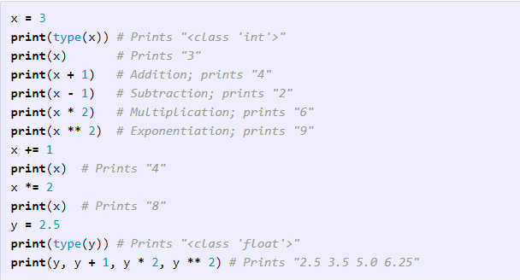
Python – Basic Data Types
Python has a number of basic types including integers, floats, booleans, and strings

Slide 4
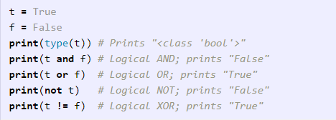
Python – Booleans
Python implements all of the usual operators for Boolean logic, but uses English words rather than symbols (&&, ||, etc.)

Slide 5
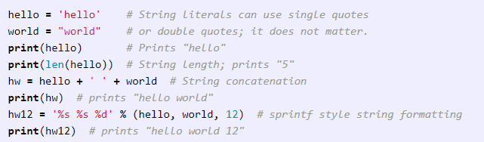
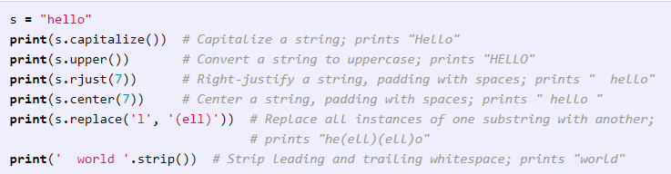
Python – Strings
Python has great support for strings
String objects have a bunch of useful methods

Slide 6
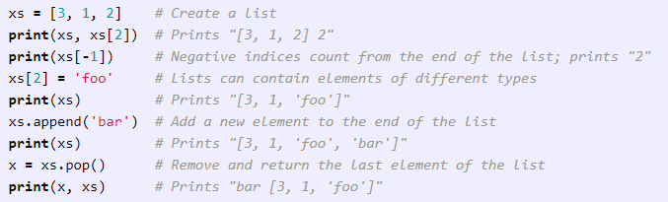
Python – Lists
A list is the Python equivalent of an array, but is resizeable and can contain elements of different types

Slide 7
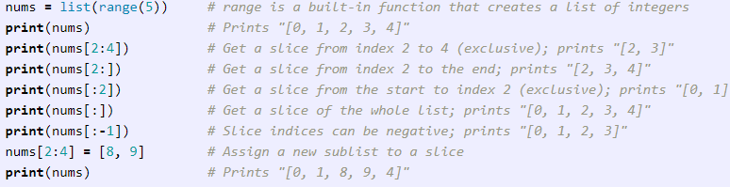
Python – Lists
In addition to accessing list elements one at a time, Python provides concise syntax to access sublists; this is known as slicing
We will see slicing again in the context of numpy arrays

Slide 8


Python – Loops
You can loop over the elements of a list like this
If you want access to the index of each element within the body of a loop, use the built-in enumerate function

Slide 9
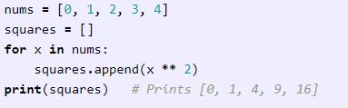
Python – List Comprehensions
When programming, frequently we want to transform one type of data into another. As a simple example, consider the following code that computes square numbers

Slide 10


Python – List Comprehensions
You can make the previous code simpler using a list comprehension
List comprehensions can also contain conditions

Slide 11
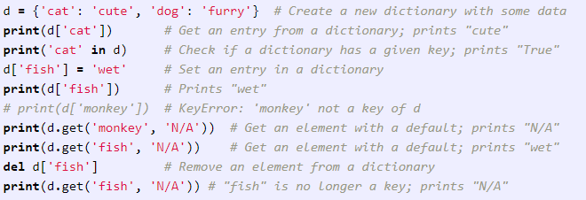
Python – Dictionaries
A dictonary stores (key, value) pairs, similar to a Map in Java or an object in Javascript. You can use it like this

Slide 12
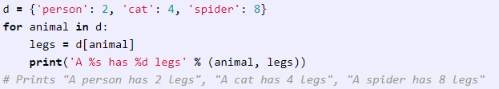

Python – Dictionaries
It is easy to iterate over the keys in a dictionary
If you want access to keys and their corresponding values, use the ‘items’ method

Slide 13

Python – Dictionary Comprehensions
These are similar to list comprehensions, but allow you to easily construct dictionaries. For example

Slide 14
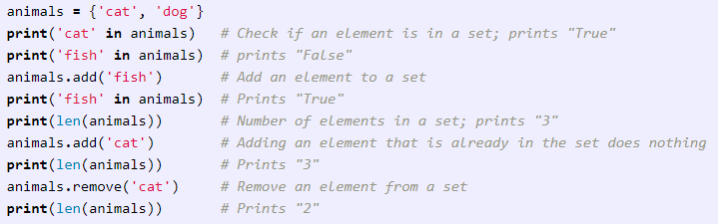
Python – Sets
A set is an unordered collection of distinct elements. As a simple example, consider the following

Slide 15


Python – Sets
Iterating over a set has the same syntax as iterating over a list; however since sets are unordered, you cannot make assumptions about the order in which you visit the elements of the set
Like lists and dictionaries, we can easily construct sets using set comprehensions

Slide 16
Python – Sets
Iterating over a set has the same syntax as iterating over a list; however since sets are unordered, you cannot make assumptions about the order in which you visit the elements of the set
Like lists and dictionaries, we can easily construct sets using set comprehensions

Slide 17
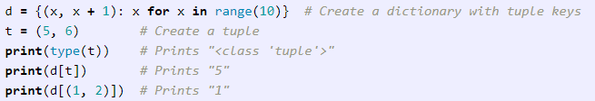
Python – Tuples
A tuple is an (immutable) ordered list of values. A tuple is in many ways similar to a list; one of the most important differences is that tuples can be used as keys in dictionaries and as elements of sets, while lists cannot. Here is a trivial example

Slide 18
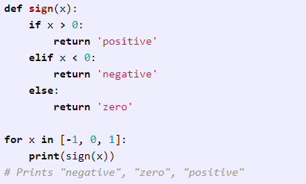
Python – Functions
Python functions are defined using the ‘def’ keyword.

Slide 19
Python – Functions
Python functions are defined using the ‘def’ keyword.

Slide 20
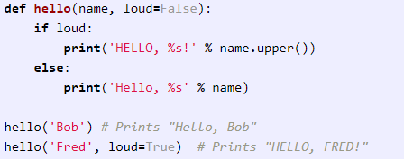
Python – Functions
We will often define functions to take optional keyword arguments, like this:

Slide 21
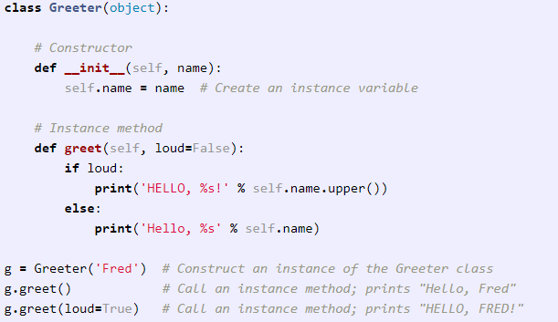
Python – Classes
The syntax for defining classes in Python is straightforward:

Slide 22
Numpy
Numpy
core library for scientific computing in Python.
high-performance
multidimensional array object
tools for working with these arrays
Numpy array
is a grid of values
all of the same type
indexed by a tuple of nonnegative integers.
number of dimensions is the rank of the array
shape of an array is a tuple of integers giving the size of the array along each dimension

Slide 23
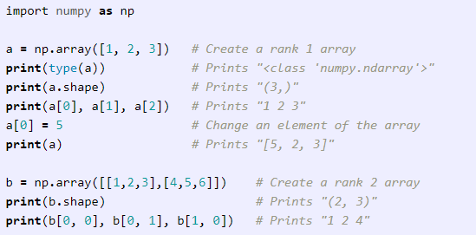
Numpy
We can initialize numpy arrays from nested Python lists, and access elements using square brackets

Slide 24
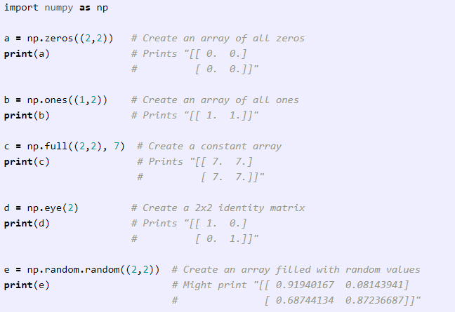
Numpy
Numpy also provides many functions to create arrays

Slide 25
Numpy
Numpy also provides many functions to create arrays

Slide 26
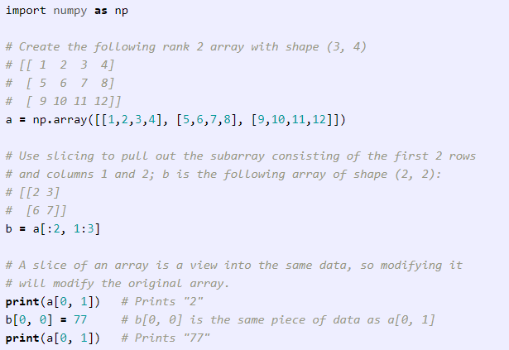
Numpy - Indexing
Similar to Python lists, numpy arrays can be sliced. Since arrays may be multidimensional, you must specify a slice for each dimension of the array

Slide 27
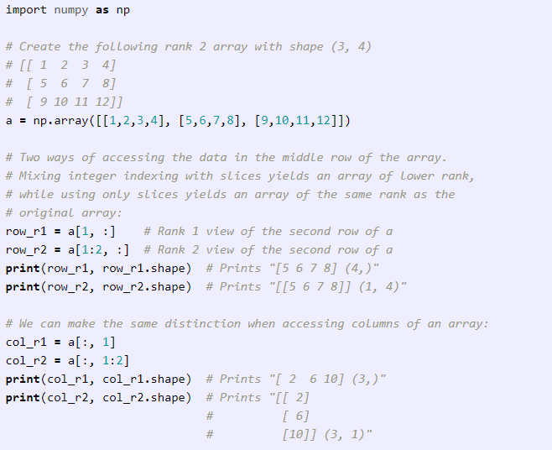
Numpy - Indexing
You can also mix integer indexing with slice indexing. However, doing so will yield an array of lower rank than the original array

Slide 28
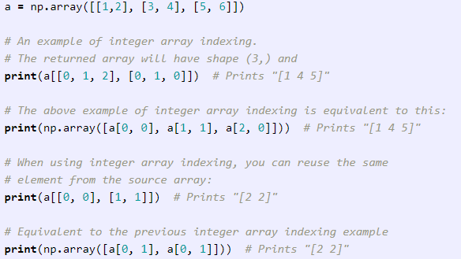
Numpy - Indexing
Indexing into numpy arrays using slicing will always be a subarray of the original array.
While, integer array indexing allows to construct arbitrary arrays using the data from another array. Here is an example

Slide 29
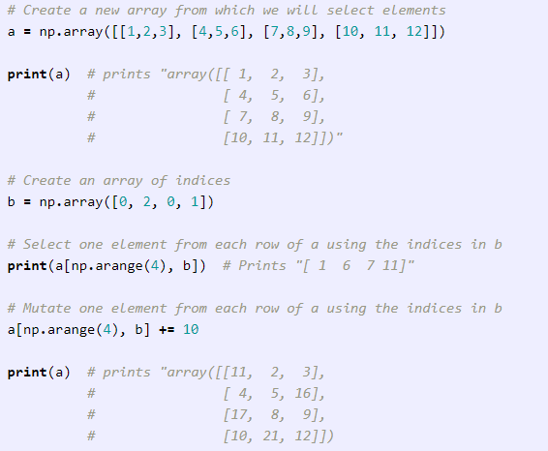
Numpy - Indexing
One useful trick with integer array indexing is selecting or mutating one element from each row of a matrix

Slide 30
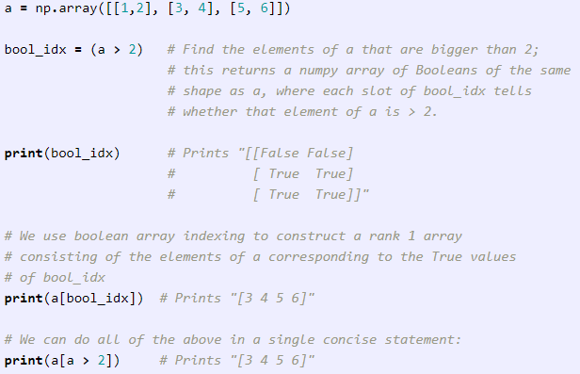
Numpy - Indexing
Boolean array indexing lets you pick out arbitrary elements of an array. Frequently this type of indexing is used to select the elements of an array that satisfy some condition

Slide 31
Numpy - Indexing
Boolean array indexing lets you pick out arbitrary elements of an array. Frequently this type of indexing is used to select the elements of an array that satisfy some condition

Slide 32
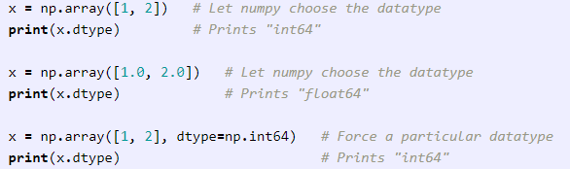
Numpy - Datatypes
Every numpy array is a grid of elements of the same type.
Numpy provides a large set of numeric datatypes to construct arrays.
Numpy tries to guess a datatype but functions that construct arrays have optional argument to explicitly specify the datatype

Slide 33
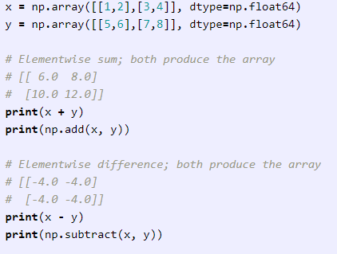
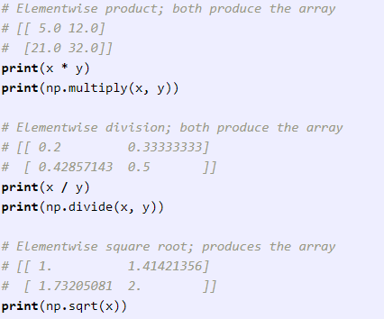
Numpy - Math
Basic mathematical functions operate elementwise
Available both as operator overloads and as functions

Slide 34
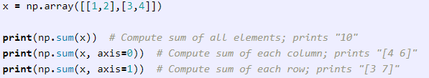
Numpy - Math
Numpy provides many useful functions for performing computations on arrays; one of the most useful is ‘sum’

Slide 35
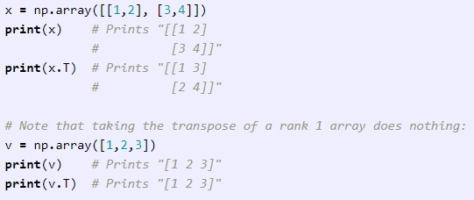
Numpy - Math
We frequently need to reshape or otherwise manipulate data in arrays
Transposing a matrix is widely used

Slide 36
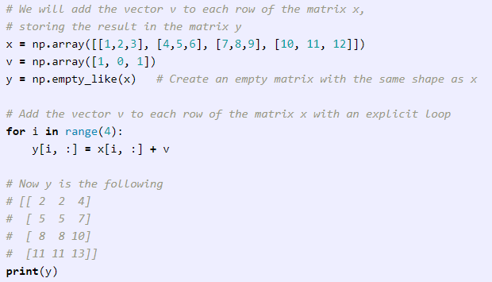
Numpy - Broadcasting
Allows numpy to work with arrays of different shapes when performing arithmetic operations
Use smaller array multiple times for an operation on the larger array

Slide 37
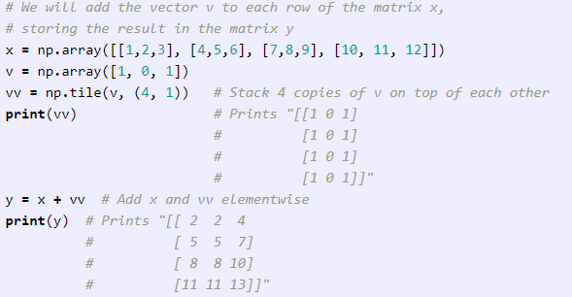
Numpy - Broadcasting
If matrix x is very large, an explicit loop could be slow.
Adding vector v to each row of the matrix x = forming a matrix vv by stacking multiple copies of v vertically, then performing elementwise summation of x and vv.

Slide 38
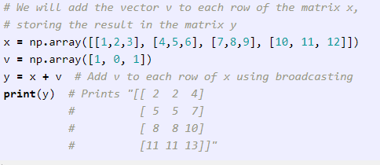
Numpy - Broadcasting
Numpy broadcasting allows us to perform this computation without actually creating multiple copies of v

Slide 39
Numpy - Broadcasting
Broadcasting two arrays together follows these rules:
If arrays do not have same rank, prepend shape of the lower rank array with 1s until both shapes have same length.
Two arrays are compatible in dimension if they have same size in the dimension, or if one of the arrays has size 1 in that dimension.
The arrays can be broadcast together if they are compatible in all dimensions.
After broadcasting, each array behaves as if it had shape equal to the elementwise maximum of shapes of the two input arrays.
In any dimension where one array had size 1 and the other array had size greater than 1, the first array behaves as if it were copied along that dimension

Slide 40
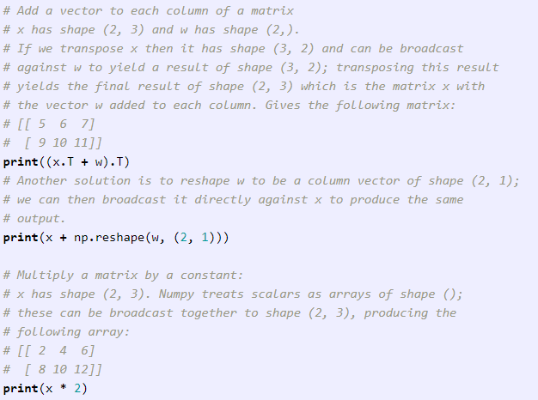
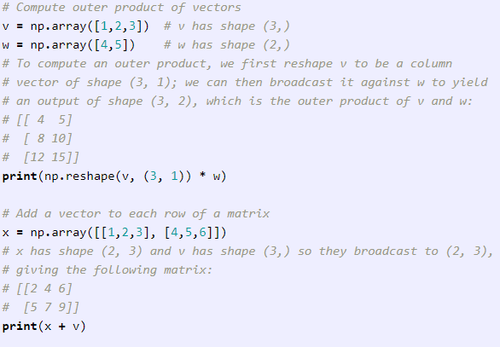
Numpy - Broadcasting
Applications of broadcasting

Slide 41
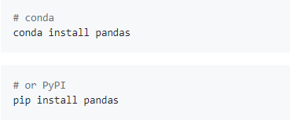
Pandas – Intro & Install
Fast, flexible, and expressive data structures designed to make working with "relational" or "labeled" data both easy and intuitive
Binary installers for the latest released version are available at the Python package index and on conda
Goal of becoming the most powerful and flexible open source data analysis / manipulation tool available in any language

Slide 42
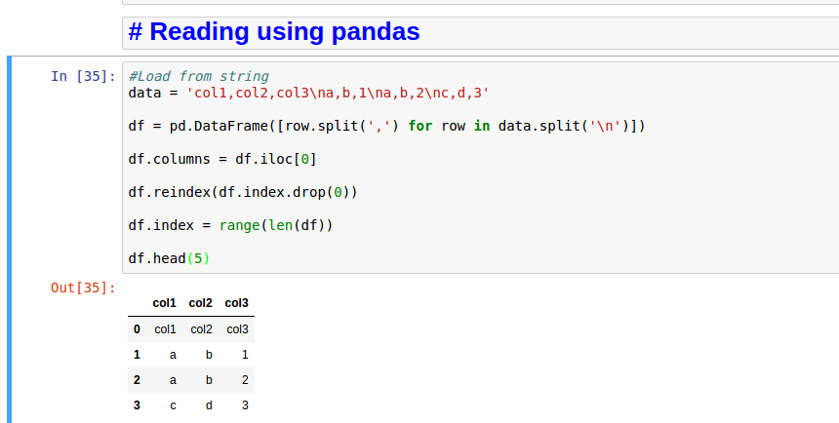
Pandas - Read/Load from text

Slide 43
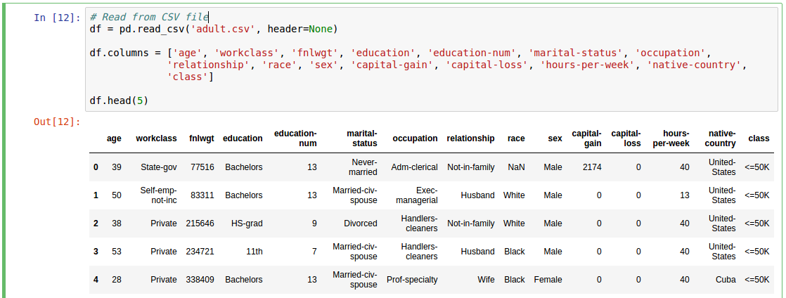
Pandas - Read/Load files

Slide 44
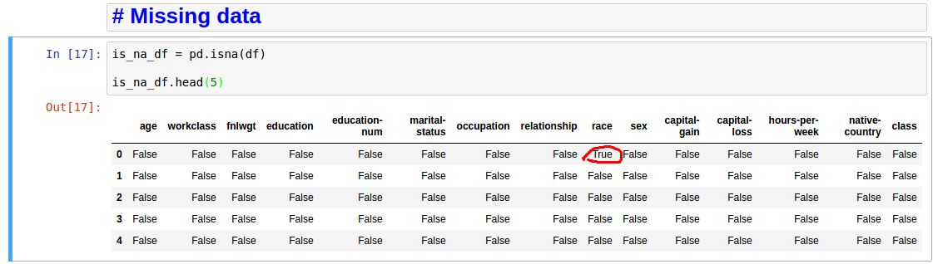
Pandas – Missing data

Slide 45
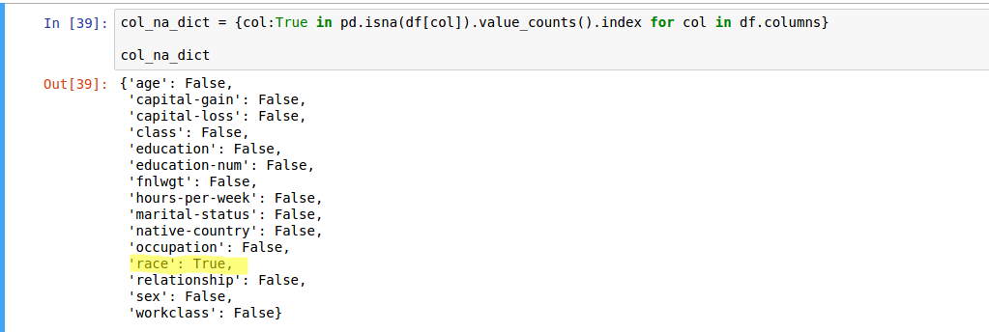
Pandas – Missing data

Slide 46
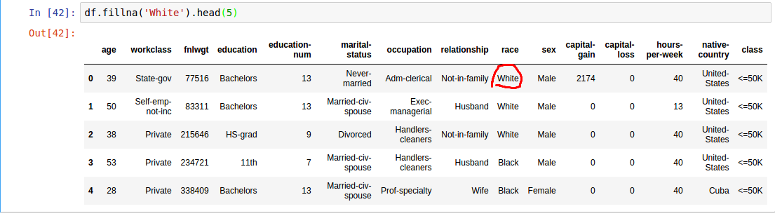
Pandas – Missing data

Slide 47
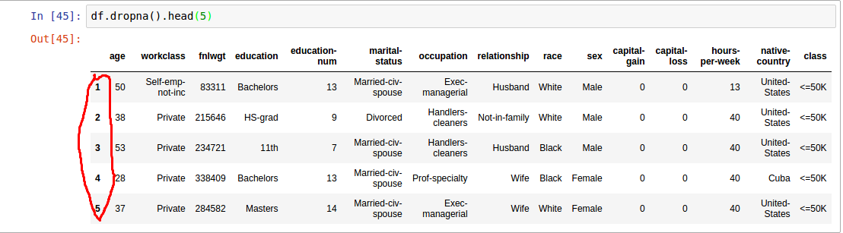
Pandas – Missing data

Slide 48
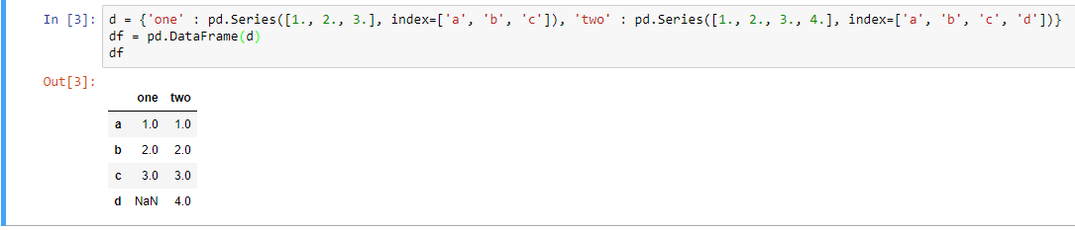
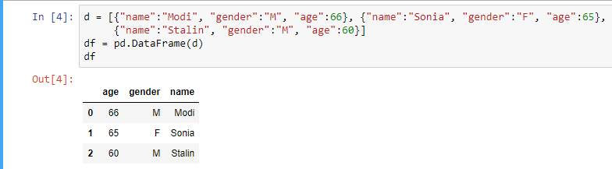
Pandas – From other Data Structures

Slide 49
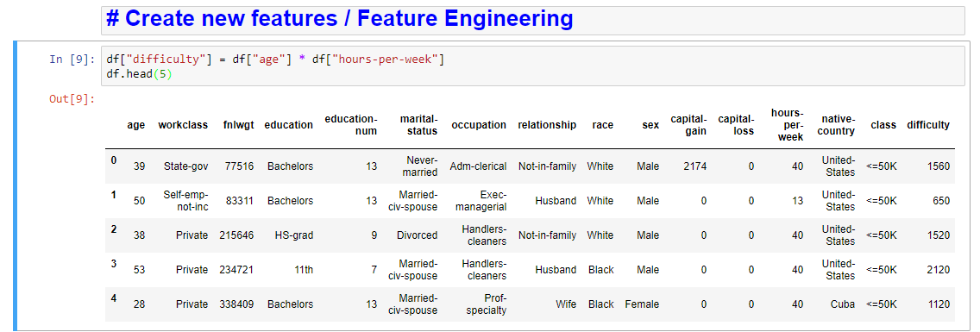
Pandas – Feature engineering

Slide 50
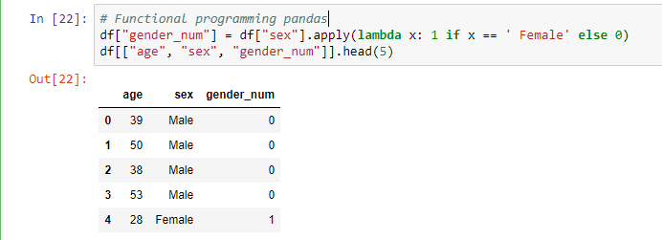
Pandas – Functional Programming

Slide 51
Pandas – Functional Programming

Slide 52
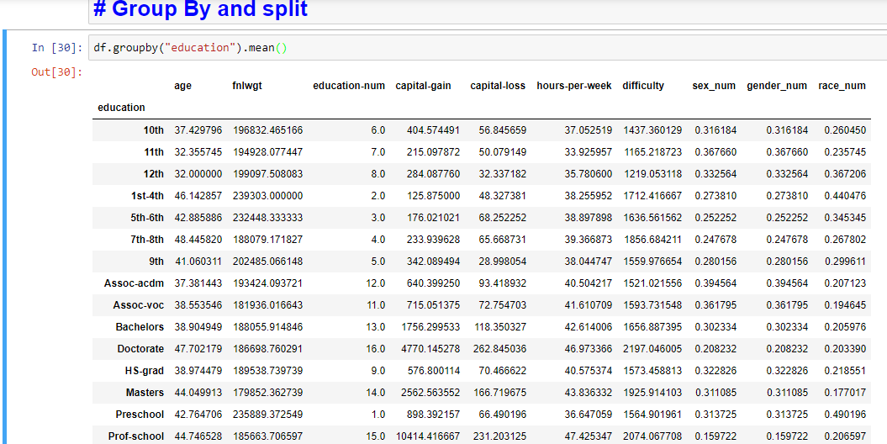
Pandas – Group By operations

Slide 53
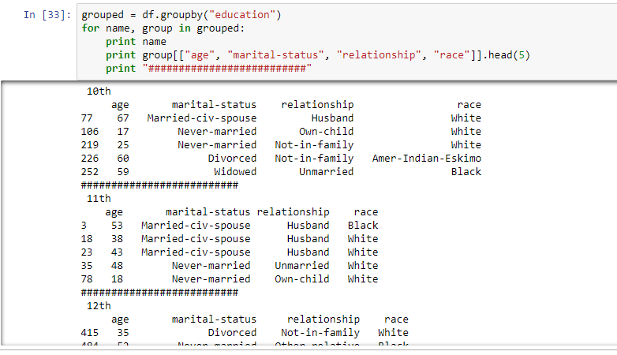
Pandas – Group By iterate

Slide 54
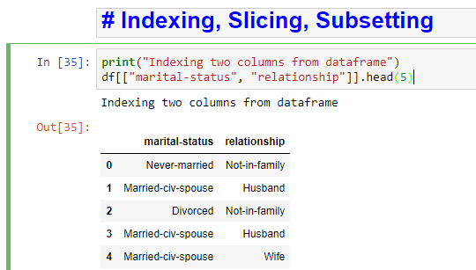
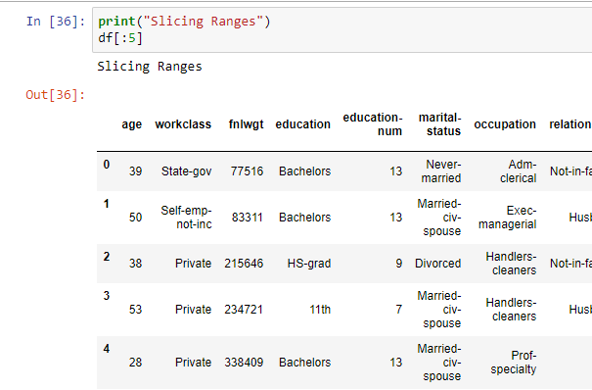
Pandas – Indexing / Slicing / Subsetting

Slide 55
Pandas – Indexing / Slicing / Subsetting

Slide 56
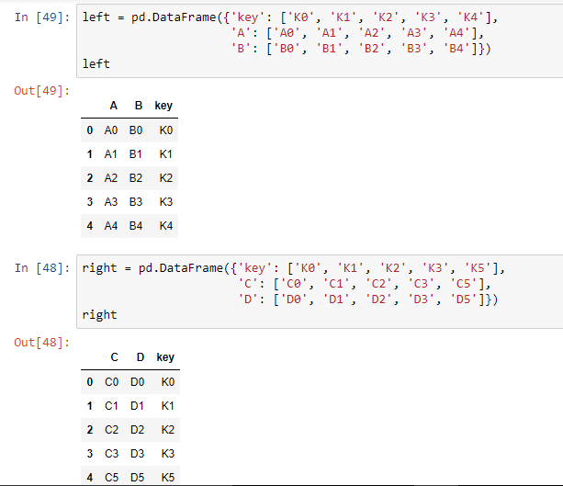
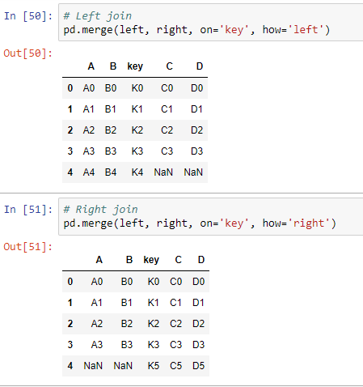
Pandas – Merging / Concat

Slide 57
Pandas – Merging / Concat

