Slide 1
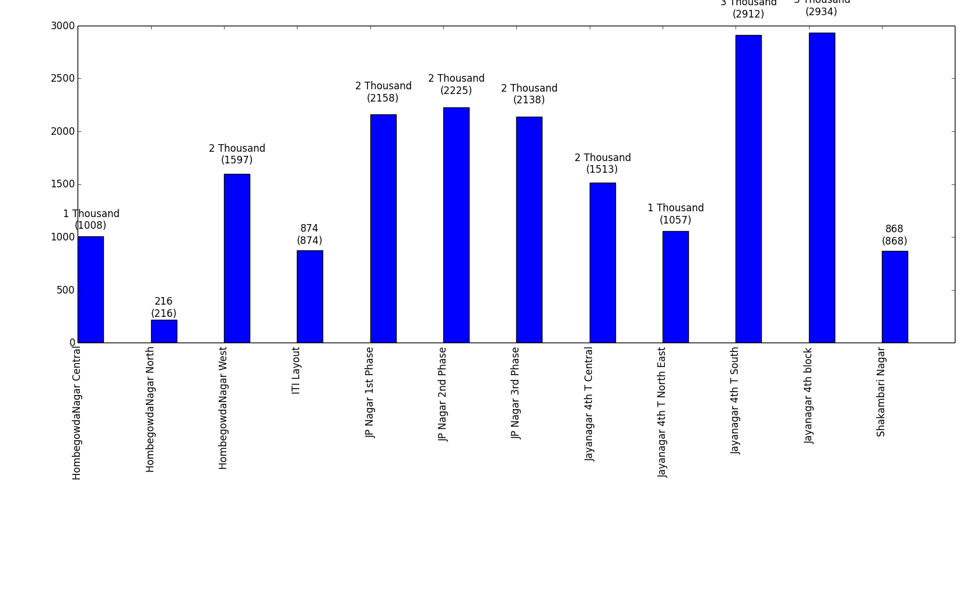
How many connections per DMA?

Slide 2
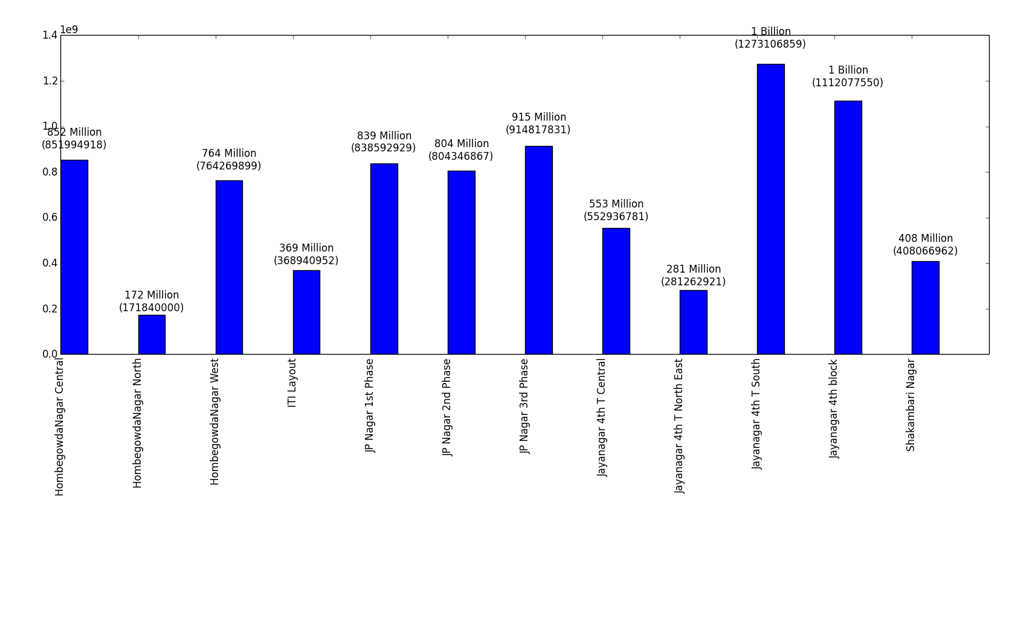
Annually, how much water does every DMA consume?

Slide 3

On an average, monthly, how much water does every DMA consume?

Slide 4
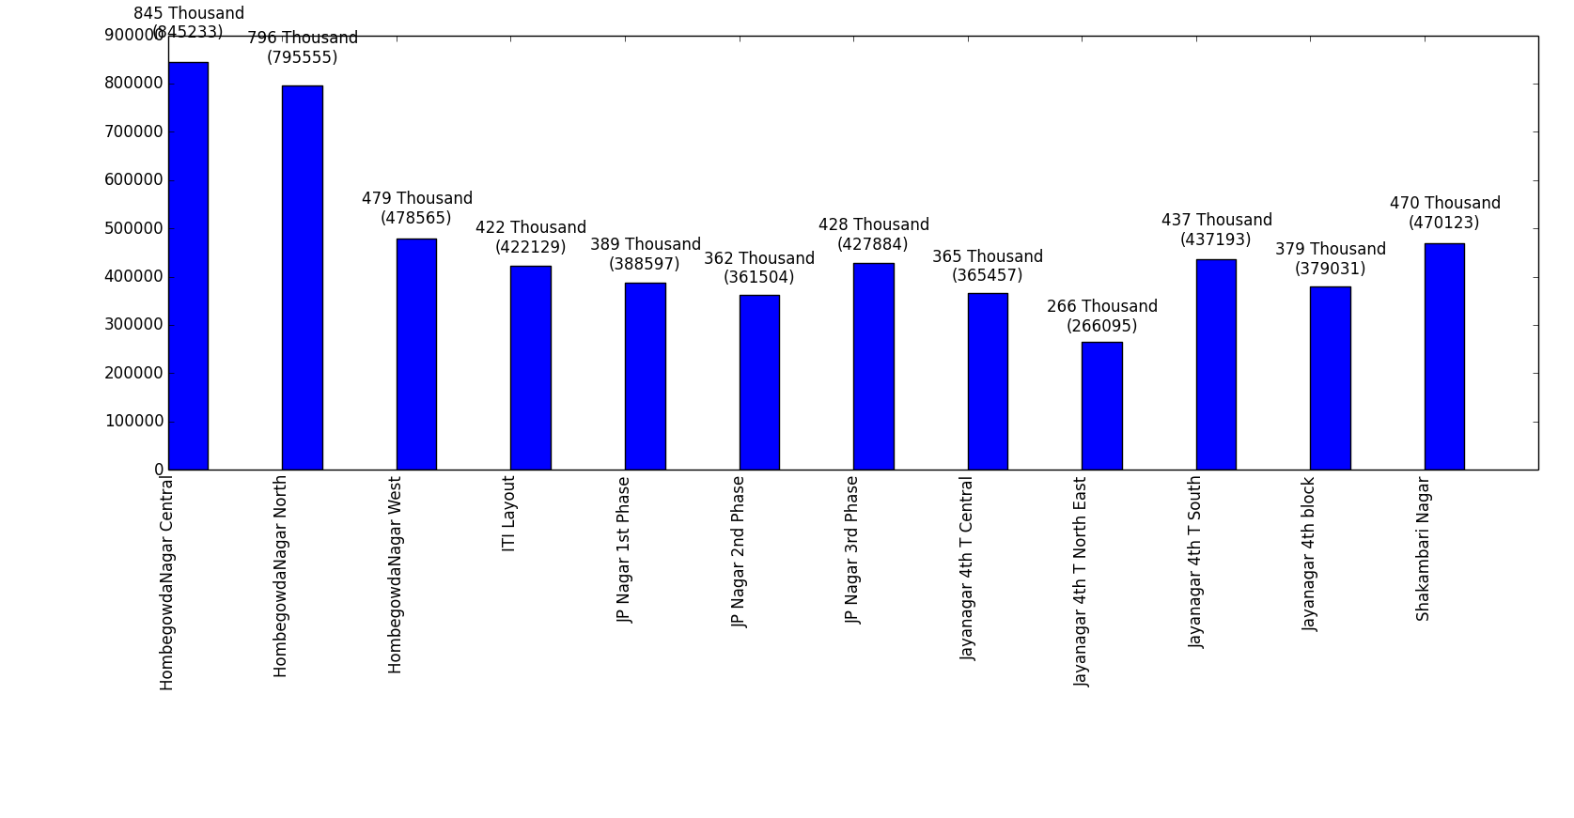
On an average, how much water does every connection in a DMA consume (annually)?

Slide 5
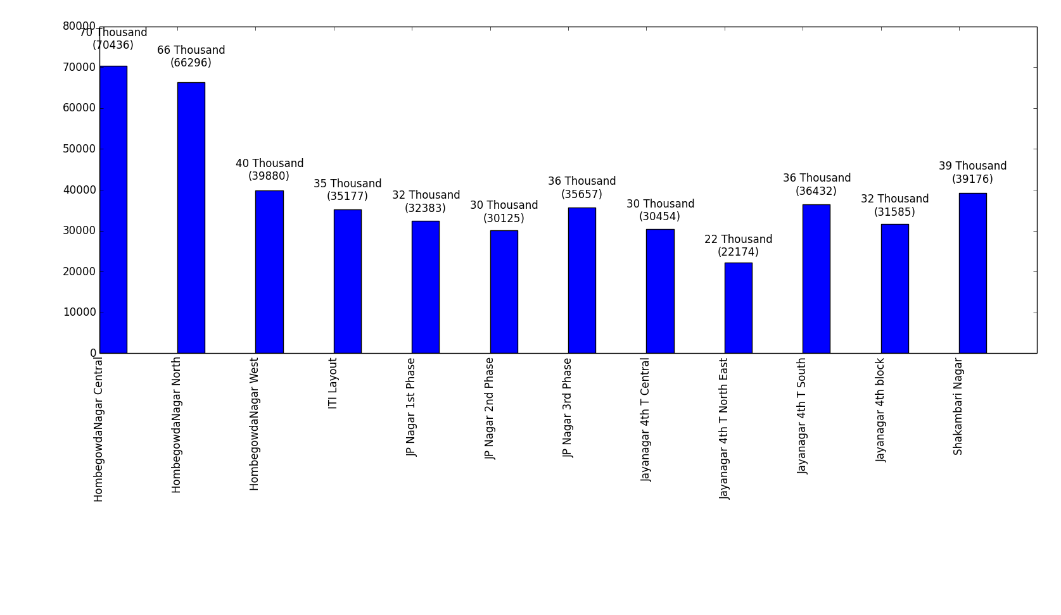
On an average, how much water does every connection in a DMA consume (monthly)?

Slide 6
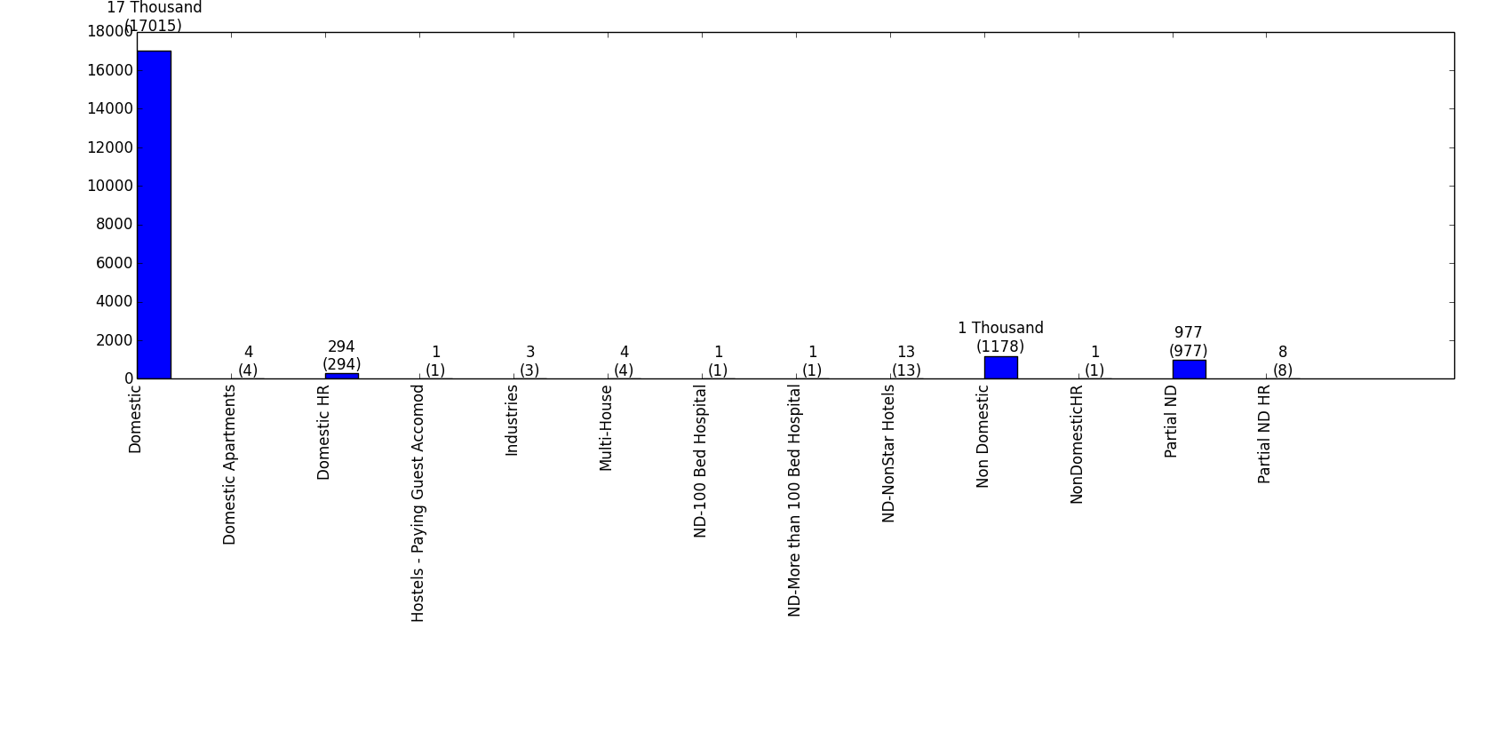
There are different types of water connections, what and how many?

