Slide 1
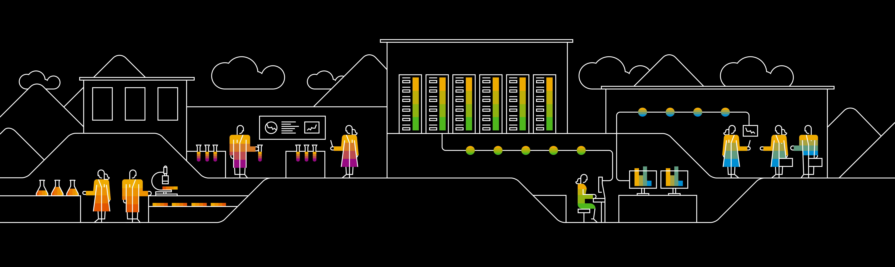
Life Cycle of Transactional Data in In-memory Databases
Authors: Amit Pathak, Aditya Gurajada, Pushkar Khadilkar SAP Labs India,
Presented by: Pushkar Khadilkar
April 16, 2018

Slide 2
Agenda
Background
Overall Architecture
Auto IMRS Partition Tuning
Packing Cold Data
Experiments
Conclusions

Slide 3
ASE Background
SAP Adaptive Server® Enterprise (ASE) is a fully featured, ANSI compliant, highly scalable, relational Database engine that provides portable, multi-platform system for high performance data management.
High performance geared towards OLTP oriented applications.
Traditionally disk based.
ASE 16.0 SP03 : Extreme OLTP (XOLTP) architecture to enhance performance
In-memory row storage (IMRS) added to support in-memory processing of hot rows
Information life cycle management (ILM) handles hot-cold data classification.

Slide 4







Background: In-memory Row Store Architecture [VLDB 2018]
Leverage multicore processors with large memory.
Hot data stored in row oriented in-memory store (IMRS).
In-memory versioning
Table / partition data can be present in all tiers.
Hash indexes on hot in-memory data.
SQL statements / queries transparently access data in IMRS or page store.
In-memory data persisted using sysimrslogs.
IMRS GC: Multi-threaded, non-blocking garbage collection.
Pack: Multi-threaded subsystem to efficiently harvest cold data based on ILM decisions.
Hot Data Inserts
RID-Map Table
R/W Buffer Cache
Hot Data
Cold Data
IMRS
Paged I/O
Redo-Only Transaction Log
for In-Memory DMLs
Redo/Undo Transaction Log

Slide 5
ILM Design Goals and Principles
Objectives
Keep cache utilization stable while retaining hot rows.
Application compatibility.
Minimal user tuning
Respond to changing workloads.
Low transaction impact.
Guiding Access Patterns
Frequency of data access
Contention in page store. For example, latch contention.
Type of operation: Insert / Select / Update / Delete / Utilities
Granularity: Row, partition, table.

Slide 6
Auto IMRS Partition Tuning

Slide 7
Auto IMRS Partition Tuning: Introduction
Individual Partitions affected differently by the workload
For example, partition containing latest orders could be hot.
Partition Tuning: Disable or re-enable use in-memory storage for certain DMLs on the partition.
Disable IMRS usage if rows are not significantly re-used by the workload.
Enable IMRS usage for a partition if IMRS may provide large gains. For example, latch contention on page store.
Auto IMRS Partition Tuning: Allows users to enable IMRS at database level and automatically tune partitions based on changing workload patterns.
Monitor
Self tuning

Slide 8
Auto IMRS Partition Tuning: Monitoring
Workload monitoring to identify usage of partition
Number of inserts / updates / deletes
Memory used
Total number of rows
Parameters: Per-CPU cache friendly counters. Aggregated infrequently on read.
Row access timestamps maintained for hotness
Immediately updated for new versions.
Periodically updated for selects.

Slide 9
Auto IMRS Partition Tuning: Self Tuning
ASE internally tunes IMRS usage by partition in a background thread.
Counters are tracked for multiple iterations and counter differences are used to identify new IMRS usage for a partition.
Heuristic Parameters:
Average re-use of rows
Partition IMRS utilization
Total IMRS cache utilization
New IMRS usage by a partition
Contention on page store.
Partition enable / disable decision is made if partition is found useful / unused for several iterations.

Slide 10
Packing Cold Data

Slide 11
Packing Cold Data From IMRS
Cold data moved to page store by pack background threads.
Steady Cache Utilization Percentage
Pack thread modes
Steady state
Aggressive
Identification of cold rows
Locating cold rows

Slide 12

Locating Cold Data
Relaxed LRU to identify cold rows.
Partition level queues of packable rows.
Captures partition level activities.
Aggregate table specific accesses.
Avoids contention
Cold rows are found at the head and hot rows at the tail.
Queue maintenance offloaded from user transactions.
Ptn
Pack Thread
Ptn
Ptn
Pack Thread
Pack operation

Slide 13
Locating Cold Data: Partition Aware Pack Selection
Assumption: Partitions in OLTP workloads have similar coldness behavior.
Patterns:
Number of re-use operations
Growing or stable partitions
Pack cycle
Time epochs
Packs small percentage of total data in IMRS.
Pack transactions
Batch packing of a number of rows in partition.
Partition specific transactions.
Number of rows packed auto adjusted based on physical characteristics.

Slide 14
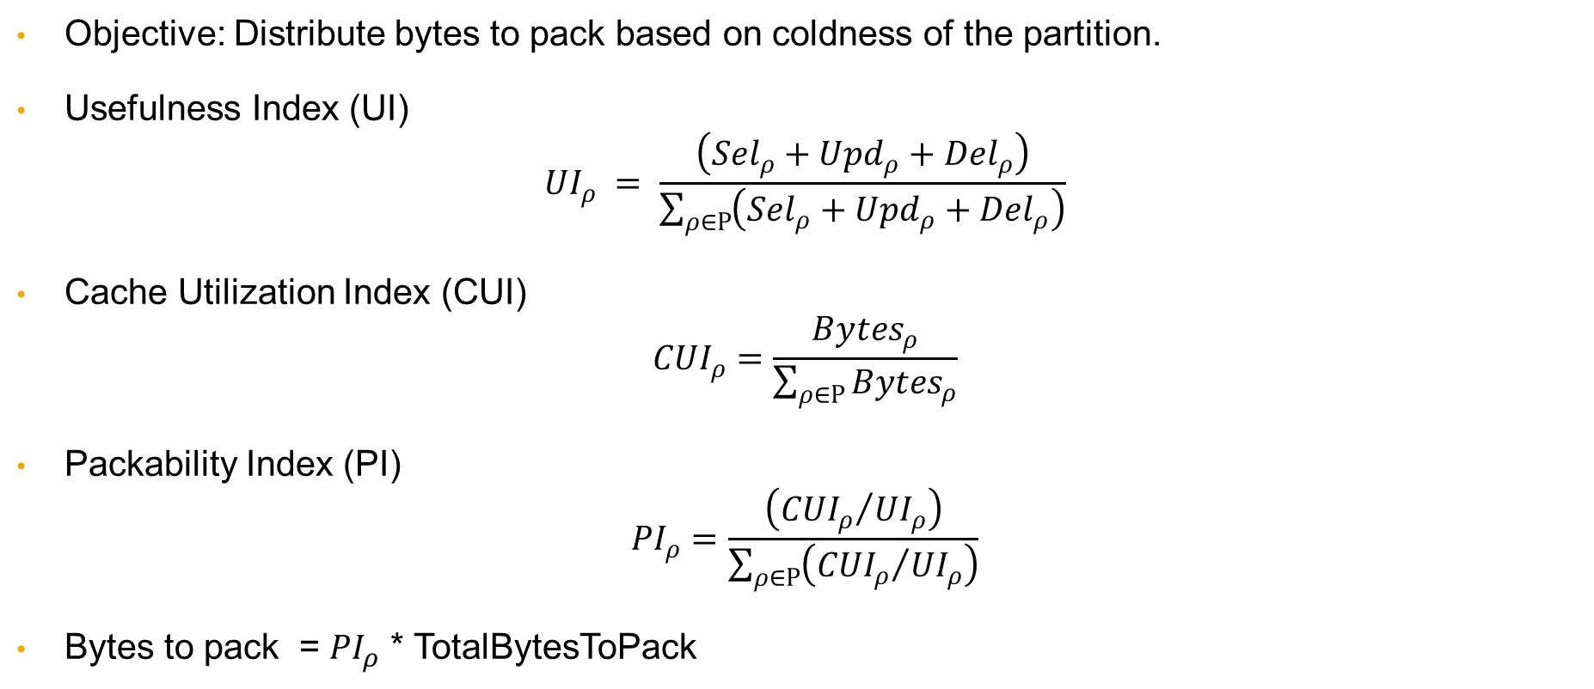
Partition Aware Pack Selection: Pack Cycle Byte Distribution
Objective: Distribute bytes to pack based on coldness of the partition.
Usefulness Index (UI)
$${UI}_{ρ} = \frac{\left({Sel}_{ρ}+{Upd}_{ρ}+{Del}_{ρ}\right)}{\sum_{ρ∈Ρ}{\left({Sel}_{ρ}+{Upd}_{ρ}+{Del}_{ρ}\right)}}$$
Cache Utilization Index (CUI)
$${CUI}_{ρ}=\frac{{Bytes}_{ρ}}{\sum_{ρ∈Ρ}{{Bytes}_{ρ}}}$$
Packability Index (PI)
$${PI}_{ρ}=\frac{\left({{CUI}_{ρ}}/{{UI}_{ρ}}\right)}{\sum_{ρ∈Ρ}{\left({{CUI}_{ρ}}/{{UI}_{ρ}}\right)}}$$
Bytes to pack = ${PI}_{ρ}$ * TotalBytesToPack

Slide 15
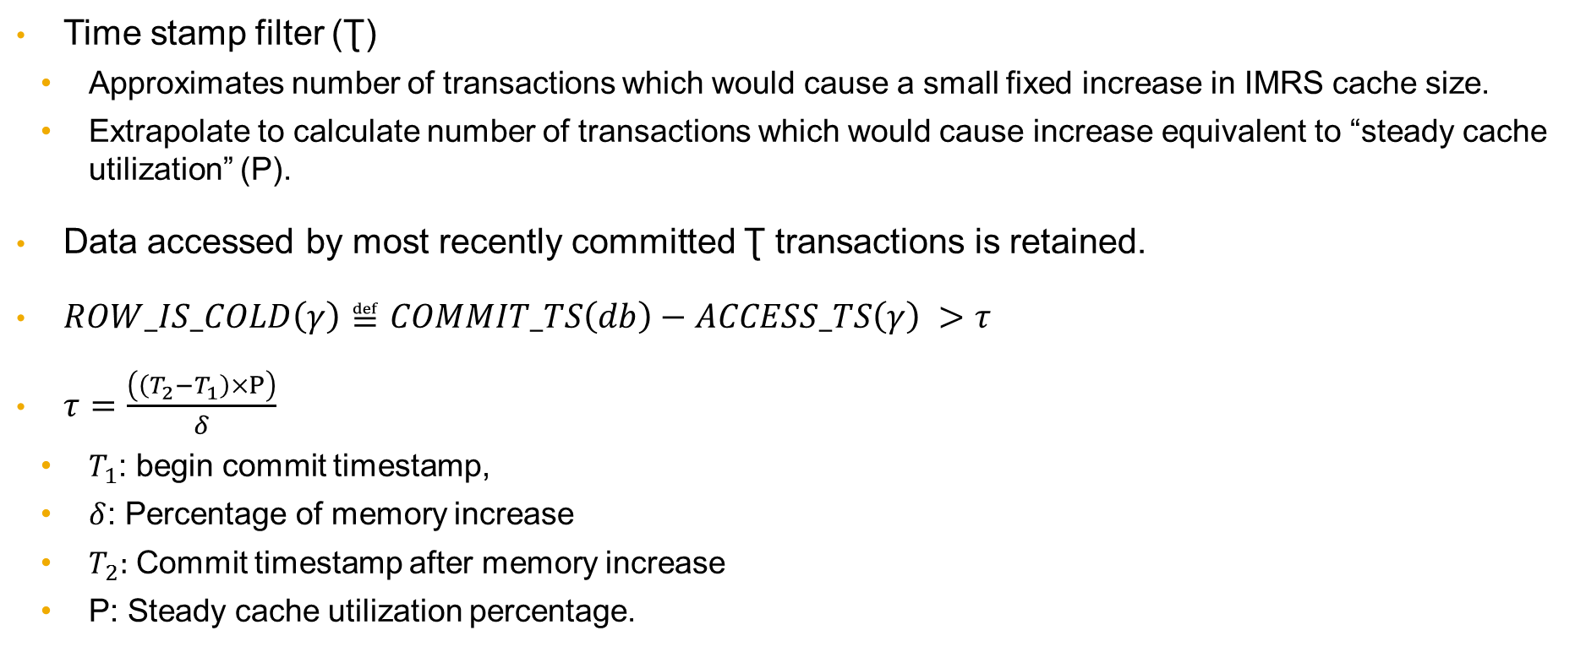
Identifying Cold Data
Time stamp filter (Ʈ)
Approximates number of transactions which would cause a small fixed increase in IMRS cache size.
Extrapolate to calculate number of transactions which would cause increase equivalent to “steady cache utilization” (P).
Data accessed by most recently committed Ʈ transactions is retained.
$ROW_IS_COLD\left(γ\right)≝COMMIT_TS\left(db\right)−ACCESS_TS\left(γ\right) >τ$
$τ=\frac{\left(\left(T_{2}−T_{1}\right)×Ρ\right)}{δ}$
$T_{1}$: begin commit timestamp,
$δ$: Percentage of memory increase
$T_{2}:$ Commit timestamp after memory increase
P: Steady cache utilization percentage.

Slide 16
Experiments

Slide 17
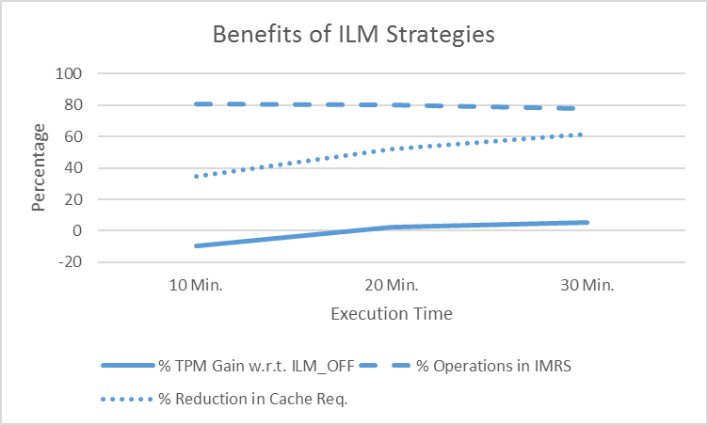
Benefits of ILM
Setup: 60 cores, 4 sockets, 1TB RAM
OLTP benchmark based on TPCC.
Configurations:
ILM off
ILM on
Parameters
Relative throughput
In-memory Hit rate
Reduction in cache utilization

Slide 18
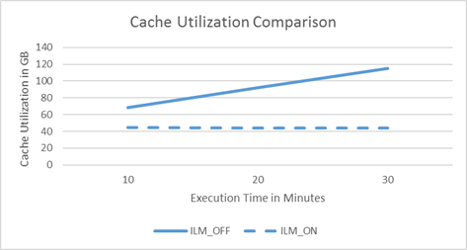
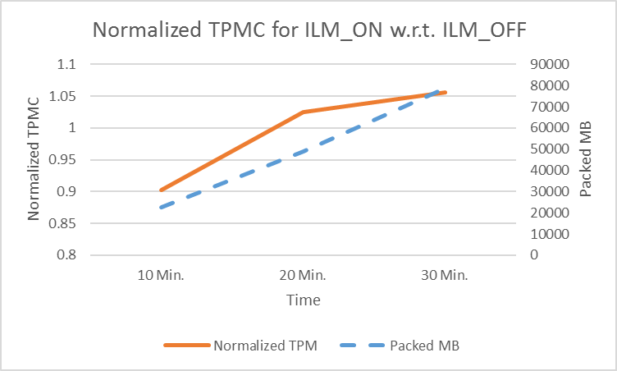
Cache Utilization and Relative TPM with Pack

Slide 19
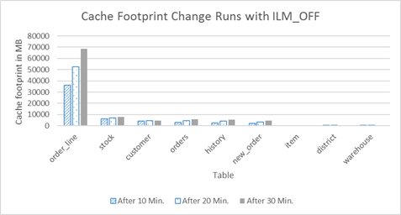
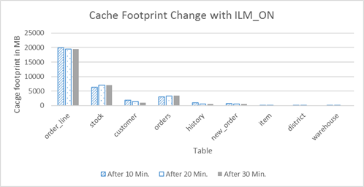
Partition Level Cache Footprint
ILM_OFF
ILM_ON

Slide 20
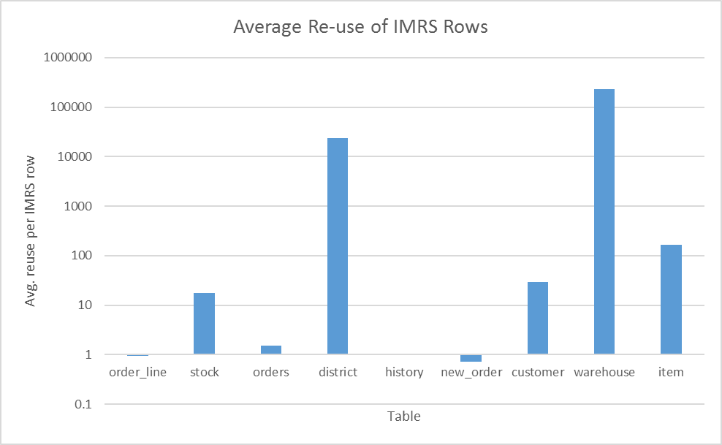
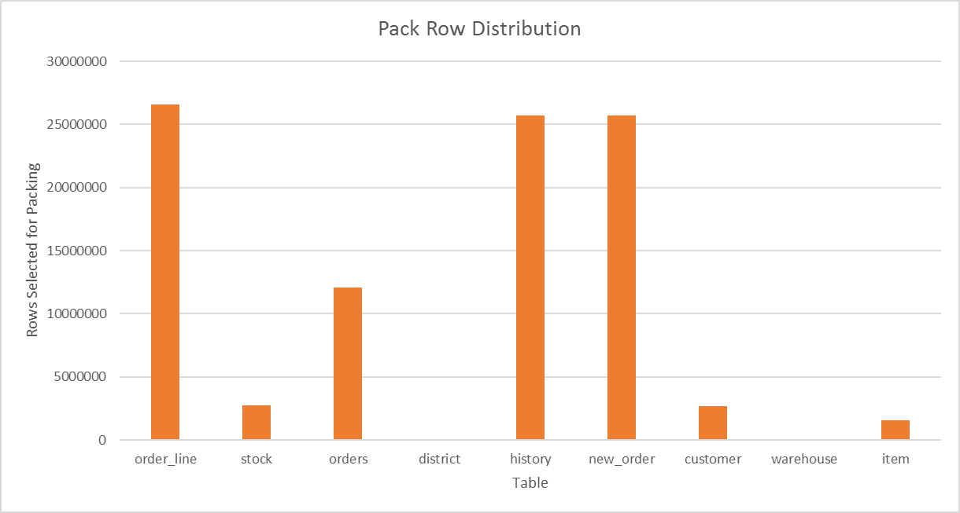
Pack Cycle Bytes Distribution

Slide 21
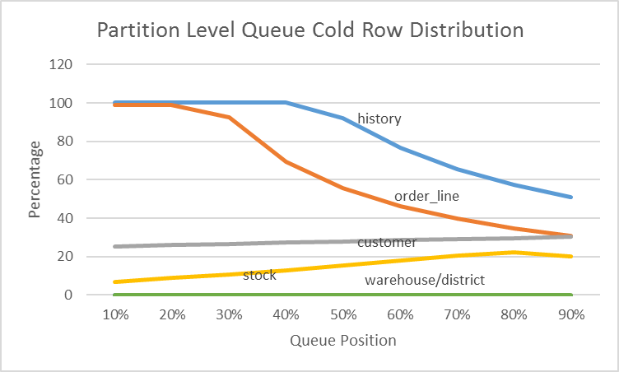
Partition Level LRU Queues
Cold rows in every 10% of the rows in queue
History – Insert only table.
Warehouse – Frequently updated / accessed.
Customer – Heavy updates to existing rows.

Slide 22
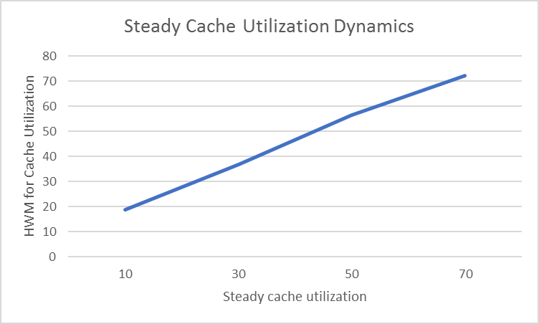
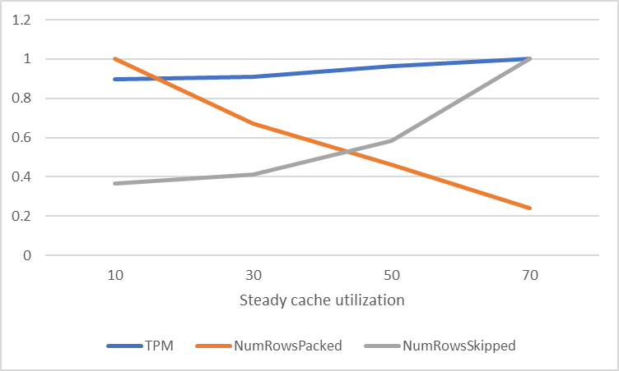
Impact of Steady Cache Utilization

Slide 23
Conclusions
ILM techniques retain only hot data in memory.
Demonstrated tight integration of ILM techniques in OLTP database.
Performance gains of in-memory processing possible on larger dataset.
Stable cache utilization maintained without impacting throughput.
Workload aware and auto tuned ILM reduces additional configuration overheads.

Slide 24
Thank you.
Contact information:
Pushkar Khadilkar
SAP Labs India
pushkar.khadilkar@sap.com
Partner logo

