Slide 1
Practical-06 Representing Data using XML with CSS/XSL and Internal/External DTD

Slide 2
Q1) Create a XML document to store some information of Books (with at least five fields) and format this XML document using suitable CSS. Also create internal DTD.

Slide 3
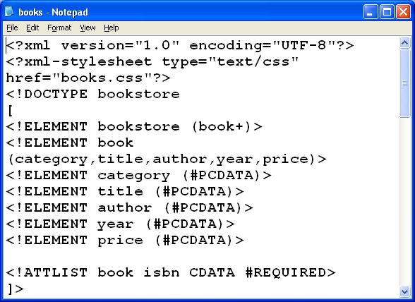
File name:books.xml

Slide 4
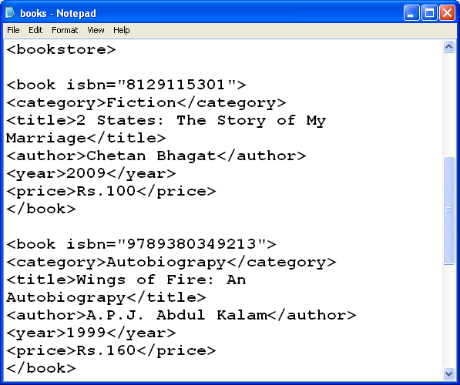

Slide 5
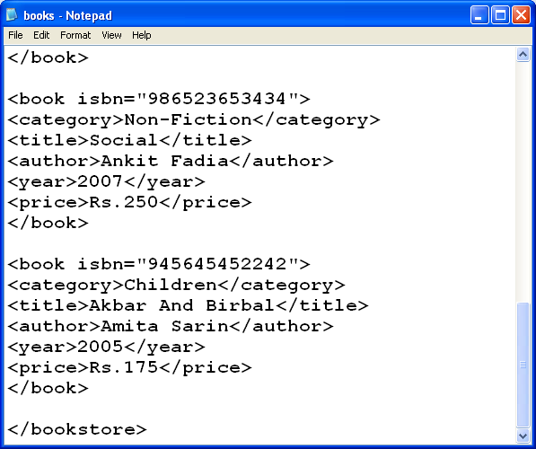

Slide 6
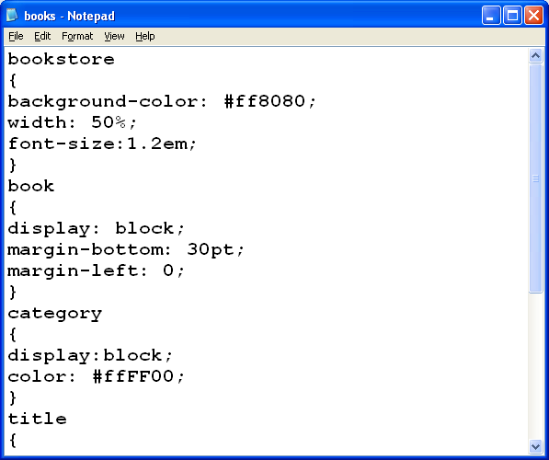
File name:books.css

Slide 7
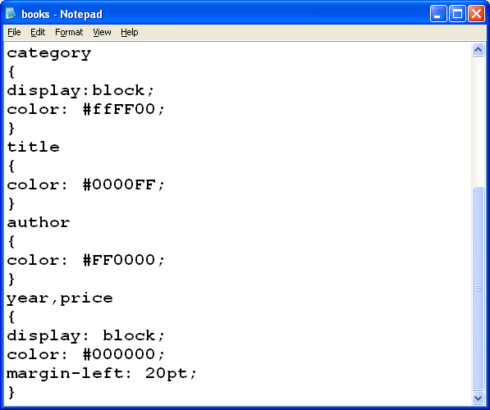

Slide 8
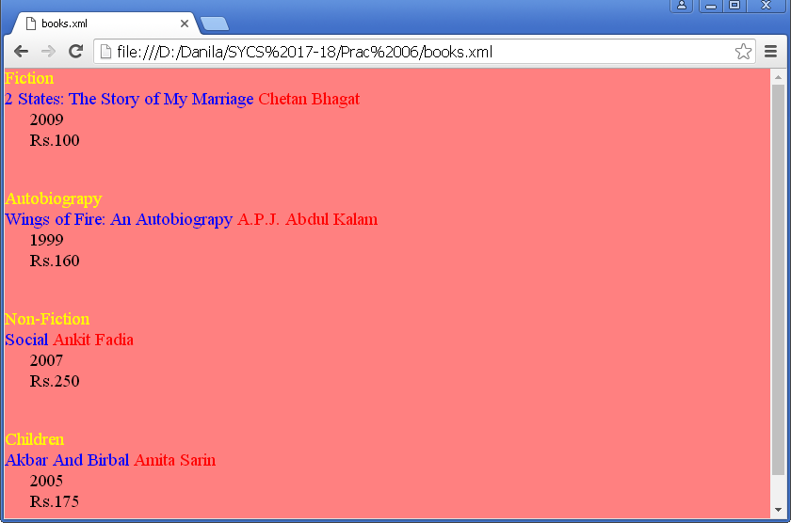
Output

Slide 9
Q2)Create an XML document with XSL and DTD listing your favorite movies.

Slide 10
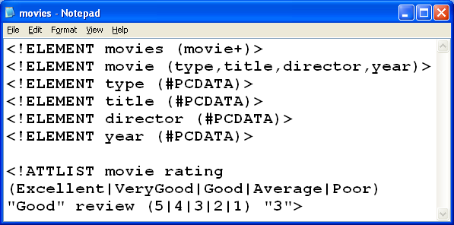
File name:movies.dtd

Slide 11
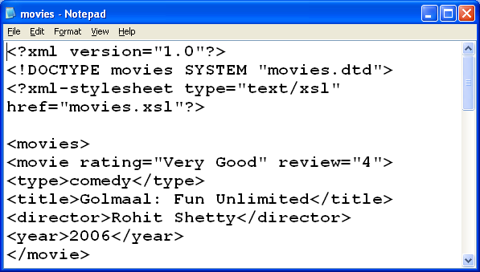
File name:movies.xml

Slide 12
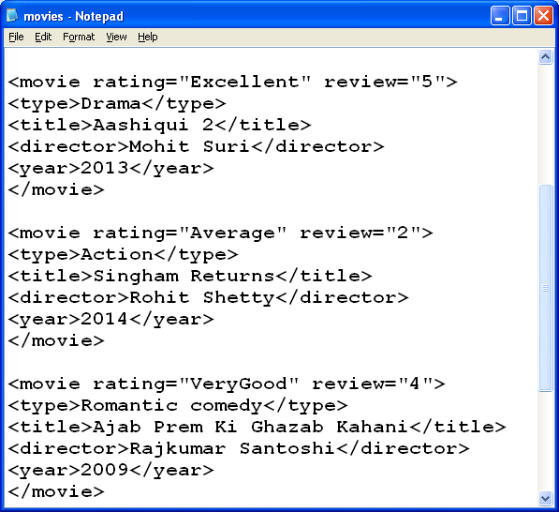

Slide 13
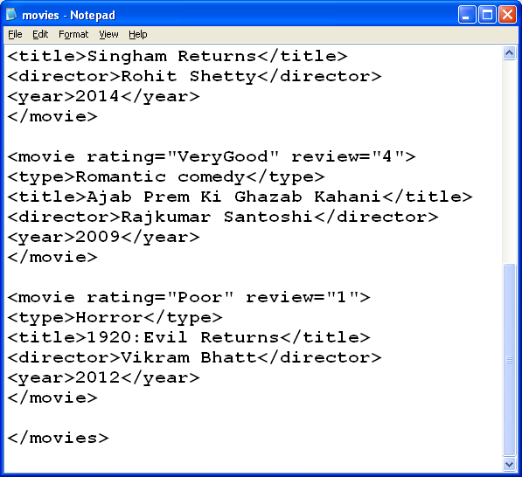

Slide 14
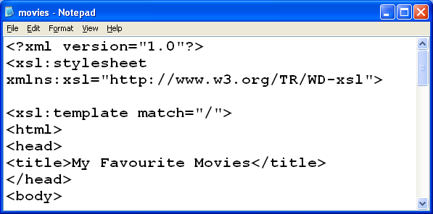
File name:movies.xsl

Slide 15
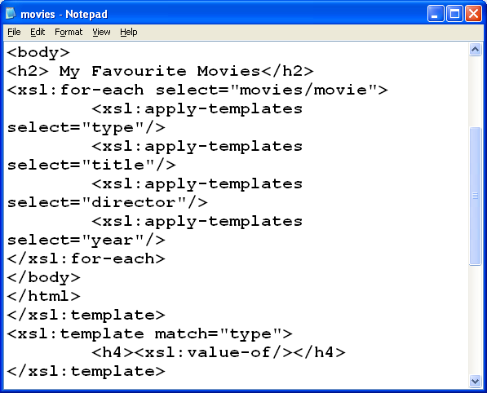

Slide 16
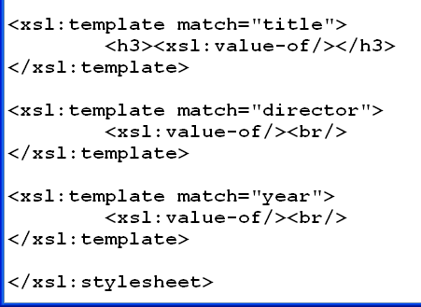

Slide 17
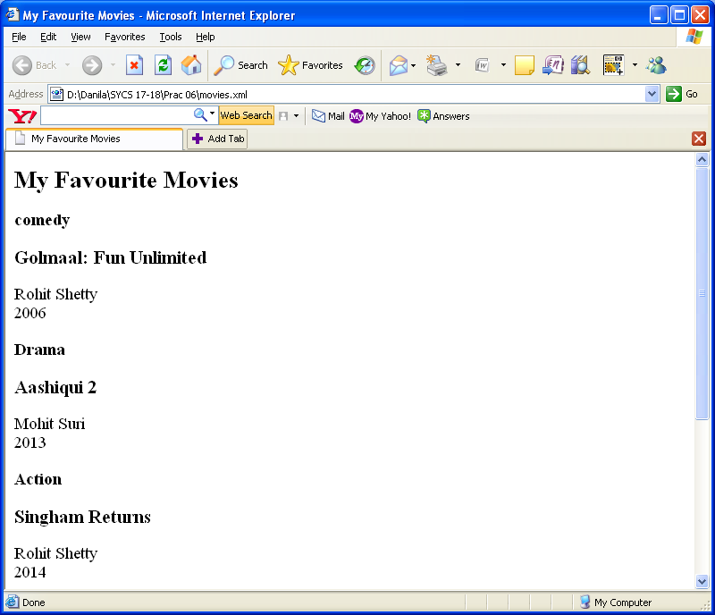
Output

