Slide 1
Practical-II
Script and Interactive modes

Slide 2
Semicolon separated list of statements
Example:
1) >>>a=5; b=9998
>>> print ("a=",a,"b=",b); print("b=",b,"a=",a)
2) >>> 2+3;4**4;100//3;print("hello");x=None;print("The value of x is",x)

Slide 3
1) Write a python program to calculate the sum of two numbers
1: Using Interactive mode:
a=input("Enter first number") # first number
b=input ("Enter second number") # second number
sum = a + b # sum of two numbers
print(a , " + " , b , " = ", sum) #print a+b=sum

Slide 4
type(a)
type(b)
type(sum)

Slide 5
1) Python treats the values entered through the input() function as string. Hence the value of a and b were treated as string.
2) + is treated as concatenation for strings. E.g., when a=5 and b=6, a+b displays 56 and not 11.
3) We are required to explicitly cast the value '5' to integer by using int() function.

Slide 6
a=input("Enter first number") # first number
b=input ("Enter second number") # second number
sum = (int)(a) + (int)(b) # sum of two numbers
print(a , " + " , b , " = ", sum) #print a+b=sum

Slide 7
a=input("Enter first number") # first number
b=input ("Enter second number") # second number
sum = a + b # sum of two numbers
print(a , " + " , b , " = ", sum) #print a+b=sum

Slide 8
2: Using Script mode:

Slide 9
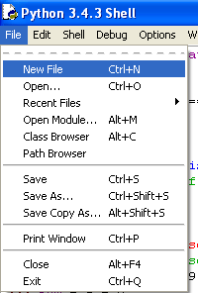

Slide 10
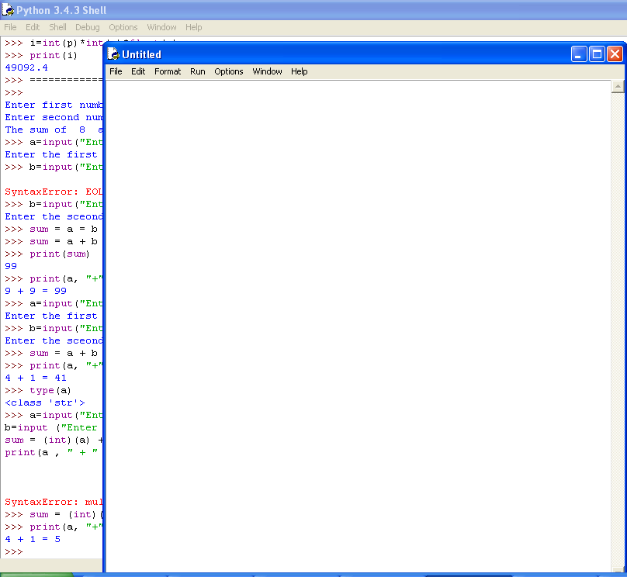

Slide 11
a=input("Enter first number") # first number
b=input ("Enter second number") # second number
sum = (int)(a) + (int)(b) # sum of two numbers
print(a , " + " , b , " = ", sum) #print a+b=sum

Slide 12
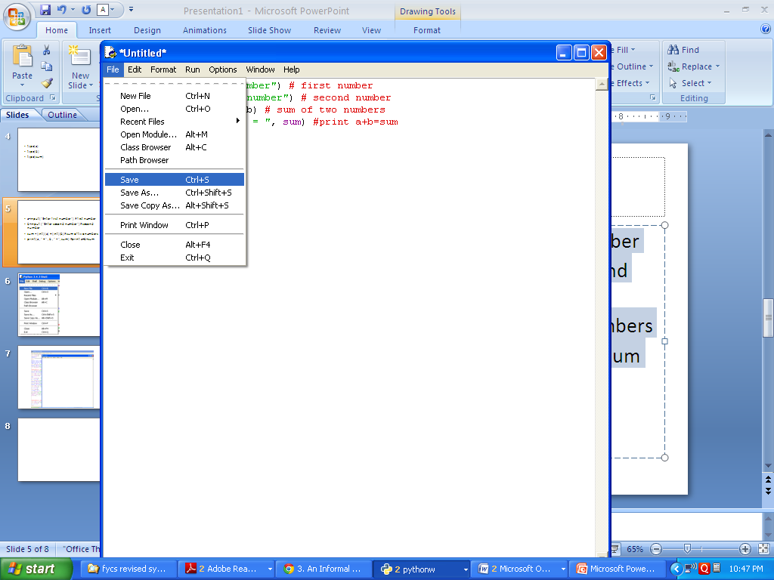

Slide 13
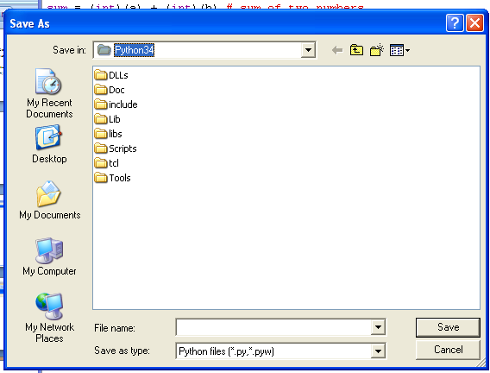

Slide 14
2) Write a python script to enter your name and display it.
myname=input(“Enter your name”)
print(“Welcome ”, myname)

Slide 15
3) Write a program to ask for following as input
Enter your first name: Niel
Enter your last name: Khanna
Enter your date of birth
Month? March
Day? 10
Year? 1992
And display following on screen
Niel Khanna was born on March 10, 1992.

Slide 16
fname=input("Enter the first name")
lname=input("Enter the last name")
print("Enter your date of birth")
month=input("Month?")
day=int(input("Day?"))
year=int(input("Year?"))
print(fname, lname, "was born on", month, day, "," , year )
#print(fname+" "+lname+" was born on "+month+str(day)+ "," +str(year) )

Slide 17
4) Write a python program that prompts the user of two integer values and displays the result of first number divided by second number with exactly two decimal places displayed.
(Hint: formula (12/5,’0.2f’))

Slide 18
#Input first number
first_no=int(input("Enter first number"))
#Input second number
second_no=int(input("Enter second number"))
#Divison of two numbers with exactly two decimal places
print(first_no,"/",second_no,"=",format(first_no/second_no,'.2f'))

Slide 19
5) Write a python script to find the ascii value of a given character

Slide 20
# Program to find the ASCII value of the given character
# Take the character from the user
c = input("Enter a character: ")
print("The ASCII value of '" + c + "' is",ord(c))

Slide 21
6) Write a python script to display calendar of given month of the year

Slide 22
# Python program to display calendar of given month of the year
# import module
import calendar
yy=int(input("Enter the year"))
mm=int(input("Enter the month"))
# display the calendar
print(calendar.month(yy, mm))

Slide 23
7) Write a python script to input temperature in Fahrenheit and prints the temperature in Celscius.
(Conversion: Celsius = (F - 32) * 5/9).

Slide 24
fah=float(input("Enter the temperature in Fahrenheit"))
cel=(fah-32)*5/9
print(fah,"F = ",cel,"C")

Slide 25
8) Write a python program that prompts the user for side of a square and print its area and perimeter and display it with two decimal places.

Slide 26
#Input side of a square
side=float(input("Enter the side of a square"))
#calculate the area
area = side**2
#calculate the perimeter
perimeter=4*side
#print area and perimeter upto two decimal places
print("Area =", round(area,2))
print("Perimeter = ", round(perimeter,2))

Slide 27
9) Write a python script to input the length and breadth of a rectangle and print its area and perimeter

Slide 28
length=int(input("Enter the length of a rectangle"))
breadth=int(input("Enter the breadth of a rectangle"))
area = length*breadth
perimeter=2*(length + breadth)
print("Area =", area)
print("Perimeter = ", perimeter)

