Slide 1
NIMMA
BENGALURU
A mobile-first civic issue reporting
and official response prototype
CMR University
B.Tech CSE, Data Science
Project presentation for guide review
NOVEMBER 2026
Notes:
Introduce Nimma Bengaluru as a mobile-first web prototype for collecting structured civic issue reports and supporting authorised official follow-up.
This is an academic project presentation from CMR University. It is not an official Government of Karnataka or Greater Bengaluru Authority service.
Source: Nihal Final Report, title page and abstract.

Slide 2
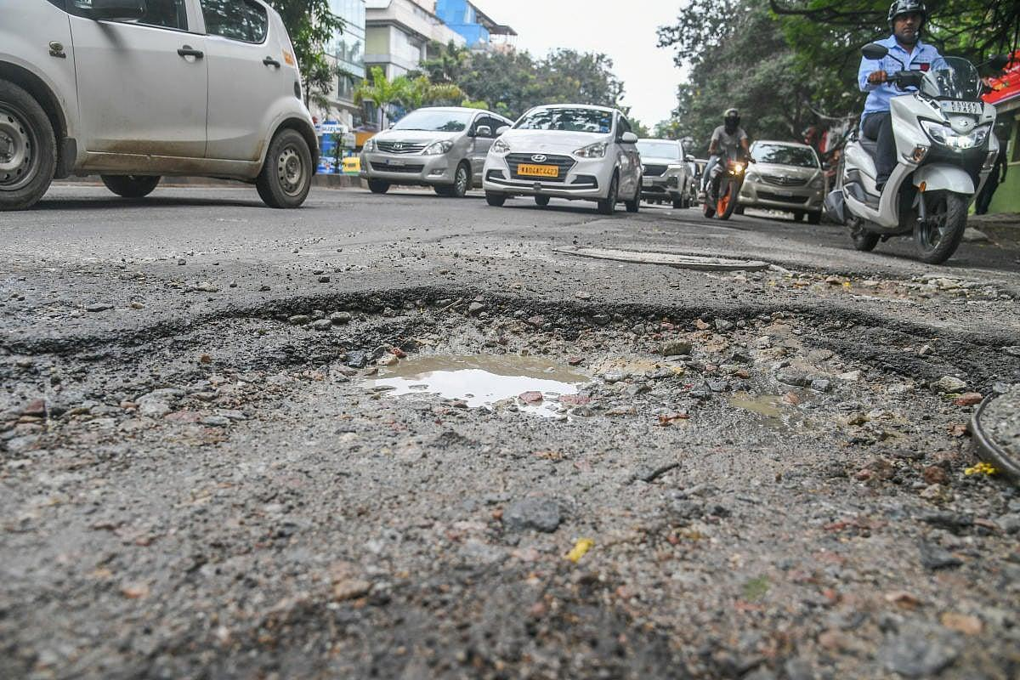
A useful civic report needs clear evidence
The issue is local. The first report should make its location and condition easy to understand.
A report should answer three practical questions.
WHERE
A map pin and a readable place description
WHAT
A category and a concise description
EVIDENCE
A recent photo or video from the location
Existing grievance channels remain the official routes. This prototype explores a guided intake and traceable review workflow that could complement them.
Representative road-damage photo from the project report
02 / 10
Notes:
The report describes common local problems such as damaged roads, streetlights, blocked drains and unsafe construction. The central design issue is how to capture enough location and evidence for a reviewer to understand a submission.
Position Nimma Bengaluru as a complementary academic prototype. The report notes that formal grievance channels already exist, including GBA/SAHAAYA 2.0 and Karnataka Janaspandana. Do not imply that those channels are absent or that this project replaces them.
Image source: Nihal Final Report, printed page 1, Figure 1.1 (PDF page 8). Other context: report pages 1 and 5–6. References listed in the report: https://gba.karnataka.gov.in/ ; https://site.bbmp.gov.in/departmentwebsites/bbmpit/mobileapps.html ; https://negd.gov.in/isl/Directory/statedata/418

Slide 3
Project goals and working method
Design the report around what a resident can capture and what an authorised reviewer can act on.
01
02
03
Capture
Control access
Track
Collect a category, description, incident pin and live media in a phone-friendly form.
Keep reporter details private and limit each official to their assigned wards.
Give every report a reference and preserve a visible status history through resolution.
Development method
Stakeholders
Requirements
Workflow design
Implementation
Verification
03 / 10
Notes:
The project objectives in the report focus on no-account public intake, evidence and location capture, official role permissions, a reference number, status history and privacy controls.
The report proposes an iterative method: analyse roles and needs, define requirements, design user journeys and data, implement the two portals, then verify them. The current slides distinguish the working prototype from the unexecuted formal test plan.
Source: Nihal Final Report, printed pages 1–2 and 7–8.

Slide 4
Citizen report journey
The phone form guides a resident from first contact to a trackable reference.
1
2
3
4
5
6
Contact
Issue
Capture
Locate
Describe
Submit
Name and
self-reported phone
Choose a civic
issue category
Take a live
photo or video
Confirm the GPS
pin on the map
Add details
and severity
Review, accept
declaration, get reference
No citizen account or OTP
The contact number is self-reported and unverified. A unique reference lets the reporter return to the submission and track updates.
04 / 10
Notes:
Walk through the six public form stages. The current implementation asks for a name and phone number, but it does not send or verify an OTP. The camera and GPS flow is intended for a phone browser.
After submission the system returns a unique reference number. A reporter can use that reference to check the status. Personal contact details are not presented in the public tracking view.
Sources: current client/src/pages/public/Report.tsx and client/src/components/CitizenStartForm.tsx; Nihal Final Report, printed pages 7–8.

Slide 5
Official review and area control
The official portal keeps report access tied to a person’s assigned role and ward scope.
1
2
3
4
Review
Assign
Update
Close or reopen
Check category, location, description and supporting media.
Route an accepted report to the appropriate official or team.
Record progress and keep earlier status events in the history.
Add a resolution note and evidence, or return the case to action.
Area administration
An owner/admin creates official accounts and assigns permitted wards. Server checks enforce that scope on protected requests.
05 / 10
Notes:
Explain that an official queue is not a citywide public feed. The API applies role and area scope when it returns reports and when an official opens a specific report.
The owner/admin can create an official account and assign wards and optional issue categories. Status history and audit records provide a reviewable record of changes.
Sources: current server/lib/auth.js, server/routes/official.js, server/models/Official.js and client/src/pages/official/admin/Officials.tsx; Nihal Final Report, printed pages 13–18.

Slide 6
System architecture in the current prototype
A browser client and one Node server connect the public and official workflows to MongoDB.
Browser client
Application server
Data storage
React + TypeScript
Citizen and official portals
Leaflet with OpenStreetMap
Node.js + Express
Validation, authentication
Area checks and report workflow
MongoDB Atlas with Mongoose
Report and account records
GridFS stores photo/video media
HTTPS from a phone on the same Wi-Fi
OpenStreetMap tiles show map context; the app stores the selected issue coordinates.
Implementation note
The report proposes PostgreSQL. The current code uses MongoDB and Mongoose, with GridFS for media.
06 / 10
Notes:
Describe the architecture as implemented. Vite builds the React/TypeScript browser client, and the Node/Express server serves it along with the API. MongoDB Atlas stores the application data; the project can also use a built-in local MongoDB for a demo. The media helper stores files in MongoDB GridFS.
Location selection uses Leaflet with OpenStreetMap tiles. On a phone the locally hosted app is opened over HTTPS while the phone and computer share a Wi-Fi network.
Important report-to-code difference: chapter 4 and chapter 5 of the report name PostgreSQL and object storage. The current repository instead uses MongoDB/Mongoose and GridFS. Update the final report so it matches the implementation.
Sources: current package.json, server/db.js, server/app.js, server/lib/media.js, client/src/components/MapView.tsx; Nihal Final Report, printed pages 11–14.

Slide 7
Misuse controls and privacy boundaries
Automated checks flag patterns for review. They do not establish a person’s identity or guilt.
Signals considered
How reviewers should use them
Repeated submissions from a phone or area
Similar media used on multiple reports
Location distance or photo metadata mismatch
Unusually fast forms and other abuse signals
Phone details are self-reported and unverified. Device, network and location signals can be inaccurate or shared. A flag supports human review; any restriction or referral requires a recorded decision under the responsible institution’s process.
Private by design
Reporter contact and original media stay out of public report views.
07 / 10
Notes:
Explain that anti-abuse signals include submission bursts, repeated nearby reports, reused or old media, GPS distance and mismatches, device/network reuse and form timing. These are risk indicators, not proof.
This distinction is important because the citizen phone number is not verified after the OTP flow was removed. Reports can be mistaken or malicious, but device and network information cannot reliably identify a person or prove intent. Human reviewers make any recorded restriction or referral decision.
Sources: current server/lib/risk.js, server/models/Reporter.js, server/routes/public.js, client/src/pages/public/About.tsx and client/src/pages/official/Evidence.tsx; Nihal Final Report, printed pages 4 and 22–23.

Slide 8
Bengaluru issue coverage
The current category catalogue covers everyday road, sanitation, drainage and public-safety reports.
Roads and walking
Water and sanitation
Public space and safety
Potholes and damaged roads
Garbage dumping or missed collection
Broken streetlights and exposed wires
Unrestored road cuts
Construction debris and street cleaning
Fallen trees and park issues
Broken or blocked footpaths
Waterlogging, blocked drains and sewage
Stray dogs and traffic signals
Unsafe speed breakers
Open manholes and water-supply issues
Unsafe construction and encroachment
Examples from the app’s current issue catalogue. No complaint-volume percentages are claimed here.
08 / 10
Notes:
These examples are category labels from the current app. The catalogue includes roads, footpaths, waste, flooding and drains, water supply, streetlights, trees, parks, traffic and public safety, buildings and other issues.
The project report and code mention Bengaluru complaint categories, but this presentation does not claim volume estimates or rankings. Sensitive allegations have restricted handling and should not be blended into the public civic issue list.
Sources: current server/data/categories.js and client/src/pages/public/Home.tsx; Nihal Final Report, printed pages 1 and 5–6.

Slide 9
What the prototype can show today
A working local demonstration is different from an authorised public service.
Implemented in the app
Not yet established
Mobile report flow with camera and GPS
Reference-based tracking and status history
Authenticated official portal with ward scope
Admin account and area assignment
English-only monochrome interface
Government integration or agency partnership
A field pilot or representative usability study
Production response-time commitments
Completed results for the report’s test matrix
The citizen-facing Issues Map has been removed. The report pin and authorised official maps remain.
09 / 10
Notes:
The current code supports the citizen report and tracking flows, official login and area-scoped case work, admin account/area management and report location maps. The public Issues Map was removed at the user’s request.
The report itself marks every listed test case “Not executed” and says no live government integration, official partnership, field deployment or measured performance is claimed. A build and TypeScript check were completed for the current code, but these do not replace workflow, security or usability evaluation.
Sources: current client and server implementation; Nihal Final Report, printed pages 20–23.

Slide 10
Validation and next steps
The next milestone is a supervised prototype evaluation with a clear scope and recorded results.
01
02
03
04
Test the full flow
Check permissions
Review privacy
Plan a small pilot
Run citizen submissions and status tracking on desktop and phone.
Verify officials cannot read reports outside their assigned wards.
Agree on evidence access, retention and correction procedures.
Get institutional approval before any public agency integration.
Suggested discussion
Which ward and low-risk issue categories should the first supervised demo cover?
10 / 10
Notes:
Close by asking the guide to help select a safe, manageable evaluation scope. A useful pilot should test form completion, valid location/media, duplicate flags, time to first review and whether reporters understand the status labels.
The report recommends testing with representative residents and reviewers, completing legal/security review, and obtaining written permission before integration. Keep sensitive allegation intake and public claims out of scope until a competent institution approves the process.
Sources: Nihal Final Report, printed pages 20–23 and appendix pages 25–27.

