Slide 1

Concept Of Database Project Basketball League (NBA)
Group 4
Bibek Pokharel​
Reagan Schulte​
Hardik Poudel​
Yathartha Regmi​
Seth Michaels​
​

Slide 2

Motivation:
NBA:
82 games per season, 30 teams , 17 players in each roster
Can store large amount of data and It is convenient to sort them
Easy and quick accessible to all the data about Players and Teams

Slide 3

Problem Definition:
Find the trustworthy website which has all the required details of Players and Teams
Decide what are the information that need to go into database
Decide about primary key and foreign key
Decide main table need to be created

Slide 4

Basketball League
Entities:
Teams
Players
Contracts
Player stats
Team stats

Slide 5
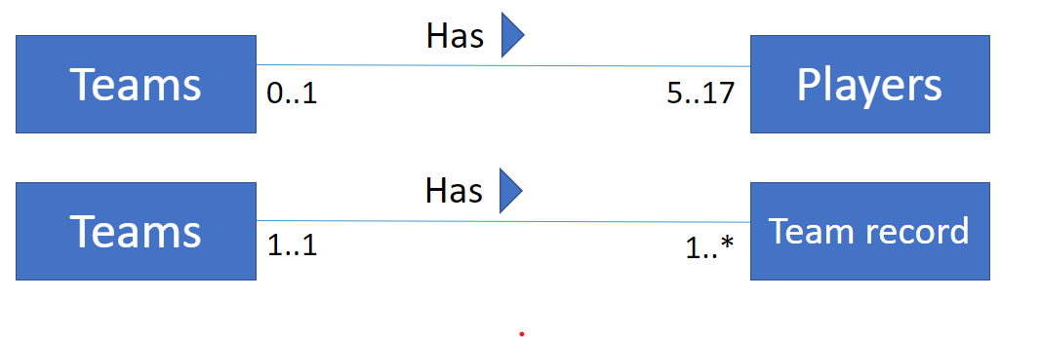
Relationships
Primary Keys:
Teams:
teamID
Players
PlayerID
TeamID
Team_record
TeamID
Season

Slide 6
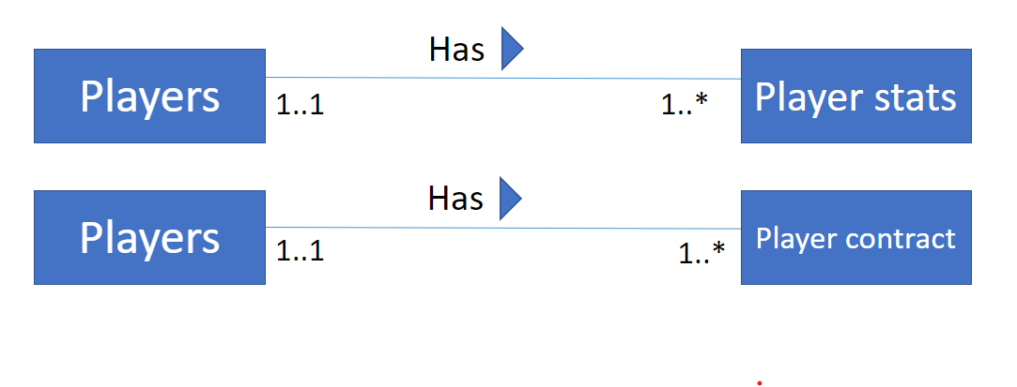
Relationships
Primary Keys:
Players:
PlayerID
TeamID
Player_stats
PlayerID
Season
Player_contract
PlayerID
Amount
years

Slide 7
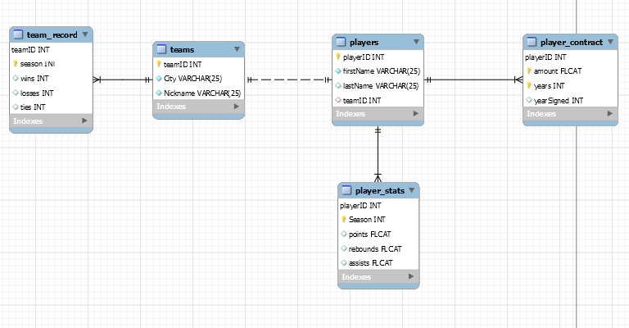
Attributes

Slide 8
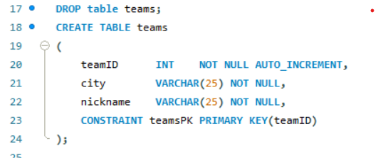
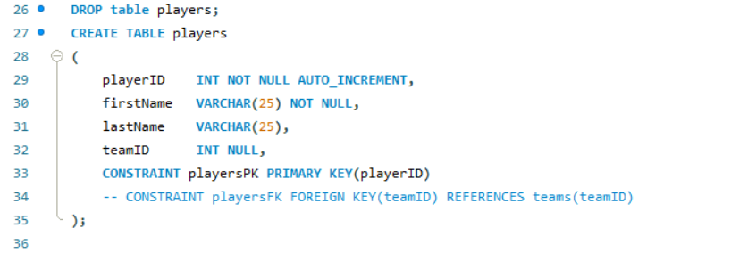
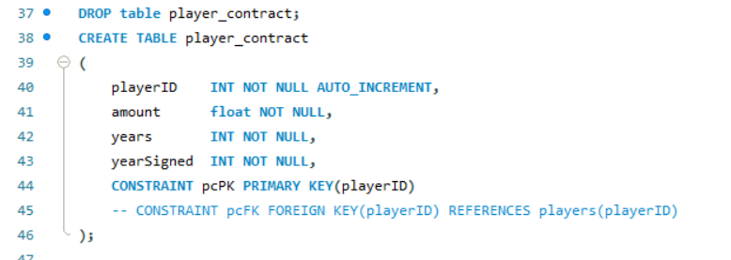
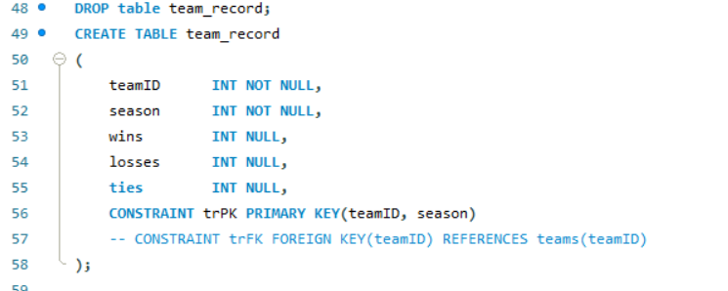
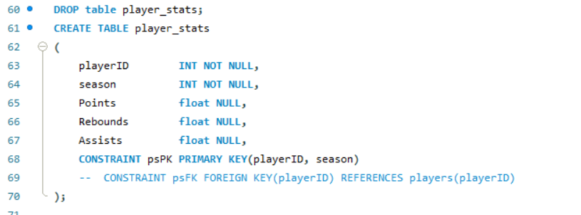
Results
Create tables for
Teams
Players
Player contract
Team record
Player stats

Slide 9
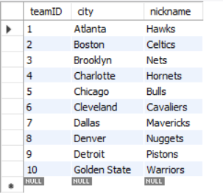
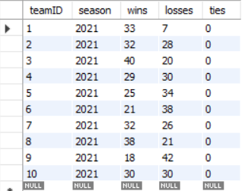
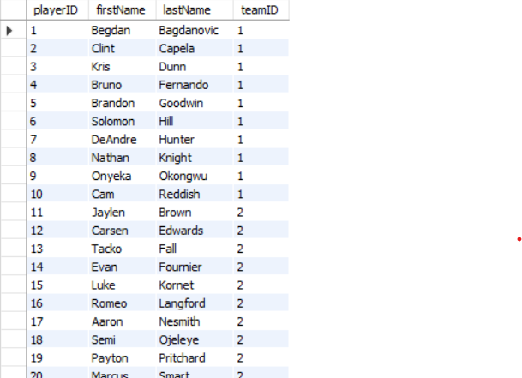
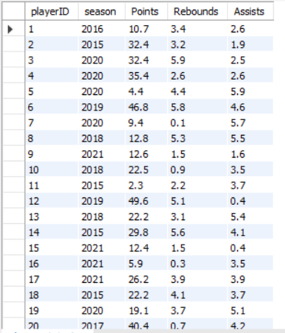
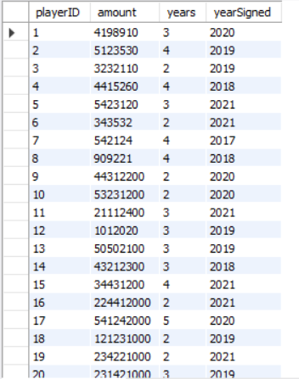
Insert
Insert data to the tables.

Slide 10
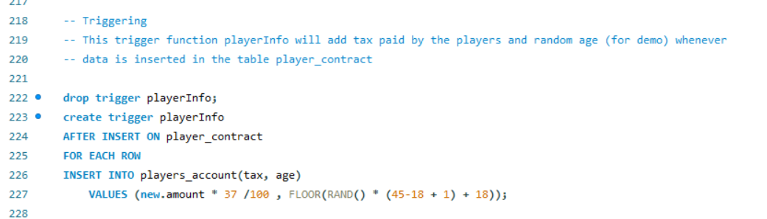
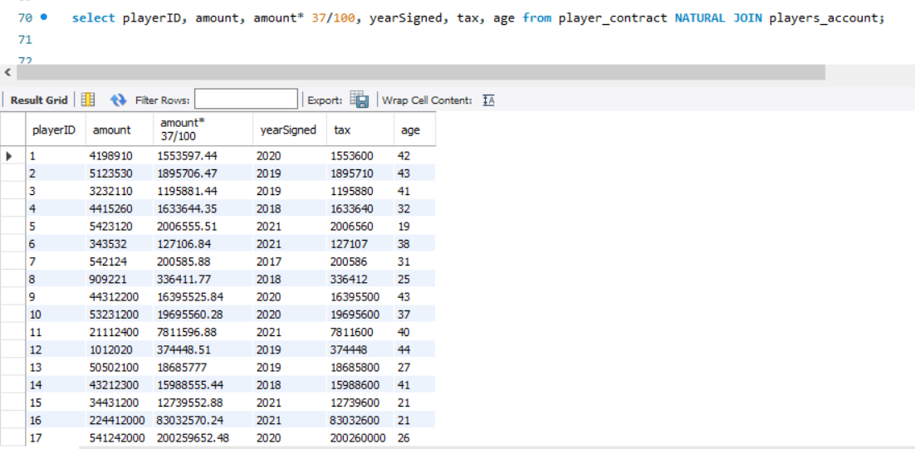
Trigger
Trigger function helped to reduce extra work to create a new table for player's account.
When data for player's contract was inserted, the tax paid by the players was automatically calculated and was inserted into the table player's account.

Slide 11
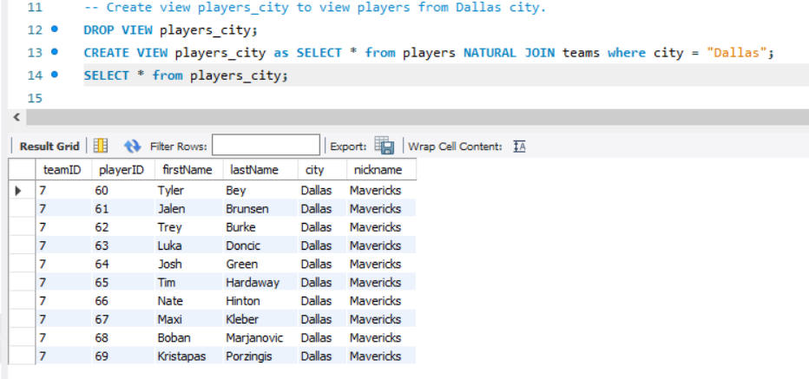
Views
Views makes a new table with custom queries and can be reused to create new relations.

Slide 12
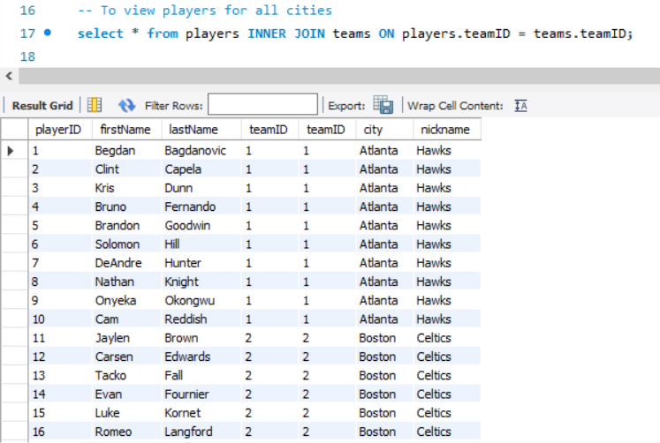
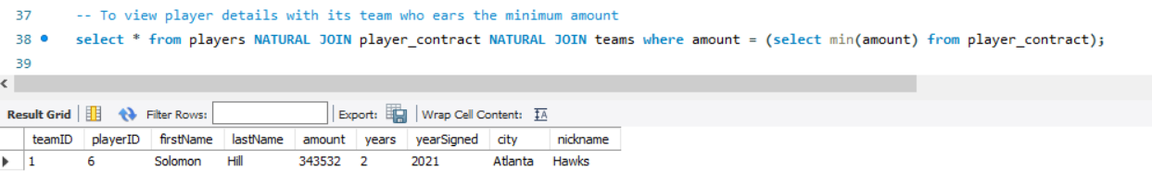
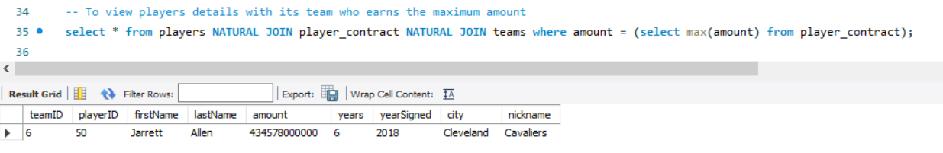
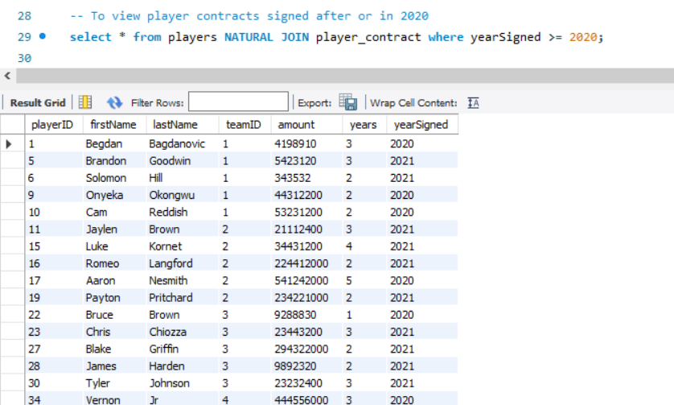
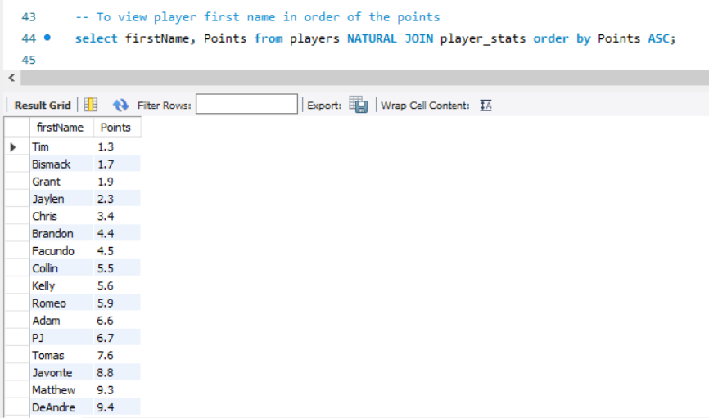
Joins and built-in methods

Slide 13
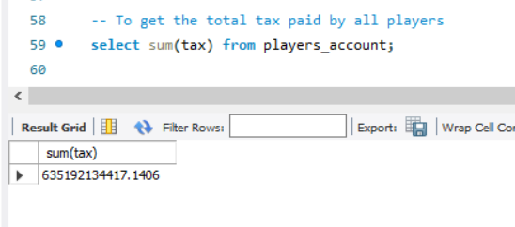
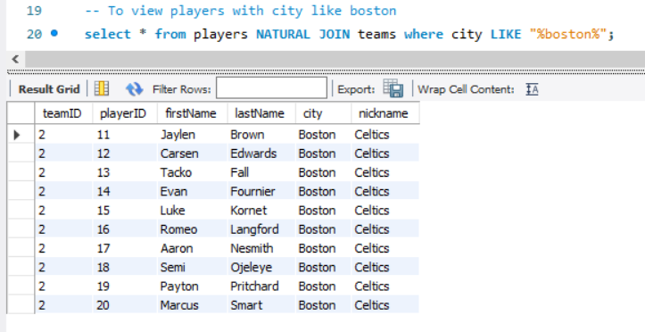
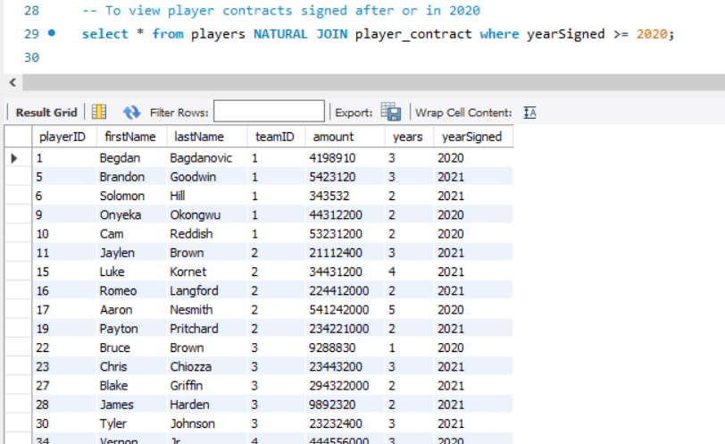
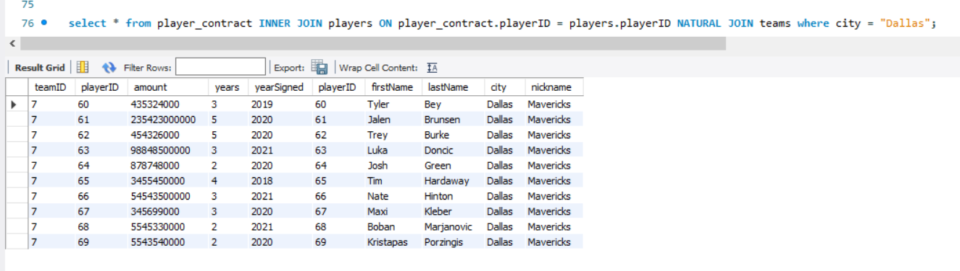
Built in methods
Order by
Like
where
> < =
Sum
Max
Min

Slide 14
Conclusion
How using a database like ours helps in sports science.
Strengths of our database. (The data and the functions)
Everything has a weakness. (Limitation of analytics)
What we left out
Future Updates

Slide 15
Databases in Sports Science
Database that have tools to capture, store, manage, and retrieve information and have potential to be one of the most powerful tools in sports science.
We have tried to replicate some of that by using functions like: views, where, join, order by, sum, and many others.
There are many parts in sports where people could implement our model, an interesting possibility would be for athletes competing in judged sports like gymnastics or springboard diving

Slide 16
What we did and what we missed
What we were focused on
What wasn't our priority
Integrity
Databases can help ensure that the data contained within them is accurate. We made our table with this in mind.
Access
Access is about making data available to users. This was our main priority.
Redundancy Clearing
As every attribute was unique it wasn't necessary to check for redundant elements.
Indexing
We used primary keys to do lookups, as everything in our database had unique attributes, implementing indexing wasn’t a priority.

Slide 17
Future Updates
Iterative Refinement
Our community breeds innovation, experimentation, and shared learning, which leads to applying and adopting the best practices across multiple teams. This enables us to keep our system up-to-date with modern needs
Protecting sensitive data
By ensuring safe and compliant for developing and testing we can minimize the risk and increase trust in our database support system

Slide 18
Questions?

