Slide 1
ABSTRACTIVE SUMMARISATION OF TWEETS
HARDEEP SINGH ARORA – MT2022047

Slide 2
CONTENTS:
Data Acquisition
Pre-Processing
Data Preparation
Dataset
Finetuning Pre-trained model
Evaluation

Slide 3
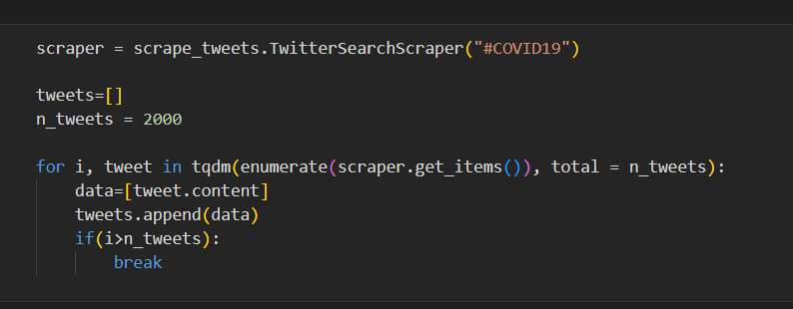
DATA ACQUISITION
Data scraping using Snscraper

Slide 4
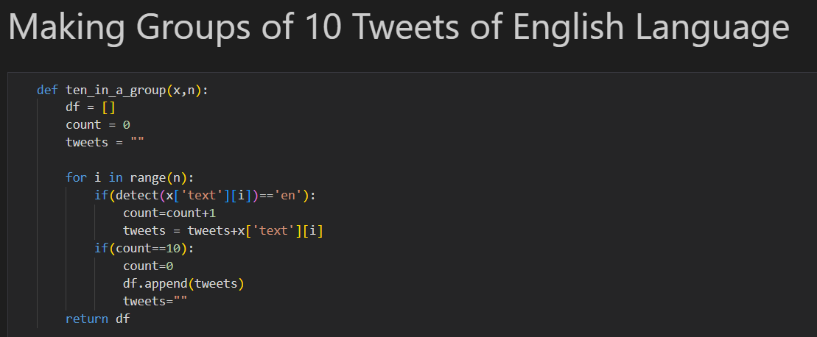
PRE-PROCESSING

Slide 5
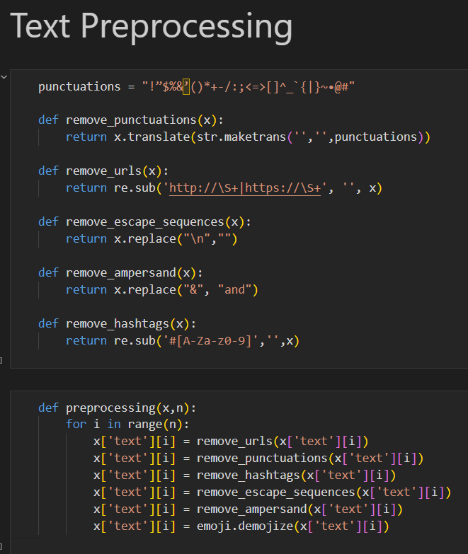
PRE-PROCESSING

Slide 6
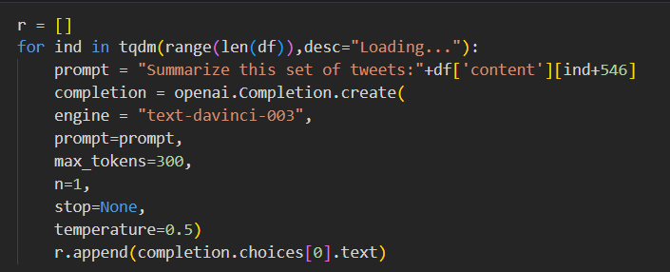
DATA PREPARATION
Generating summary using Chat-GPT API

Slide 7
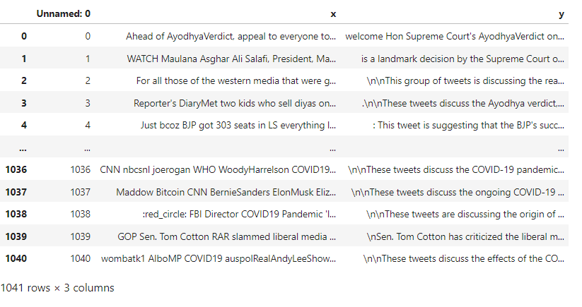
DATASET
Prepared dataset:-
X:- Source text
Y:- summary

Slide 8
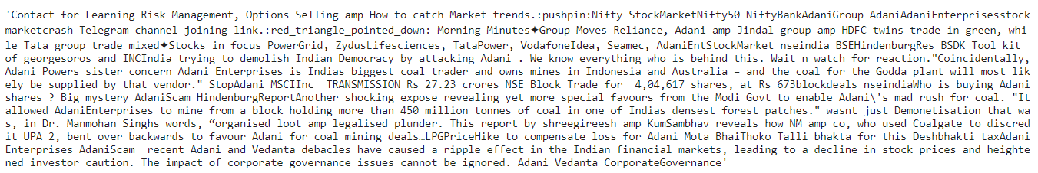
DATASET
Group of 10 tweets
Summary

Slide 9
FINE TUNING PEGASUS MODEL
Model used:- google/pegasus-cnn_dailymail (transformer based model)
The dataset of 1041 rows with text and their summary was split into training and test (10%).
Trained the model on the training set (936 rows) for 10 epochs and 20 epochs.

Slide 10



EVALUATION
Before Fine-Tuning
After Fine-Tuning (10 epochs)
After Fine-Tuning (20 epochs)

