Slide 1
CODING WITH STRUCTURED TEXT
CODESYS
Onur Ümit Şener
2006102010

Slide 2
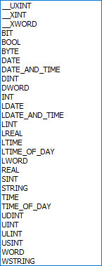
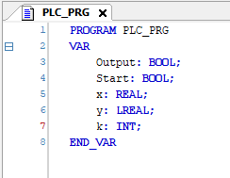
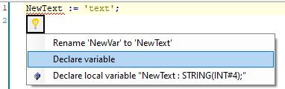
Declaring Variables
You can declare variables by just typing into the top window in your program.
Another option is to write the variable in your code and auto-declare it by pressing SHIFT+F2 or clicking to the troubleshooting icon
Available Data Types

Slide 3
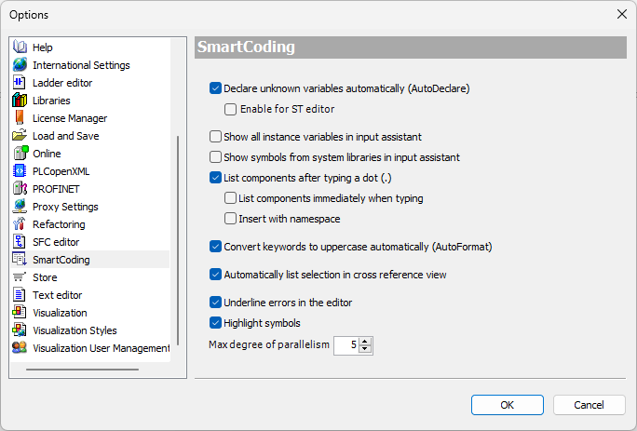
Enabling AutoDeclare
This option allows us to declare variables on the go while coding.
Pressing ENTER or losing focus on current line triggers AutoDeclare window to pop up.

Slide 4
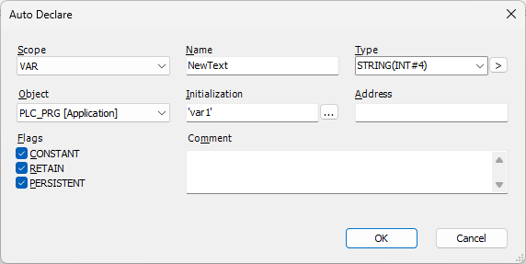

AutoDeclare Window
Variable Scope: Input, Temp, Global etc
Variable Name: How you call the variable
Variable Type: Int, Real, String, Bool etc
Initial Value: How the variable exist without an assignment
Flags: How your variable is stored and used
Variable Scope
Variable name
Variable type
Initial Value
Properties to select
Result of the declaration

Slide 5
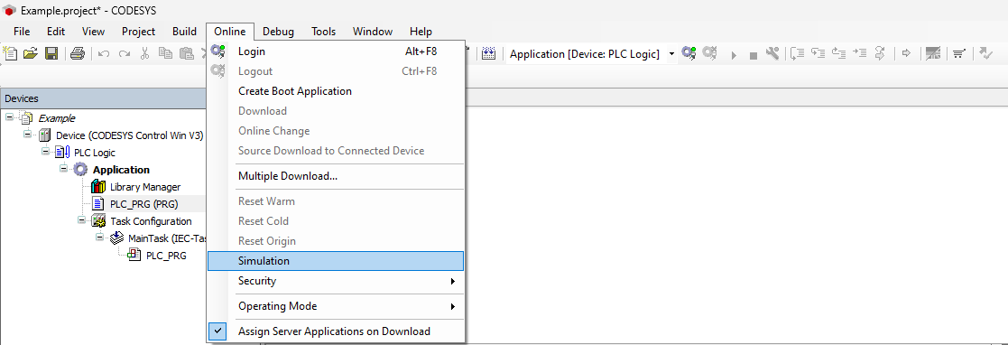
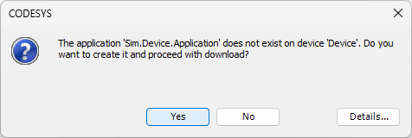
How to Simulate a Project
2
4
1
3

Slide 6
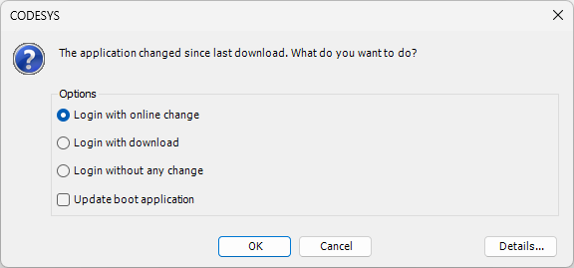
How to Apply Changed Code
Only update the changes
Reset everything in cache and update
Load the previously ran version

Slide 7
Assignments
VAR := NUM;
NUM => VAR;
VAR S= TRUE;
VAR R= TRUE;
Assigns Right to Left
Assigns output value Left to Right
Sets the variable
Resets the variable

Slide 8
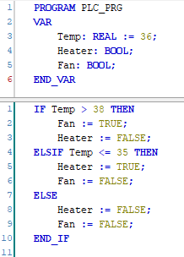
Basic If Condition
IF Temp > 38 THEN
Fan := TRUE;
Heater := FALSE;
ELSIF Temp <= 35 THEN
Heater := TRUE;
Fan := FALSE;
ELSE
Heater := FALSE;
Fan := FALSE;
END_IF

Slide 9
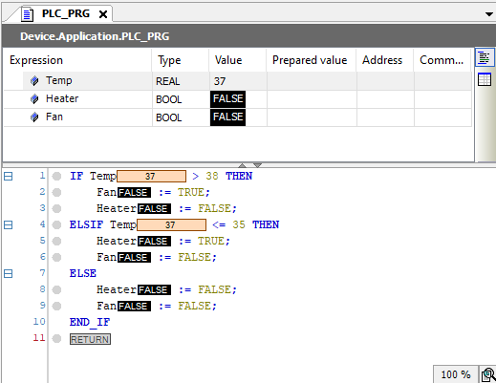
First Example
The PURPLE area marks the fields used to change variable values online.
By clicking the fields you can either type in a new value or cycle Boolean values.
After entering or choosing the new value, you can apply the new value by pressing CTRL+F7

Slide 10
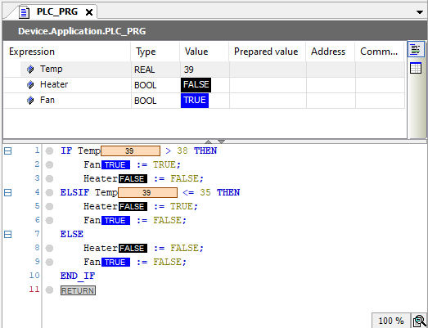
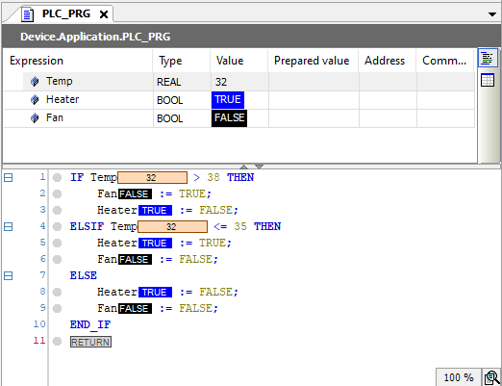
Other Conditions

Slide 11

Math Operations
$$\left(A+\frac{\left|B\right|}{\sin\left(c\right)}\right)∙\left(\arccos\left(D\right)+\log\left(E\right)\right)−4^{2}+\ln{ⅇ}$$
(A + ABS(B) / SIN(C)) * (ACOS(D) + LOG(E)) - EXPT(4,2) + LN(EXP(1))

Slide 12
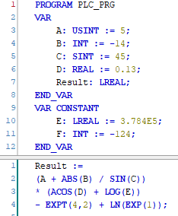
Math Operation Code

Slide 13
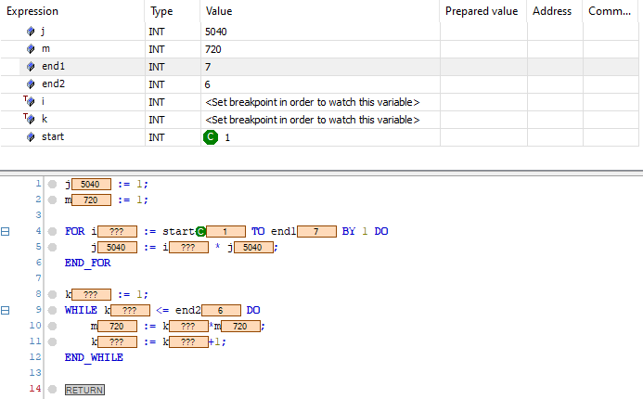
Loops
j := 1;
m := 1;
FOR i := start TO end1 BY 1 DO
j := i * j;
END_FOR
k := 1;
WHILE k <= end2 DO
m := k * m;
k := k + 1;
END_WHILE

Slide 14
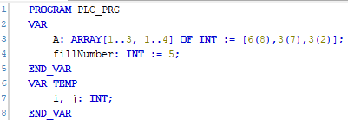

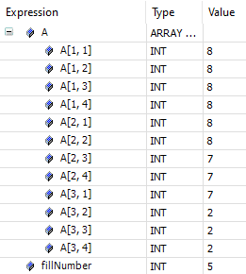
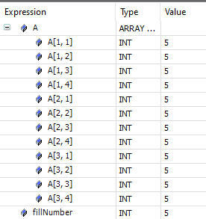
Arrays
Filling Array
with a Number
Array Initialisation
You can assign numbers on initialisation
And wipe/rewrite the elements on the run.

Slide 15
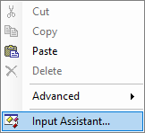
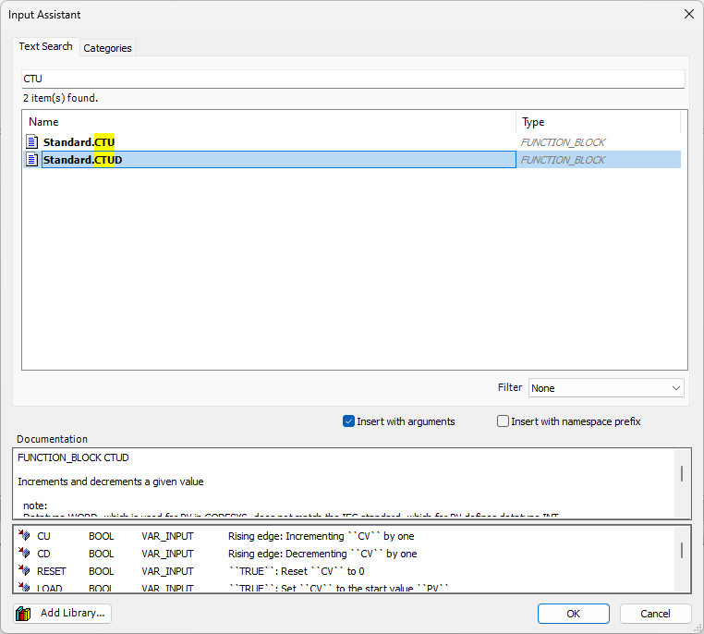
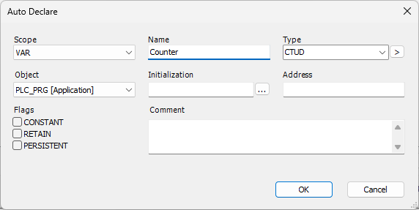
Adding Function Blocks
Search for the function
(even the math functions work)
Chose the function
RIGHT CLICK or F2 on the coding space and choose Input Assistant
Name your variable and fill the parameters on your code

Slide 16
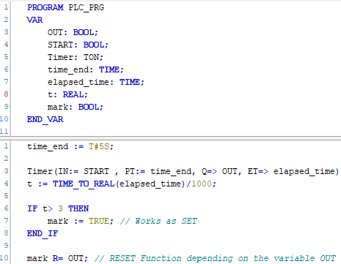
Timer Example
We can use timers in code.
By using the parameters, we can define the timer.
IN: Enabling signal for the timer - BOOL
PT: When the timer ends - TIME
Q: Output signal when the timer is done - BOOL
ET: Elapsed time - TIME

Slide 17
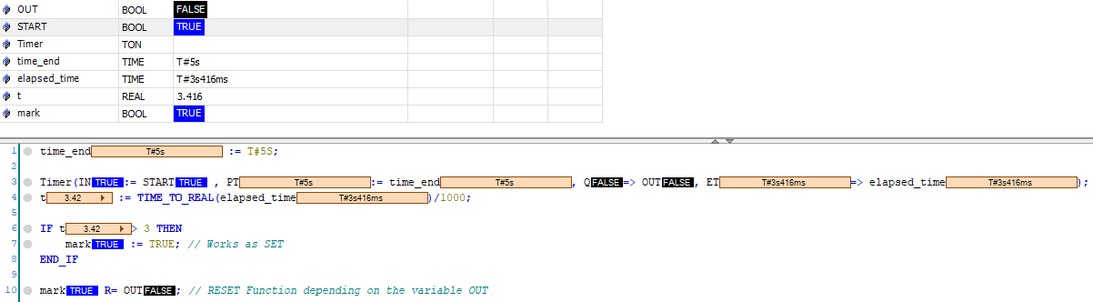
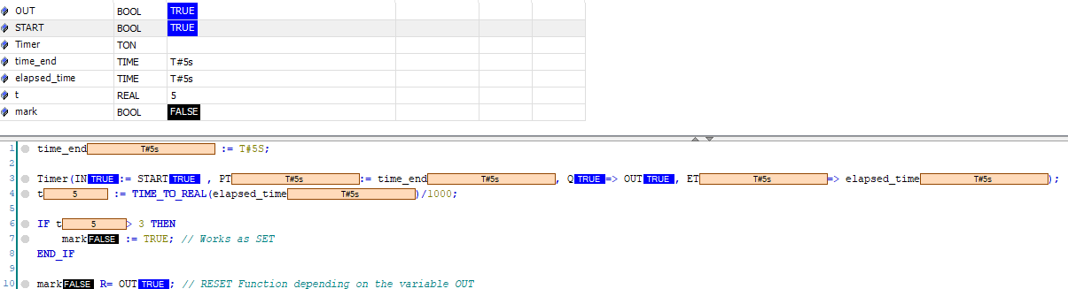
Conditions for t>3

Slide 18
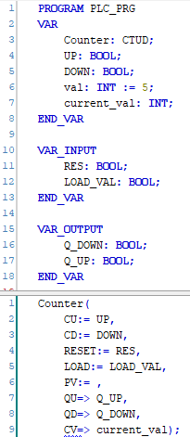
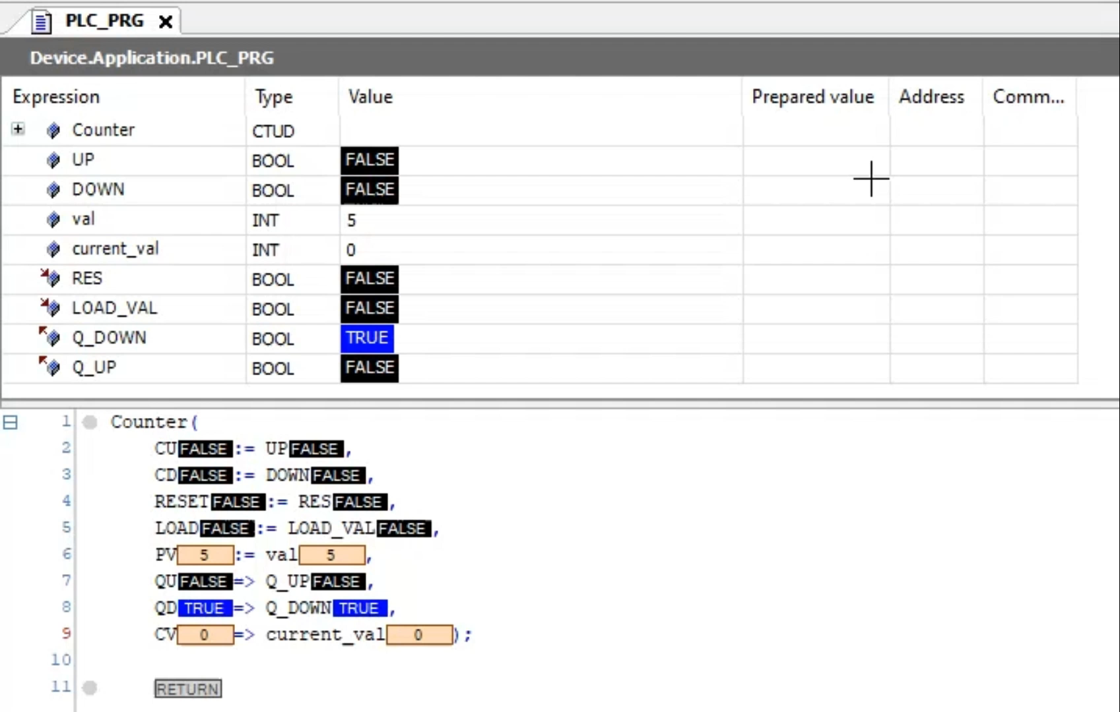
Counter Example

