Slide 1


Configure TLS Web Server
Tom Li (@biergaizi) <biergaizi@member.fsf.org>

Slide 2
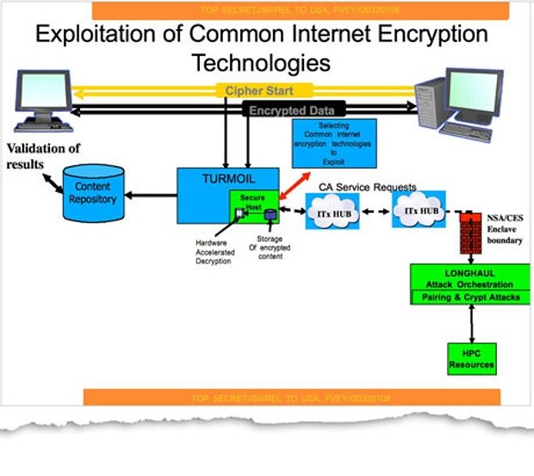

Slide 3

Enabling TLS is as easy as few lines?
server {
server_name example.com;
listen 10.0.0.1;
listen 10.0.0.1:443 ssl;
ssl_certificate example.crt;
ssl_certificate_key example.key;
ssl_protocols SSLv2 SSLv3 TLSv1;
ssl_ciphers HIGH;
}
Wow! Such TLS! Very Secure!

Slide 4

ssl_protocols SSLv2 SSLv3 TLSv1;
ssl_ciphers HIGH;
  Very HIGH Security
Does it really works?
No, compatibility is not a valid reason.

Slide 5
ssl_protocols SSLv2 SSLv3 TLSv1 TLSv1.1 TLSv1.2;
Why?
  POODLE Attack (CVE-2014-3566)
  SSLv2 is dead, SSLv3 is insecure.
  TLSv1.2 is the only version without known bug, but v1.0 and v1.1 are considered secure for web with workarounds & mitigations.
  SSL is dead, long live TLS. We should stop to use the term “SSL” for web encryption.

Slide 6
ssl_ciphers HIGH;
Why?
  Dispute its name, not all of “HIGH” ciphers have a security level.
  But there are too many ciphers, let's start from the weakest cipher (but still acceptable) to the best cipher.
ssl_ciphers EXPORT;
  What! “EXPORT” ciphers?
    Are you from NSA?

Slide 7
ssl_ciphers DES-CBC3-SHA:RC4-SHA:RC4-MD5;
Why?
  It means during TLS connection, DES is used with CBC3 mode and SHA1 hash function.
  If you want to compatible with Windows XP with Internet Explorer 6, the only secure algorithm is 3DES.
  Although there is no efficient attacks of mass destruction for RC4, Practical attacks are exist for an ATP attackers.

Slide 8
Mode of Operation
  Encryption algorithms are designed to encrypt a single block. Mode of operation encodes data to multiple blocks.
  Example of common modes in cryptography are ECB (insecure, explanation), CBC and GCM.
Hash Function
  Although data is encrypted, it still needs to be verified to prevent unwanted modification. Using RSA to sign encrypted data is possible but slow, a hash function is used (in certain ways) instead.

Slide 9
ssl_ciphers AES256-SHA256:AES128-SHA256:AES256-SHA:AES128-SHA:DES-CBC3-SHA:RC4-SHA:RC4-MD5;
Why?
  AES is included, prefer AES256 over AES128.
  Prefer SHA256 over SHA1.
  Both SHA256 and AES256 improve security, but SHA256 > AES256. Since hash collusion is a larger threat.
  The rest of slides will keep this pattern, however, some people think AES256 is a waste of CPU and more vulnerable to timing attack. You can Interchange them by you own.

Slide 10
ssl_ciphers AES256-GCM-SHA384:AES128-GCM-SHA256:AES256-SHA256:AES128-SHA256:AES256-SHA:AES128-SHA:DES-CBC3-SHA:RC4-SHA:RC4-MD5;
Why?
  GCM mode is included, prefer GCM.
  In CBC mode of operation, A Initialization Vector (IV) is used for encryption; A HMAC function is used separately for verification, which is the target of some previous attacks.
  In GCM mode, verification and encryption are combined, reduces the attack surface.

Slide 11
Attack CBC mode, or why did RC4 survive.
  BEAST Attack (CVE-2011-3389)
    Attack to CBC mode, allows a MITM attacker to recover plaintext, by encrypting the same message multiple times.
    Fixed in TLSv1.1. Patched by 1/n-1 split mitigation in modern broswers.
    What? BEAST Attack? Let's use RC4! Or you may use it with SSLv3?
  Lucky13 Attack
    Attack to Padding Checks of CBC mode implementations, attackers are able to decrypt ciphertext. Patched.
Why do we still have RC4? It became lesser evil since it's a stream cipher.

Slide 12
Attack CBC mode, or why did RC4 survive.
  BEAST Attack (CVE-2011-3389)
  Lucky13 Attack
    Attack to Padding Checks
Why do we still have RC4? It became lesser evil since it's a stream cipher.
But a new flaw was targeted to stream ciphers
  HTTPS Bicycle Attack
    No known solution

Slide 13
ssl_ciphers ECDHE-RSA-AES256-SHA384:ECDHE-RSA-AES128-SHA256:DHE-RSA-AES256-SHA256:DHE-RSA-AES128-SHA256:ECDHE-RSA-AES256-SHA:DHE-RSA-AES128-SHA:AES256-GCM-SHA384:AES128-GCM-SHA256:[...]
Why?
  Perfect Forward Secrecy is used.
  Oops, no GCM, but Perfect Forward Secrecy is our first priority. PFS > AES256 > SHA256.
  ECDHE is as safe as DHE, Prefer ECDHE for better performance. But some people don't like ECDHE because of a magic number in NIST standard, or a possible backdoor from NSA. Feel free to tweak it.

Slide 14
Perfect Forward Secrecy
  In non-PFS connections, certificate signing and symmetric key (AES or 3DES) encryption is create by the same pair of RSA keys!
  If the private key is lost, all previous connections are able to be decrypted by attackers.
  “Even if you are offering Perfect Forward Secrecy, very few clients will take advantages.” - Ladar Levison, Lavabit

Slide 15


Slide 16
Perfect Forward Secrecy
  In PFS connections, RSA is only used for signing, a safe one-time key (Ephemeral) exchange is performed by Diffie–Hellman (DH), or Elliptic curve Diffie–Hellman (ECDH).
Don't be confused with the name, Letter E in DHE or ECDHE stand for Ephemeral. Plain DH / ECDH use the same key, without no PFS.

Slide 17
Logjam Attack
  There are two DHE public parameters, p and g are shared during the key exchange. g is the prime base, g = 2 for most of the time, p is a prime modulus. p and g specify a group, a random key is picked up from this group each time.
  DHE is a discrete logarithm algorithm, like RSA, p should have at least 2048 bits.
  They are public, like a public key. But, millions of servers use the same hardcoded 1024-bit p, if this group is cracked, millions of servers are vulnerable.

Slide 18
Generate our own DHE paramater
  $ openssl dhparam 2048 -out example.dhparam
  Generating DH parameters, 2048 bit long safe prime, generator 2
  ssl_dhparam example.dhparam;
“generator 2” means g = 2. You can use command line argument -5 to make g = 5, but there is no reason to do it and has performance impact.
Generation takes lots of time.
ECDHE is not vulnerable to Logjam Attack.

Slide 19
Compatibility
  Java 6 does not support dhparam greater than 1024-bit.
    It supports ECDHE but not useful, because Java 6 prefers DHE and plain RSA over ECDHE.
  Java 7 does not support dhparam greater than 2048-bit.
  Java 8 support 4096-bit dhparam.

Slide 20
ECDHE-ECDSA
  both RSA and ECDSA are signing algorithms. We can replace RSA with ECDSA.
  ECDSA requires a ECDSA-based certificate.
  You need to add ECDHE-ECDSA ciphers to the list.
  Only ECDHE is used for key exchange, DHE is not used.
  No dhparam is needed, no Logjam Attack.
  Some people still don't trust ECC-based algorithm.

Slide 21
ssl_ciphers ECDHE-RSA-AES256-GCM-SHA384:ECDHE-RSA-AES128-GCM-SHA256:DHE-RSA-AES256-GCM-SHA384:DHE-RSA-AES128-GCM-SHA256:ECDHE-RSA-AES256-SHA384:ECDHE-RSA-AES128-SHA256:[...]
Why?
  Perfect Forward Secrecy and GCM is used.
  ECDHE + AES256 + GCM + SHA384/256 is the most secure combination. But if you don't trust ECDHE, feel free to tweak it.
  DHE + AES256/128 + GCM + SHA384 is as secure as ECDHE, but slower.

Slide 22
ssl_prefer_server_ciphers on;
Why?
  Make sure clients respect the order of list from the server.

Slide 23
ssl_ciphers [...]:!aNULL:!eNULL:!EXPORT:!RC4:!MD5:!PSK:!aECDH;
Why?
  aNULL and eNULL provide zero security.
  EXPORT is designed to make sure NSA cracks it easily, for exporting from the United States
  RC4, MD5 are weak.
  PSK is not useful for the web.
  aECDH is anonymous, provide no authentication

Slide 24
Finally.
ssl_ciphers ECDHE-RSA-AES256-GCM-SHA384:ECDHE-RSA-AES128-GCM-SHA256:DHE-RSA-AES256-GCM-SHA384:DHE-RSA-AES128-GCM-SHA256::ECDHE-RSA-AES256-SHA384:ECDHE-RSA-AES128-SHA256:DHE-RSA-AES256-SHA256:DHE-RSA-AES128-SHA256:ECDHE-RSA-AES256-SHA:DHE-RSA-AES128-SHA::AES256-GCM-SHA384:AES128-GCM-SHA256:AES256-SHA256:AES128-SHA256:AES256-SHA:AES128-SHA:DES-CBC3-SHA:!aNULL:!eNULL:!EXPORT:!RC4:!MD5:!PSK:!aECDH;
ssl_prefer_server_ciphers on;

Slide 25
Or you may use
ssl_ciphers EECDH+CHACHA20:EECDH+AES128:RSA+AES128:EECDH+AES256:RSA+AES256:EECDH+3DES:RSA+3DES:!MD5;

Slide 26
SSLCompression off (Apache)
Why?
  CRIME Attack (CVE-2012-4929)
    Attack to TLS Compression (not HTTP compression). Information leakage that occurs when data is compressed prior to encryption.
  BEAST Attack
    Improved CRIME Attack.
Most webservers don't support TLS Compression, or removed TLS Compression after CRIME and BEAST attacks.
Refers your server documentation if you are not sure.

Slide 27
SSLInsecureRenegotiation off (Apache)
Why?
  Insecure renegotiation is dangerous because it is easy to exploit and has effects similar to Cross-Site Request Forgery (CSRF) and, in some cases, Cross-Site Scripting (XSS).
  Patched to disable in many servers.

Slide 28
ssl_session_timeout 5m; # 5 minutes
ssl_session_cache shared:SSL:5m; # 5 MiB
ssl_session_tickets off;
ssl_session_ticket_key generated.key;
Why?
  ssl_session_cache caches a TLS session, which avoid extra handshakes. However, the cache will not be properly cleared after expiration.
  ssl_session_tickets_key is even “better”, it uses a ticket for clients to restore a session at any time (stateless), encrypted by AES-128-CBC and the key is permanent: generated during startup, or fixed by ssl_session_tickets_key.

Slide 29
ssl_session_timeout 5m; # 5 minutes
ssl_session_cache shared:SSL:5m; # 5 MiB
ssl_session_tickets off;
ssl_session_ticket_key generated.key;
Why?
  Perfect Forward Secrecy ciphers are useless! And if tickets are used, AES-256 ciphers are useless!
  If attackers can compromise the running server to get keys from memory, any key won't be safe. Thus ssl_session_cache is probably okay.
  ssl_session_tickets are permanent keys, don't use unless you can rotate keys frequently and correctly.
  Watch out! We have no idea if 5 megabytes for cache is appropriate, after all, don't make it too big...

Slide 30
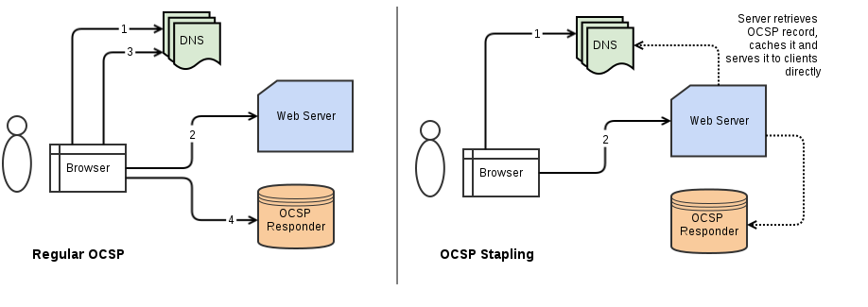
ssl_stapling on;
ssl_stapling_verify on; ssl_trusted_certificate chain.crt;
resolver 127.0.0.1;
Why?
  OCSP is inefficient and has potential security and privacy issues.

Slide 31
if ($server_port ~ "^80$") {
rewrite ^/(.*) https://example.com/$1 permanent;
}
Why?
  TLS/HTTPS must be enforced.
add_header Strict-Transport-Security "max-age=31536000;" always;
Why?
  When access a website, HTTP Strict Transport Security tells browsers to always use TLS to connect the server. This policy will be stored to by browsers.
  If the certificate on the server is invalid, browsers won't allow users to add a exception.

Slide 32
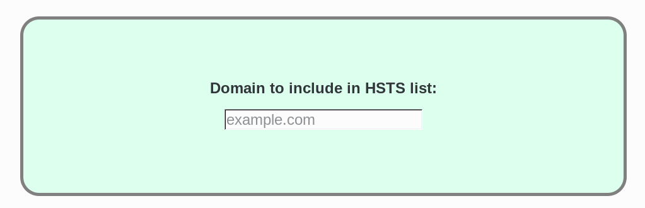
add_header Strict-Transport-Security "max-age=31536000; includeSubdomains; preload" always;
Why?
  includeSubdomains secures all subdomains.
  HSTS only works after the first access of your website, but your website can be preloaded to the default HSTS lists of Chromium, Firefox, Internet Explorer, Tor Browser, etc.
  https://hstspreload.appspot.com/ (GFWed)

Slide 33
add_header Public-Key-Pins
"pin-sha256='X3pGTSOuJeEVw989IJ/cEtXUEmy52zs1TZQrU06KUKg=';
pin-sha256='MHJYVThihUrJcxW6wcqyOISTXIsInsdj3xK8QrZbHec='; includeSubdomains; max-age=31536000" always;
Why / Why not?
  HTTP Public Key Pinning tells browsers which public key is trusted. Protect you from CA rogues.
  First key is used on the server, second key is used for backup and generate a new certificate.
  Public keys hashes can be generated from CRT or CSR.
  If you lost both keys, browsers will refuse to access your website.
  Alternatively, you can pin your CA's key if you trust them!

Slide 34
listen 10.0.0.1:443 spdy ssl;
listen 10.0.0.1:443 http2 ssl;
Why?
  SDPY was a great improvement to HTTP/1.1, and it's the prior draft of the next generation of HTTP. It's obsolete now, since nearly all modern browser supports HTTP/2.
  Nginx never support SDPYv4, potential security vulnerabilities may exist SDPYv3. Although TLS Compression is not one of them.
  HTTP/2 provides an overall improvement to HTTP, the improvements make encrypted HTTP/2 web applications almost as fast as unencrypted HTTP/1.1.

Slide 35
What Certificate to Purchase?
Domain Validation: no paper work
Organization Validation
Extended Validation: green bar
Domains: www or not? It's a question.
  What about multiple domains or wildcard?
Assurance: $$$$$$$$$
128-bit / 256-bit / 4096-bit?

Slide 36
Which CA?
Without CA (self-signed)
  12306
CNNIC
Be your own CA?
  盖子CA
Community CA
  CACert
  Let's Encrypt
Commerical CA

Slide 37
CA Requirements
Security posture
market share
Business focus
Services offered
  CRL & OCSP are required
Support

Slide 38
Key Generation
RSA-2048 / ECDSA-256
  RSA-1024 with free cloud backup service from NSA!
Protect your private key.
Replace your key every year.
Revoke all certificate if something happens...
  CA with Free Revocation
SHA256

Slide 39
CSR in, CRT out
openssl genrsa -out exp.key 2048
openssl req -new -sha256 -key exp.key -out exp.csr
openssl ecparam -out exp.key -name prime256v1 -genkey
openssl req -new -sha256 -key exp.key -nodes -out exp.csr
Send CSR to a CA

Slide 40
Thanks!
while (availtime() >= 0) {
Question *q = question_queue_get();
for (size_t i = 0; i < ANSWERS_LEN; i++) {
if (matches(question, answers[i])) {
return answers[i];
}
}
return NULL;
}
return NULL;

