Slide 1



HARDIANTO TANDI SENO
FUTURE ML ENGINEER
Make Neural Style Transfer (NST) model
https://github.com/hardiantots/nst_projectHTS.git
Hardianto Tandi Seno
hardiantotandiseno@gmail.com

Slide 2
1
What is NST ?
Content
2
NST Workflow
Neural Style Transfer Model
3
Implementation in PyTorch
4
Conclusion

Slide 3
What is NST?
Neural Style Transfer (NST) is a technique for combining the style of an image with content from another image using an artificial neural network. NST allows us to transfer art styles from one image to another in a very realistic way.

Slide 4
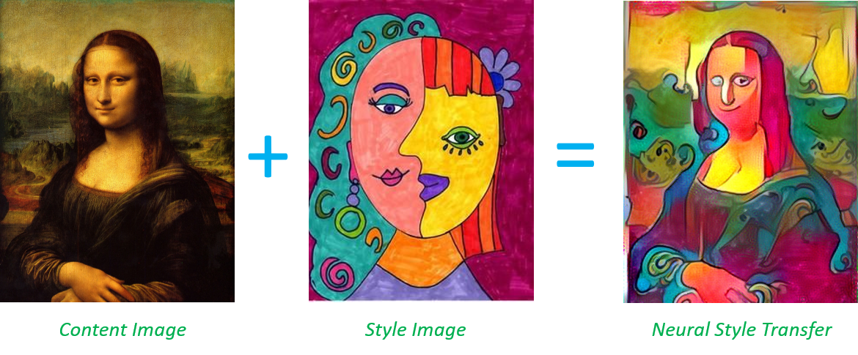
NST involves two images, namely a style image and a content image. The style image is the image that contains the art style we want to apply, while the content image is the image to which we want to apply the style. NST then generates an image that has the content from the content image and the style from the style image.

Slide 5


NST Workflow
Preparation
Feature Extraction
Loss Computation
Optimization
Output
Setting up image styles and content images
Use CNN to extract features from images
Compute content loss and style loss, and combine them to total loss
Adjusts the output image to minimize the calculated total loss
The output result is an image that has content from the style image & content image

Slide 6
Implementation NST Model in Pytorch

Slide 7
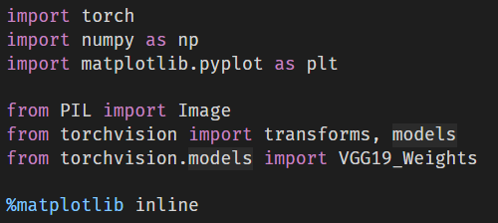
Implementation NST Model in Pytorch
1. Import all package that needed

Slide 8
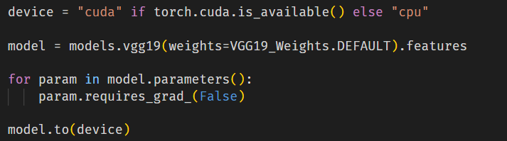
Implementation NST Model in Pytorch
2. Load VGG19 Model from PyTorch
Choosing VGG19 model because this model has faster training speed, fewer training samples per time, and higher accuracy. Additionally, many are using VGG19 to perform NST methods

Slide 9
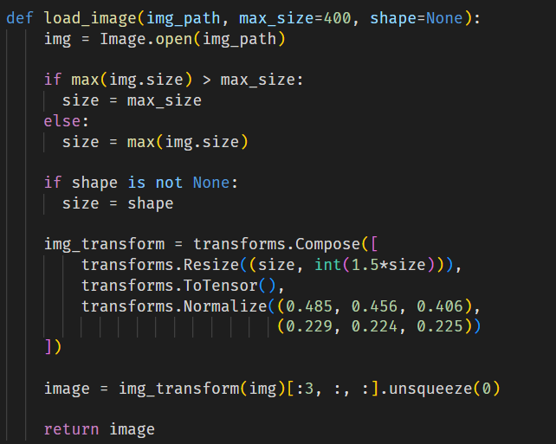
Implementation NST Model in Pytorch
3. Make Function to read and processing Content & Style Image
There are function load_image() for load image using PIL Library and processing image using torchvision.transforms

Slide 10
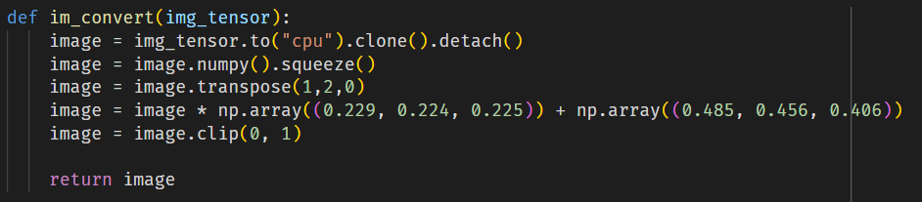
Implementation NST Model in Pytorch
4. Displaying Content & Style Image
To show the Content & Style Image, we must make function (im_convert()) to convert the result of processing image back to numpy array for show the image

Slide 11
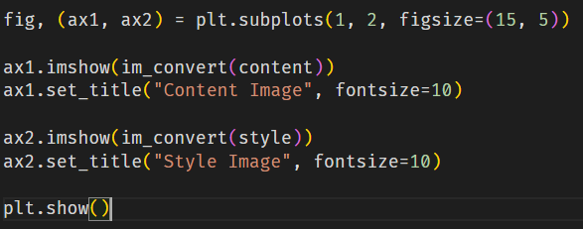
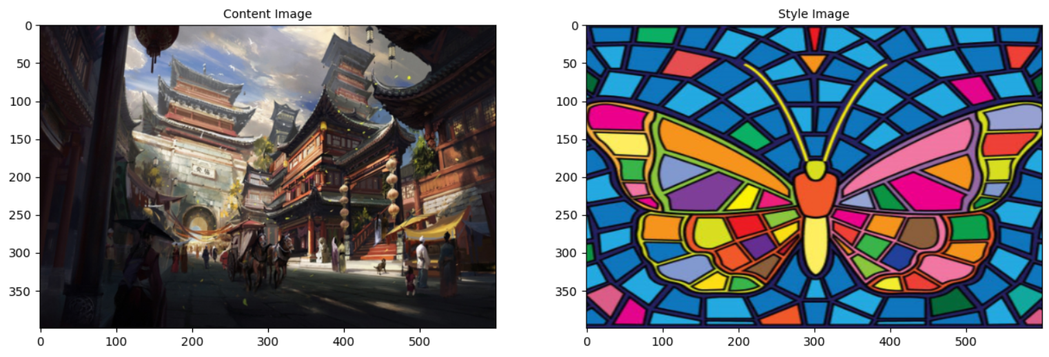
And then we can show the image with using matplotlib library

Slide 12
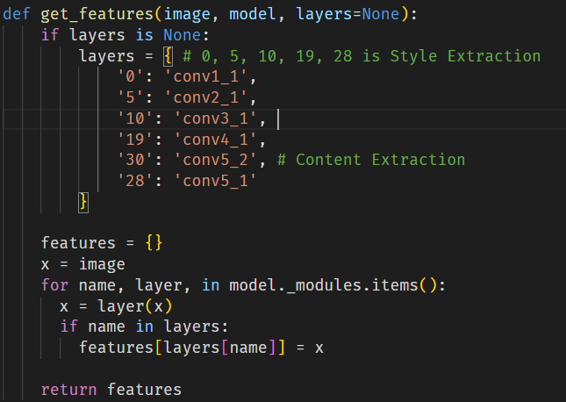
Implementation NST Model in Pytorch
5. Set the intermediate layers for Content & Style
The function performs a forward pass through the model, one layer at a time, and stores the feature map responses if the name of the layer matches one of the keys in the predefined layer dict. This dict serves as a mapping from the Pytorch VGG19 implementation's layer indices to the layer names defined in the paper. If no layers are specified, we'll use a complete set of both the content layer and the layer style as a default.

Slide 13
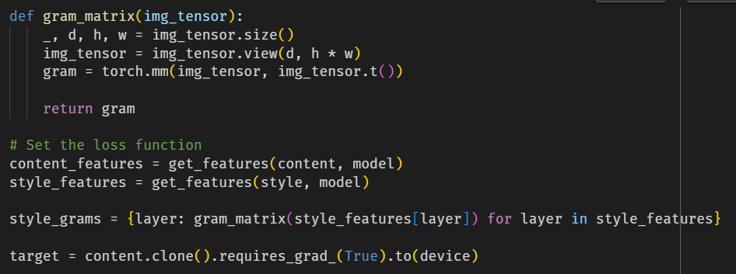
Implementation NST Model in Pytorch
6. Set the Loss Function & Assign the weights
Make the function gram_matrix() for calculate the gram matrices for each layer. Start by cloning the content image and then iteratively change its style.

Slide 14
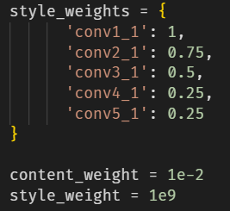
Weights are assigned to each style layer. Weight the previous layer with a higher number to get a bigger style artefact. In addition, weights are given for the overall strength of the two individual loss terms (content and style image).
The loss function look in content loss (Mean Square Error between two feature map responses of the target image and the content image.) & style loss (Similar like content loss, replacing the feature map response by the Grams matrix and also dividing the mean squared error by the total number of elements in each feature map.). Implementation of this in the next slide

Slide 15
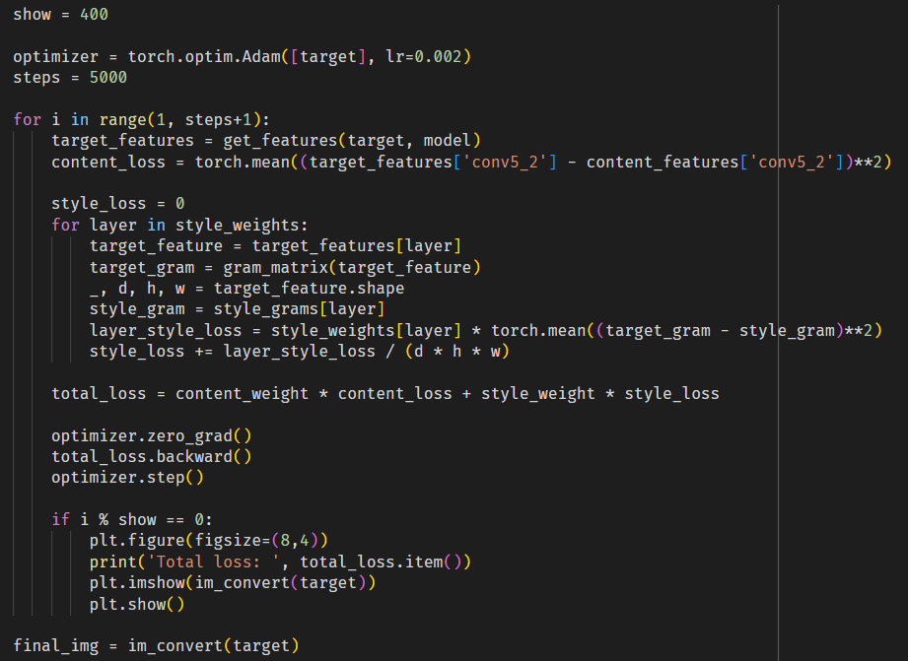
Implementation NST Model in Pytorch
7. Train & Optimize the Model
The optimizer used in the process of training this model is Adam Optimizer with Learning Rate 0.002 to decrease loss of model. Total iteration is set to 5000.
During the loop, call the feature from VGG and the content loss calculation process will be performed. Get a force representation to calculate the style loss. Then, calculate the total loss. After that, do the back-propagation step and update the image pixel value iteratively until it's finished.

Slide 16
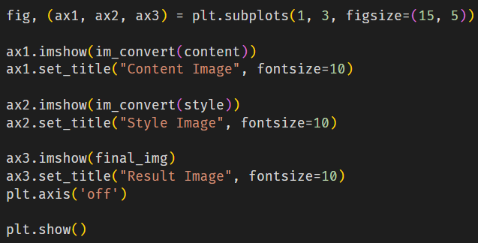
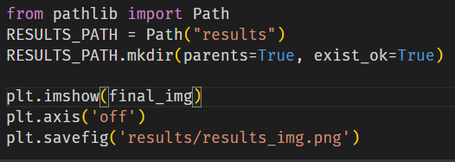
Implementation NST Model in Pytorch
8. Show the results & Save the image
After the training process on the model is done, we can display the results of combining the content & image styles.
In addition, the result of combining the content and style of the image can be saved with pathlib library to make new folder and matplotlib library for save image

Slide 17
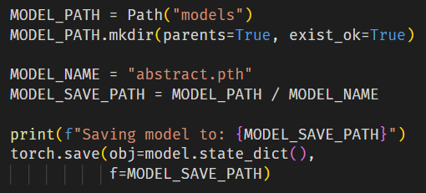
Implementation NST Model in Pytorch
9. Save the Model
We can also save the results of model training that has been done according to the image style used so that when we want to apply the style, we just have to load state_dict into the model.

Slide 18
Conclusion
From the various explanations and stages of implementing Neural Style Transfer on PyTorch, I can conclude that this NST has quite different implementation stages because there are stages for setting the intermediate layers, determining different loss functions, and also the process of training the model which calls the feature from VGG.
Apart from that, from implementing it on PyTorch, we can try to make style transfers with different image styles so that we can produce various styles that can be applied to the image content.
To see the completed code, can see in ipynb file in GitHub
https://github.com/hardiantots/nst_projectHTS.git

Slide 19
HARDIANTO TANDI SENO
FUTURE ML ENGINEER
Sorry if there are still deficiencies in it. I will try to continue to develop my skills so that I can be even better in the future.
Thank You
Hardianto Tandi Seno
hardiantotandiseno@gmail.com

