Slide 1
Marketing Campaign Performance Analysis
Data-Driven Insights & Strategic Recommendations
~HARDIK MUDGAL

Slide 2
Executive Summary
Analyzed 200,000+ marketing campaigns across 6 channels and 5 campaign types
Total Revenue Generated: $20.9B across 2021
Top Performing Channel: Google Ads ($8.14B revenue, highest ROI)
Top Campaign Type: Influencer ($8.07B revenue)

Slide 3
Key Findings: Channel Performance
Channel | Revenue | ROI | Insight
Google Ads | $8.14B | Highest | Best performer
Facebook | $4.60B | High | Strong secondary
YouTube | $2.96B | Medium | Growth potential
Instagram | $2.89B | Medium | Engagement driven
Email | $1.55B | Low | Cost efficient
Website | $0.75B | Lowest | Needs optimization

Slide 4
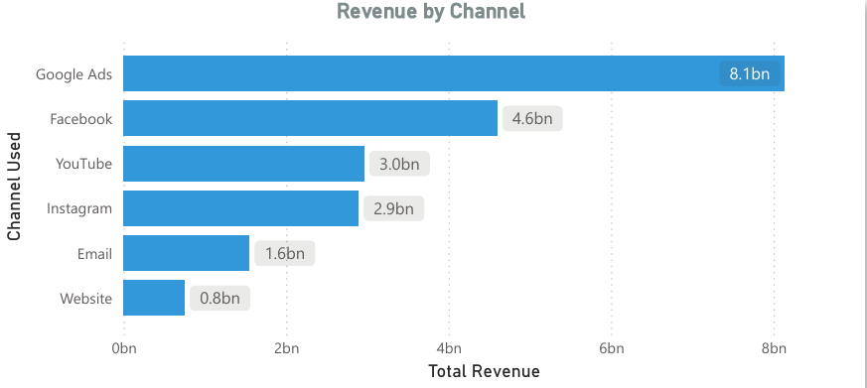

Slide 5
Key Findings: Seasonal Trends
Revenue dips significantly in Jan-Feb (post holiday slowdown)
Steady growth from March through October
Peak performance in November ($2.74B) and December ($3.12B) — Holiday season
August shows a mid-year spike — likely Back to School campaigns

Slide 6
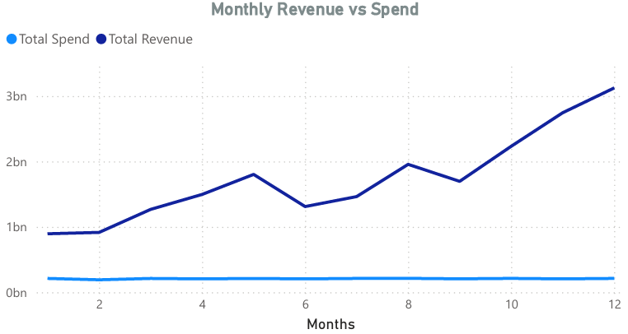

Slide 7
Key Findings: Customer Segments
Tech Enthusiasts drive the highest revenue ($6.70B)
Fashionistas are strong second ($5.19B)
Outdoor Adventurers significantly underperform ($2.09B)
Top 2 segments contribute 57% of total revenue

Slide 8
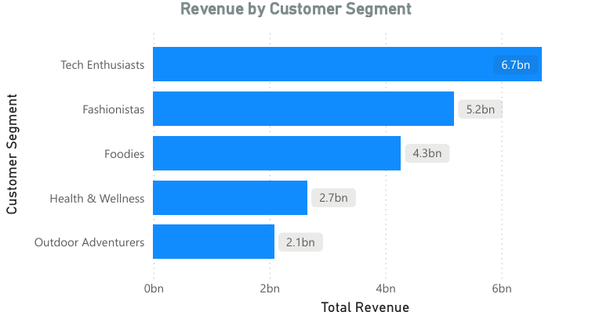

Slide 9
3 Strategic Recommendations
Recommendation 1: Double down on Google Ads + Influencer combo
Google Ads delivers highest ROI
Influencer campaigns drive highest revenue
Allocate 40% of budget to this combination
Recommendation 2: Capitalize on Holiday Seasonality
Nov-Dec generates 30% more revenue than average months
Plan campaigns 6-8 weeks in advance for Black Friday & Christmas
Reduce spend in Jan-Feb and reallocate to Q4
Recommendation 3: Re-engage Tech Enthusiasts & Fashionistas
These 2 segments drive 57% of revenue
Create dedicated campaigns targeting these segments via Google Ads
Use personalized influencer content for Fashionistas specifically

Slide 10
Expected Business Impact
Recommendation | Expected Revenue Lift | Timeline
Google Ads + Influencer focus | +15-20% ROI | Q1 2026
Holiday campaign planning | +25-30% Q4 Revenue | Q3-Q4 2026
Segment-focused targeting | +10-15% Conversion Rate | Q2 2026
Projected 20-25% overall revenue increase by end of 2026

Slide 11
THANK YOU
HARDIK MUDGAL
hardikmudgal7793@gmail.com
+91 8529165345

