Slide 1
Sentiment Analysis

Slide 2
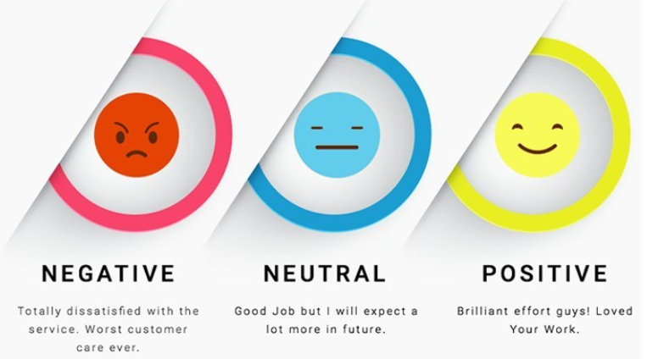
Introduction
Sentiment analysis is contextual mining of text which identifies and extracts subjective information in source material and helping a business to understand the sentiment of their brand, product or service while monitoring online conversations.
Source: KDNuggets

Slide 3
Problem Statement
The major challenge for businesses and organizations arise when they have to identify the pain areas of their end customers. Their views, sentiments and interest in a particular product can help companies identify product sales and its future growth. To understand those sentiments, we have come up with one such sentiment model and it works as: given a message, classify whether the message is of positive, negative, or neutral sentiment. For messages conveying both a positive and negative sentiment, whichever is the stronger sentiment should be chosen.

Slide 4
Domains
Social Media Monitoring:
Analyze tweets and/or Facebook posts over a period to detect sentiment of a particular audience
Monitor social media mentions of your brand and automatically categorize by urgency
Automatically route social media mentions to team members, best fit to respond
Gain deep insights into what’s happening across your social media channels
Market Research:
Analyze product reviews of your brand and compare those with the competition
Generate weekly, monthly, or daily reports – a sort of early-warning system
Compare sentiments across international markets
Analyze formal market reports or business journals for long-term, broader trends
Analyze tweets and social media posts for real-time happenings
Analyze reviews for unfiltered customer feedback
Customer Feedback:
Analyze aggregated NPS(Net Promoter Score) or other survey responses
Analyze aggregated customer support interactions
Track customer sentiment about specific aspects of the business over time. This adds depth to explain why the overall NPS score might have changed, or if specific aspects have shifted independently.
Target individuals to improve their service. By automatically running sentiment analysis on incoming surveys, you can detect customers who are ‘strongly negatively’ towards your product or service, so you can respond to them right away
Determine if particular customer segments feel more strongly about your company. You can zero in on sentiment by certain demographics, interests, personas, etc
Customer Service:
Automate text classification all incoming customer support queries
Rapidly detect disgruntled customers and surface those tickets to the top
Route queries to specific team members best suited to respond
Gain deep insights into your customer support

Slide 5
Motivation
Analysis and prediction of consumers and their behavior has always been a promising and blooming area of study with great value of research. If we see the existing methods in this field, sentimental analysis on textual context could be feasible especially in regarding with E-commerce.
Ecommerce markets have given an entirely new definition to how B2B or B2C models operate, much more differently than their traditional ways. The best part about their platform is the immediate feedback option (often referred to as rating and reviews section) wherein they know how their products performed, inspect the strengths and weaknesses of their products, anticipate the complaints, sales trend and even which sellers did good and who all are the culprit ones. In this use case I have tried to predict reviewers’ sentiments based on their review texts.

Slide 6
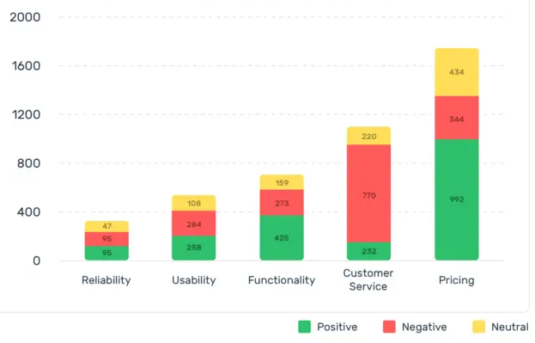
Parameters

Slide 7
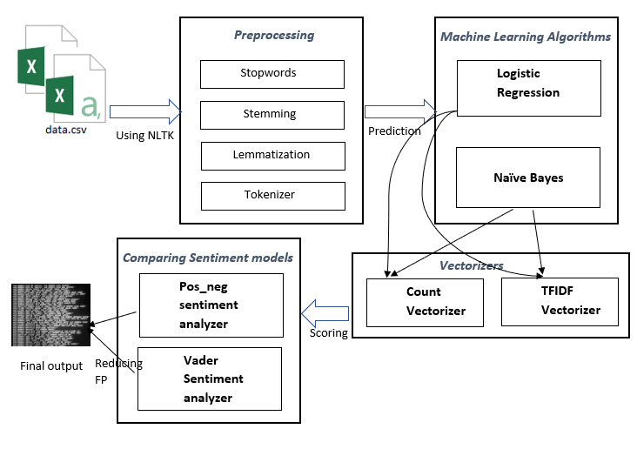
High Level Design

Slide 8
Technology Stack
Python: 3.7
Libraries used:
NumPy for numerical python calculations
pandas for dataframe related executions
seaborn for plotting specific graphs
matplotlib for plotting
datetime for datetime values
sklearn,.linear model for logistic regression
Sklearn.naive bayes for multinomial Naïve Bayes
Sklearn.model selection for cross validation and splitting
Sklearn.metrics for classification metrics
Sklearn.feature extraction.text for Vectorizers
Sklearn.pipeline for Tfidf vectorizers
Nltk (Natural Language Toolkit) for NLP
Wordcloud for generating word frequency
VaderSentiment for comparing sentiment models

Slide 9
Preprocessing
EDA (Exploratory Data Analysis) on train data and doing data munging, wrangling, cleansing on it.
Doing feature engineering and applying natural language processing techniques such as tokenizers, lemmatizers, stemmers and stopwords to process our raw data into a more meaningful information.
Understanding features:
reviewerID: Unique reviewer ID asin: Unique product ID summary: Title of review reviewText: written review overall: Rating 1-5 stars reviewerID: Reviewer ID reviewerName: Person’s name helpful: Helpfulness rating of review reviewTime: YYYY-MM-DD unixReviewTime: Time of the review(unix time) pos_neg: 1) Positive for 4-5 or 2) Negative for 1-3

Slide 10
Algorithms available in market to solve this problem
Logistic Regression
Naïve Bayes
Random Forest
SVM(Support Vector Machines)

Slide 11
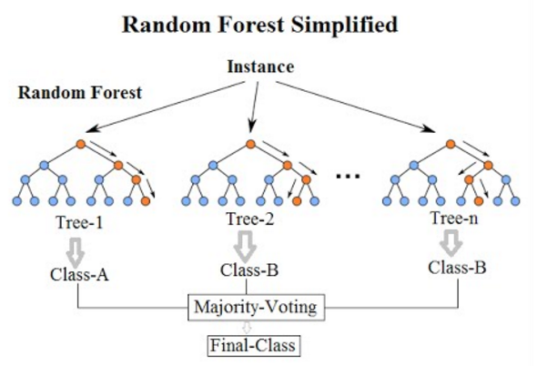
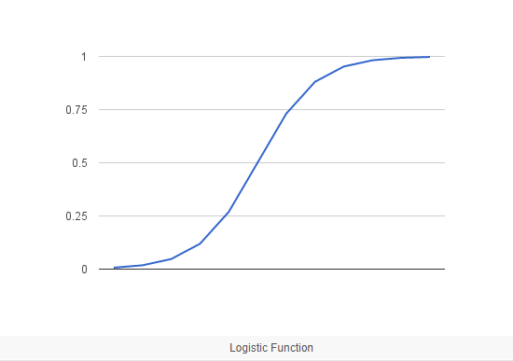

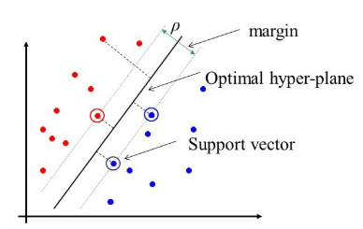
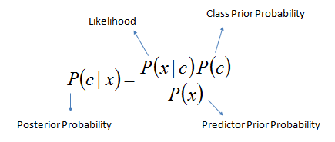
Algorithms explained
Logistic Regression: Logistic regression is a statistical classification model used to model a binary dependent variable and probability of a certain class or event existing such as pass/fail, win/lose, alive/dead or healthy/sick.
Each object being detected would be assigned a probability between 0 and 1. It uses Sigmoid function.
Random Forest: Random forests is a Bagging based ensemble learning method for classification and regression that operates by constructing a multitude of decision trees at training time and outputting the class that is the mode of the classes (classification) or mean prediction (regression) of the individual
Support Vector Machines: A support vector machine (SVM) is a supervised machine learning model that uses classification algorithms for two-group classification problems. After giving an SVM model sets of labeled training data for each category, they’re able to categorize new text. It makes use of hyperplane which distinguishes among feature vector planes.
Naïve Bayes: Naive bayes uses Bayes' theorem with strong (naïve) independence assumptions between the features and is a simple technique for constructing classifiers.
Only a single algorithm is not sufficient to train such classifiers, so a family of algorithms based on a common principle is needed:
All Naive Bayes classifiers assume that the value of a feature is independent of the value of any other feature.

Slide 12
Top 2 algorithms
Logistic Regression:
Accuracy: 0.9018559762435041
F1 score: 0.9442335273770354
Multinomial Naïve Bayes:
Accuracy: 0.8925828440305055
F1 score: 0.9384789028557293

