Slide 1
Design Principles
Hardik Singh

Slide 2
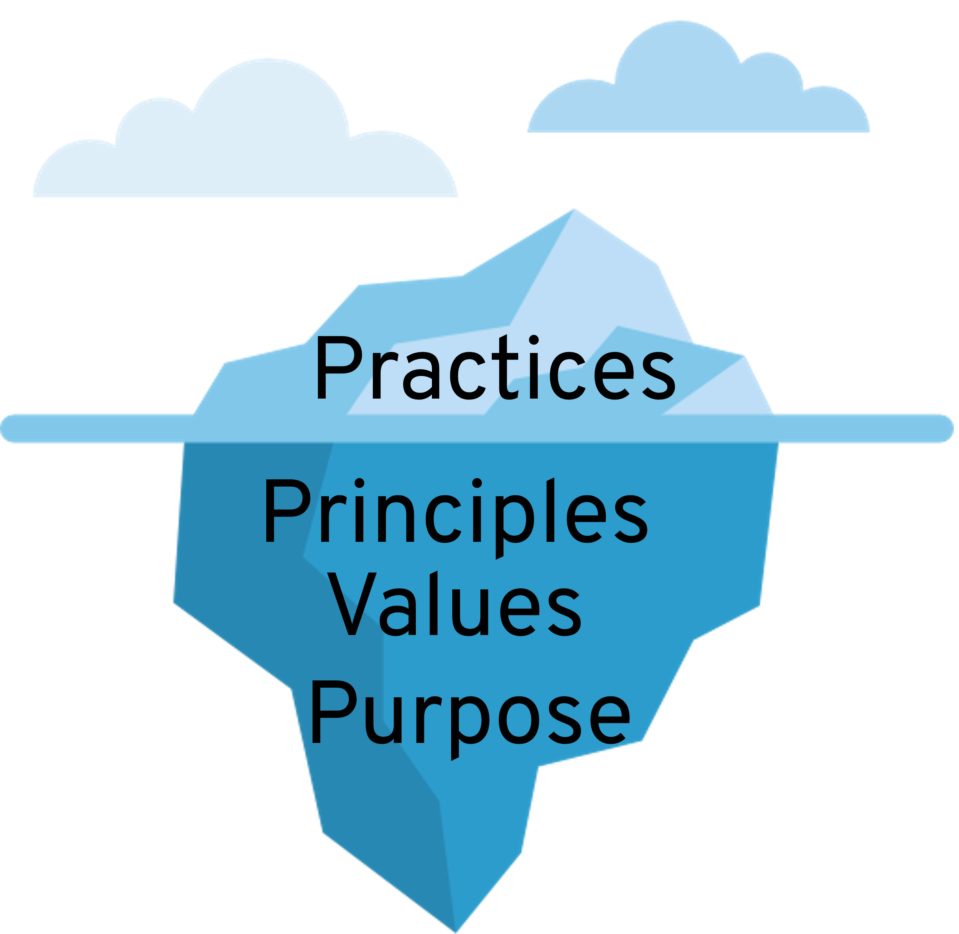
Table of Content
Single Responsibility Principle
Open-Closed Principle
Liskov Substitution Principle
Interface Segregation Principle
Dependency Inversion Principle
Boy Scout Rule
Principle of Least Astonishment
You Ain’t Gonna Need It
Law of Demeter
Keep it Simple Stupid
Don’t Repeat Yourself
Composition Over Inheritance
Information Hiding Principle
Image Source: https://openpracticelibrary.com/practice/establish-shared-principles/

Slide 3
Single Responsibility Principle (SRP)

Slide 4
A class should have one, and only one, reason to change.

Slide 5
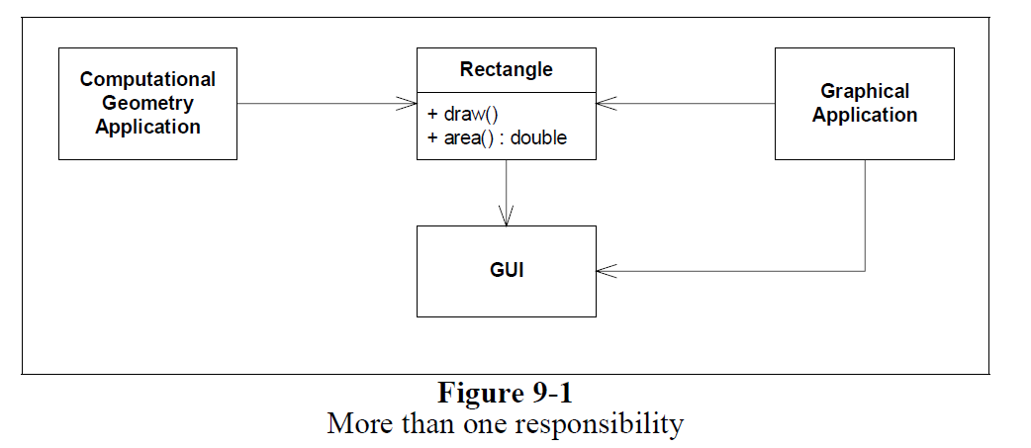
SRP Violation
Image Source : Robert Martin

Slide 6
Explanation
Two different applications use the Rectangle class.
One application does computational geometry. It uses Rectangle to help it with the mathematics of geometric shapes. It never draws the rectangle on the screen.
The other application is graphical in nature. It may also do some computational geometry, but it definitely draws the rectangle on the screen.
Rectangle class has two responsibilities
To provide a mathematical model of the geometry of a rectangle
To render the rectangle on a graphical user interface

Slide 7
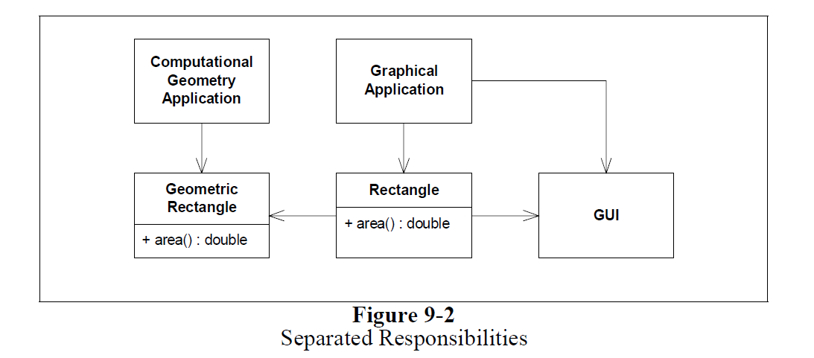
Solution

Slide 8
What is a Responsibility?
In the context of the Single Responsibility Principle (SRP) we define a responsibility to be “a reason for change.”

Slide 9
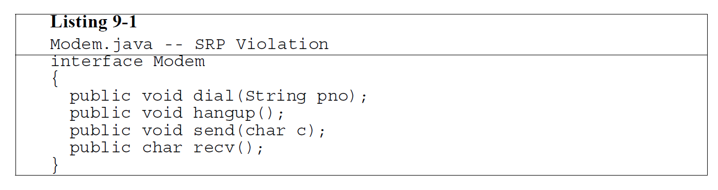
Another Example

Slide 10
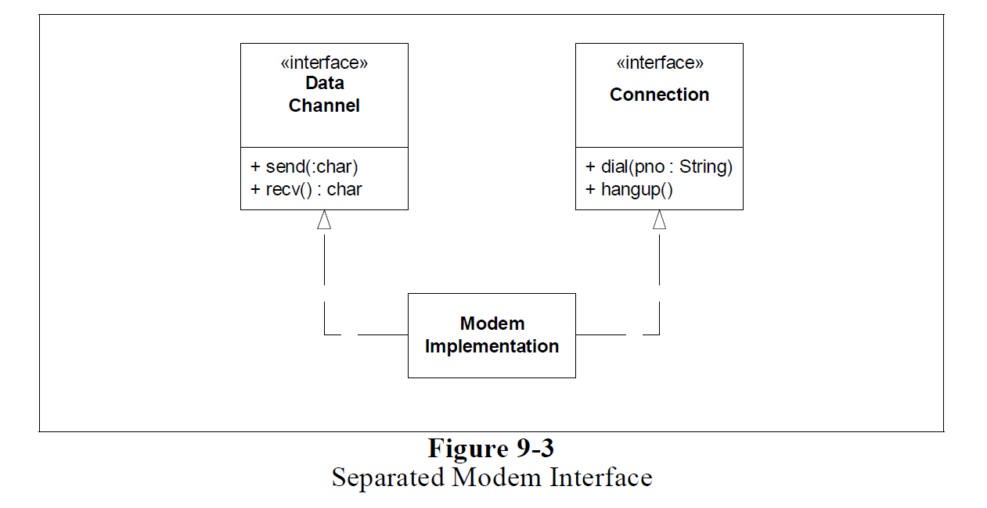
Solution

Slide 11
Open-Closed Principle (OCP)

Slide 12
Software entities (classes, modules, functions, etc.) should be open for extension, but closed for modificaiton.

Slide 13
Modules that conform to the open-closed principle have two primary attributes.
They are “Open For Extension”. This means that the behavior of the module can be extended. That we can make the module behave in new and different ways as the requirements of the application change, or to meet the needs of new applications.
They are “Closed for Modification”. The source code of such a module is inviolate. No one is allowed to make source code changes to it

Slide 14

-It would seem that these two attributes are at odds with each other.
-The normal way to extend the behavior of a module is to make changes to that module.
-A module that cannot be changed is normally thought to have a fixed behavior. How can these two opposing attributes be resolved?

Slide 15
Abstraction is the key.

Slide 16
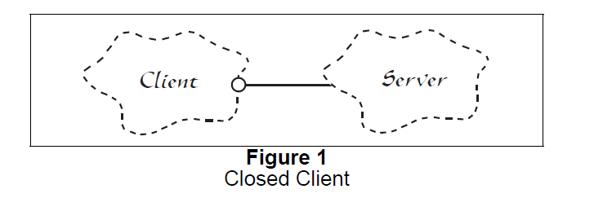
OCP violation
The Server is directly coupled with Client, If it were to be replaced with another Server then the Client code would also have to be modified. Hence OCP is violated here.

Slide 17
Code sample of violation
static class Program
{
static void Main(string[] args)
{
Client client = new Client();
client.ConnectToServer();
}
}
class Client
{
public void ConnectToServer()
{
ServerA server = new ServerA();
server.Connect();
}
}
class ServerA
{
public override void Connect()
{
Console.WriteLine("Connected to server A");
}
}

Slide 18
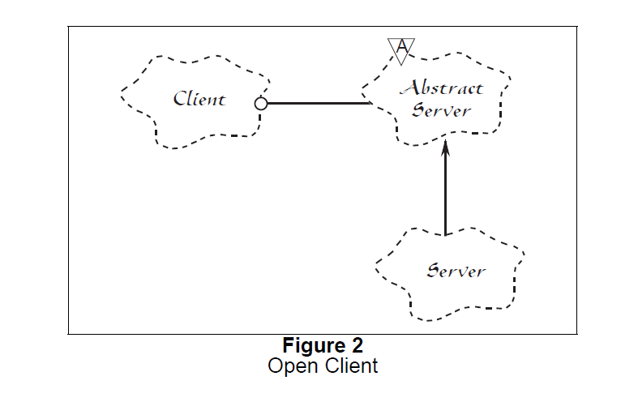
Solution

Slide 19
Code Sample
static class Program
{
static void Main(string[] args)
{
Client client = new Client(new ServerA());
client.ConnectToServer();
client = new Client(new ServerB());
client.ConnectToServer();
}
}
class Client
{
private readonly ServerBridge server;
public Client(ServerBridge serverInstance)
{
server = serverInstance;
}
public void ConnectToServer()
{
server.Connect();
}
}
abstract class ServerBridge
{
abstract public void Connect();
}
class ServerA : ServerBridge
{
public override void Connect()
{
Console.WriteLine("Connected to server A");
}
}
class ServerB : ServerBridge
{
public override void Connect()
{
Console.WriteLine("Connected to server B");
}
}

Slide 20
Liskov Substitution Principle (LSP)

Slide 21
Derived classes must be substitutable for their base classes.

Slide 22
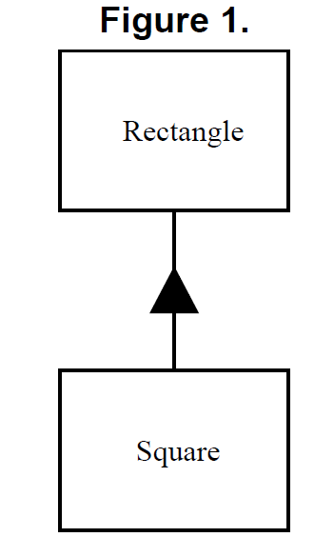
Violation
Here is a classic example of violation.
Mathematically square is a special case of rectangle where the width and height are same.
Hence you would think that this should be modeled same in program also by following inheritance, where square inherits rectangle class.
However this is a violation of LSP.
Consider the code in following slide for more detail

Slide 23
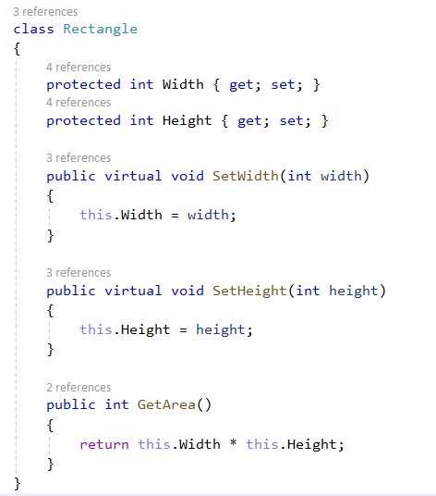
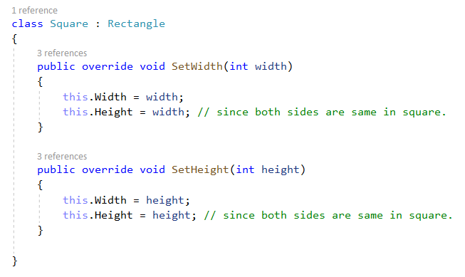

Slide 24
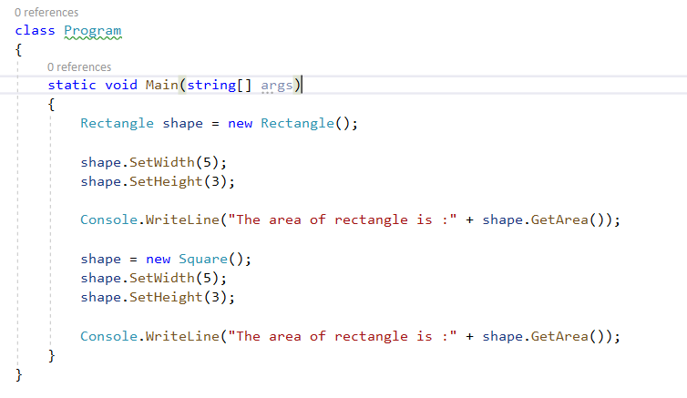

Exchanging derived class with base class breaks the application. Hence a strong subtyping must be in place if inheritance is used.

Slide 25
Interface Segregation Principle (ISP)

Slide 26
Make fine grained interfaces that are client specific.

Slide 27
Violation
Let say here Epson does not have oiptions to send mail or color scan, but it still has to implement those function since it is mandated in interface.
Client

Slide 28
Solution

Slide 29
Dependency Inversion Principle (DIP)

Slide 30
Depend on abstractions, not on concretions.

Slide 31
Violation & Solution

Slide 32
Boy Scout Rule

Slide 33
Leave the code cleaner than you found it.

Slide 34
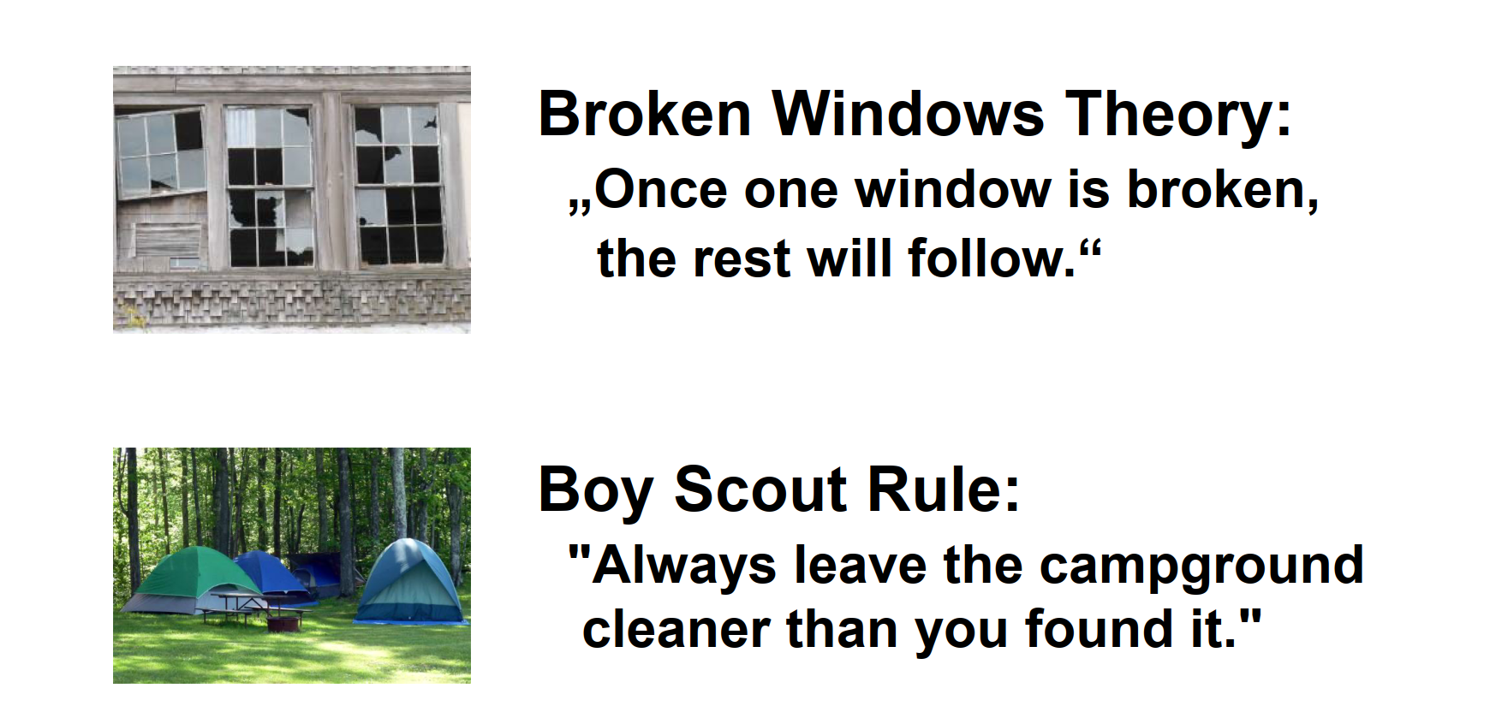

Slide 35
Principle of Least Astonishment

Slide 36
A component of a system should behave in a way that most users will expect it to behave; the behavior should not astonish or surprise users.

Slide 37
You Ain’t Gonna Need It (YAGNI)

Slide 38
Always implement things when you actually need them, never when you just foresee that you need them.

Slide 39
Law of Demeter

Slide 40
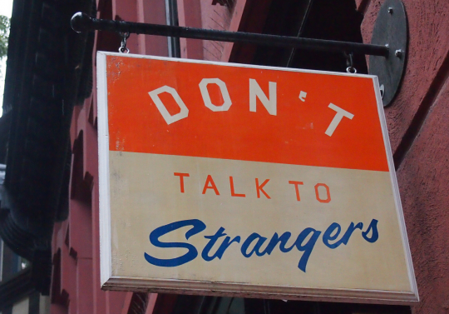
Each unit should only talk to its friends; don't talk to strangers.

Slide 41
More Definitions
Each unit should have only limited knowledge about other units: only units "closely" related to the current unit.
Only talk to your immediate friends.

Slide 42
Keep It Simple Stupid (KISS)

Slide 43
Simplicity should be key goal in design and unnecessary complexity should be avoided

Slide 44
Don’t Repeat Yourself

Slide 45
Every piece of knowledge must have a single, unambiguous, authoritative representation within a system

Slide 46
Composition Over Inheritance

Slide 47
Classes should achieve polymorphic behavior and code reuse by their composition (by containing instances of other classes that implement the desired functionality) rather than inheritance from a base or parent class.

Slide 48
Information Hiding Principle

Slide 49
Information hiding is the ability to prevent certain aspects of a class or software component from being accessible to its clients, using either programming language features (like private variables) or an explicit exporting policy.

Slide 50
Design Principles for Packages
Release-Reuse Equivalency Principle (REP)
The granule of reuse is the granule of release.
Common Reuse Principle (CRP)
Classes that are used together are packaged together.
Stable Abstractions Principle (SAP)
Abstractness increases with stability.
Stable Dependencies Principle (SDP)
Depend in the direction of stability.
Common Closure Principle (CCP)
Classes that change together are packaged together.
Separation of Concerns
Group related stuff on every level of hierarchy: Method, Class, Package, Component, Subsystem, …
Acyclic Dependencies Principle (ADP)
The dependency graph of packages must have no cycles.

Slide 51
References

Slide 52
Hardik Singh
hardik.singh@siemens-healthineers.com

