Slide 1
INTERNAL MARKS ASSESSMENT SYSTEM

Slide 2
Abstract
The goal of this project is to create a system that will capture IA marks, calculate final marks .
HoD and Principal also like to see these marks hence a multi user system that will allow each faculty to enter marks from her/his room and others to view should be of value to college.
A faculty typically keeps records of marks of each internal exam in an Excel file so it will be easy to manage with help of system.

Slide 3
Introduction
Engineering colleges conduct internal exams (IA) generally three times in a semester for each subject. A faculty typically keeps records of marks of each internal exam in an Excel file.
The Internal marks assessment system helps teacher to reduce the overhead of marks calculation and to manage them
The most significant feature of the website is the online exam in which student can log into the system, and give his external examination.

Slide 4
Project Requirement Specification
Internal assessments can serve two different purposes.
The first (‘formative assessment’) is to help students to find out what they still should do and how.
The second (‘summative assessment’) is to gather information to inform others about the progress a student has made so far.
Users are categorized in three categories
Student
Faculty
Checker

Slide 5
Any teacher can submit objective based question which would be asked randomly by student.
A student can create an account in the system, and each seller
has a username and a password.
The student can log into the system, and give his external
examination.
The teacher can submit internal marks for each student.
A student can view its own marks sheet which can be selected according to semester.

Slide 6
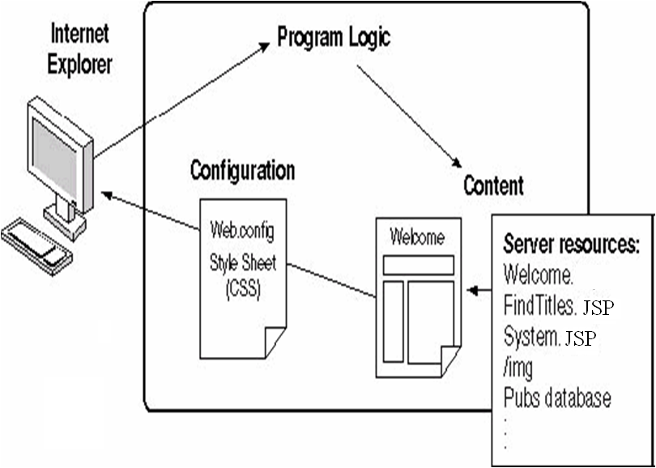

Slide 7
Objective
To provide an interface through which faculty can assist internal marks of student.
To provide registration for students done by themselves.
To provided username and password facility and credentials should be checked properly at the time of login for student, faculty and Admin.
To provide an interface from where faculty will be generated the report of student

Slide 8
Platform Specification (Development and Deployment)
Hardware Specification
Processor: Pentium 4 & above
RAM: 128 MB or more
Hard Disk: Around 100 MB of free disk space
Software Specification
JAVA Tools
Net beans IDE 7.2.1 Framework
IBM Rational Rose
Oracle 10g,
OS (Windows)
Apache tomcat
Any web browser
IBM Tivoli storage manager

Slide 9
Use Case Diagram

Slide 10
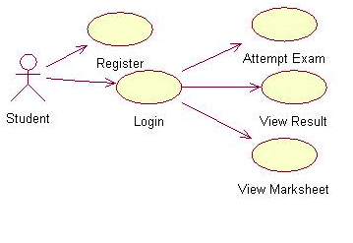
Student

Slide 11
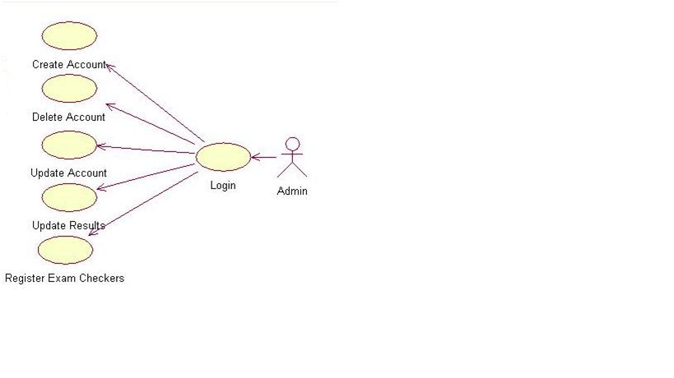
Admin

Slide 12
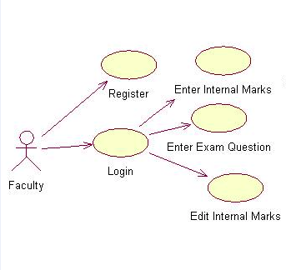
Faculty

Slide 13
Activity Diagram

Slide 14
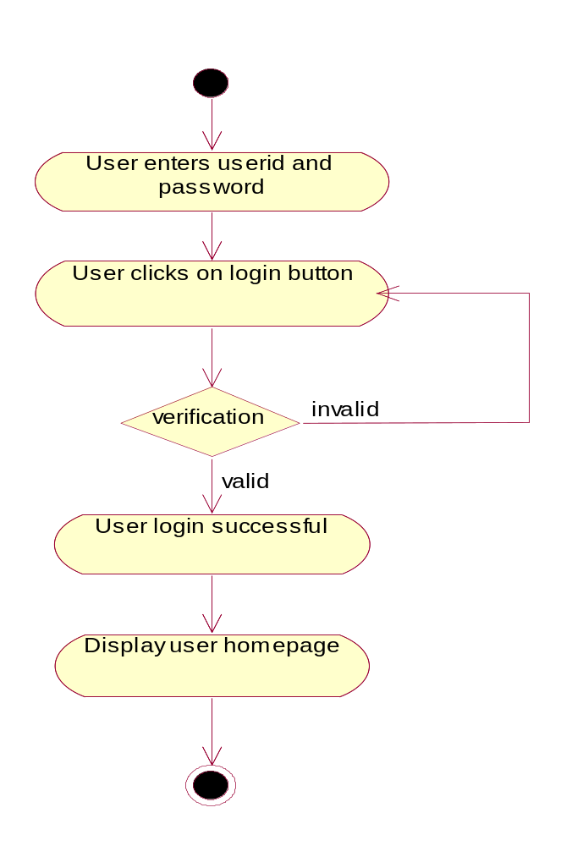
User Login

Slide 15
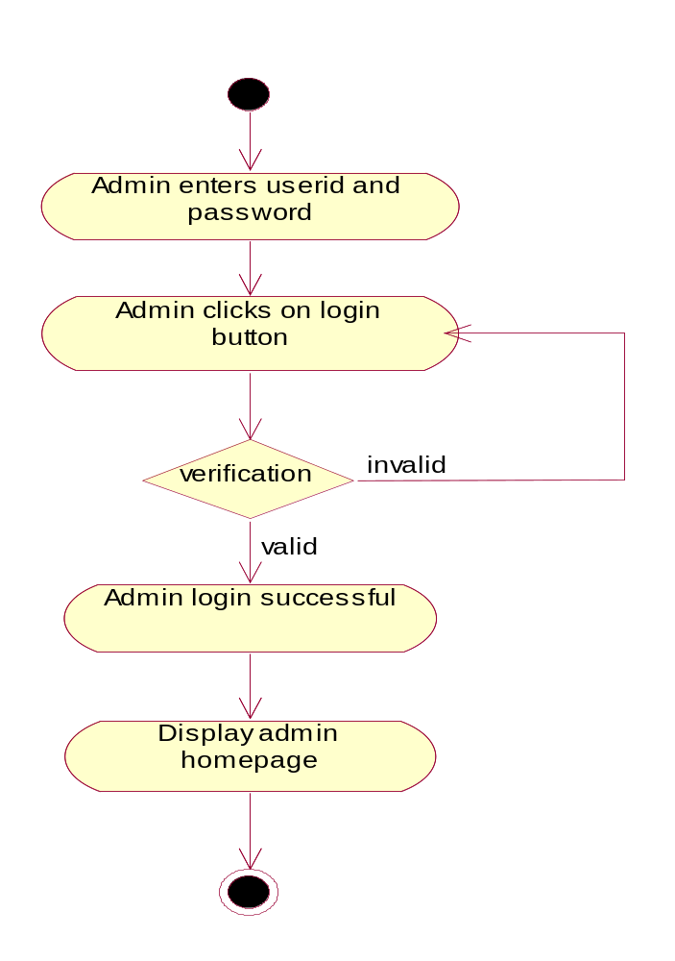
Admin Login

Slide 16
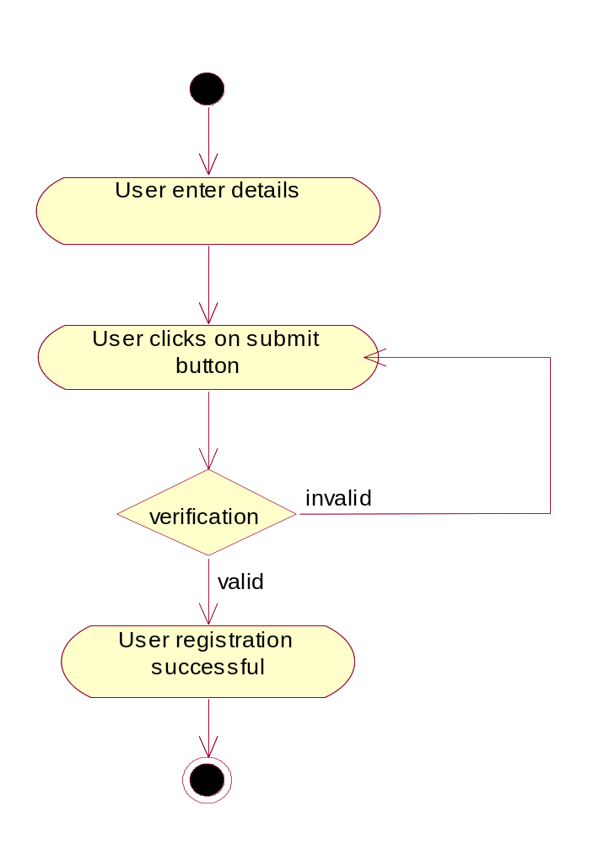
Registration

Slide 17
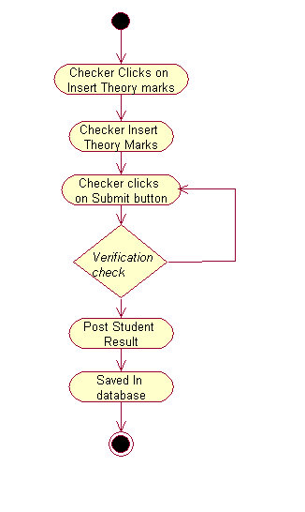
Insert Theory Marks

Slide 18
Class Diagram

Slide 19
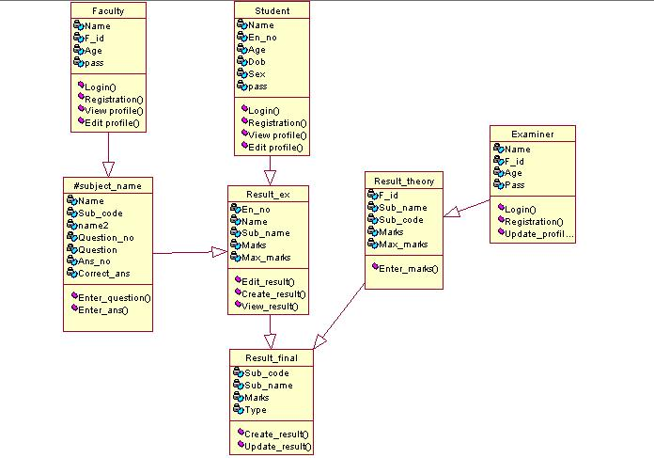
Class Diagram

Slide 20
Problems in existing systems
The current system is as mentioned earlier very complicated and
expensive as compared to the new system. It also wastes the
precious time of the faculties which can then be used in solving
student queries and helping them improvise.
Existing system has some limitations that said as follows:
At present keeping records is manual.
Large no of records is required
Lacks of security
Calculation takes more time
Chance for getting error is more

Slide 21
Future Scope
Proper consideration has been given for enhancements in future throughput the development of the software. But the system can be extended, as the software is constantly evolving and always has a scope for future enhancement.
The current system was mainly designed to support the management of the organization. In the future the system can be enhanced to include details of students who are failed. Present system has not included such a provision. All the functions have been done carefully and successfully in the software, and if any development is necessary in future. It can be done without affecting the design by adding additional modules to the system.

Slide 22
Conclusion
The system is flexible and changes if any can be made without much difficulty. Every step has been taken to make the working of the project comfortable as possible for the users.
The Major Advantages Are:
Easy retrieval of data available in database
Quick implementation of results
Very user friendly
Does not require large amount of memory
Very less manual work is needed

