Slide 1
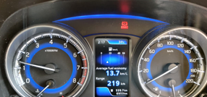
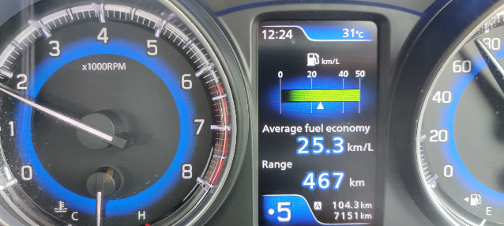
A Presentation on
POWER O₂
An Ultimate Solution for Fuel Saving
By Sun Petrochemicalss

Slide 2
Introduction
We XXXXXXXXXXXXXXX are a set of Energy Professionals; active in Energy Solutions business in India
We have rich experience in implementing energy saving solutions which enables us to save Fuel, Electricity, Oil and Water in many Industries
Value added services like; Advisory on Energy Conservation measures & Vendor selection make us a ‘one stop shop’
Our wholistic facility approach helps to; generate the best value for the end user and plan for; future changes and budgets
For more details please visit XXXXXXXXXXX

Slide 3
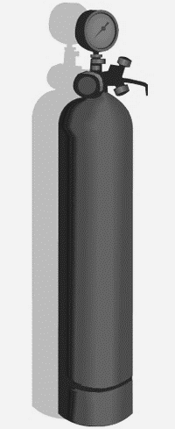
The Concept
The internal combustion Engine burns Fuel ( Petrol or Diesel) for which it needs oxygen
The oxygen in the Air (21%) controls the amount / volume of Fuel an engine can burn
Ratio of Fuel to Air is usually 1:14.7 or more which means for each gram of fuel to burn it needs 14.7 grams or more grams of Air
Engine can’t burn more Fuel than the amount of oxygen allows, so; Extra fuel = Unburnt Wastage
If an engine is provided with more oxygen, then it would obviously improve the combustion increasing thermal efficiency and reducing fuel consumption
Also there will be substantial reduction in unburnt Hydrocarbons, carbon monoxide & smoke
More Oxygen, better Combustion

Slide 4
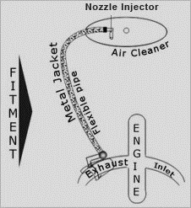
What is Power O₂?
Power O₂ is a ‘PATENTED’ clamp on type catalytic converter with pre-combustion technology
It’s a simple external attachment with NO alteration to engine design
Different from Conventional Systems
It provides engine with enriched homogenous mixture of oxygen for ideal air- fuel mixture
Hot air enriched with Oxygen ensures high burning efficiency and maximum heat out put

Slide 5
Technology & Function
It is a device; clamped to exhaust gas manifold and natural air is sucked in to the adapter which then passes through a cavity having intermetallic compound.
Intermetallic compound ensures optimum heat conductivity and catalytic action which separates out Oxygen to enrich the air with O₂
The adapter helps to produces homogeneous, rich oxygen mixture required for atomization (in the engine) to the maximum limits to get finest vapor which burns completely
Almost 97.5% of fuel is atomized in ﬁne vapor form and burns completely improving volumetric eﬃciency and reducing fuel consumption avoiding wastage and pollution
Pre-combustion Catalytic Converter

Slide 6
Benefits Vehicle Engines
Makes the combustion complete; boosting engine power, ensuring smooth functioning and saving fuel from 20% up to 40% or more
Engine runs lighter and driving on steep roads (Ghats) becomes easier in upper gears saving significant fuel
Allows to drive the car in 3rd or 4th gear even at lower speeds of 30 to 40 Kmph
The power received is like Turbo engines & saves significant fuel expenses
Keeps the Engine Cool (avoids hot spots)
Carbon deposits are cleaned up protecting the engine and reducing maintenance cost
Risk Free – 100% Satisfaction

Slide 7
Benefits Gensets - Static engines
PATENTED Power O₂ Technology can be easily implemented on Gensets. The results can be evaluated through pre-ﬁtment and post-ﬁtment Trial. The beneﬁts are –
Minimum 10% to 40% fuel saving
30% reduction of smoke emission
Better engine life (Trouble free smooth operation)
Less engine noise & vibration, no jerking & knocking
No voltage ﬂuctuation.
No Starting trouble
Reduction in maintenance cost

Slide 8
Negative Effects?
Maintenance?
Life?
ANY NEGATIVE EFFECTS?
There are absolutely ZERO negative effects of Power O₂ on engine or related components & is a completely safe device.
Power O₂ takes the combustion process to the best efficiency level, cleanse up the engine and saves significant amount of fuel
WHAT ABOUT MAINTENANCE?
Almost Zero maintenance & zero cost
Filter mesh in adopter is to be cleaned by flushing water jet or Compressed Air every 2# months
Metal braided hose may have to be changed once in 9 to 12 months
WHAT’S THE LIFE SPAN?
The life span is 3# Years provided min. required maintenance is done as detailed above
Minimum maintenance time

Slide 9
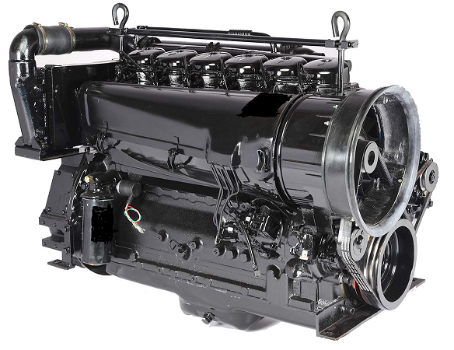
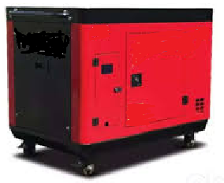
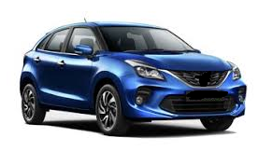
Applications
Fuels
APPLICATIONS:
Petrol & Diesel Engines
Gensets
HCV to LCV
Mining Equipment
Earth Moving Equipment
Hydraulic Machines & Cranes
FUELS:
Diesel
Petrol
LPG
CNG
All Internal Combustion Engines

Slide 10
FREE TRIAL
STEP 1:
End User has to provide Preliminary details (Model. Year of Mfg., Kms / Liter of Fuel OR Avg. KWH produced / Liter of Fuel, etc.) for Vehicle / Diesel Generator / Respective Engine to enable us to create a baseline
Our Representative / Technician visits the end user’s place / site to inspect the engine and collect exhaust manifold details (if required)
STEP 2:
Appropriate Model of Power O₂ is selected OR Designed by us for that specific requirement
A formal Proposal with Prices is submitted to end users. A Conditional PO is released by End users for supply and installation on FOC basis. Payment will be done BY end user only after satisfactory results
In case If the end user is not willing to continue / pay money for Power O₂, we remove it and take back the same in our custody
ZERO charges for TRIAL

Slide 11
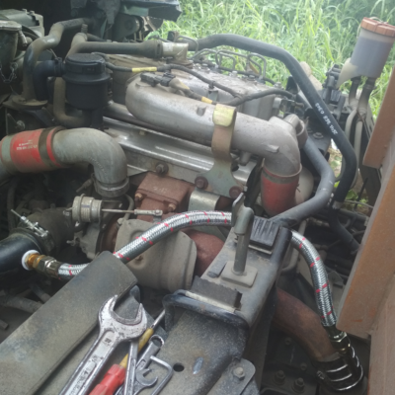
Installation 1 of 2
Power O₂ Hose Pipe
Power O₂ Clamping on Exhaust pipe
Simple installation in 20# minutes
Power O₂ Nozzle Fitting in Air Filter

Slide 12
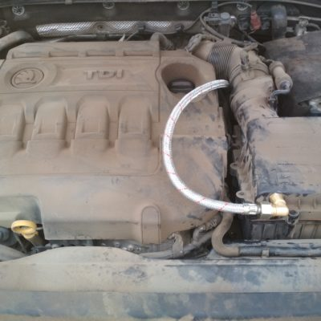
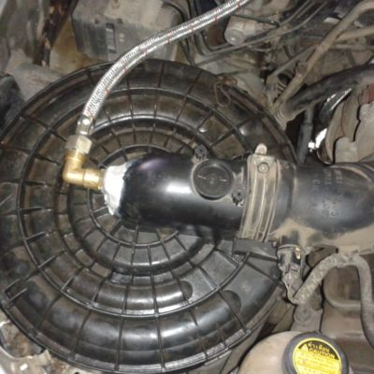
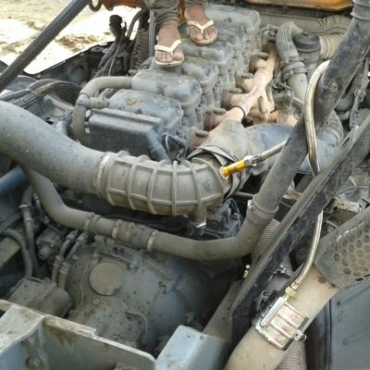
Installation 2 of 2
TATA Truck
SKODA Octavia
Suitable for all types of IC Engines
TOYOTA Innova
SCANIA Dumper

Slide 13
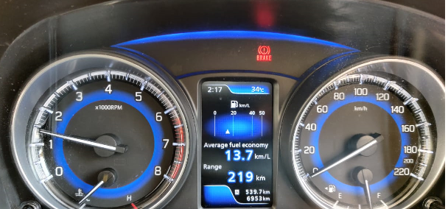
Case Study Page 1 of 4
Date: 21.02.2020
Car Model : Maruti Suzuki Nexa Baleno
Manufacturing Year: 2018, Petrol
Average before fitting of Power O₂ : 16.0 Km/ Liter (Highway / Long Distance)
Average before fitting of Power O₂ : 13.7 Km/ Liter (within Mumbai City)
BEFORE Installing POWER O2
Average before installing POWER O₂

Slide 14
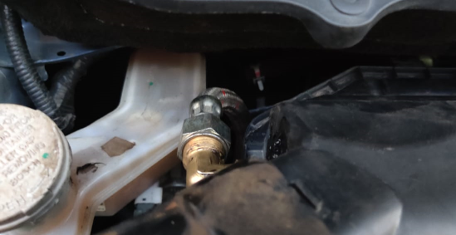
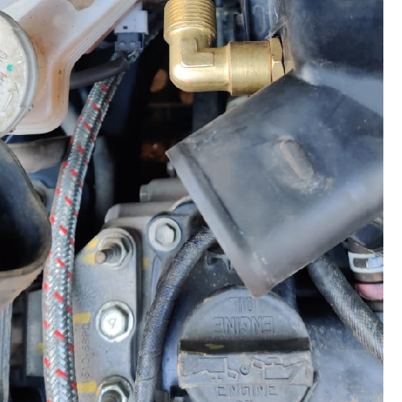
Case Study Page 2 of 4
Date: 21.02.2020
Car Model : Maruti Suzuki Nexa Baleno
Manufacturing Year: 2018, Petrol
Installation of POWER O2
Power O₂ Hose
Power O₂ Nozzle Fitting in Air Filter
Power O₂ Nozzle Fitting in Air Filter

Slide 15
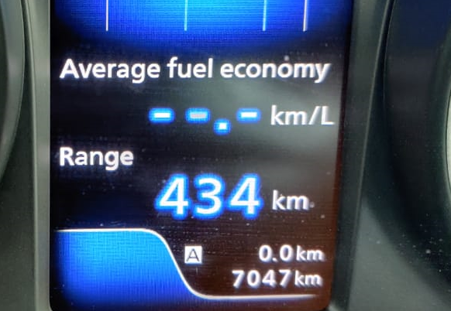
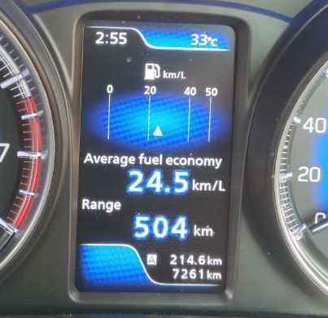
Case Study Page 3 of 4
Date: 22.02.2020
Starting : 7047 Km End : 7261 Km
Total Distance Travelled: 214 Km
Average after fitting of Power O₂ : 24.5 Km/ Liter (On Highway)
AFTER Installing POWER O2
SAVINGS ACHIEVED @53.12%

Slide 16
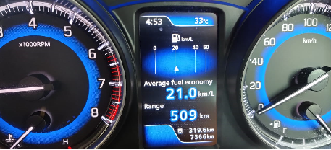
Case Study Page 4 of 4
In City:
BEFORE AVG. 13.7Km/L
Minimized Pollution
PETROL SAVINGS ACHIEVED @53.28%
AFTER AVG. 21 Km/L

Slide 17

Thank You !

