Slide 1
Book Search Android Application
A simple android app that helps you keep your favorite books in one place and search online books of your choice and subject you want. Millions of books are available online on this app and can be found just by searching them through the app.

Slide 2

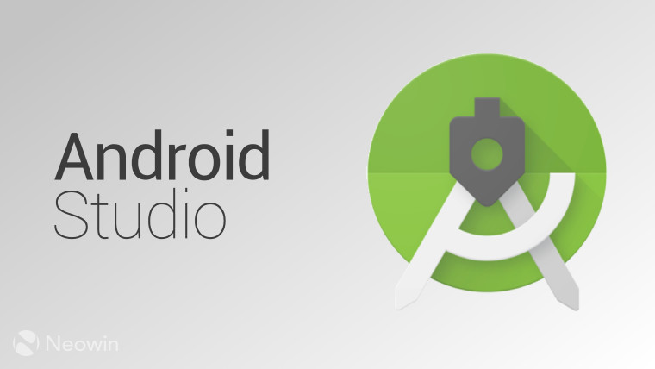
Techstack used...
Languages -
Kotlin
Java
XML
IDE-
Android Studio

Slide 3
Libraries used...
Android Libraries -
Picasso - Image loading library
Volley - Network Library
XmlPullParser - XML parsing
Backend API’s -
Good reads API (https://www.goodreads.com/api)

Slide 4
Features of the App...
Search for any book you like.
Add a book to your favorite list.
See authors and their related works.

Slide 5
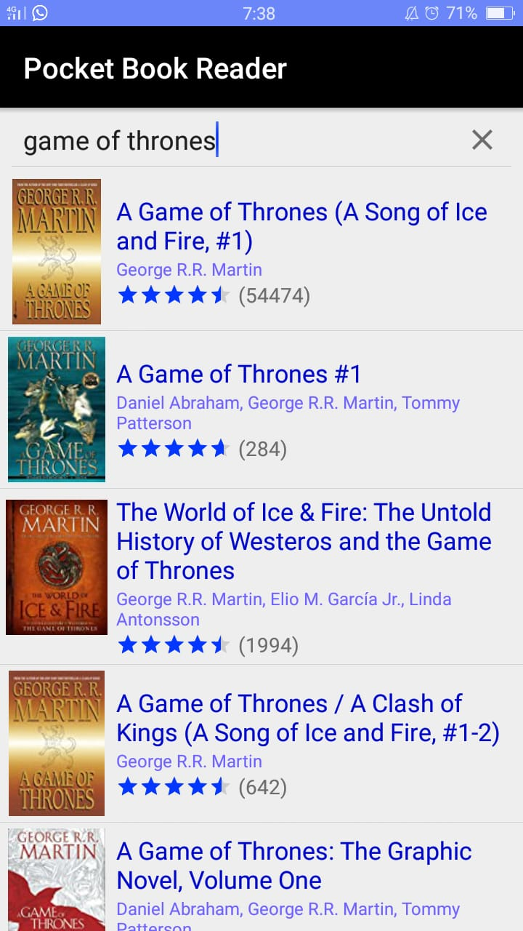
1.) Search for any book you like
Just search the name of your desirable book and this hit search button on the keyboard. All the related books of the name being searched will be displayed in the RecyclerView as shown.

Slide 6
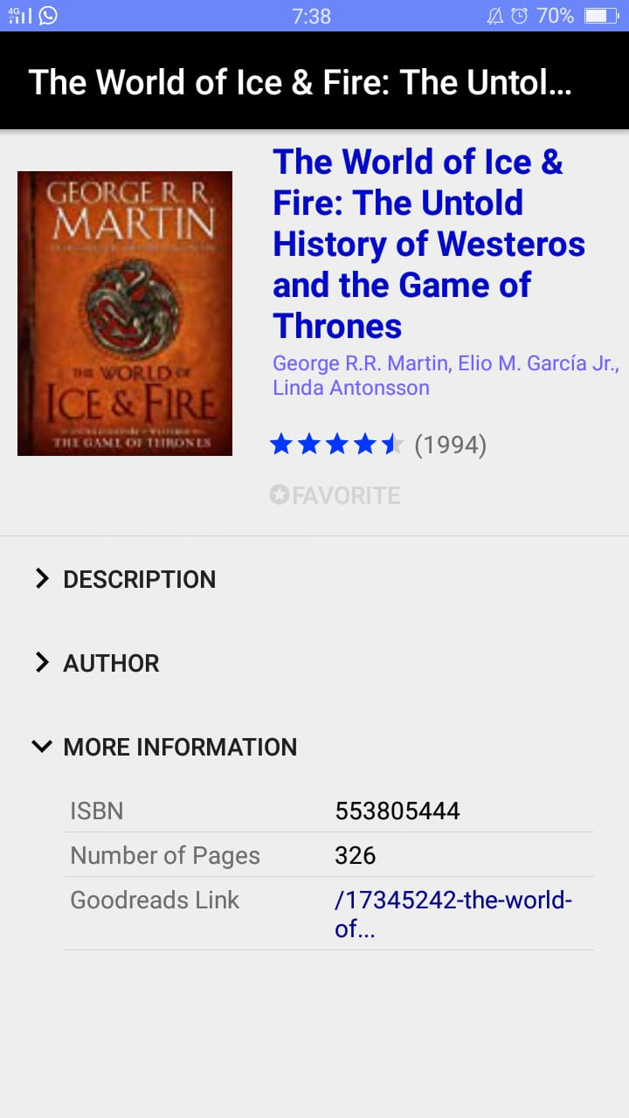
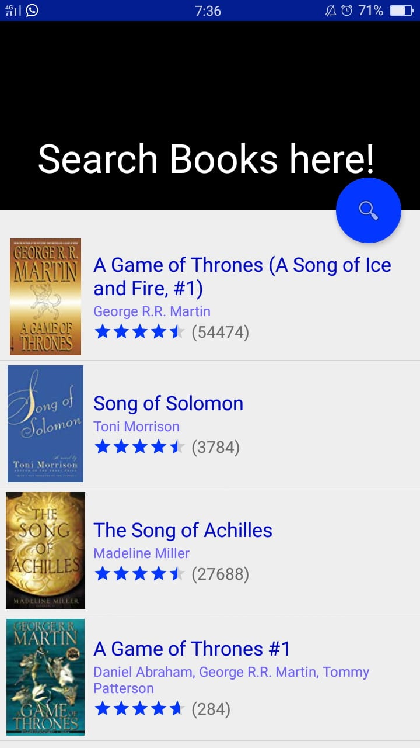
2.) Add a book to your favorite list.
Basically this app provides you the functionality of adding the books you love to favorite section.

Slide 7
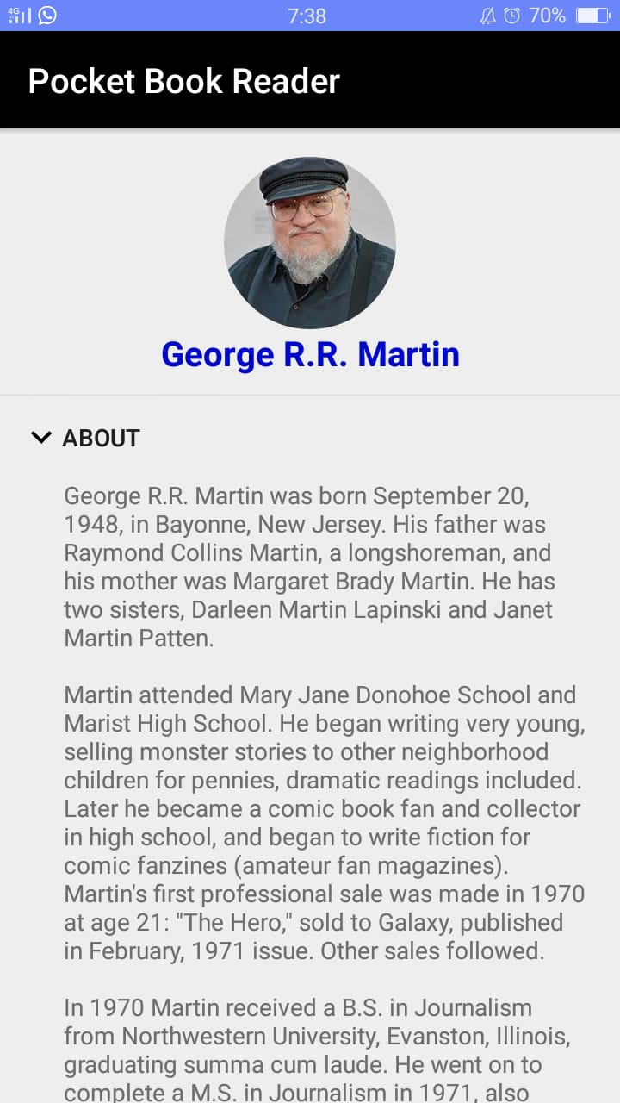
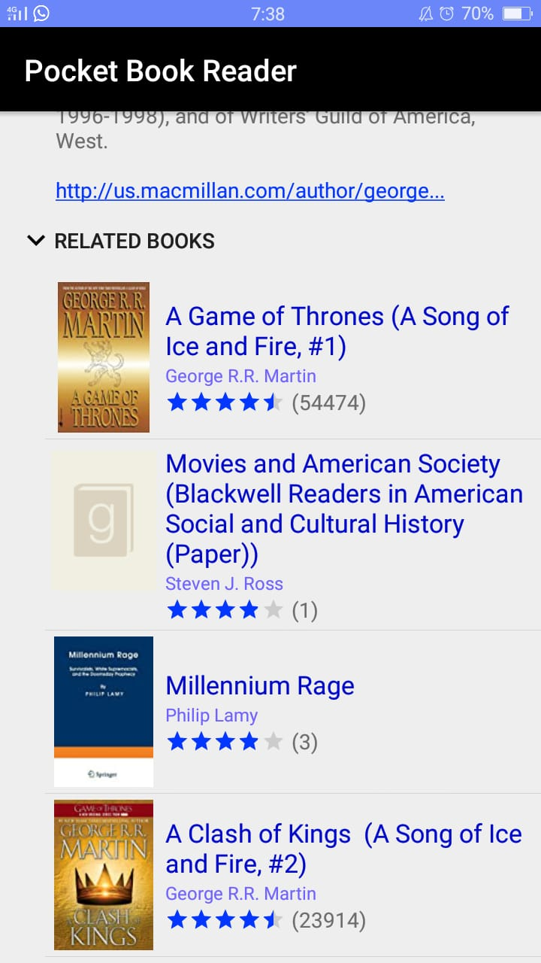
3.) See authors and their related works.
As every book has some author associated with it, therefore this app provides you to view author’s biography and also his related books.

Slide 8
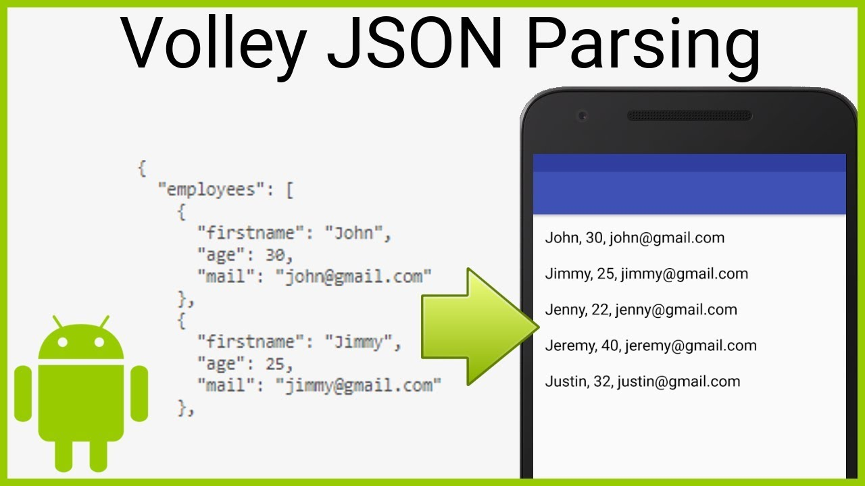
Workflow of the Application..
Basically, just we have to hit the base url and fetch the data that is present in the json(key-value) format and finally display that data in our application at various places.

Slide 9
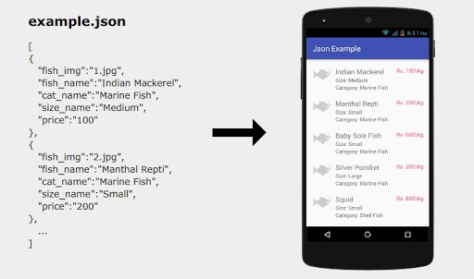
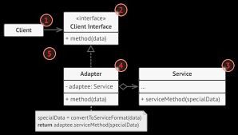

Slide 10
References…
https://developer.android.com/docs
https://medium.com/androiddevelopers
Thank you..

