Slide 1

Innovate Project Presentation
This presentation showcases the development journey and outcomes of the TBPPP project, a Pinterest-clone app built by Group 34 at GLA University, Mathura. The team used a robust MERN stack to create a functional and user-friendly platform.

Slide 2
Feasibility
Project Scope
Technology Readiness
The objective was to build a Pinterest-like app with core features including sign-up/login, pin management, boards, and a responsive UI.
Technologies chosen for this project – MongoDB for NoSQL database, Express.js for REST APIs, React.js for dynamic UI, and Node.js for scalable backend – were assessed and deemed suitable.

Slide 3
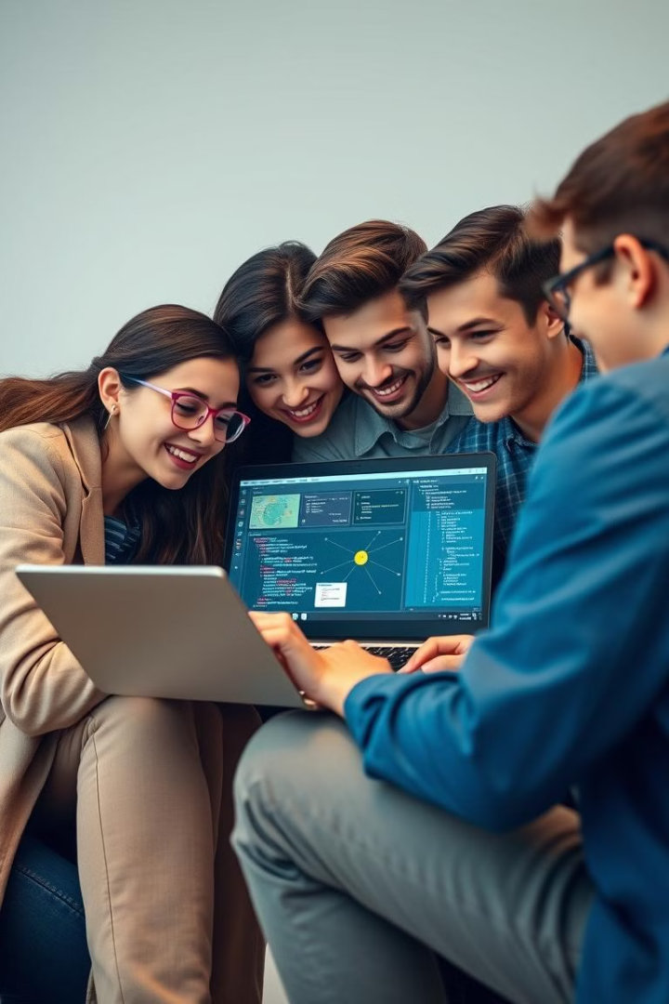
Student Contribution
Roles and Responsibilities
Key Contributions
Significant contributions included JWT authentication for secure login, optimized MongoDB queries for improved performance, and reusable UI components for modularity.
Team members were assigned roles based on their strengths and interests.
Teamwork and Collaboration
The team utilized Git for version control and conducted regular sync-ups for seamless project progress.

Slide 4
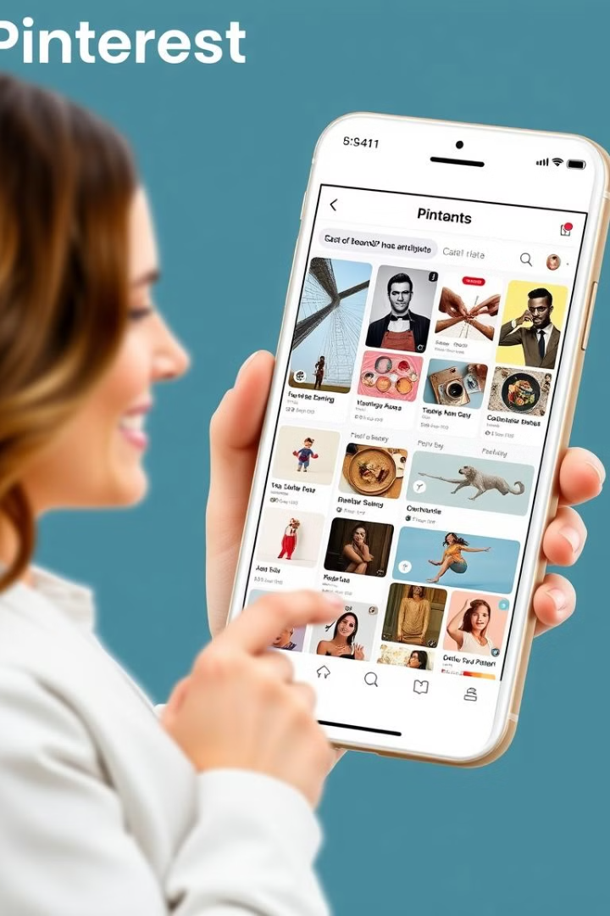



Impact and Outcome
End-User Benefits
Community/Organizational Value
The app streamlines the user experience by providing an easy-to-use platform for sharing and discovering content.
The Pinterest-clone app is scalable to handle increasing users seamlessly, offering a simple, intuitive design that enhances engagement.
Measurable Success
Success is measured by user engagement metrics like sign-ups and daily active users, along with system performance indicators such as load times and uptime.

Slide 5
Technology
Stack Overview
Why MERN?
The project uses a robust MERN stack consisting of React.js for interactive UI development, Node.js and Express.js for API and server-side logic, and MongoDB for efficient data storage and retrieval.
The MERN stack provides seamless integration of full-stack JavaScript, ensuring scalability and performance for modern applications.

Slide 6
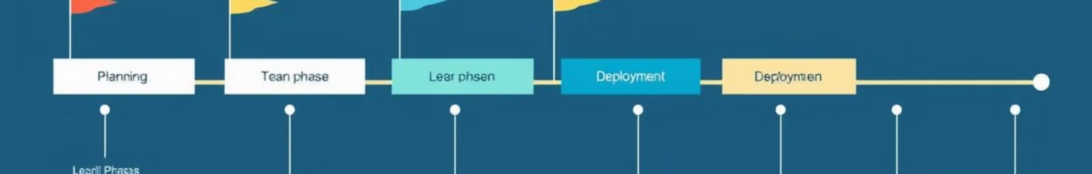
Progress Monitoring
Development Workflow
Milestones
The team adopted an Agile methodology for iterative development, utilizing Git for version control and GitHub for collaborative code management.
Key milestones included UI design completion with React.js, API integration using Node.js and Express.js, and database setup with MongoDB.
1
2
3
Tracking Tools and Testing
Trello was used for task management and progress tracking. Regular unit testing and manual testing were performed to ensure quality.

Slide 7




Future Plan
1
Feature Enhancements
2
Scaling the Application
3
Maintenance and Updates
4
Advanced Technologies
Future plans include implementing social media login, image editing, and load balancing for scalability. The team also aims to integrate AI/ML for recommendations and explore microservices.

Slide 8
Our Team
Group-34, Batch 1 – Morning (Tuesday – 8:30 : 11:00 AM) – Project Based Evaluation.
Backend => Krishna Agarwal (Team Leader) – 3AC – 2215500088 - krishna.agarwal_cs.aiml22@gla.ac.in -7037210765
FullStack => Hardik Arora – 3AC – 2215500071 – hardik.arora_cs.aiml22@gla.ac.in – 9997859116
Frontend => Devansh Sharma – 3AC – 2215500058 – devansh.sharma_cs.aiml22@gla.ac.in – 6398853290
Database => Saurabh Nagayach – 3AC – 2215500141 – saurabh.nagayach_cs22@gla.ac.in – 7800733100
Evaluated and Mentored By : Aakash Kumar Chaudhary (Training and Placement department)

