Slide 1




Innovate X Hackathon
November 2024
SLCHACK
Team Name : NextStep Academy
Team Members: Hardik Arora (hardikarora483@gmail.com) Amitabh Singh (amitabhsingh128@gmail.com) ShobhitChaturvedi (shobhitchaturvedi14@gmail.com)
Github link : https://github.com/hardik121121/InnovateXhackathon2024_NextStep-Academy

Slide 2
PROBLEM STATEMENT
Challenge: Develop a specialized EdTech platform for master’s entrance exam preparation focused on test series and practice exams, without including video lectures.
Key Requirements:
Emphasis on Testing: The platform should provide extensive test series and customizable practice exams.
Instant Query Resolution: A real-time chatbot to answer user queries.
Enhanced User Experience: Creative UI/UX features to engage and support users.
Objective: Provide a user-centric solution to aid students in structured, efficient practice, focusing on adaptive testing and interactive feedback.

Slide 3
SOLUTION OF THE PROBLEM
Platform Overview:
Main Features:
Comprehensive Test Series and Practice Exams: Topic-wise and full-length exams with real-time score.
Real-Time Chatbot: Supports instant query resolution and data insights, such as tips for improvement.
Engaging UI/UX:
Personalized Dashboard with progress tracking and performance insights.
Gamification Elements: Points, badges, and progress streaks for motivation.
Error Book Feature: Logs and highlights commonly missed questions for focused revision.
Unique Value Proposition: Tailored for serious exam preparation, the platform emphasizes personalized feedback and real-time support to ensure students can study effectively.

Slide 4
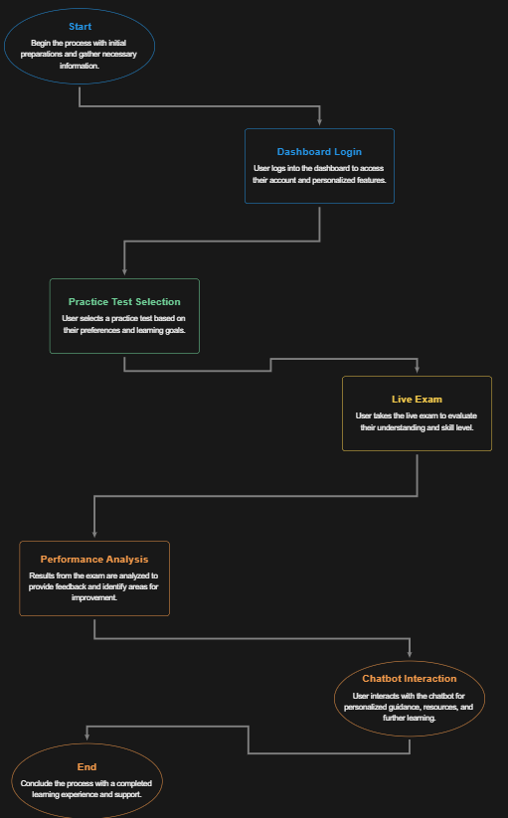















TECHNICAL APPROACH
System Workflow:
Technology Stack
Web-Dev:
Chatbot:

Slide 5
FEASIBILITY AND VIABILITY
Feasibility:
Technical: Real-time chatbot and test feedback can be implemented using a rule-based approach, making it achievable within the given timeline without AI tools.
Scalability: Modular code allows for easy expansion of test topics, question banks, and chatbot capabilities.
Viability:
Market Demand: High demand for focused, test-centric platforms with real-time support as students prioritize test practice over video content.
Sustainability: Low operating costs due to minimal server load (focused on testing rather than video content), and the platform is easily updatable with new tests.

Slide 6
IMPACT AND BENEFITS
Student Success: Provides targeted, practice-oriented preparation, essential for improving test performance and increasing student confidence.
Personalized Insights: Enables students to identify their weak areas through the Error Book and adjust their study plans accordingly.
Engagement Boost: Gamified elements (badges, progress tracking) and chatbot-driven feedback make studying more interactive and enjoyable.
Scalable and Inclusive: Designed to support a wide range of exams and user needs, the platform can adapt to different entrance exams and expand with new content.

Slide 7
THE END

