Slide 1
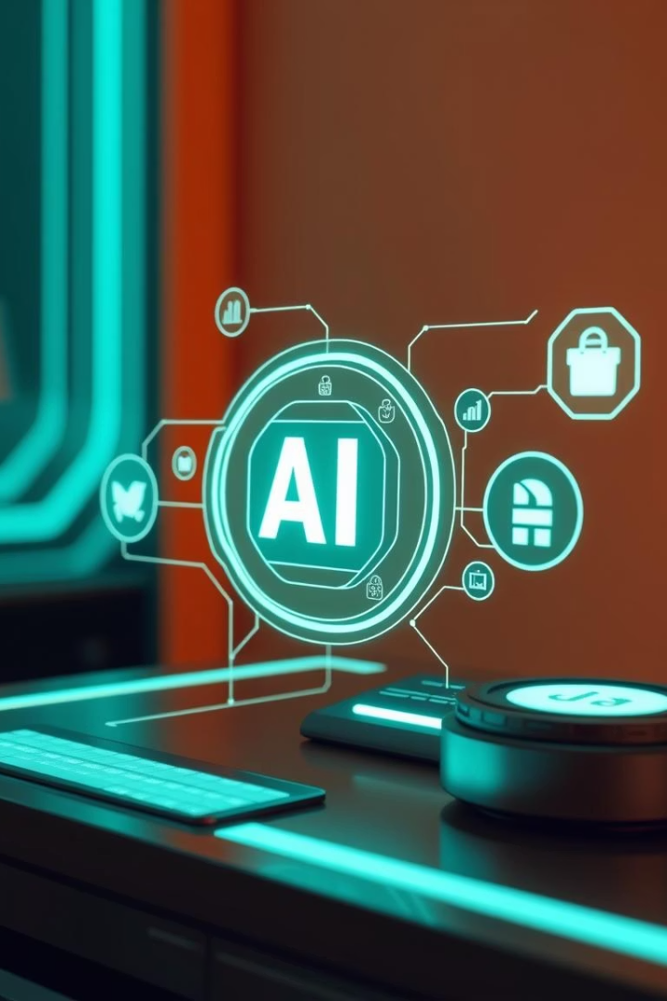
🚀 InsurAI – AI-Powered Insurance Advisor
Smart Insurance Decisions Backed by AI
By: Hardik, Hemant and Harsh || GLA University Mathura

Slide 2
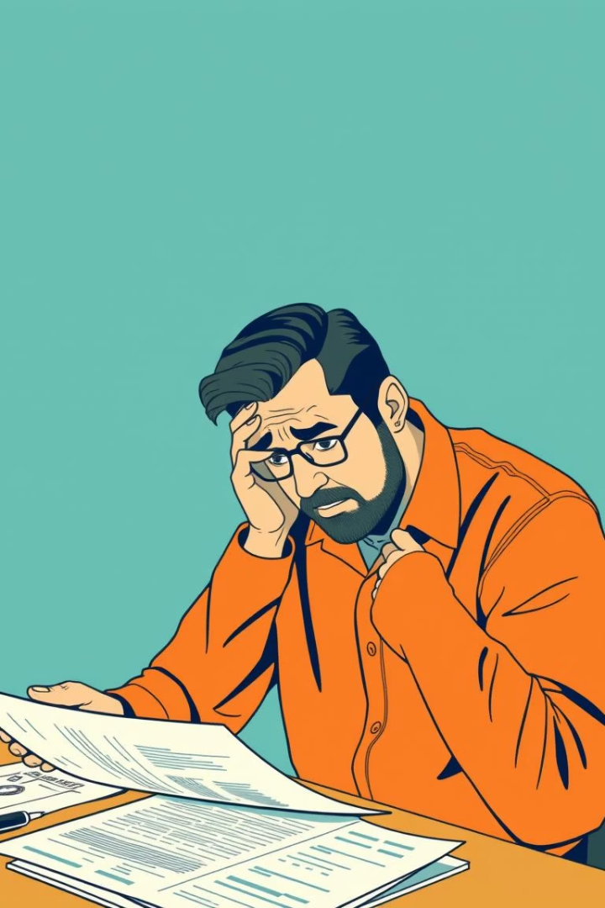



🌟 Introduction & Problem Statement
Insurance choices are complex
Need for intelligent advisory
Many struggle identifying right policies
Personalized, data-driven guidance required
Our Vision
Simplify decisions using AI-powered insights

Slide 3
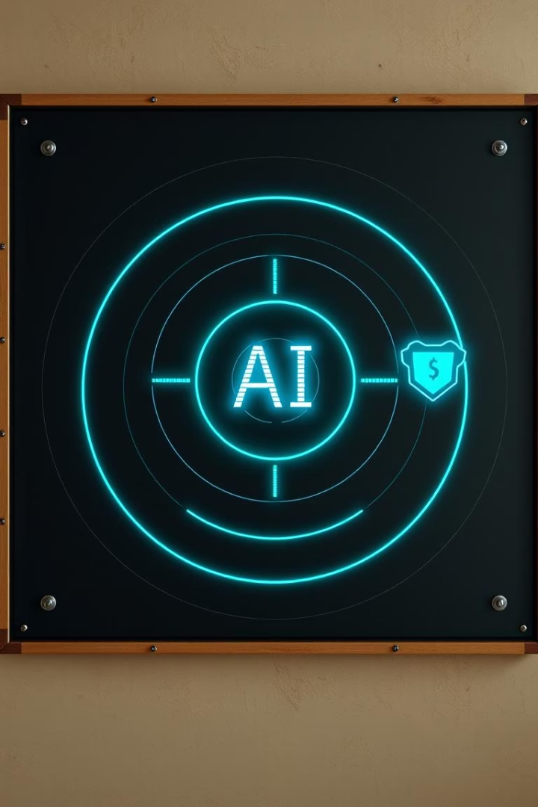
🎯 Objective of InsurAI
Primary Goal
User Pain Points
Assist users in choosing optimal insurance plans with AI
Confusing policies
Lack of personalized advice
Time-consuming research
Solution
Offer tailored, real-time recommendations and support

Slide 4





🔥 Key Features
PDF Analysis
Live Web Scraping
Personalized Advice
AI Chat Support
Memory Retention

Slide 5

🛠️ Tech Stack
Language
Python
UI Framework
Streamlit
AI Model
Groq AI (Mixtral)
PDF Parsing
PyMuPDF
Web Scraping
BeautifulSoup

Slide 6
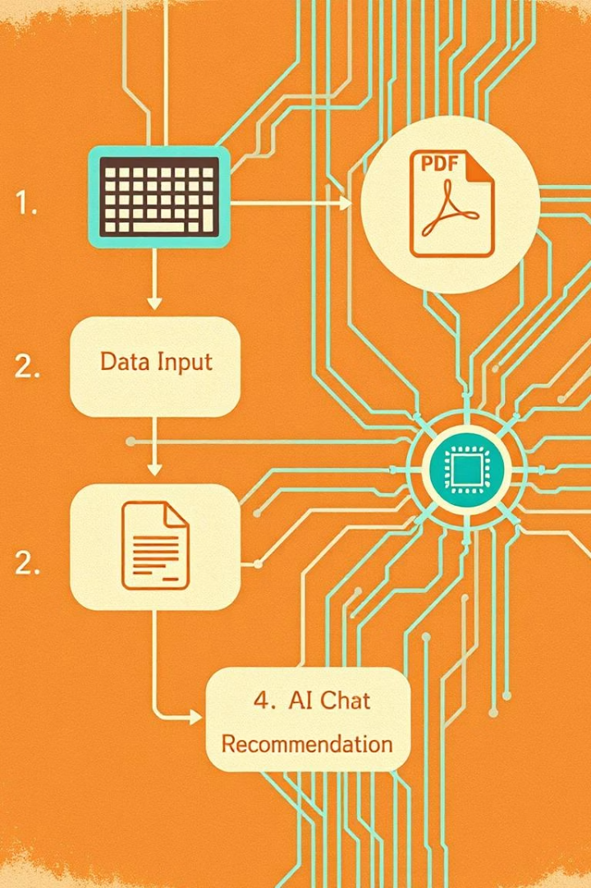




🔁 How It Works – Workflow
Enter Details
User provides personal info
Upload PDF
Extract insurance policy data
Web Scraping
Live data collection from insurers
AI Recommendation + Chat
Personalized policy advice

Slide 7
📈 Progress & Challenges
Completed Milestones
Challenges & Solutions
PDF analysis implemented
PyMuPDF parsing fixes
Initial AI model integrated
Adjusting Streamlit UI
Basic web scraping operational
Addressed scraping limitations

Slide 8
🔮 Next Steps & Conclusion
Completed Final Steps
Enhance UI/UX
Add More Insurers & OCR
Fine-tune AI Models
Thank You
Committed to smarter insurance decisions

