Slide 1

Seismic Event Classification and Magnitude Prediction Using Deep Learning on Earthquake Waveform Data
Presented by: [Team No./ 08]
Date: [29.04.2025]

Slide 2
Introduction & Objective
Seismic events generate distinct ground motions detectable by sensors.
Build AI to classify event types
Predict earthquake magnitude from waveform data
Enhance hazard response efforts
Accurate classification and magnitude prediction supports early warnings.

Slide 3
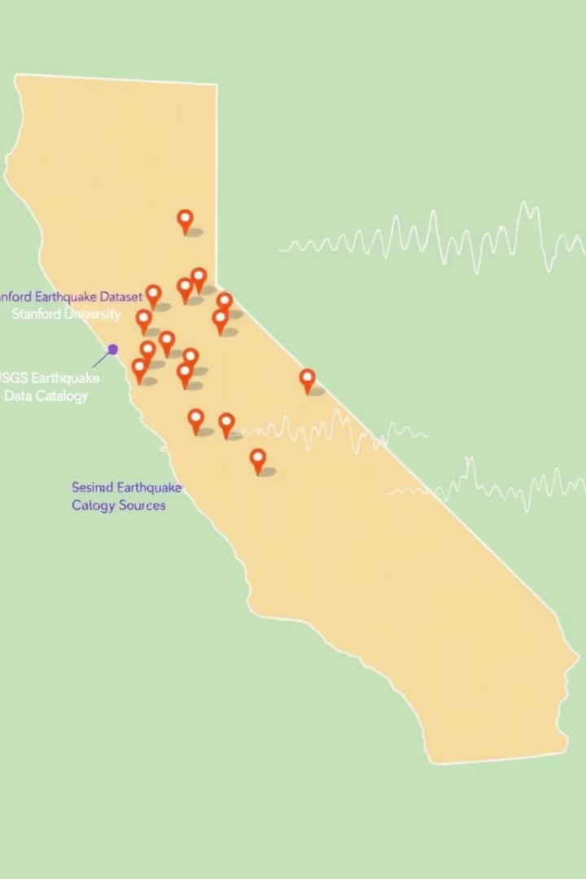
Dataset & Data Collection
Stanford Earthquake Dataset (STEAD)
USGS Earthquake Catalog & IRIS Data
High-quality labeled seismic waveforms from global stations
Comprehensive event data with paired waveform recordings
Data Importance
Real data ensures model validity and operational reliability

Slide 4
Exploratory Data Analysis (EDA)
Waveform plots differentiate event types visually
Explosions produce sharp high-frequency spikes.
Spectrograms reveal frequency-time signal characteristics
Earthquakes exhibit smoother low-frequency waveforms.
Identified class imbalance needing correction

Slide 5
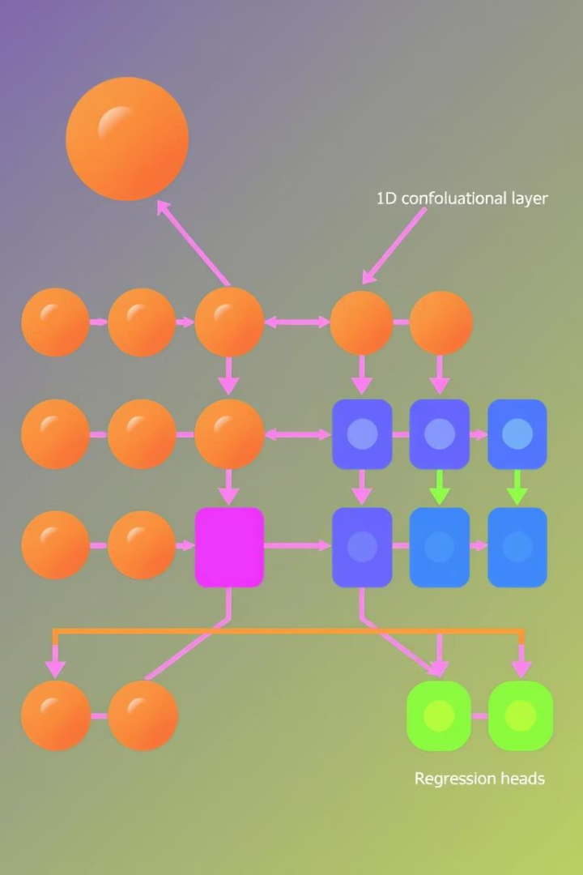
Model Architecture
Baseline Model
1D CNN extracts waveform features; LSTM captures temporal patterns
Final Model
Multi-output network with heads for event classification and magnitude prediction

Slide 6
Model Evaluation & Technical Approach
Classification: Accuracy, F1-score, Confusion Matrix
Preprocessing: Normalization, trimming waveforms
Regression: Mean Squared Error (MSE), R² Score
Augmentation: Time-shifting, noise injection
Explainability: Grad-CAM and SHAP for interpretability

Slide 7





Key Features & Benefits
Real Earthquake Data
Physics-Inspired Features
Fast Classification
Ensures model accuracy and realism
Enhances signal representation
Supports prompt emergency responses
Scalable Architecture
Extends to aftershock and risk prediction

Slide 8

Practical Implications and Research Opportunities
1
Enhanced Early Warning
Improves public safety and disaster mitigation
2
Data Fusion Potential
Integrate local and global seismic datasets for accuracy
3
Model Generalization
Adapt to diverse seismic regions and event types
4
Expand Explainability Tools
Develop advanced interpretability for stakeholder trust

