Slide 1
KMeans clustering on Food Places
By Hardik Makwana
For IBM Data science capstone

Slide 2
Introduction
People who lives away from their family and who have to do everything by their own faces many problems.
One of them being where to eat every day and which places are popular in neighborhood.
The main problem is to find places around any neighborhood based on how many people have rated particular place.

Slide 3
Data
For this problem to be solved, we will need data of different boroughs and their neighborhoods to find food places around it.
The Latitude and Longitude of neighborhoods will be sent to Foursqaure API to find nearby places around them.
We will also need number of likes to able to cluster similar places and also categories of places.

Slide 4
Data(cont’d)
1) https://en.wikipedia.org/wiki/List_of_postal_codes_of_Canada:_M – This page provides postal codes, name of boroughs and neighborhoods.
2) http://cocl.us/Geospatial_data - It contains latitudes and longitudes of the boroughs.
Foursqaure API – This API provides information such as nearby venues with categories, location, likes etc.

Slide 5
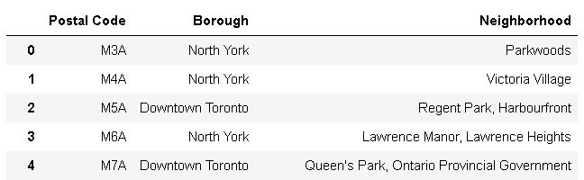
Methodology
After collecting data from various sources, it was necessary to filter out the data that will be used to get solution.
Data collected from Wikipedia page https://en.wikipedia.org/wiki/List_of_postal_codes_of_Canada :

Slide 6
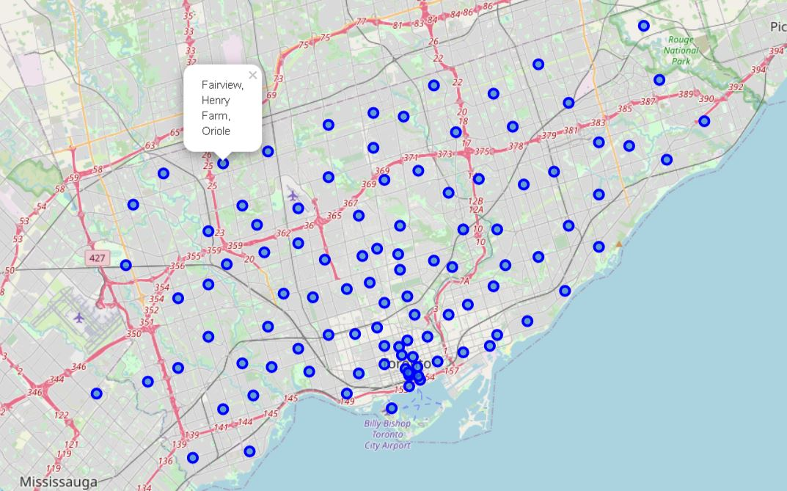
Visualization of data of Toronto, CA

Slide 7
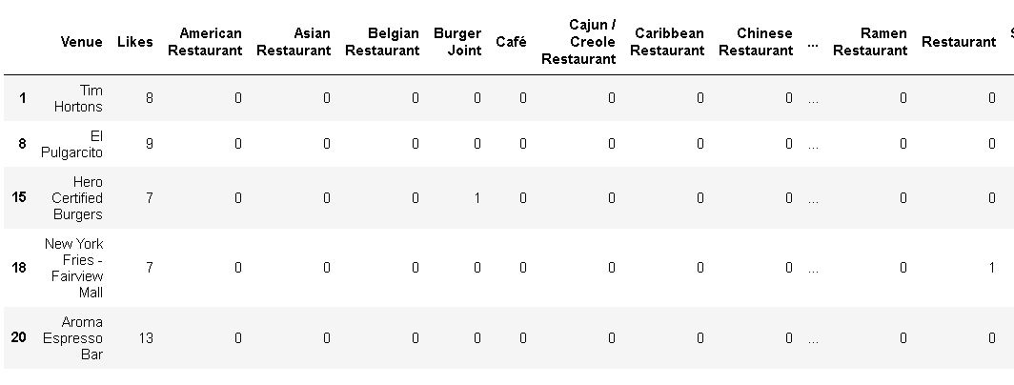
Data passed to KMeans for clustering

Slide 8
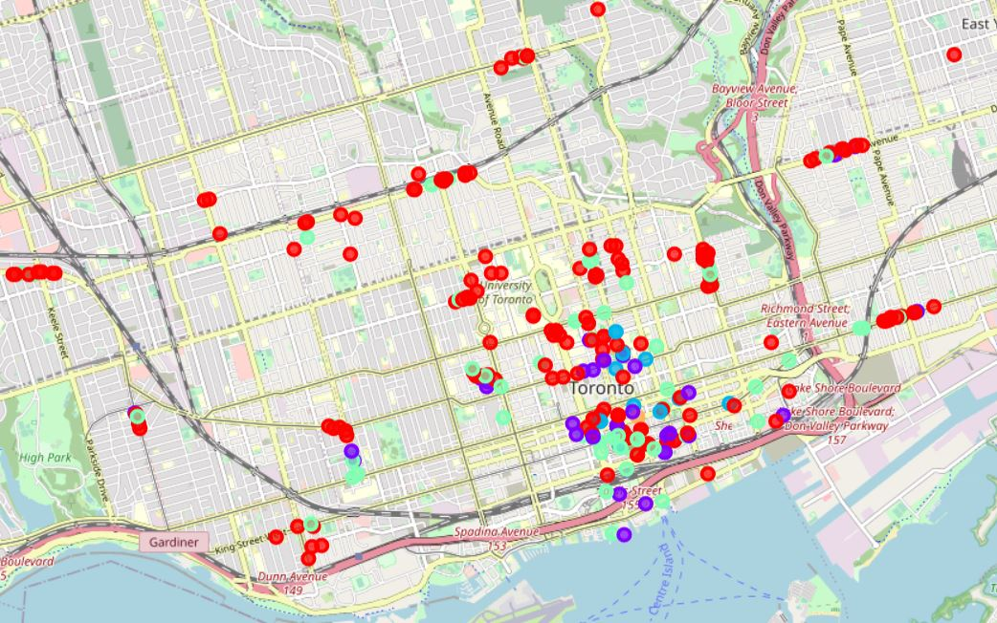
Result
The photo shows different clusters on map showing result of KMeans.

Slide 9
Analysis
we can easily find highly rated places in particular neighborhood in Toronto.
It can also be used to analyze that in which area what kind of food places have low number of likes. So, if someone want to open a restaurant or food chain.
They can do so and have good sells if they can provide good food as other places are not much popular in neighborhood.

Slide 10
Conclusion
The problem mentioned in introduction is solved using data from various places, we found out similar places which can be recommended to anyone looking for a good place to eat.

