Slide 1
Bhoomi Kaaval
CLINE AI BUILDER HACKATHON · ROUND 2
SALE DEED
भूमि காவல் Bhoomi = land (Sanskrit/Hindi) · Kaaval = guard (Tamil)
Check your property papers before you pay.
✓
An AI reader plus fixed rules, with a page and a quote behind every finding. It never certifies title.
Notes:
Bhoomi Kaaval: Bhoomi is land, Kaaval is guard. We help a buyer or a Sub-Registrar check property documents before money changes hands, and we always show where each finding comes from. We never certify title.

Slide 2



India registers deeds, not title
Registration is not title
Risk hides in the papers
No record of what was seen
Registering a deed records that it was presented and executed. It does not prove the seller owns the land, and registering officers cannot decide title.
A broken ownership chain, a second sale of the same plot, an area that does not add up: all buried in scanned deeds, in several languages.
When a dispute follows, there is no structured record of which risks were visible at the moment of registration.
The result: preventable property disputes, for buyers and for honest officers.
Notes:
The gap is structural: registration confirms a document was executed, not that the seller owns the property. Officers cannot decide title, so signals that sit inside historic deeds go unseen.

Slide 3


One engine, two faces
Core engine: deed bundle → structured fields → fixed rules → findings with evidence
Citizen: Check my documents
Sub-Registrar: Officer console
Pick or upload deeds: PDF, scan or phone photo, English or Hindi
See every finding with its page and quote
Get an ask-your-seller list and an advocate brief
Record a disposition and a reason for every flag
Class B advisories can never be a refusal ground
The decision is signed into a tamper-evident log
Design rule: the AI only reads. Fixed, explainable rules decide. Legal wording never comes from free AI text.
Notes:
The same core serves two users. The line we keep repeating: the AI only extracts. Every flag comes from deterministic code, so it is explainable and reproducible.

Slide 4







How it works, end to end
Upload
Redact
AI reads
Cross-check
Rules
Decide
Sign + log
PDF, scan or photo; SHA-256 of the original file
Aadhaar and PAN masked before any image is sent
Vision model returns value, status, confidence, quote
Text layer or Tesseract confirms the quote is on the page
Class A and Class B checks, no AI involved
Officer records a reason for every flag
Hash-chained, Ed25519-signed ledger entry
Extraction: reads and verifies the page
Deterministic
Human + ledger
Anything the AI cannot read becomes “needs review”. No rule ever fires on a field we could not read, so a bad scan never produces a false accusation.
Notes:
Walk left to right. Steps one to four are extraction: we hash the original file, mask ID numbers, let a vision model read the page, then check its quote against an independent reader. Step five is deterministic rules. Steps six and seven are the officer and the signed ledger.

Slide 5



Three states, never a guess
Extracted
Absent
Unreadable
Read with enough confidence and a quote found on the page.
The page is readable and the item is genuinely not stated.
Probably there, but we cannot read it reliably.
The rules use the value.
Class A rules may fire, for example a power of attorney with no registration number.
Treated as unknown: no flag is raised and a human reviews it.
Confidence, from three signals
Real result from our tests
40% model's own score
30% value has the right format
30% quote really found on the page
On a poor scan, “POA number not stated” was not trusted. It became “needs review” instead of a false hard stop.
Notes:
This is our core idea. Most tools collapse missing and unreadable into one bucket, which either hides real gaps or invents false ones. We keep them apart. The model's own confidence is poorly calibrated, so it gets only 40 percent of the vote.

Slide 6


Class A and Class B checks
Class A · Registrability
Class B · Title advisories
Objective checks that may justify refusal or return for correction.
Signals to investigate. Never a ground for refusal.
A1 Power of attorney has no registration number
A2 Property area and unit stated
A3 All four boundaries described
A4 Presented within the allowed window (draft rule)
A5 Seller and buyer names present
A6 Consideration (price) stated
A7 ULPIN consistent with the parent deed
B0 Registry cross-check could not run
B1 Seller is not the registry's current owner
B2 Possible double sale in the registry index
B3 Area exceeds the parent deed
B4 Boundary differs from the parent deed
B5 Dates out of order
B6 Possible same person, spelled differently
B7 Unregistered instrument in the chain
B8 Encumbrance recorded in the registry
A chain gap explained by a succession document raises no B1 (our decoy case). A mock registry index stands in for NGDRS and land-stack APIs. Rules are heuristics, not legal conclusions.
Notes:
Class A are objective registrability checks. Class B are advisories: the officer records a disposition, but cannot refuse on title grounds, matching the draft Registration Bill's position that registering officers do not decide title. Draft-Bill statements stay labelled as draft.

Slide 7
Every finding shows its source
A1
Power of attorney has no registration number
1
Check my documents
Findings, fields read with confidence, ask-your-seller list, advocate brief
🛑 Class A · Registrability
POA_REGISTRATION_MISSING
📍 Page 1
2
Officer console
“…acting through his duly constituted attorney Anil…”
A disposition and a reason for every flag, then a signed receipt
Why it matters: the deed was executed through an attorney, but gives no registration number for that power of attorney.
3
Decision ledger
Next step: obtain the registered power of attorney and its registration number.
Chain view, one-click verify, and a tamper test on a copy
Example from a synthetic sample deed.
Notes:
This is what a user actually sees. Every flag carries the page and the exact words. The same data feeds the citizen view, the officer console and the ledger.

Slide 8
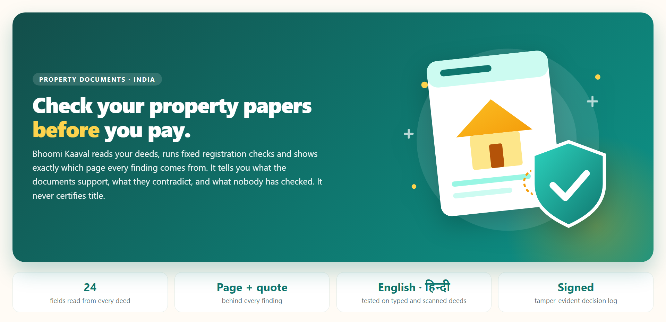
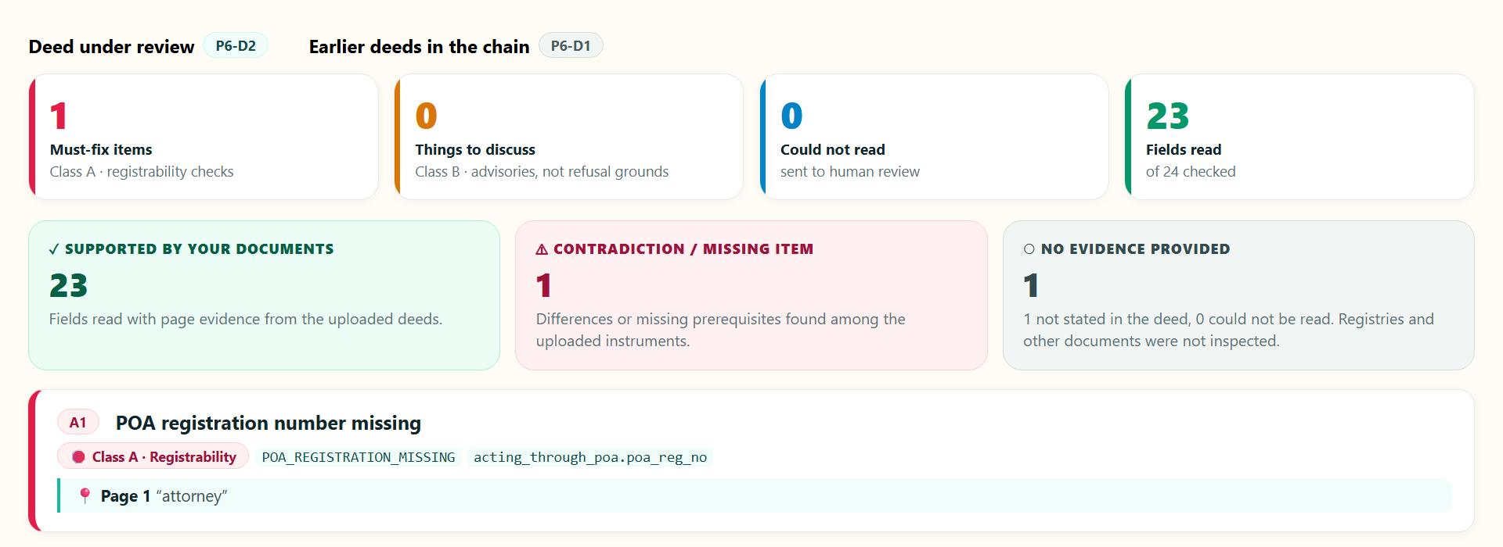
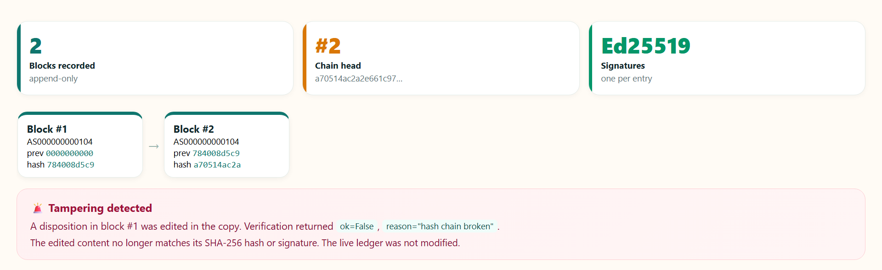
The app, as built
Findings, each with its page and quote
Home
A website-style landing page: what it does, three simple steps, why it can be trusted, and what it never does.
Ledger chain and the tamper alert
Rendered from the app's own pages and styles (synthetic sample data).
Notes:
These are the app's own pages rendered with its real styles, using the synthetic sample data. The finding card shows the red Class A item with its page; the ledger shows two linked blocks and the red alert from the tamper test.

Slide 9

Safe by design, provable by log
Safe by design
Tamper-evident decision record
Aadhaar and PAN numbers are masked before any image is sent to a model
Never “clean”, never “safe”, never a title score
Legal wording comes from a fixed library, not AI text
Every result lists what we did not check
Block 1
Block 2
Block 3
prev hash → this hash
prev hash → this hash
edited after the fact
Verification fails at block 3
Each entry binds: SHA-256 of the original files, extraction hash, ruleset and model version, salted name commitments, and an Ed25519 signature. A hash-chained, signed log: not a blockchain, and it proves integrity, not fault.
Names are stored in the log only as salted commitments.
Notes:
The ledger shows what the system produced, what the officer recorded, and that none of it was altered afterwards. We say tamper-evident, not blockchain, and we do not claim it proves fault: for Class B advisories the officer may rightly proceed.

Slide 10






Models and tools
Vision LLM
Local reader
Cline SDK agent
Gemini Flash reads the page images. One provider interface: Claude also supported, a self-hosted model can be swapped in.
Tesseract 5 (English, Hindi, Marathi, Assamese packs) and the PDF text layer. Cross-checks the model and finds ID numbers to mask.
@cline/sdk on Node 22 reviews fields the extractor could not read. It can only propose; Python re-checks.
Python core
Rules + ledger
Streamlit app
PyMuPDF, OpenCV, pydantic and rapidfuzz for ingest, preprocessing, validation and matching.
Deterministic Python rules, SQLite, SHA-256 hash chain, Ed25519 signatures, salted HMAC commitments.
Website-style interface with SVG illustrations. Runs offline from cached extractions for the demo.
Notes:
Gemini does the reading; everything that decides is ordinary code. The extractor sits behind one function, so a department can later swap in a self-hosted model and keep documents on its own infrastructure.

Slide 11


How Cline was used
In the build
Inside the product
Cline (ClinePass, in VS Code) made real changes: a prompt fix so the extractor must return every field, plus a version bump and a test
Cline wrote the request-list test suite and the README write-up
Each change is a visible diff, a green test run and a commit
Cline SDK review agent
get_field
read_page_text
validate_field
propose_correction
Python re-checks: format valid AND quote found on the page
To be plain: the first version of the pipeline, rules bridge and ledger signing was drafted with other AI coding assistants. The commit history shows who contributed what.
It has no tool to run rules, create flags or touch the ledger. It works with the agent switched off. On our test set it recovered 0 of 1 field: deliberately conservative.
Notes:
Two kinds of Cline use. In the build, Cline made reviewable changes with tests and commits. Inside the product, a Cline SDK agent helps with unreadable fields but is deliberately powerless: it can only propose, and ordinary code decides whether to accept. We also say plainly that other AI assistants wrote the first pass.

Slide 12
Measured results
161
labelled fields, 7 synthetic deeds: clean and scanned English, Hindi, handwriting-style
11 / 11
rule cases correct on planted defects, including the succession decoy
75
offline tests pass
Synthetic data we authored; one model. One blurred “Bora” was read as “Boro”.
Rule results use canned extraction replies, so they test the rules, not OCR. Abstained fields: 1.9% (sent to review).
Notes:
These numbers show the pipeline logic works. They do not show real-world OCR robustness: the documents are synthetic and the labels were authored by the team. Recent benchmarks show vision models degrade on real Indic scans, so we report abstentions and say so.

Slide 13



Challenges we hit and fixed
5 problems found with real inputs, all fixed:
Privacy · 1
Reliability · 2
Integration · 1
Cost and quota · 1
An Aadhaar number was not masked when a full stop (or the Hindi danda) followed it
Punctuation-aware matching and regression tests
Gemini spent 15.7k of 16.4k tokens “thinking”; the reply was cut off
Capped thinking; a cut-off reply is an error, never parsed
On empty forms the model looped, copying dotted blanks
Prompt rule, one re-ask, and only valid replies are cached
Extractor and registry disagreed on the ULPIN format
14-character IDs everywhere, short codes aliased
Free API tier: 20 requests per day per model
Raw-reply cache and offline sample data for the demo
Notes:
Real documents found real bugs that clean test files never showed. The redaction one matters most: a privacy guarantee is only as good as the formats it has been tested on.

Slide 14






Against the evaluation criteria
Creativity and uniqueness | A three-state reader on top of fixed rules, and a Class A / Class B split so officers are never pushed to refuse on title grounds
Innovation | “Needs review” instead of guessing; quotes checked against an independent reader; a signed, tamper-evident decision record
Real-world usefulness | A citizen pre-flight and an officer console, with an ask-your-seller list; built to sit on top of land-record systems, not replace them
Effective use of Cline | Cline in VS Code made reviewable changes with tests and commits (see the demo video and the commit history)
Usability and execution | Website-style app, plain-language wording, three clear flows, runs offline for the demo
Technical implementation | Python pipeline, 75 tests, masking before any model call, Ed25519 plus hash chain, swappable model provider
Bonus: Cline inside the product | A Cline SDK review agent that can only propose, with every proposal re-checked on the page
Notes:
This slide maps our work to the judging criteria. For Cline we describe exactly what Cline did, and the bonus is the SDK agent inside the product.

Slide 15



Limits and what comes next
What we have and have not tested
Roadmap
English, typed deeds (digital and scanned)
Tested
Pilot with one Sub-Registrar office on a sandbox registry feed
Hindi, typed deeds (digital and scanned)
Tested
Self-hosted Indic vision model, so documents never leave the department
Handwriting, using a handwriting font
Partly
State rule packs and a real Indic handwriting test set from consented specimens
Real handwritten deeds
Not tested
Assamese deeds
Not tested
Transliteration-aware name matching across scripts
Real deeds and a real registry feed
Not tested
A Cline-powered assistant that answers “why was this flagged?”
Also: handwritten ID numbers cannot be masked automatically, and a deed-only view cannot see inheritance, mutations or litigation.
Next
Later
Notes:
Left: exactly what we have and have not tested, so nothing is overclaimed. Right: the roadmap, with the pilot and a self-hosted model first, because those matter most for real use.

Slide 16


Bhoomi Kaaval
Land guarded by evidence, not guesses.
It shows what your documents support, what they contradict, and what nobody has checked. It never certifies title.
Demo video · GitHub repository and README · Built with Cline
Notes:
Close on the promise and the limit: we show what the documents say and where it comes from, and we never certify title.

