Slide 1
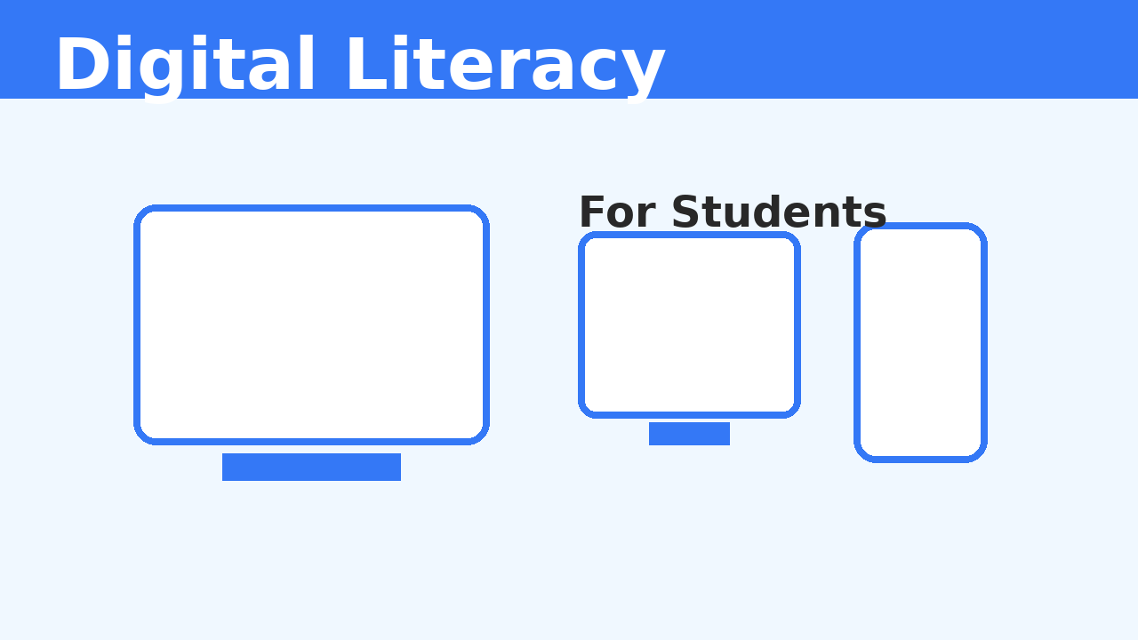
Digital Literacy for Students
Prepared by: Hardik Rajpal | Reg No: 25BMR10003

Slide 2
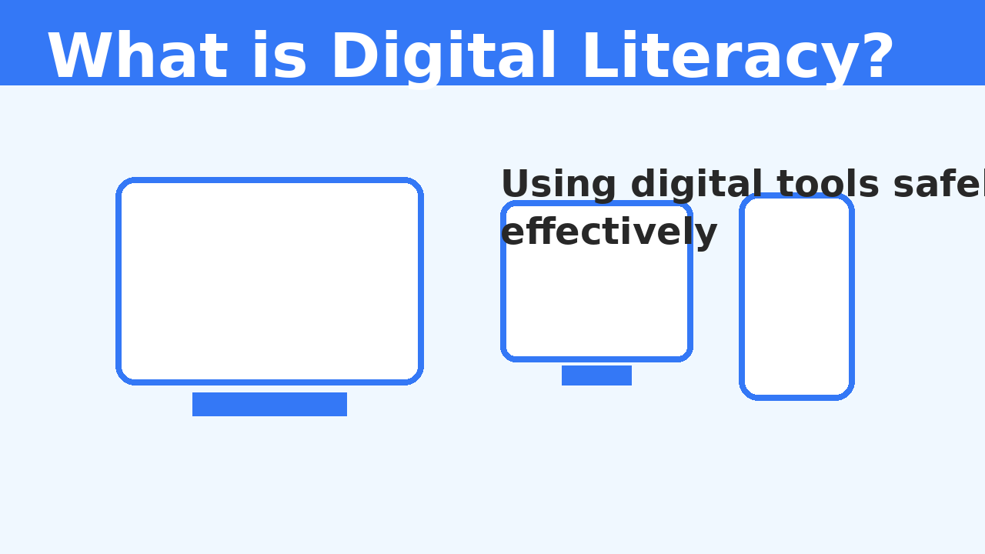
What is Digital Literacy?
Digital literacy means the ability to use digital devices, websites, apps, and online tools properly, safely, and effectively.

Slide 3
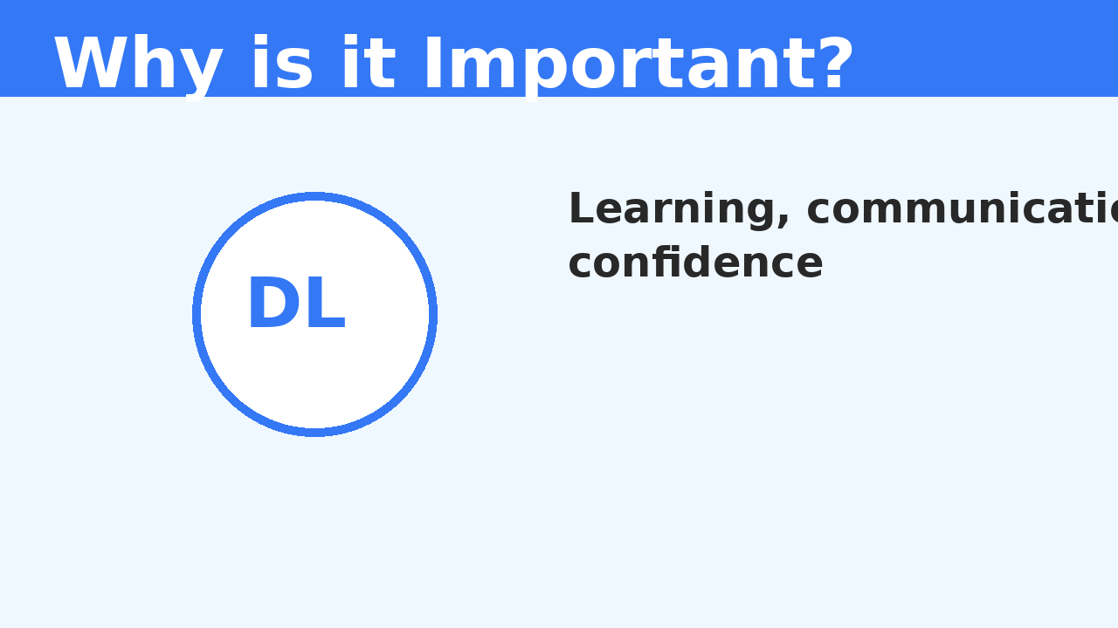
Why is Digital Literacy Important?
Helps students learn better online
Improves communication
Builds confidence with digital tools
Keeps students safe on the internet
Creates a positive online presence

Slide 4
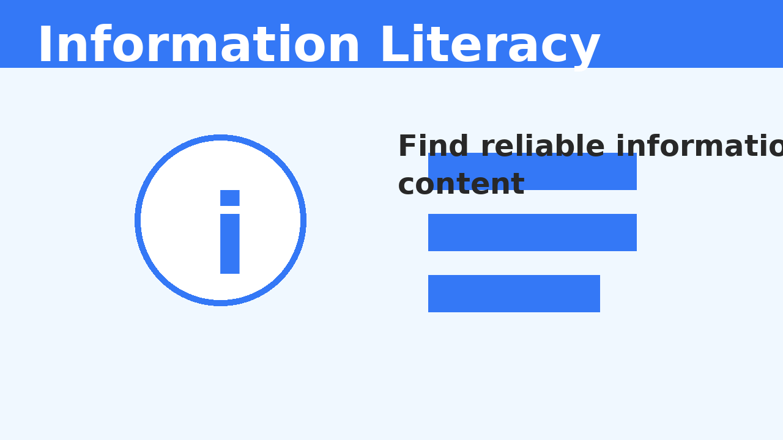
1. Information Literacy
Searching information online
Using trusted sources
Avoiding fake or misleading content

Slide 5
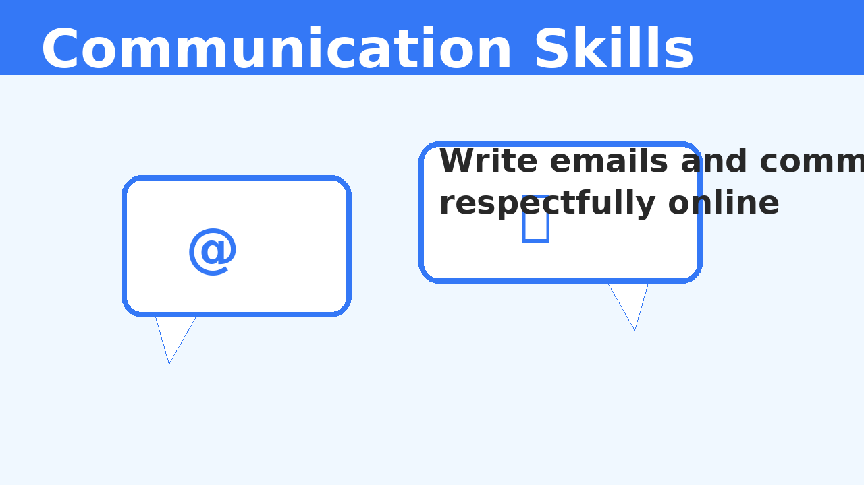
2. Communication Skills
Writing emails properly
Joining online classes respectfully
Using digital communication tools effectively

Slide 6
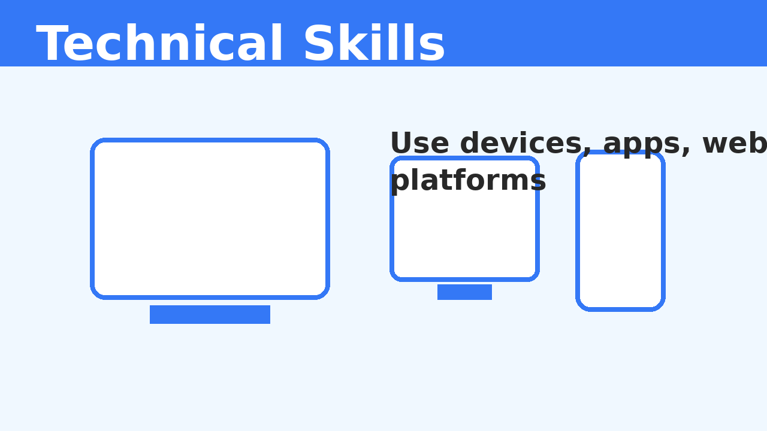
3. Technical Skills
Using devices and software
Working with websites and online tools
Basic understanding of digital platforms

Slide 7
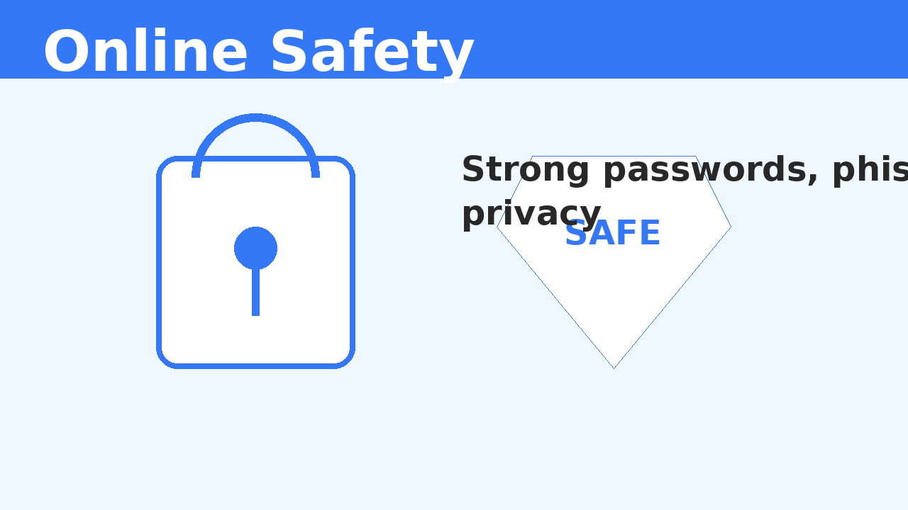
4. Online Safety
Creating strong passwords
Avoiding phishing and scams
Keeping personal information safe

Slide 8
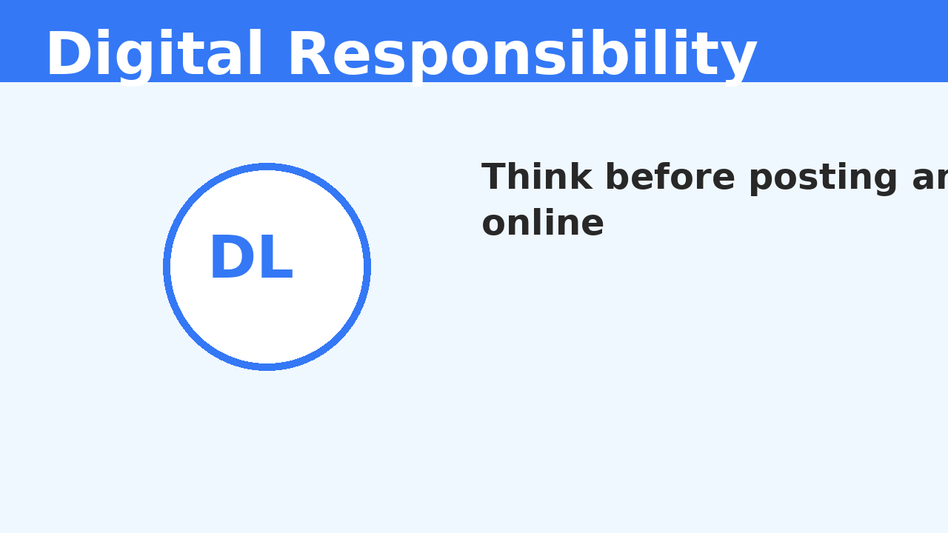
5. Digital Responsibility
Respecting others online
Using social media wisely
Thinking before posting

Slide 9
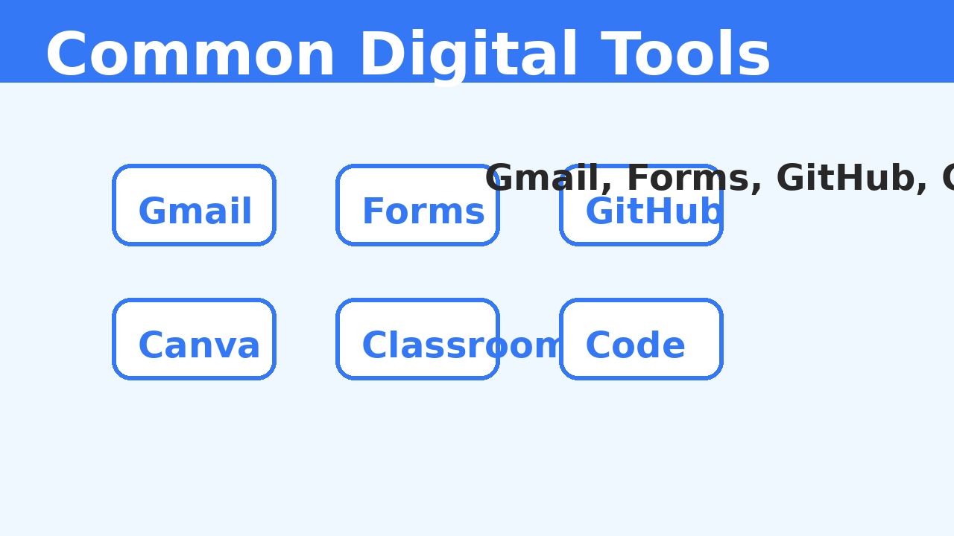
Common Digital Tools Used by Students
Gmail
Google Forms
GitHub
Google Classroom
Canva
Coding Platforms

Slide 10
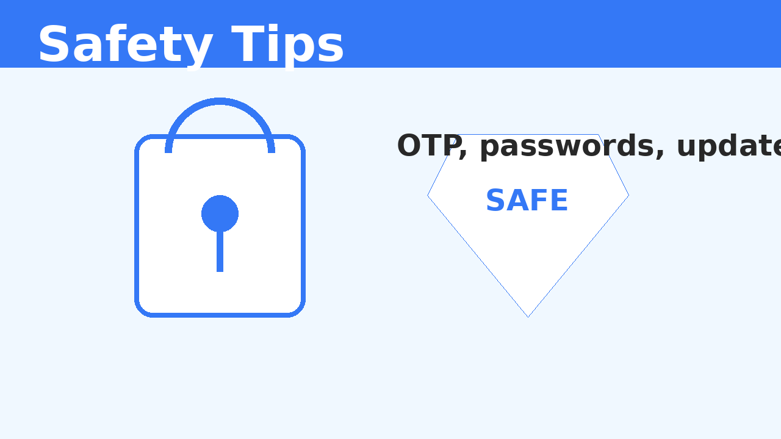
Safety Tips
Never share your OTP or password
Check links before clicking
Use strong passwords
Keep your apps and devices updated
Avoid sharing too much personal information online

Slide 11
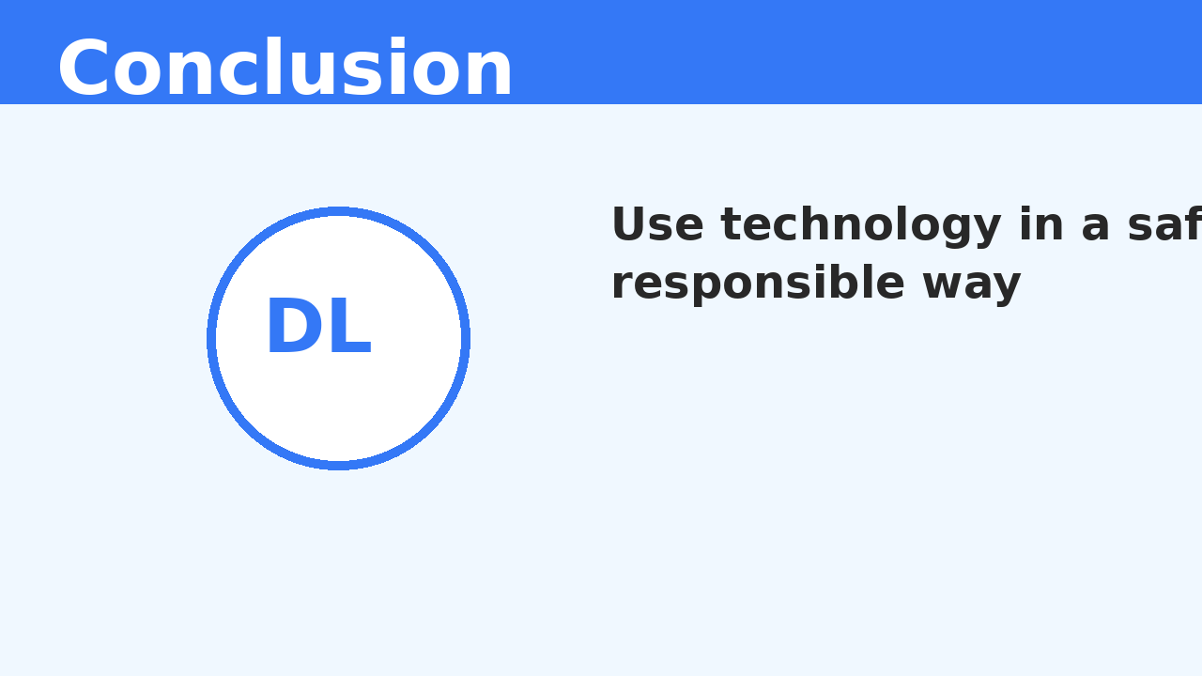
Conclusion
Digital literacy is an important life skill for students.
It helps us use technology in a safe, smart, and responsible way.

