Slide 1

CASE 2: GROUPING PRODUCTS INTO FAMILIES
Name: Hardik Singh
College: Indian Institute Of Technology Patna
Date: 08/02/2024

Slide 2
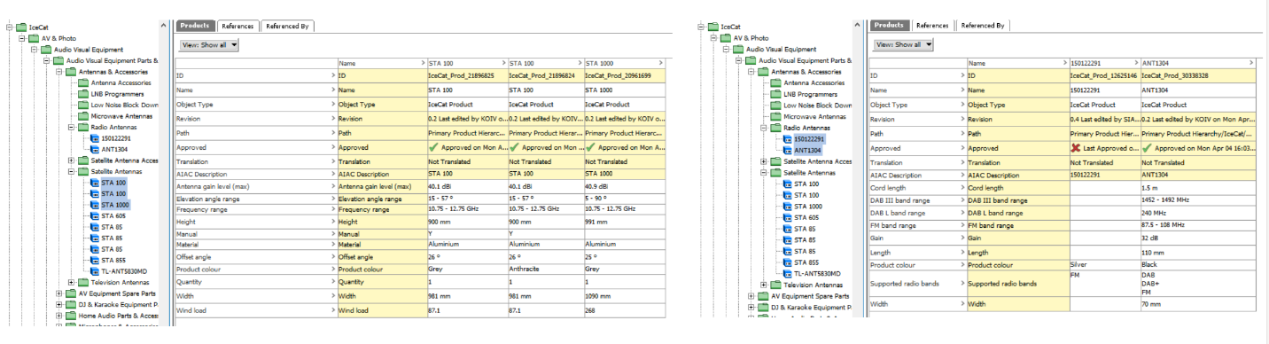
OVERVIEW OF PROJECT
In order to minimize data maintenance in Master Data Management, products are often grouped into families, so that for instance features such as inheritance can be exploited (similar products have same features).
For instance, a number of T-shirts of different sizes and colors being grouped because they’re made from the same fabric.
Objective: From a large dataset, bundle similar products into logical product families – I have used unsupervised machine learning

Slide 3
IMPORTANCE FOR CLUSTERING FOR COMPANY
The importance of clustering for a company lies in its ability to uncover meaningful patterns and insights within the data, which can inform strategic decision-making and drive business success.
Market Segmentation: Clustering helps in segmenting customers or market segments based on similarities in behavior, preferences, or demographics.
Product Development: By clustering products based on features, usage patterns, or customer feedback, companies can identify product categories or attributes that resonate with specific customer segments.
Resource Allocation: Clustering can aid in optimizing resource allocation by identifying areas of focus or investment that are most likely to yield positive returns.

Slide 4
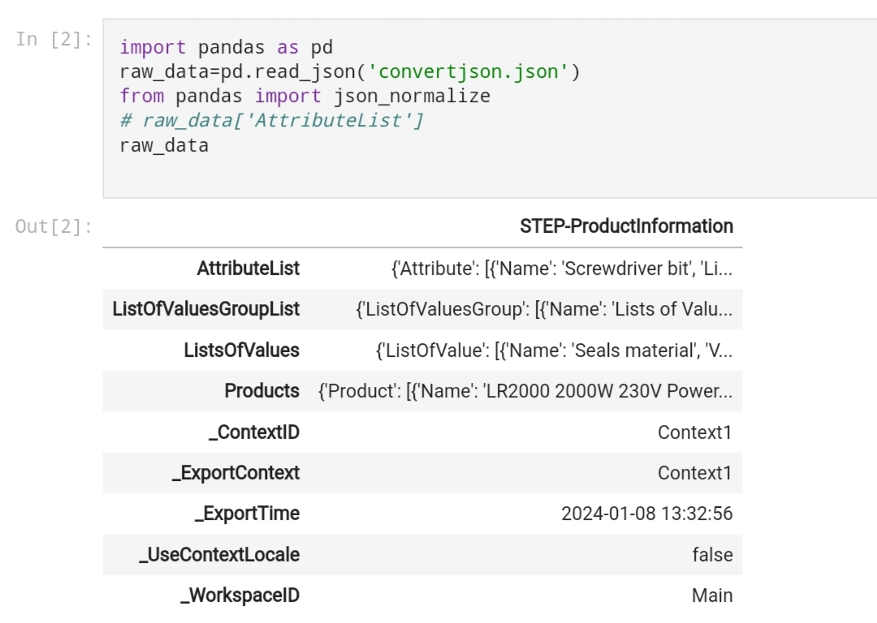
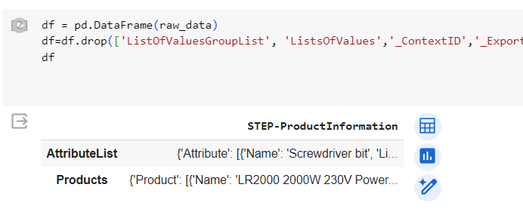
OVERVIEW OF THE DATASET
The dataset contains two major rows as shown below, which will give us grouping information (Products and Attributes).
Both rows have nested JSON containing information for various attributes and products.
There are overall nearly 12,000 products and 4,000 attributes in the dataset, which will be the basis of our clustering.
Removing unnecessary row’s

Slide 5
PART 1:
CLUSTERING ON BASIS OF ATTRIBUTES

Slide 6
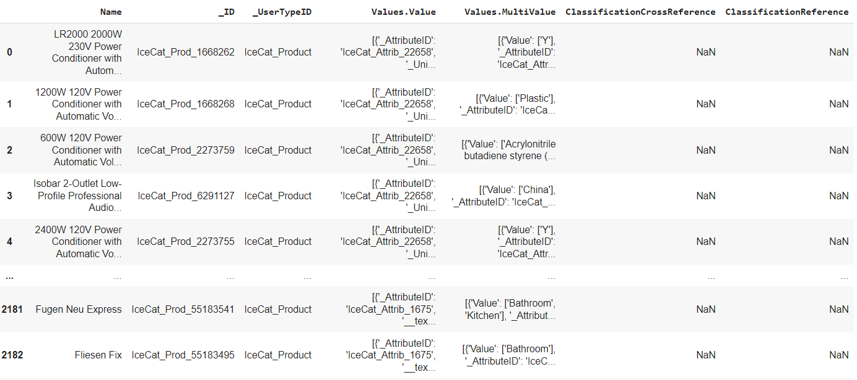
DATA PREPROCESSING
Flattening the nested JSON inside the dictionary to obtain product information in a more comprehensible format.

Slide 7
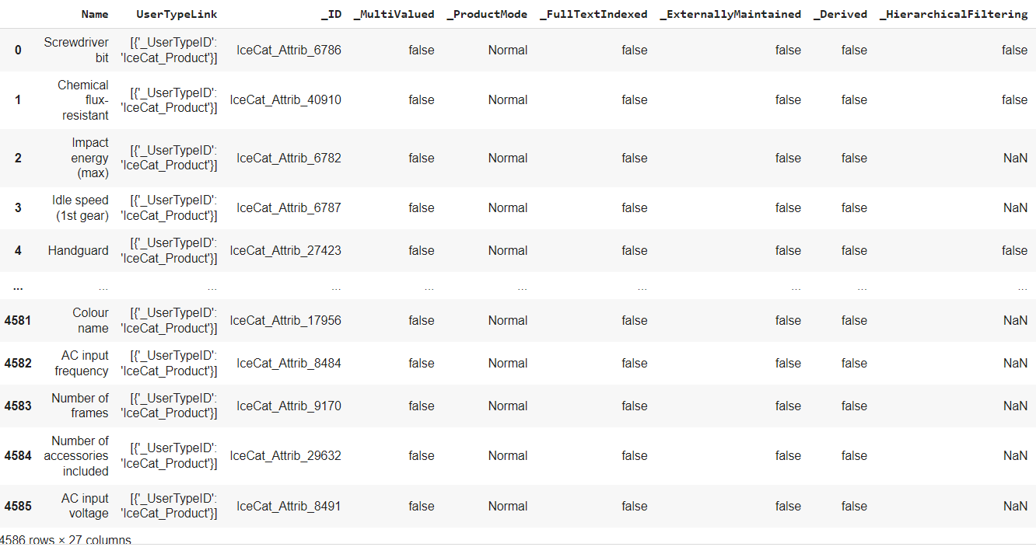
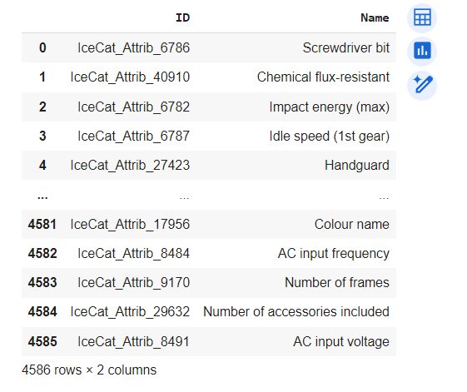
DATA PREPROCESSING
2. Flattening attributes in the same way and creating a mapping of attribute IDs with attribute names in a separate dictionary.
Mapping attribute’s ID with it’s name

Slide 8
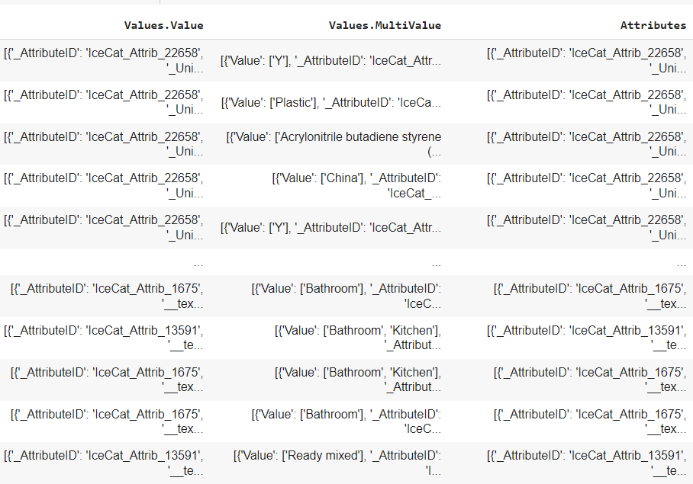
DATA PREPROCESSING
3. Removed NaN row’s as they were nearly 5% of the data.
4. Combining Values.Values and Values.MultiValues column’s into a single Attribute’s column

Slide 9
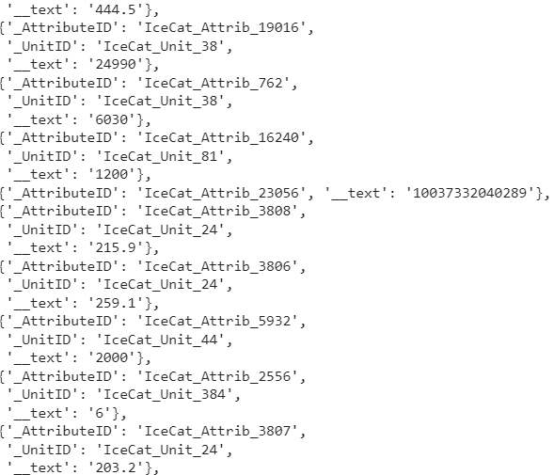
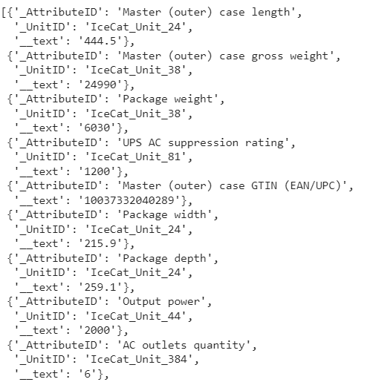
DATA PREPROCESSING
4. Now, since each row in the attribute's column is a list of dictionaries where each dictionary represents a product attribute, there is an attribute ID for each attribute of the product. This ID has been previously mapped with its corresponding name using attribute information. We will use this mapping to replace the IDs with names here, as name of attribute’s is an important information for grouping data. ID’s do not hold much inference.
Replace IceCat_Attrib_xyz with Attribute’s actual name

Slide 10
WHAT WE ACHIEVED TILL NOW
This basic preprocessing step has laid the foundation for our clustering analysis by enabling us to construct the fundamental building blocks.
An important observation in the dataset is that it contains a variety of products, making two randomly chosen products totally different in terms of existing attributes. For example, a chair can have attributes related to legs, but a pillow cannot..
Based on this observation, I decided to cluster my products based on their existing attributes, i.e., the names of attributes that exist for each product.
After clustering based on the names of existing attributes, we can further cluster the formed clusters to refine our clustering and obtain more similar groups.
Let’s pre-process more!

Slide 11
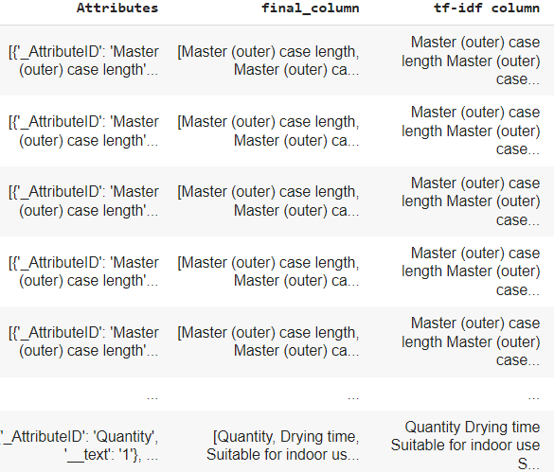
FURTHER PREPROCESSING
Extracting the names of attributes from the dictionaries in the attributes column for each product and storing them as lists in a new column named ‘final column’.
Furthermore, concatenate the items of the lists to convert them into strings and add them in a new column. Finally, we obtain a new column ‘tf-idf column’ in which each row has a string.

Slide 12
USING TF-IDF
Since I have a final column named 'tf-idf column', I will apply clustering on it. However, before that, I need to convert the string data into numerical data, which I will do using the TF-IDF technique.
Why Tf-Idf?
Relevance of Terms: TF-IDF reflects the importance of terms in a document relative to a corpus. In the context of clustering based on textual data, it helps in identifying the significance of terms within each document (or in this case, each product attribute list).
Dimensionality Reduction: By using TF-IDF, common and less important terms are down-weighted while unique and relevant terms are up-weighted. This helps in reducing the dimensionality of the data and focusing on the distinguishing features of each document, which is beneficial for clustering.
Normalization: TF-IDF normalizes the term frequencies based on their occurrence across the entire dataset. This ensures that the clustering algorithm is not biased towards terms that are simply more frequent overall, but rather towards terms that are relatively more important within each document.
4.Compatibility with Clustering Algorithms: Many clustering algorithms, such as K-means, work well with numerical data. TF-IDF provides a numerical representation of textual data that is suitable for clustering algorithms.

Slide 13
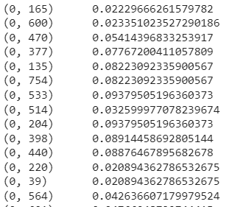
RESULT OF TF-IDF AND DIMENSION REDUCTION
String data converted to numerical data in which clustering can be applied.
The dimension of the resulting TF-IDF matrix is typically large, especially when dealing with a large number of documents or terms. To address this issue and reduce computational complexity, dimensionality reduction techniques like Singular Value Decomposition (SVD) or Principal Component Analysis (PCA) are commonly used. I used SVD and reduced the dimension to 100 columns (subjective to requirement).

Slide 14
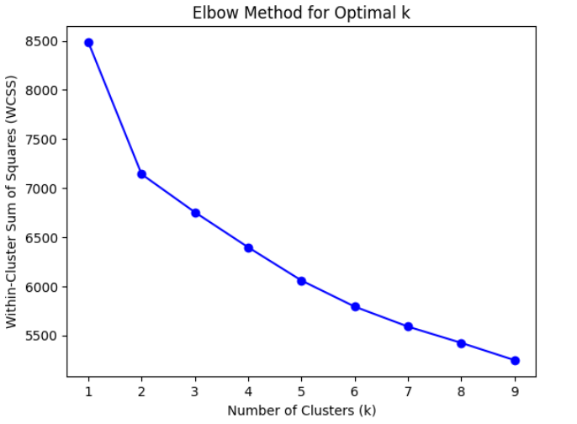
CLUSTERING ON FINAL DATA
After reducing dimension’s I used K-Means clustering to cluster the data.
Why K-Means:
K-Means is computationally efficient and can handle large datasets with a large number of samples. It works well with numerical data and is relatively easy to implement.
Also method’s like tf-idf work well with K-Means.
How to find appropriate number of cluster’s:
Using methods like the elbow method to determine the appropriate number of clusters is a common approach in clustering analysis.

Slide 15
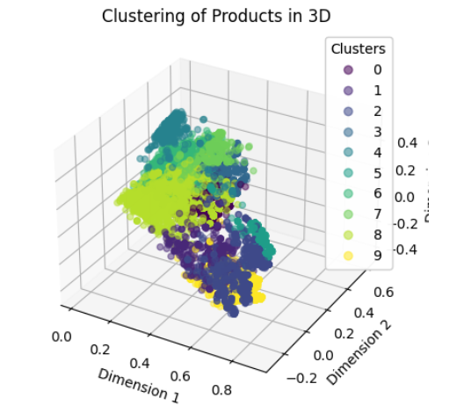
FINAL CLUSTER’S ON BASIS OF ATTRIBUTE’S NAME
On setting a optimum value of K (subjective to requirement), I got the following cluster’s
Saving element’s of each cluster in a separate csv file we will move to part2 for further refinement.

Slide 16
PART 2:
MULTILEVEL CLUSTERING

Slide 17
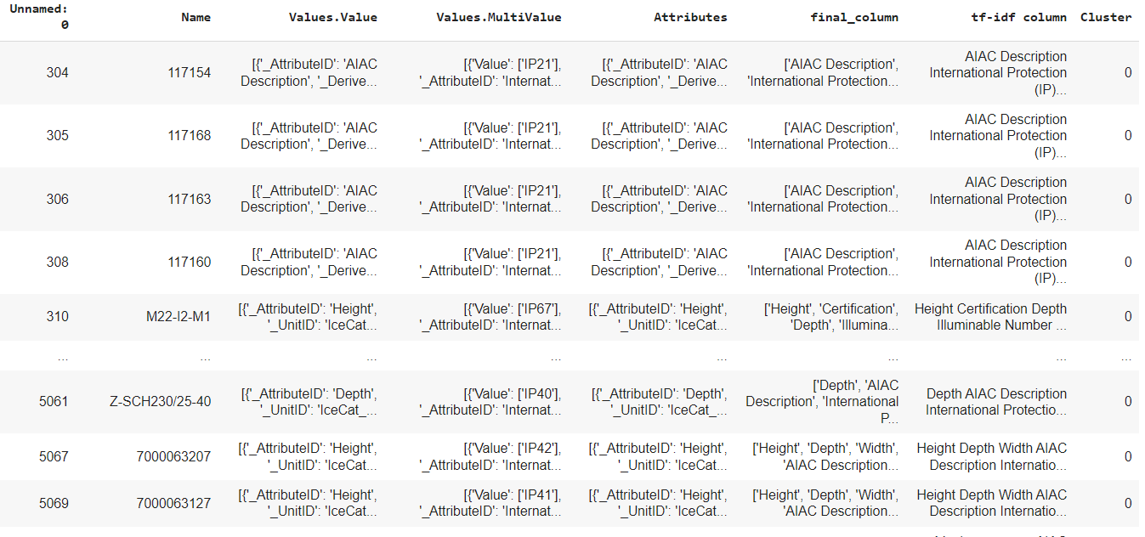
ANALYZING A SINGLE CLUSTER OF PART 1
Based on the previous clustering, we will further divide each cluster into sub-clusters.
As we have divided clusters based on similar existing attributes, we will now sub-divide each cluster based on attribute values.
Elements of cluster 0

Slide 18
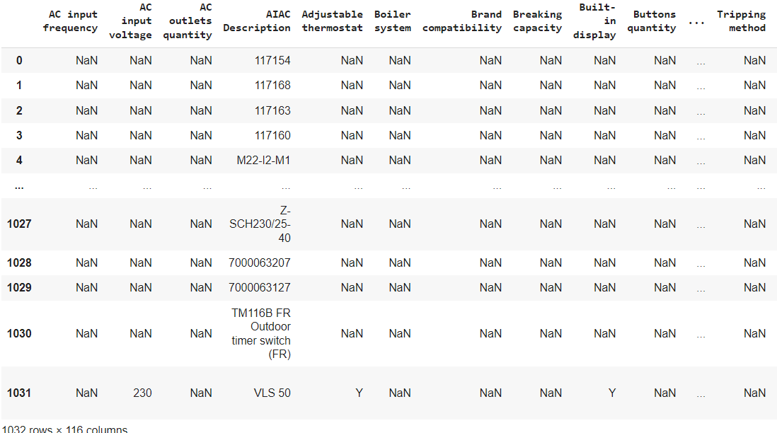
PRE-PROCESSING
Forming a new Data Frame on which clustering will be applied. In this Data Frame, all rows represent products and columns represent existing attributes. (Missing values filled with NaN).
Conversion from one dataframe to other

Slide 19
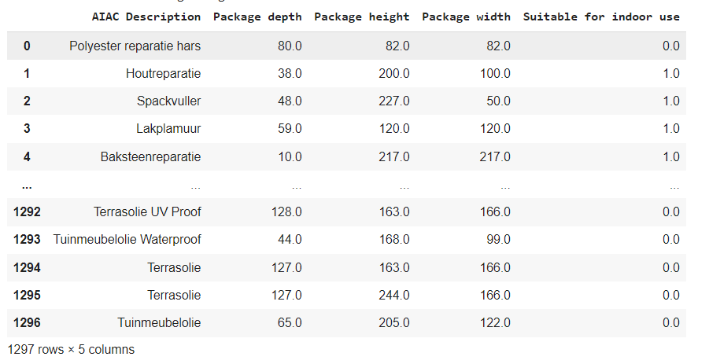
FURTHER PRE-PROCESSING
Removed those column’s having NaN value’s greater than 5% (subjective to requirement).
Handle data types by converting numerical data to numbers and encoding categorical data.
Conversion from one dataframe to other

Slide 20
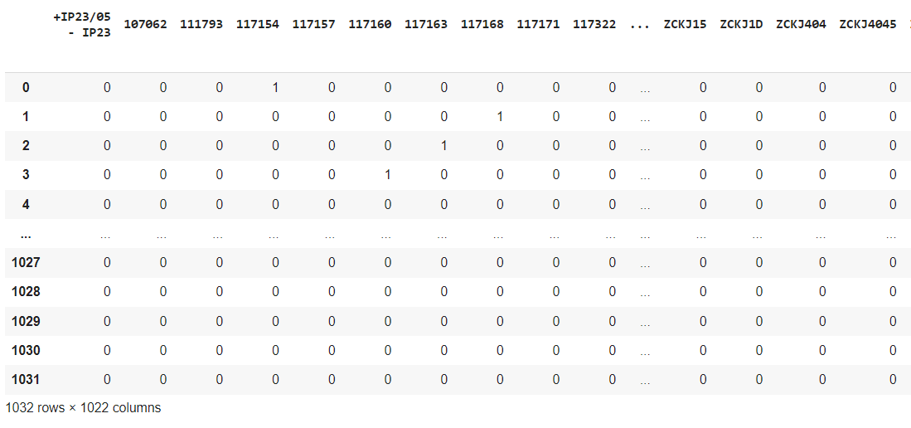
USING ONE HOT ENCODING /TF-IDF (if necessary)
Categorical data was handled using the one-hot encoding method, which transformed each categorical variable into a vector.

Slide 21
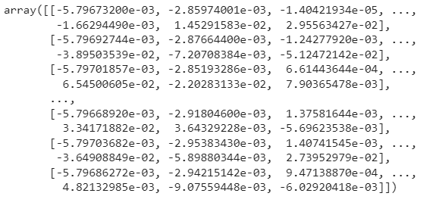
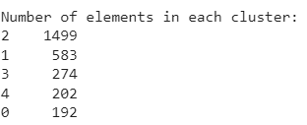
USING PCA TO REDUCE DIMENSION AND CLUSTERING
PCA was used to reduce the dimensions while preserving the maximum variability of the data, followed by clustering the data.
Clustering
Clustered data
Data after PCA

Slide 22
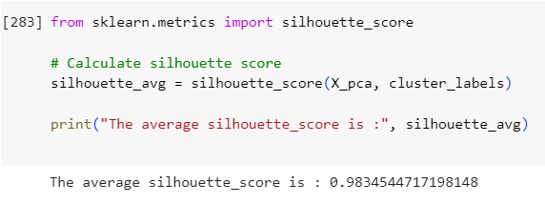
HOW TO EVALUATE THE CLUSTERING?
The silhouette score is a metric used to evaluate the quality of clustering in unsupervised learning methods like K-means clustering. The silhouette score ranges from -1 to 1:
A score close to +1 indicates that the data point is well-clustered and is far away from neighboring clusters.
A score of 0 indicates that the data point is on or very close to the decision boundary between two neighboring clusters.
A score close to -1 indicates that the data point may have been assigned to the wrong cluster.
Achieved nearly 1 silhouette score

Slide 23
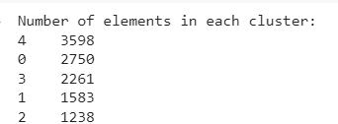
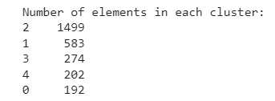
SUMMARY
The dataset was extensive and diverse, comprising a wide range of products with varying attributes.
Due to this diversity, it was essential to group the products into clusters based on similarities in their existing attributes.
Initial clustering was performed to group products with similar attributes together.
Following the initial clustering, the clusters were further refined by considering the specific values associated with the attributes.
Subsequently, sub-clusters were formed within each initial cluster to enable a more detailed grouping based on attribute values.
Part1 clustering
Part2 clustering

Slide 24
                Thank you
                Now let’s visit the code

