Slide 1

CGAS MINI PROJECT
FoodBert
under supervisor : Ganesh Bagler
Presented By :
Gunjan Panda (MT22099)
Shubhangi Agrawal (MT22126)
Hardik Kumar (2020506)

Slide 2
1
PROBLEM STATEMENT
Creating Bert embeddings to capture the culinary knowledge encapsulated in recipe instructions and the ingredients section.
OBJECTIVE-1
Creating average Bert Embeddings for all the ingredients in the Recipe
Instructions & Ingredients Section.
CGAS Mini Project : FoodBert
OBJECTIVE-2
Finding the cosine similarity among all pairs of ingredients.
OBJECTIVE-3
Manually evaluating ingredient pairs with Top X & Bottom X pairs of
ingredients based on a reproducible protocol.

Slide 3

2
METHODOLOGY
2
3
1
2
3
4
5
DATASET COMPILATION
DATA PRE-PROCESSING
COUNT INGREDIENT OCCURENCES PER RECIPE INSTRUCTION
CALCULATE BERT EMBEDDINGS
MANUAL VERIFICATION OF BERT EMBEDDINGS
Combine data for ‘South-American’ Cuisine based on common field ‘Recipe-ID’ field. getting ‘RecipeID’, ’Ingredients’ and ‘Recipe Instructions’ as final set of features.
Clean Ingredients by converting multi-word ingredient into single word.
Clean Recipe Instructions by removing digits, extra spaces and punctuations.
Tally occurrences of unique ingredients in all recipes,
creating a dictionary with ingredients as keys and counts as values. Use this dictionary to calculate bert embeddings.
As Bert has high computation power, randomly sample 100 recipes for ingredients with over 100 occurrences.
Calculate average Bert embeddings for each ingredient.
Use the Bert Embeddings generated for each ingredient to get the most similar ingredient based on Cosine Similarity score. Manually verify the similar ingredient pairs.

Slide 4
DATA PRE-PROCESSING
3
CONVERT MULTI-WORD INGREDIENTS
Ex: mozzarella cheese gets replaced with mozzarella_cheese converting it from a multi-word ingredient to a single word ingredient.
CLEANING INSTRUCTIONS
Cleaning ingredient phrases by removing digits, extra spaces and punctuations.
MEANINGFUL INGREDIENT SENTENCES
CONVERTING MULTI-WORDS IN INSTRUCTIONS
Converting ingredients of each recipe into meaningful sentences making it easier for BERT to capture context against each ingredient.
Ex: This recipe contains egg milk as ingredients.
Ex: ‘mozzarella cheese’ gets replaced with ‘mozzarella_cheese’

Slide 5

CALCULATE BERT EMBEDDINGS
4
COUNT INGREDIENT OCCURENCES PER RECIPE INSTRUCTION
For ingredients having occurrence more than 100, randomly sample any 100 recipe instructions to calculate Bert Embeddings from.
For ingredients having occurrence less than 100, consider all recipe instructions using the ingredient to calculate the Bert Embeddings.
Calculate BERT Embeddings using the embedding4bert python library for each key (i.e., 'Ingredient') in the generated dictionary. Multiple embeddings are computed for each ingredient, taking into account its corresponding context from the sampled instructions.
The final embedding is obtained by averaging out the BERT embeddings and is saved in a dictionary containing all ingredients along with their respective average BERT embeddings.
Cosine Similarity to determine the similarity between all pairs of ingredients based on their embeddings. Store the most similar ingredient pairs together.
Following the generation of similarity, conducted Manual Verification based on four reproducible protocols, as discussed later, for both the Top-200 and Bottom-200 Ingredient Pairs.

Slide 6
MANUAL VERIFICATION OF BERT EMBEDDINGS
5
(Analysing the Top 200 and Bottom 200 ingredient pairs manually)
The South American cuisine so studied follows a Positive Food Pairing due to which apart from consciously mapping ingredients, their flavor pairing was also checked on FlavorDB to see if a pair of ingredient shares good amount of flavor molecules or not (for our experiment, a count>=90 was randomly chosen to qualify this).
Ex: (Oregano, Marjoram): 151, (Red Grape, Great Northern Bean): 138, (Coconut Milk, Canola Oil): 100.
Many ingredients were listed in its processed or derivative form and FlavorDB does not consist of such exhaustive list of ingredients due to which their respective generic ingredients were considered.
Eg: Brown Sugar->Sugar, TomatoPuree->Tomato, OnionPowder->Onion, Chuck Roast->Beef Processed.
Online resources were also referred to look for substitutes or other names for an ingredient.
Eg: (Kumara->Sweet Potato), (Lime Juice, Rice Vinegar).
Also, ingredient pairs belonging to the same category were considered valid for the
experiment. Eg: (Stewing Lamb, Beef Bacon): Meat, (Champagne, Vermouth): Beverage.

Slide 7
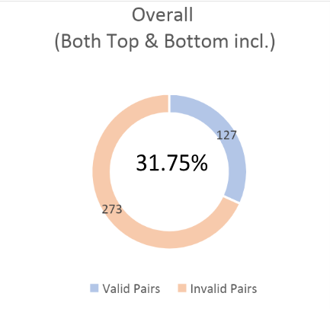
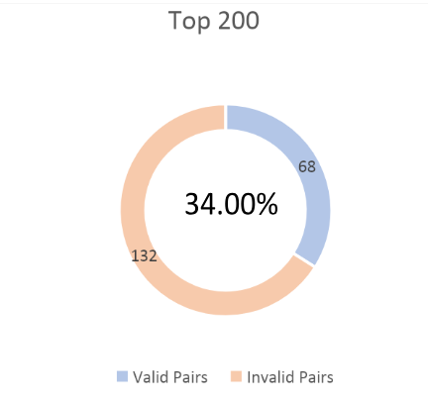
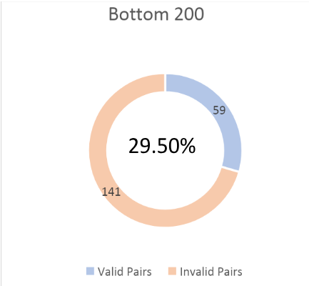
MANUAL VERIFICATION OF BERT EMBEDDINGS
6
(Analysing the Top 200 and Bottom 200 ingredient pairs manually)

Slide 8
THANK YOU!

