Slide 1


iPHONE Programming
TELEFÓNICA I+D
Fecha:
© 2009 Telefónica Investigación y Desarrollo, S.A. Unipersonal

Slide 2
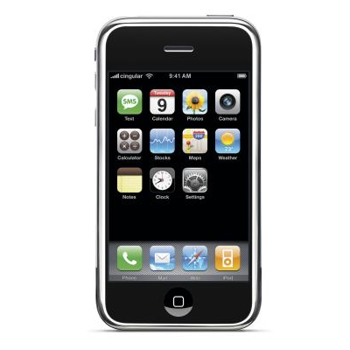
Index
01 iPHONE Programming
- Context
- iPHONE OS layers
- Tools
- Objective C
- Best practices
02 iPHONE Resources
- Camera, GPS, accelerometer
- Networking Features
- Telephone functions
03 Useful References
04 Environment
- SW Requirements
- Jailbreak
05 A project example
- Application development
- Deployment

Slide 3

iPHONE Programming
Context
01
There is a huge learning curve dealing with iPHONE Apps developing. You have to learn
The basics of the Cocoa frameworks
The iPhone specific frameworks
A whole new IDE - XCode and Interface Builder - and the associated development tools, such as Instruments.
A new programming language, Objective C.
How to do design icons and graphics for your app.
Un maestro burro no puede enseñar más que a rebuznar
Francisco de GOYA

Slide 4
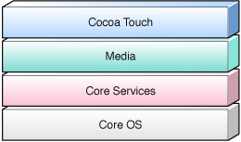
iPHONE Programming
iPhone OS technology layers
Obj-C library for graphical elements
Audio Video technology
OpenGL / Quarz / Core Animation…
C-based libraries for basic services
data management, net protocols, SQL
C-based libraries for memory alloc,
threading, etc…
The starting point for any new project is the Cocoa Touch layer, and the UIKit framework in particular. It is recommended that you start with frameworks in the higher-level layers and fall back on the frameworks in the lower layers as needed. The only time you should fall back to the lower-level frameworks is when you want to implement custom behavior that is not provided at a higher level.

Slide 5




iPHONE Programming
Tools
Xcode: IDE for development
Interface builder: UI design
Iphone simulator
Instruments: performance optimizer

Slide 6
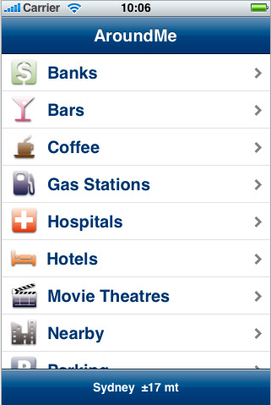
iPHONE Programming
Good practices for iPHONE Apps
01
An iPhone app should do one thing well -> Reduce complexity
Make sure it performs all tasks well
Use icons and imagery that are familiar
All apps should autosave
Let me listen to my music
Where appropriate, all apps should be location aware
Focus on minimal startup time
REF: http://apcmag.com/seven_things_all_iphone_apps_need.htm

Slide 7
iPHONE Resources
What can and can not be done
01
YOU CAN:
  Access camera
  Obtain iPHONE location
  Use accelerometer and motion events
  Add networking features
  Access sound system
  Store data locally in a mySQL based DB
  Initiate a phone call
  Use HTML and Java Script
YOU CAN NOT *:
  Run background tasks except some default applications (iPOD, phone…) It is possible with Jailbreak
  Use JAVA. Unofficially there are ways to install a JVM on a Jailbreaked iPhone
  Modify the routing table, nor select network interfaces
  Access the Bluetooth stack using the SDK
  Use FLASH
  *To the best of our knowledge

Slide 8
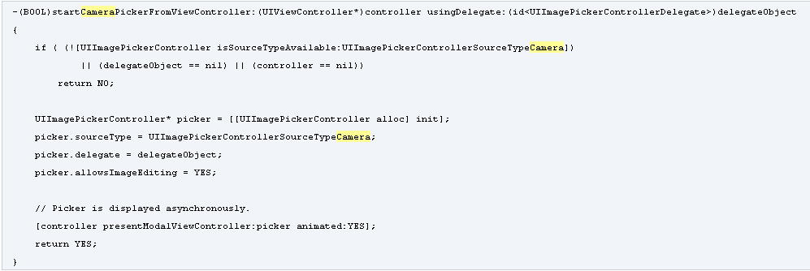
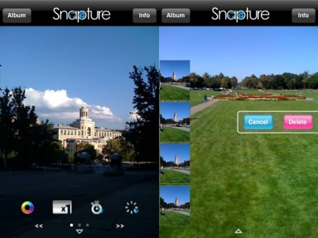
iPHONE Resources
Camera access
01
UIKit provides access to a device’s camera through the UIImagePickerController class
This class can also be used to select photos from the user’s photo library
Video capturing only included with iPHONE 3GS
Application examples: Image capturer, Snapture, Panorama …

Slide 9
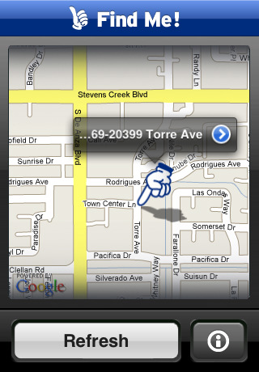
iPHONE Resources
Enabling geolocation services
01
#import <CoreLocation/CoreLocation.h>
@implementation MyLocationGetter
- (void)startUpdates
{
// Create the location manager
locationManager = [[CLLocationManager alloc] init];
locationManager.delegate = self;
locationManager.desiredAccuracy = kCLLocationAccuracyKilometer;
[locationManager startUpdatingLocation];
}
- (void)locationManager:(CLLocationManager *)manager
didUpdateToLocation:(CLLocation *)newLocation
{
[manager stopUpdatingLocation];
printf("latitude %+.6f, longitude %+.6f\n",newLocation.coordinate.latitude,
newLocation.coordinate.longitude);
}
@end
Using Core Location Framework
You can use this framework to grab a location, or you can be notified whenever the user’s location (or heading) changes.
Gathering location data involves querying the available cell towers, Wi-Fi hotspots, or GPS satellites. It works indoor!!
An example of geolocation application is Findme. It tracks the location of the phone and posts it on Twitter.

Slide 10
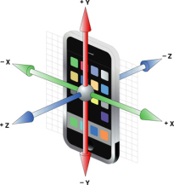
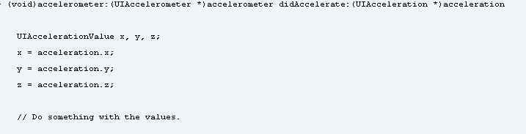

iPHONE Resources
Accelerometer Access
01
iPhone contains three accelerometers, one along each of the primary axes of the device. It allows you detect movement of the device in any direction. You can use it to track both sudden movements in the device and the device’s current orientation relative to gravity.
An iPhone generates motion events when users move the device in a certain way, such as shaking it
  Subscribe to accelerometer or motion events
  Get the device orientation
An example of motion application is iTemblor, a seimoscope.

Slide 11
iPHONE Resources
Telephone functions
01
You can’t access telephone resources directly through an API. But you may delegate on iPhone applications to perform the task for you.
How to call other applications from your application?
  You must build an URL an open it
    [[UIApplication sharedApplication] openURL:[NSURL URLWithString:urlText]];
  Each URL kind is managed by one application
    Telephone: [[UIApplication sharedApplication] openURL:[NSURL URLWithString:@"tel://663456784"]];
    SMS: [[UIApplication sharedApplication] openURL:[NSURL URLWithString:@"sms:55555"]];
How my application may be called form other applications?
  Your application must register itself as a specific URL handler
  The involved resources looks for handlers when an specific URL is opened, and calls the application that manages this kind of URL.

Slide 12
iPHONE Resources
Networking Features
01
iPhone OS includes several frameworks and libraries to let developers add networking features to their applications.
  BSD networking APIs (part of libSystem) provide low-level C-based networking functions
  CFNetwork is a C-based framework that lets your application perform a variety of network tasks, working with BSD sockets, HTTP or FTP servers, and managing Bonjour services.
  Foundation is an Objective-C-based framework that provides object-oriented abstractions for various CFNetwork APIs.
Before you begin writing code;
  choose the language for writing your networking code: C or Objective-C
  decide to work with sockets directly or use an abstraction layer; iPhone OS provides abstractions for fetching files from a URL, communicating with an HTTP server or an FTP server.
  decide whether you want to use Bonjour to discover existing network services or register new ones.

Slide 13
iPHONE Resources
Networking Features – Sockets (C/ Obj.C)
01
Communicating using sockets
  If you've a networking application from another platform and would like to port it to iPhone, you are probably using BSD networking APIs; you can continue using them
  If you are writing a new application and want to access sockets directly, you should use the CFNetwork framework (C) or the Foundation framework (Objective-C), however low-level BSD networking APIs are also available.
- (void)sendcmd:(NSString*)cmd {
NSUserDefaults *defaults = [NSUserDefaults standardUserDefaults];
NSString *hostname= [defaults stringForKey:@"hostname"];
NSHost *host=[NSHost hostWithName:hostname];
if (host) {
struct sockaddr_in addr;
int sockfd;
sockfd = socket( AF_INET, SOCK_STREAM, 0 );
addr.sin_family = AF_INET;
addr.sin_addr.s_addr = inet_addr([[host address] UTF8String]);
addr.sin_port = htons( 2001 );
int conn = connect(sockfd, &addr, sizeof(addr));
if (!conn) {
NSData* data = [cmd dataUsingEncoding:NSISOLatin1StringEncoding];
ssize_t datasend = send(sockfd, [data bytes], [data length], 0);
datasend++;
close(sockfd); } …

Slide 14
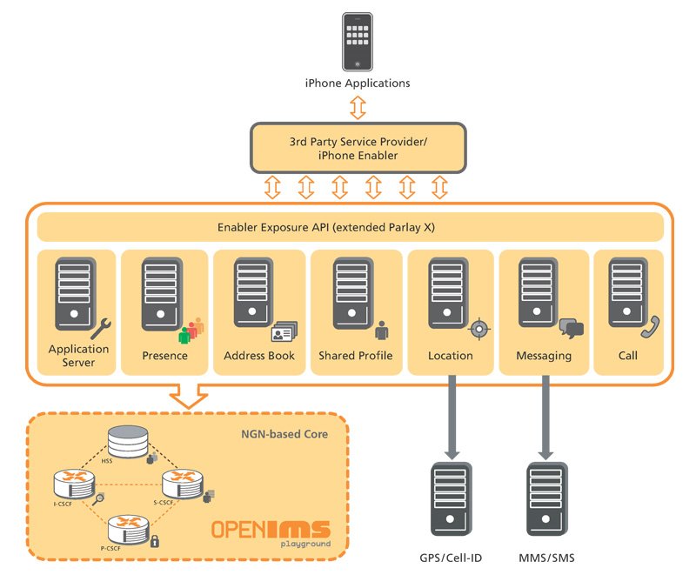
iPHONE Resources
Networking Features: iPHONE & IMS
01
FOKUS has developed a web application that demonstrates web browser based IMS service using the Open SOA Telco Playground for the iPhone.
The FOKUS Parlay X Gateway provides access to IMS-based telecommunication services like messaging, call control, conferencing, presence information, list management, etc.
The application also demonstrates how non-SIP enabled clients can benefit from value-added IMS services utilizing SOA-based NGN service exposure mechanisms.
REFs: https://www.fokus.fraunhofer.de/en/fokus_testbeds/open_soa_telco_playground/prototype_apps/iphone_client/index.html http://www.panlab.net/fileadmin/documents/services/FOKUSinno-OSTP-Update-09-2008.pdf

Slide 15
iPHONE Resources
Background Tasks
01
The inability to run third-party applications in the background badly cripples certain types of apps, such as those that do instant messaging and location-based services.
The reason Apple is being careful about this is because if it fully opened the iPhone to background tasks, the device’s excellent user experience would be threatened on a couple fronts.
  First, there’s a security concern about third-parties pushing and pulling data constantly to and from the device.
  The second concern is the iPhone’s power and speed. Some users have been bitching about the device’s battery since day one — with third party applications constantly running in the background, the battery life would run out faster
Push Notification is the system by which Apple allows third-party apps to talk to the iPhone or iPod touch without those apps actually running in the background

Slide 16
About craking iPhone
01
Jailbreak the iPhone open some possibilities unavailable with the official product
  New functions: for example the possibility to run background tasks.
  Access to unofficial repositories of applications, where you find all kind of applications that Apple doesn’t approve or can’t run on an uncracked terminal.
Apple decides what is adequate for its store, and sometimes the criteria to reject applications “seems” biased not only by performance, security, etc.
  Google Voice application was rejected without serious arguments
  Those applications goes to the informal channel, at least until they are approved
Anyway, the possibility of sell applications that requires a jailbreaked iPhone aren’t an option for Telefónica
  So, despite we develop with jailbreaked iPhones, be careful an do not build applications that need these facilities.

Slide 17
Useful references
How to Start
01
iPHONE OS Overview. A high-level introduction to iPhone OS and its technologies.
Tools for iPhone OS Development. An overview of the tools you use to create iPhone applications.
Cocoa Fundamentals Guide. The document covers the basics of the Objective-C language and the programming conventions and design patterns used by UIKit and many other system frameworks.
iPhone Application Programming Guide. Describes the fundamental structure and features of an iPhone application and shows you how to implement those features in your own projects.
iPhone Development Guide. Describes the process for setting up your computer and iPhone OS–based devices to support iPhone development.
Your First iPhone Application and Creating an iPhone Application. Step you through the creation of iPhone applications, explaining the tools and techniques you use for iPhone development along the way.
REFs: iPHONE Dev Center

Slide 18
Useful References
More useful tricks
01
Integrating with Google Maps
Use SQLite DB
Sending Emails from your App
Make an app orientation aware
How to build mobile applications in HTML and JavaScript
How To Install, Compile, Run Java On iPhone
Prevent The iPhone From Sleeping
Programmatically Getting a Screencapture of any UIView
Integrating Twitter Into Your iPhone Applications
Augmented reality on iPHONE

Slide 19

© 2009 Telefónica Investigación y Desarrollo, S.A. Unipersonal

Slide 20
iPHONE Programming
objective-C
  Objective-C extends the standard ANSI C language.
  OO language with standard class definition similar to java, C++
  Extensions .h (header files) .m (Source files including Objective-C and C code) and .mm
  How class are defined, implemented, allocated, executed
  Dynamic typing and binding
  Formal / Informal protocol
  Easy pattern implementation (chain of responsibility)
In the mac word…
Apple os X and iPhone os are modified BSD linux distribution with aqua interface
Apps are directories with description file, exec file, resources, etc.

