Slide 1
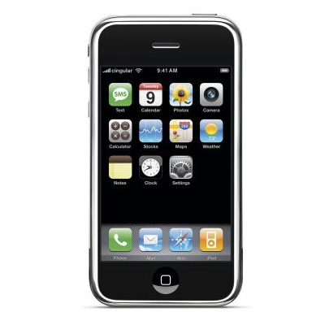
iPHONE
Certificate
distribution
© 2009 Telefónica Investigación y Desarrollo, S.A. Unipersonal

Slide 6
Obtaining your Certificate
VIDEO

Slide 7
Obtaining your Certificate
VIDEO

Slide 8
Assigning Devices
VIDEO

Slide 9
Creating your App IDs
VIDEO

Slide 10
Creating Provisioning Profiles
VIDEO

Slide 11

© 2009 Telefónica Investigación y Desarrollo, S.A. Unipersonal

