Slide 1
PROJECT NAME : AUSTRALIAN BUSHFIRE 2020
PRESENTED BY:
1. PRAJAPATI HARDIK D. (5TH CE)

Slide 2
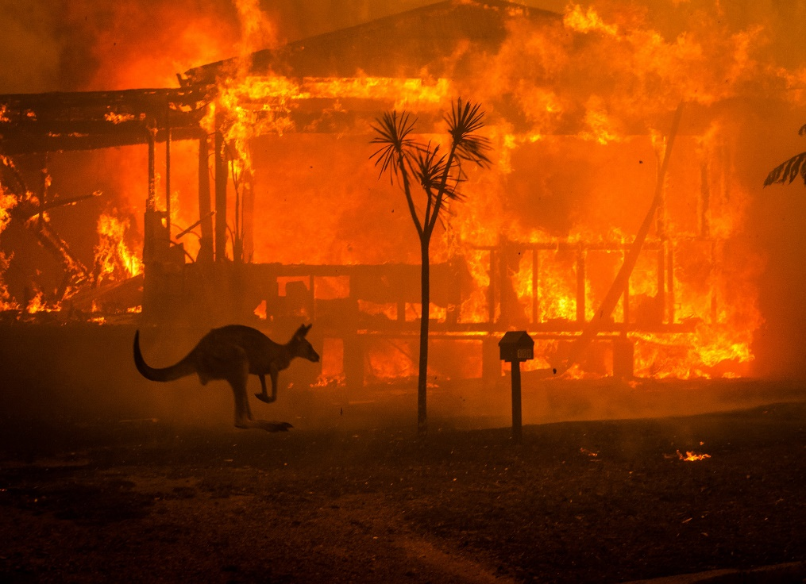
Causes of bushfire
Bushfires can originate from both human activity and natural causes with lightning the predominant natural source, accounting for about half of all ignitions in Australia. Fires of human origin currently account for the remainder and are classified as accidental or deliberate.

Slide 3
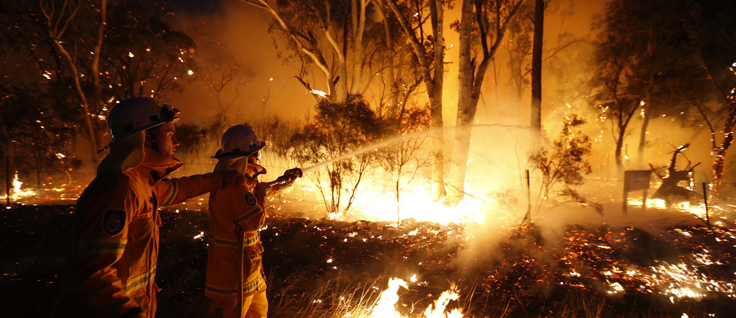

Slide 4
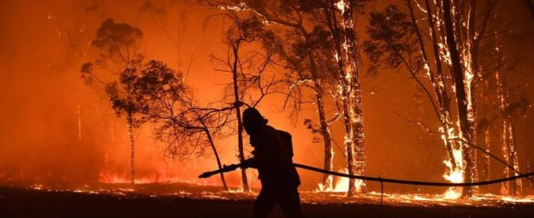
How did the Australia fires start? Australia has always experienced bushfires - it has a "fire season". But this year they are a lot worse than normal. Fires are usually caused by lightning strikes or accidentally by a spark.

Slide 5
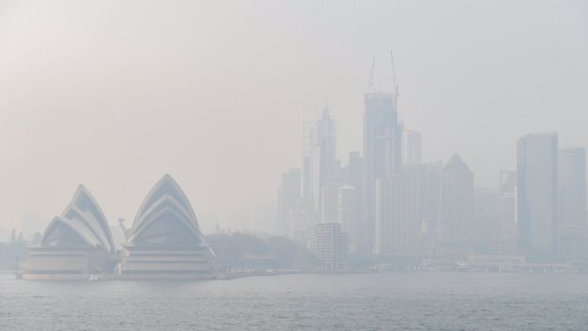
Are the Australia fires caused by climate change? This year a natural weather phenomenon known as the Indian Ocean Dipole has meant a hot, dry spell across the country. But the overwhelming scientific consensus is that rising levels of CO2 are warming the planet. And Australia has been getting hotter over recent decades and is expected to continue doing so. This year, Australia twice set a new temperature record: an average maximum of 41.9C was recorded on 18 December. That comes on top of a long period of drought. Scientists have long warned that this hotter, drier climate will contribute to fires becoming more frequent and more intense. The more extreme weather patterns and higher temperatures increase the risk of bushfires and allow them to spread faster and wider.
“

Slide 6
How are the fires fought? Firefighters are spraying water and fire retardant from planes and helicopters as well as from the ground. But fighting bush fires is extremely difficult and often authorities have to focus on just stopping the spread, rather than putting the fire out. The spread can for instance be contained by digging earth boundaries to stop the flames from spreading. The priority is saving lives. Who is fighting the fires? Professional firefighters are the first in line to battle the flames, but they are outnumbered by the thousands of volunteers. Three of them have died. There's also help coming from abroad: the US, Canada, and New Zealand have sent firefighters to help. Australia's police, military and navy are involved in rescue and evacuation efforts.

Slide 7
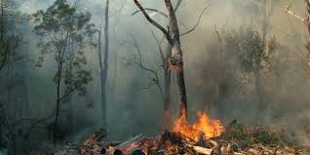
Impact after bushfire
Bushfires can cause poor air quality, which can affect human and animal health, and can have long-lasting impacts to soil and water quality. Bushfires can also have devastating impacts on plants, animals and ecosystems.

Slide 8
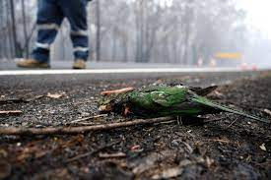
Around more than 3 billion native vertebrates, 143 million mammals, 2.46 billion reptiles, 181 million birds, 51 million frogs were burnt out by bushfires of 2020 in Australia. More than US$110 billion financial loss has been determined due to this fire of Australia. In some cases, it is also helpful for forest land.

Slide 9
THANK YOU

