Slide 1


ShiftGuard: AIoT Structural Health Monitoring
Team Members
1. Hardik Grover (RA2311003011356)
2. Advait Anand (RA Number)
3. Akash Kumar (RA Number)
4. Yograj (RA Number)
5. Team Member 5 (RA Number)
Supervisor Name:
Dr. P. Saravanan, M.E., Ph.D.
Department: CTECH
Review 2 | October 2026
Notes:
We are building a system that watches a bridge 24/7 with IoT sensors and AI, and when something looks wrong it tells you WHAT is wrong: real damage, unusual weather, or just a broken sensor.

Slide 2
The Problem We Found
In the Zeroth Review, our model judged every sensor reading on its own, allowing a 5 % error rate per reading.
At one reading per hour, that is 5 % of 8,760 hours ≈ 440 false alarms a year. Engineers would soon ignore it.
Every alarm was called “damage”. But a bridge's readings also change when it is very cold (Z24's deck stiffens when it freezes) or when an IoT sensor breaks (drift, noise, dropout, glitches).
A real deployment cannot tell us which sensor broke or when, so this is hard to test on real hardware alone.
So our question became
When the alarm rings: is it damage, weather, or a broken sensor? And can we promise false alarms are rare?
Notes:
Key point: a 5 % error looks small, but over a whole year of hourly checks it becomes hundreds of false alarms. And the old system could not say WHY it raised an alarm. Cold weather and broken sensors look like damage to a simple model.

Slide 3
Our Solution: ShiftGuard
Learn only what a healthy bridge looks like: predict each sensor from the other sensors and the temperature.
Hide the most suspicious sensor and check again. A broken sensor disagrees on its own; real damage makes a whole region disagree.
Collect evidence over time instead of judging one reading. One odd hour does nothing; a real change keeps adding up.
Three detectors run side by side (structure, each sensor, weather), so every alarm names its cause.
The guarantee
On a healthy bridge, the expected time to a false alarm is at least 10,000 hours (about 14 months).
Notes:
Think of it as a team of sensors cross-checking each other. If one sensor says something the others don't agree with, that sensor is the problem. If a whole area of the bridge changes together, the structure changed. And instead of panicking at one strange reading, we wait until the evidence adds up.

Slide 4
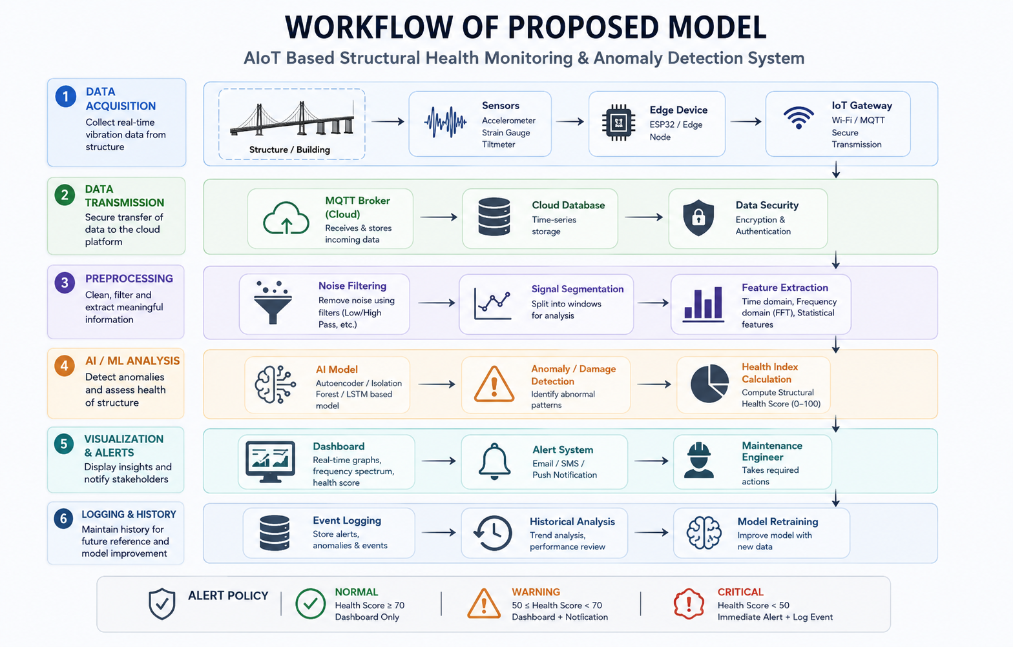
Work Flow of ShiftGuard
Virtual IoT sensors: 8 accelerometers + 1 thermometer, over MQTT every hour
↓
Feature extraction: 16 frequency bands per sensor
Masked-sensor model
predicts each sensor from the others + temperature
↓
Mask & impute
hides the most suspicious sensor, fills lost packets
↓
Conformal p-values: compared only with healthy hours at the same temperature
↓
Three e-detectors collect evidence: Structure · Each sensor · Weather
↓
Alarm only when evidence ≥ 10,000 → expected time to a false alarm ≥ 10,000 h
Structural damage
with severity: Moderate / Severe
↓
Broken sensor
names which sensor
Unusual weather
logged, not called damage
↓
Health score + damage location
↓
Dashboard + live digital twin
↓
Alert → maintenance engineer
email via Node-RED for damage and broken sensors
Trained only on healthy data. Every alarm says what changed: the structure, a sensor, or the weather.
Notes:
Read it top to bottom: sensors → features → the cross-checking model → fair comparison with healthy hours at the same temperature → evidence collectors → one of three verdicts → dashboard and email.

Slide 5
How It Works (In Plain Words)
Listen: 8 virtual accelerometers and a thermometer send a 20-second vibration recording every hour.
Fingerprint: each recording becomes 16 frequency-band values per sensor.
Cross-check: the model guesses each sensor from the others; the gap is that sensor's “disagreement score”.
Compare fairly: today's score is ranked only against healthy hours at a similar temperature (conformal p-value).
Add up evidence: small surprises accumulate; normal hours slowly erase them (CUSUM-type e-detector).
Decide and explain: damage, broken sensor or weather, plus severity, shown on the dashboard and emailed.
Notes:
If asked 'what is conformal prediction?': it turns any score into a probability-like p-value by ranking it against scores from healthy data, with no assumptions about the distribution. 'What is an e-detector?': it multiplies evidence from each hour; under no change its expected value stays at 1, which is what gives the false-alarm guarantee.

Slide 6
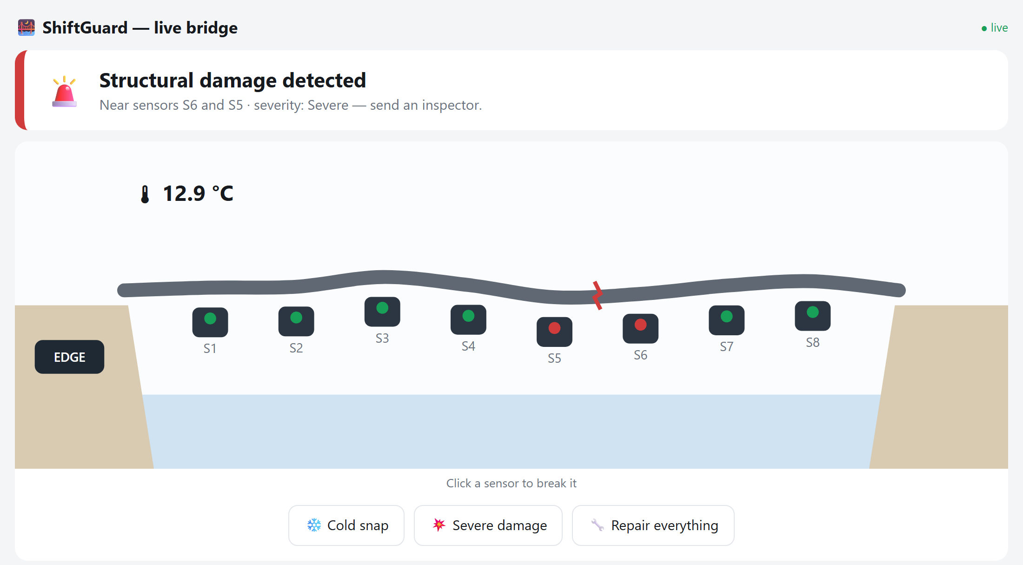
Software-Defined AIoT Testbed
Virtual sensor network over MQTT: a Tinkercad/Wokwi-style circuit, but for a whole bridge.
A fault injector breaks sensors on demand, so we know exactly which sensor failed and when.
Edge monitor: 4.9 ms per reading on a laptop.
Live digital twin: click a sensor to break it, or add snow, damage, or a repair.
Self-healing: restarts crashed parts and fills lost packets.
Optional: Wokwi ESP32 + DHT22 as a real temperature node.
Live digital twin during severe damage: located at S5–S6, severity Severe (live demo)
Notes:
Demo: run 'python run_demo.py'. Break sensor S3 → it says 'broken sensor S3', not damage. Cold snap → 'unusual weather'. Damage → 'structural damage near S5 and S6'.

Slide 7
Results
Simulated year
False alarms: 26 h vs 347 h (old method)
Damage found in under 4 hours
Broken sensor blamed on the right sensor: 94 %
Faults or cold snap called damage: 0 %
Real Z24 bridge data
False alarms: 10 h vs 391 h (old method)
Faults called damage: 0.3 % (old: 23 %)
Cold snap called damage: 0 % (old: 16.5 %)
Severe damage detected; moderate missed
What each part adds
Without evidence collection: ≈ 330 false-alarm episodes
Without sensor masking: 91 % of faults called damage
Without the weather detector: 33 % of the cold snap called damage
Without temperature matching: 4× more false-alarm hours
ShiftGuard cuts false alarms by more than 10× and tells damage, weather and broken sensors apart, on simulated and real bridge data.
Notes:
Simulation numbers are the MLP model, averaged over 3 runs; Z24 numbers are the ridge model, 3 runs. Be upfront: on real Z24 data, moderate damage is not yet caught; that is our next step.

Slide 8
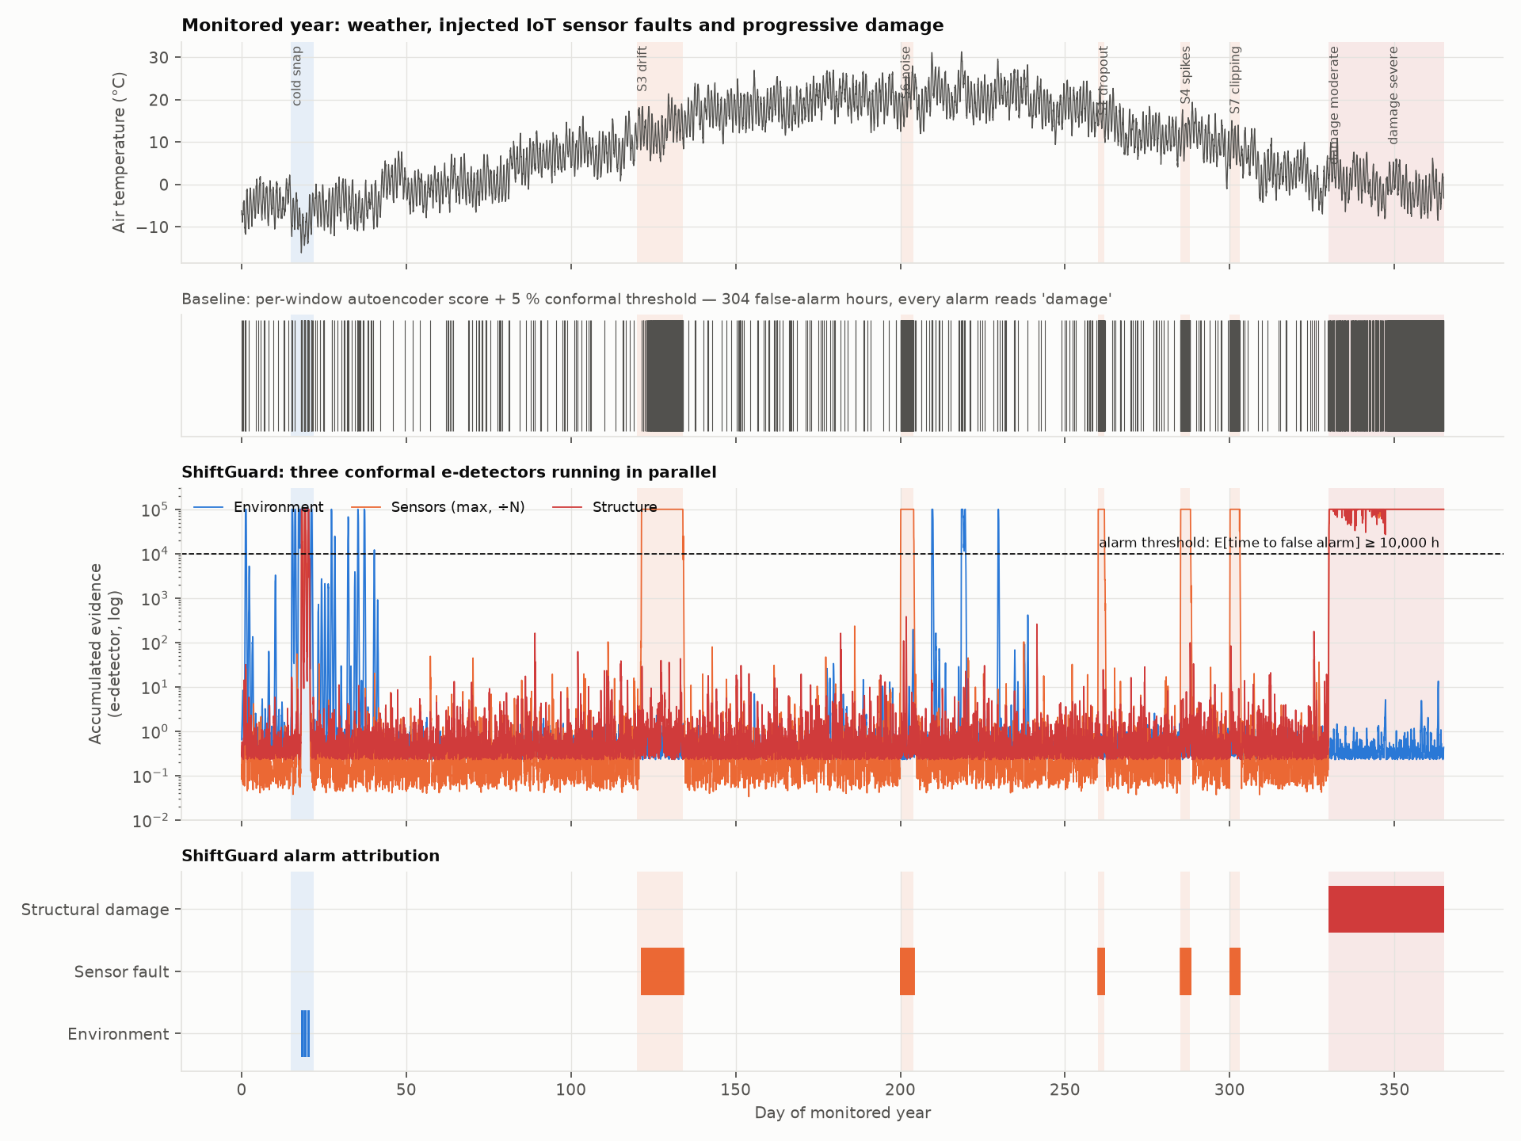
One Monitored Year at a Glance
Top: weather and injected events. Middle: the old method fires all year. Bottom: ShiftGuard raises few alarms, and each names its cause.
Notes:
Blue = weather, orange = broken sensor, red = damage. The grey ticks in the second row are the old method's alarms: they happen all year. ShiftGuard's lines only cross the dashed threshold during real events.

Slide 9
Limitations and Next Steps
Honest limitations
On real Z24 data, only severe damage is detected so far; moderate damage is missed.
The guarantee assumes healthy hours are interchangeable. Real hours are correlated, so we see a few false-alarm episodes a year, not zero.
Handles one broken sensor at a time.
Next steps
Use the full Z24 sensor layouts and modal (frequency) features to catch moderate damage.
Put a real ESP32 sensor node in the loop.
Finalise and submit the paper (IEEE format).
Notes:
Saying the limitations ourselves makes the work more credible. The moderate-damage gap is a sensor-placement / feature issue on Z24's shared channels: the old method is no better there.

Slide 10
