Slide 1
Credit Default Modeling
Project Goal
To determine the creditworthiness of a borrower based on their profile and loan characteristics.
Group 13- Participants
Aishwarya. L. Deokuliar
Daffney Deepa Viswanath
Hardika Gantara

Slide 2

DATA CLEANING & ANALYSIS
First, we thoroughly cleaned our data, by handling missing values, changing data types and manipulating columns to facilitate our analysis.
We performed extensive data analysis to learn the relationship between independent variables and the dependent variable(loan_status).

Slide 3

DATA PREPARATION FOR MODELING
Step 1. We used information value (IV) to check whether a feature is useful in predicting outcome.
Step 2. We categorized and discrete variables into bins, having similar weight of evidence(woe) by fine and coarse classing.
Step3 . We created dummy variables for bins obtained in above step.

Slide 4

MODEL TRAINING AND VALIDATION
We considered 3 classification models for predicting whether a borrower will default or not – Logistic Regression, Naïve Bayes and Decision Tree.
The output column/ target variable (good_bad) determines whether a borrower has defaulted or not. “1” – Did not default and “0” – Default.
We used Cross Validation score and Area under curve (AUC) score to determine the accuracy and reliability of the models.

Slide 5
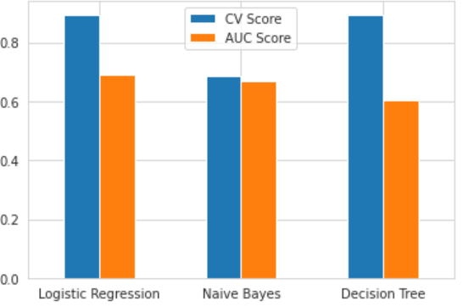
CONCLUSION
Finally, we performed model comparison using AUC and Cross Validation Score. Logistic regression was the best model for predicting Credit Worthiness.

