Slide 1
Comparison of the Effectiveness of Top Security Metrics in Information Technology Industry
ISA5010: Research Methods in Information Security
Presenter: Hardik Adesara
February 21, 2017

Slide 2
Overview
Introduction
Why do we care?
What is a metric?
Research Question
Background of Study

Slide 3
Overview
Methodology
Research Design
Sample
Instrumentation
Data Collection
Data Analysis
Limitations
Delimitation
Resulting Action
Conclusion

Slide 4
Introduction:
Why do we care?
How do we know how “secure” an organization is?
Metrics help define “secure”
Metrics let us benchmark our security investments against other organizations
The metrics “gathering” process often leads to identification of security inconsistencies or holes

Slide 5
Example:
If manager asks, “Are we secure?”
Without metrics: “Well that depends on how you look at it.”
With metrics: “No doubt about it. Look at our risk score before we implemented that firewall project. It’s down 10 points. We are definitely more secure today than we were before.”
If Manager Asks: “Have the changes that we implemented improved our security posture?”
Without metrics: “Sure. They must have, right?”
With metrics: “Absolutely. Look at our risk score before we made the recommended changes, and now it’s down 25 points. No question, the changes reduced our security risk.”

Slide 6
What is a metric?
The National Institute of Standards and Technology (NIST) define metrics as tools designed to facilitate decision-making and improve performance and accountability through collection, analysis, and reporting of relevant performance-related data. Metrics are simply a standard or system of measurement. In this case, it is a standard for measuring security, specifically measuring an organization’s security posture. Although there are some published standards for measuring security, ideally security metrics should be adjusted and tuned to fit a specific organization or situation.

Slide 7
Research Question:
This study will explore:
Effectiveness of top security metrics
Question: “Which security metrics are the most effective out of the top metrics in information?”

Slide 8
Background of Study:
Top Five Security Metrics:
Patch Latency
Patch latency explains where an organization stands in terms of the latest updates.
Basic Malware Defense Percentage
Malware defense is just a product which is formally used as an antivirus software
Password Strength
These metric deal with proxy for security maturity.
Help to knowing system is using a weak password or not
Change Authorization Percentage
metrics is to identify which changes occur without knowledge of security tracking
Return on Security Investment
Return on Security Investment (ROSI) metric helps to keep track of spending money vs. value recovered from the program

Slide 9
Methodology:
Research Design: Mixed Design
Semi-structured qualitative interviews and quantitative results of security metrics
Sample:
Huge Amounts of critical data
As a sample three MNC (Multinational Company)
Tata Consultancy Services (TCS)
International Business Machines Corporation (IBM)
Infosys

Slide 10
Instrumentation
Based upon Before and After study Method (Kumar, 2011)
What are the specific criteria will be consider in effective security metrics?
What is future or benchmark goals of organization?
After 3-4 months
- Have you achieved your benchmark goals with specific security metric(s)?
Data Collection
This will be beneficial to the managers and CISO, as the interviewer will have more information after taking surveys from different organizations and interviewer will be giving feedback to the company

Slide 11
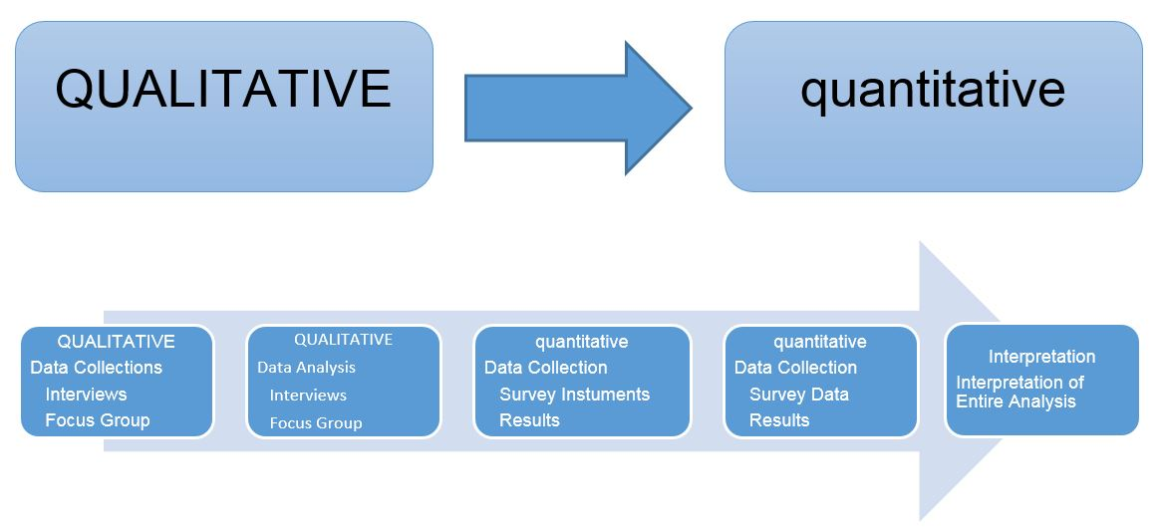
Data Analysis:

Slide 12
Limitations:
Study has limits in the areas of authentication and security
Not often open to discuss their goals and problems they faced in the past
Delimitations:
Study will be limited to three MNC of information technology
Other nontechnical industries will be excluded

Slide 13
Conclusion:
Return on Security Investment metric gives total benefit of spending and Password Strength can protect systems over hacking.
Helps to achieve their benchmark goals in the area of improvement, performance, competition, and security
Measuring and monitoring the security performance
Identify new strategies and plans

Slide 14
?...?...?
Thank You..!!

