Slide 1

Segmentation And Alignment Of Text Symbols From Printed Gujarati Document Image
Developed by,
Adesara Hardik
(11ITUOS001)
IT Department
DD University
Guided By,
Prof. M. M. Goswami
Associate Professor
IT Department
DD University
Faculty of Technology
Dharmsinh Desai University
Nadiad

Slide 2
Content
Introduction of OCR
Objective and scope
Indexing
Future enhancement

Slide 3
What is OCR?
Optical Character Recognition (often abbreviated as OCR), is converting a digital image of a machine printed document in to a computer file.
which can be stored, edited, indexed and searched more efficiently than the image of the document itself.

Slide 4
OCRs are mainly divided into 3 major steps, Like
Pre-processing
Recognition
Post processing
This work was for pre-processing step.

Slide 5

Gujarati is one of the official language of India.
Large no. of character set like, Consonants, Modifiers, Vowels,
Numerals.
Gujarati has some special features, like combination of Middle Zone character with other Upper Zone character and Lower Zone character together forming one text word.

Slide 6
Objective and scope
Major Objective:-
Binarization
Line segmentation
Word segmentation
Zone identification
Zone segmentation
Symbols collection
Alignment of symbols

Slide 7
Scope:-
For the Machine printed Gujarati Text Documents not for Handwritten Gujarati Text.
Doesn't work on classifier, complex newspaper document.
Assumption:-
The text documents taken under experiments are assumed to be skew corrected, graphics free and simple text layout.

Slide 8
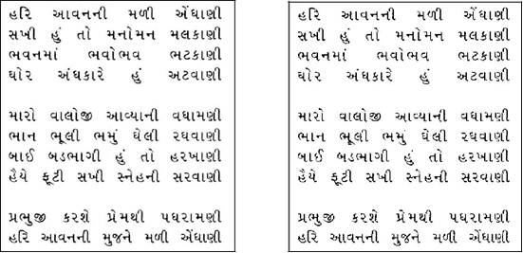

Module 1: Input Document Image
Function: Binarization
Algorithm:
Input: Image of Gujarati script
Output: Binarized Image.
Step 1: Input image is logical or not.
Step 2: If yes then directly convert into inverse image. If No then compute one threshold value.
Step 3: If values of pixel is more than threshold value so convert into 1’s. If less than convert into 0’s.

Slide 9
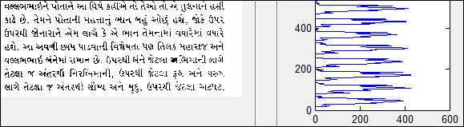
Module 2: Segmentation
Function: Line Segmentation
Algorithm:
Input: Binaries Image.
Output: Separate Images of line
Step 1: Perform HP method on Guajarati script image.
Step 2: Compute Maxima of each lines. Then find Valley between these maxima.
Step 3: Compute the height and width of each line.
Step 4: Now, based on the height of the line, separate each line as separate image and stored in “LINE” folder..

Slide 10
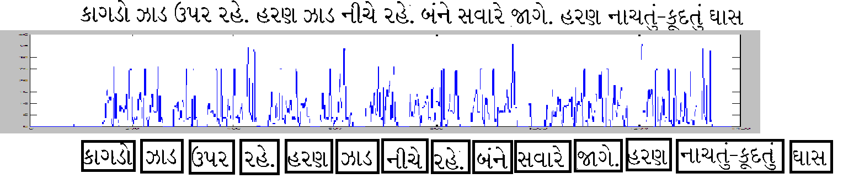
Function: Word Segmentation
Algorithm:
Input: Image of lines
Output: Separate Image of word.

Slide 11
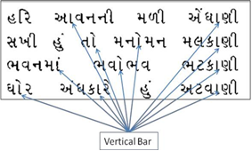
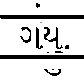
Function: Zone identification and Segmentation
Algorithm:
Input: Image of words
Output: Separate Image of zones.
Step 1: Compute Aspect ratio for each CC.
Aspect ratio = (height/width) of CC
Step 2 Identify the CC that gives highest
Aspect ratio.

Slide 12
Step 3: If VB not identify,
So,Check some condition
Conditions:,
If Y<WH
If Diff<=Error Margin
IIf Y+H<WH
If (Y+H) ==WH
Short Lines without VB:
WH=Skip word Height
Error Margin=(0.10*WH)
Y=Y value of identifier VB
H=height of identifier VB
Diff=|(Y+H)-WH|

Slide 13
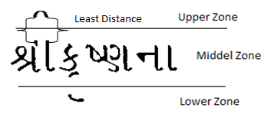
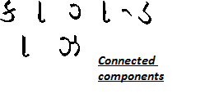
Module 3: Alignment of Symbols
Function: Alignment
Algorithm:
Input: Image of upper, middle, lower zone.
Output: Separate Images of upper, lower, middle zone component with indexing.
Step 1: Perform labeling operation on each zone to identify the Connected Components (CC) separately.
Step 2: Compute total number of black pixels in each CC. Then derive the height, width, X, Y of each CC.

Slide 14
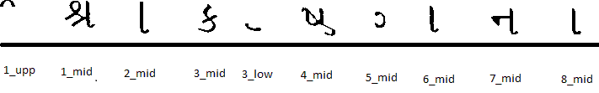
Step 3: Now, compare distance between upper zone component and middle zone component. Same process for lower zone
Step 4: compute two least distance from upper zone components to middle zone component. Same process for lower zone
Step 5: Now, check X of upper or lower zone component is between widths of this least distance middle zone component
Step 6: If yes then index value of upper zone component and middle zone component are same. Same process for lower zone component.
Step 7: This method follow for all upper zone component as well as lower zone component.

Slide 15
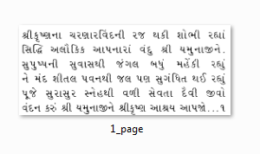
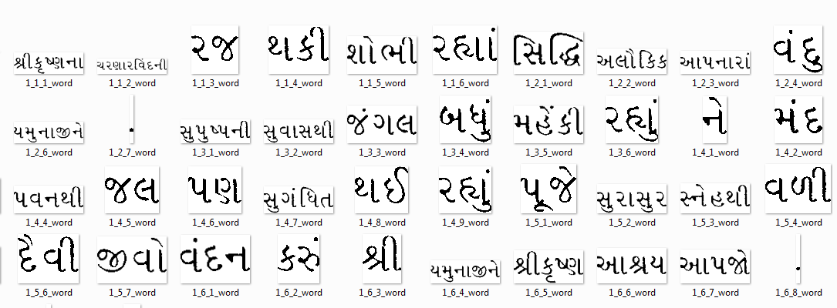
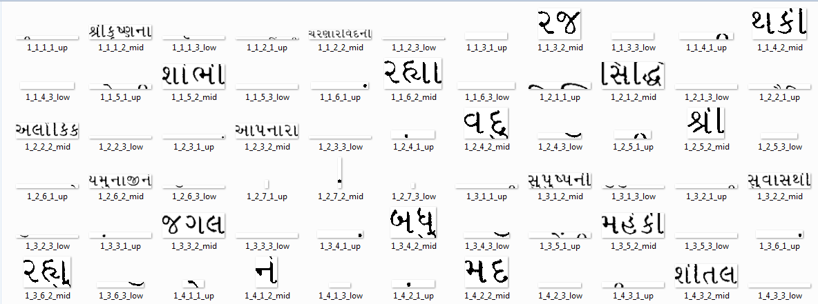
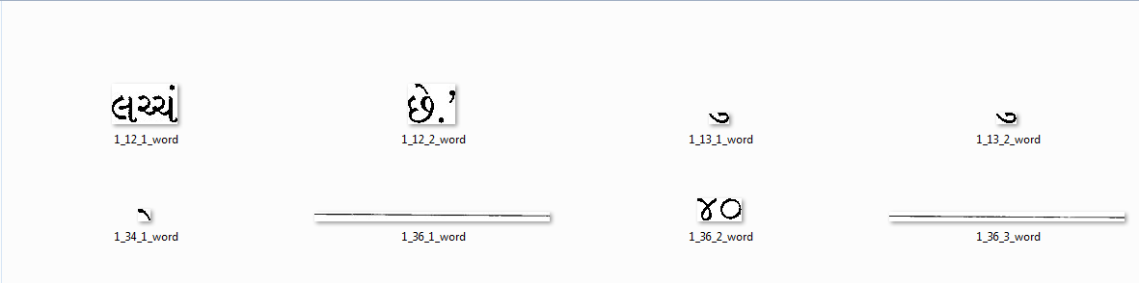
Screen Short
Folder wise Outputs:-

Slide 16
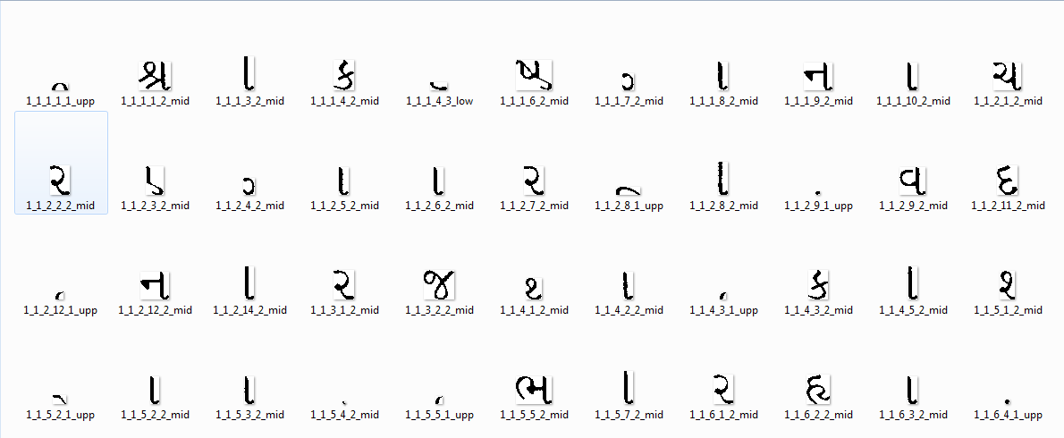
INDEXING
Each newly generated Line, Word, Zone and Symbol will be stored as separate image on given location and named in a sequence like- 2_1_3_8_1_upp, 2_1_3_8_2_mid and so on.
Here 2 are indicating image number, 1 are indicating line number. 3 are indicating word number, 8 are indicating character number, and 1 are indicating zone number. During this process, the number of lines, words, zones, symbols in a document are stored in one single folder with indexing.

Slide 17
FUTURE ENHANCEMENT
For better pre-processing certain operations like- thinning, opening and closing can be used in future.
These operations will reduce the effect if shadow characters present in words and it will improve the accuracy of the Alignment.
After completion of pre-processing we will move for the next steps of OCR that is Recognition and Post processing.

Slide 18

Thank you

