Slide 1
Project Title : Human Motion Gesture Recognition System
Student Name : Hardik Ameta
University Roll No : 2016756
Section : G
Class Roll No : 35
Student ID : 20021741
Enrolment ID : GE-202016756
Mentor Name : Dr Parul Madan (Associate Professor)

Slide 2
Introduction
Human motion gesture recognition system is an AI Software which can detect the gesture of the human body parts in moving positions. With the help of this software we can detect the sign language like ASL (American Sign Language) which was primarily developed for the deaf people to communicate with other person. Now with the help of these software people can communicate with the computer by using different gestures like that of ASL.
This software is mainly dependent on the landmarks detection of hands. By detecting the hand landmarks , we can recognition the different gesture of hand from the inputted image. All the landmark points of one image corresponds to different set of gestures such as for letter ‘A’ set of landmark point is different for ‘B’ its different. Hence by training these set of landmarks through Machine Learning Algorithm we can detection gestures in motion.

Slide 3
Problem Statement and Challenges.
This project has the potential to improve communication for people with computer. The system could be used to provide real-time translation of sign language into text. This would allow people to communicate more easily with computers in a variety of settings, such as schools, workplaces, etc.
Different challenges are there such collecting appropriate dataset, choosing right machine learning algorithm for training so as to acquire high accuracy of model, choosing appropriate technique to recognize the landmarks of hand, good quality camera to collect good quality images for training etc.

Slide 4
Methodology Used
This project is developed by using python, opencv, numpy, mediapipe, pickle. This project is made to recognition the hand gesture for ASL in a running web camera state.
Around 2600 images are collected using web camera and opencv (100 for each letter).
These images are then process to take landmarks of hand, dataset is made out of these landmarks and saved to the computer.
Then the dataset is loaded and trained with RandomForest algorithm using machine learning and the trained model is saved to the computer.
This model is then loaded for prediction where web camera is taking continues images and with the help of pre-trained model prediction is made.

Slide 5
Modules and their working :
1. captureImage.py
This module is used to capture the image for making the input dataset.
Through OpenCV access to web camera is taken, images for training is created.
2. createDatabase.py
This module is used to recognize the hand and landmarks of hand using mediapipe. With this landmarks dataset is created and dump back to hard disk
Using pickle.

Slide 6
3.2.3 train.py
This module load the dumped dataset into main memory. With the help of Random Forest Classifier it train the model. Then trained model is dump back to hard disk.
3.2.4 test.py
This module runs the web camera, take continues images and this images are then given to model to predict the output. Predicted output is then displayed over the detected gesture.

Slide 7
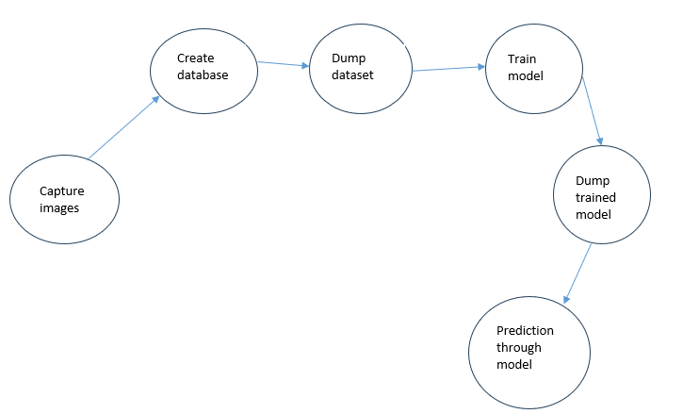
Work Flow of Project

Slide 8
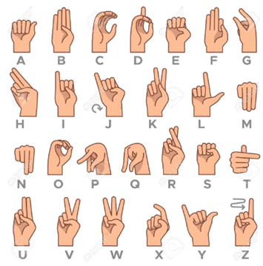
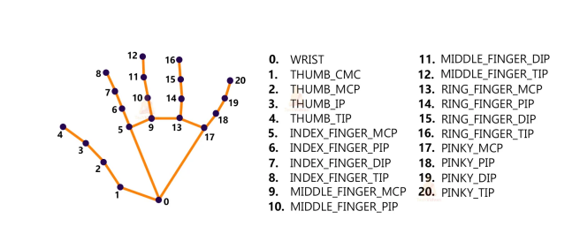
ASL
Landmarks

Slide 9

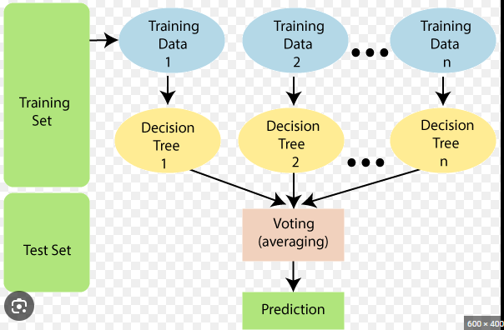
. . .. . . . .. .
. . .. . . . .. .
. . .. . . . .. .
. . .. . . . .. .
. . .. . . . .. .
2600 x 42
2600 images
For training
Creating dataset
Random Forest Classifier

Slide 10
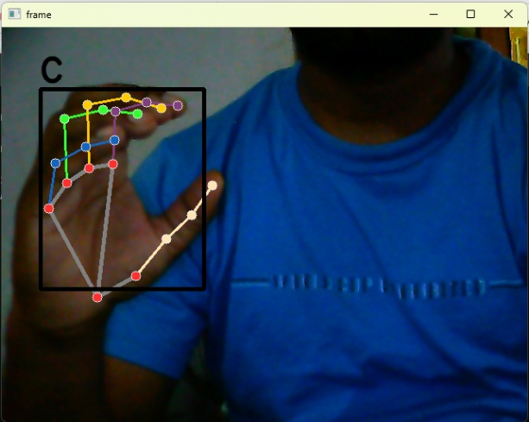
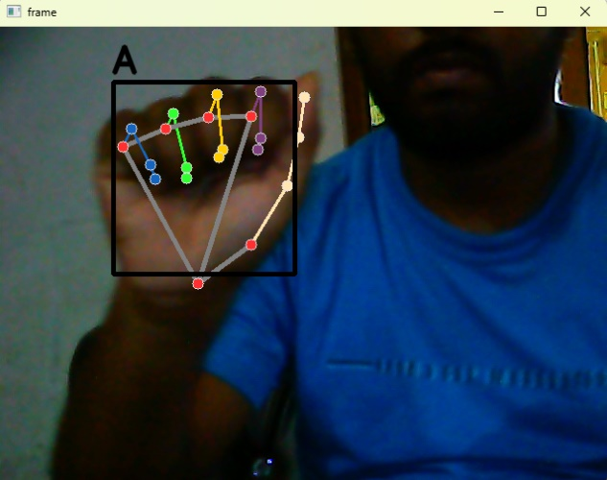
Result and Discussion
This Project has a accuracy of 98 percent.
This Project successfully the detected the ASL.

Slide 11
Conclusion and Future Scope
This is one of the example of human motion gesture recognition system.
Likewise we can create many projects related to this for example presentation controlling using gestures, etc.
Model Used in this project is trained using Machine Learning Algorithm (RandomForestClassifier). For gaining more accuracy we can use CNN , AlexNet, YOLO, ImageNet, MobileNet, etc.
High resolution camera, inferred sensory can be used to take good quality images so that dataset can be efficiently prepared.
Gesture recognition is the hotspot for today’s research and development. Because of its medical application, gaming application, embedded system application it has a very bright future in Research and Development.

